Slide 1
Car Accidents in the US
Jack Miller, Madina Zhaksylyk, Juan Marin, Glen Dagger

Slide 2
Motivation & Question
What factors are associated with higher levels of car accidents in the United States?
We tried to answer this question by exploring if the following factors were related to higher amounts of car accidents.
Income per county
Age per county
Time of year (Including Holidays)
Weather conditions

Slide 3
Summary
Income per county
No relationship between a county’s median income and frequency of accidents
Age per county
Only two areas appear to be impacted by age
Majority of counties have median age between 35-50
Time of year
Months in winter had the highest amount of accidents.
Christmas experienced most accidents.
Weather Conditions
Most accidents happened in daytime during fair weather.

Slide 4
Data Sources
In order to answer our questions we needed to pull all the car accident data for the United States for the past 5 years from Kaggle.
Our data pull from Kaggle included the exact time of accident and weather conditions.
Census data was used for obtaining age per county and income per county through API calls to Census.gov
Jupyter GMaps was used for creating our heat maps of the United States.

Slide 5
Data Cleanup
Choose specific year we want to focus on for each of our questions
Drop unnecessary columns
Additional Organization
Income/Age: API calls to Census.gov for income/population, groupby State and County, add columns for accident count/accidents per 1000 people/county boundaries/income/ population. For age median age per county was found and we created bins for age groups to see the distribution of age groups.
Time: Extra columns for year, months, holidays.
Weather: Different weather conditions were grouped to analyze our data.

Slide 6

Problems
Income and age questions required census data and that was only available for 2020 and earlier
Time and weather questions used 2021 because 2020 had limited data for certain holidays/months.

Slide 7
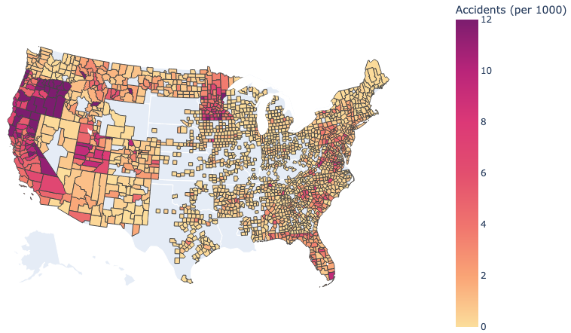
Exploration
Using Plotly Express, this map was created to visualize car accidents per 1000 people by county from 2020 data.
Missing information from many counties,
particularly in middle of US, TX/LA.
Numerous areas of 12+ accidents per 1000
in CA, OR, and MN.
Need to be cautious about conclusions
drawn based on potential missing info.

Slide 8
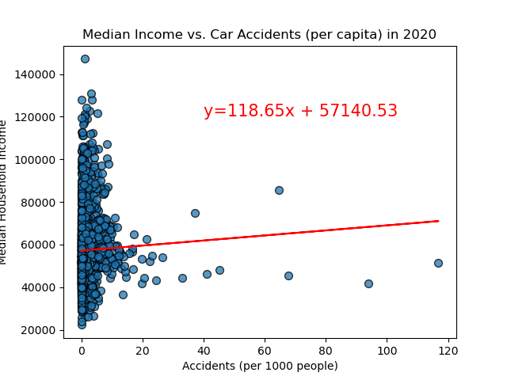
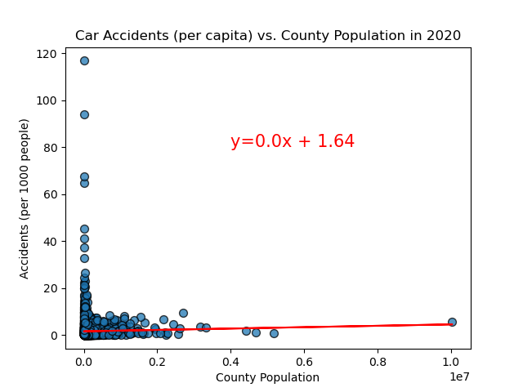
Data Analysis: Income
Does a county’s median income correlate with the relative frequency of car accidents?
Matplotlib
Does a county’s population correlate with the relative frequency of car accidents?
Matplotlib

Slide 9
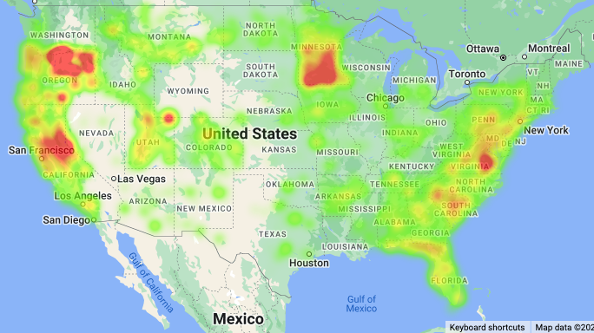
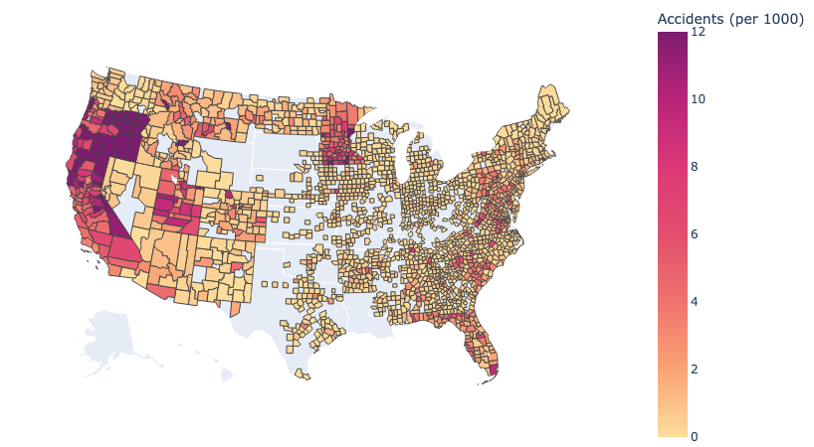
Data Analysis: Income
Heatmap weighted by Accidents per 1000 residents (per county)
Jupyter Gmaps
Chloropleth map showing Accidents per 1000 residents (scale from 0 - 12+ per county)
Plotly Express

Slide 10
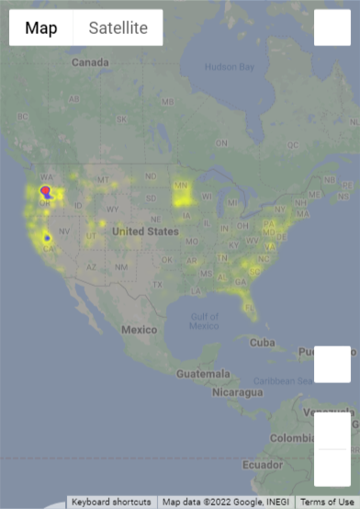
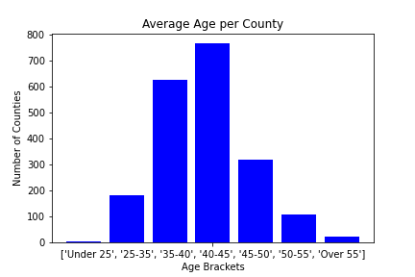
Data Analysis: Age
Does applying a per county median age multiplier change how data is visualized?
Jupyter Gmaps
Age brackets and number of counties in each bracket
Matplotlib

Slide 11
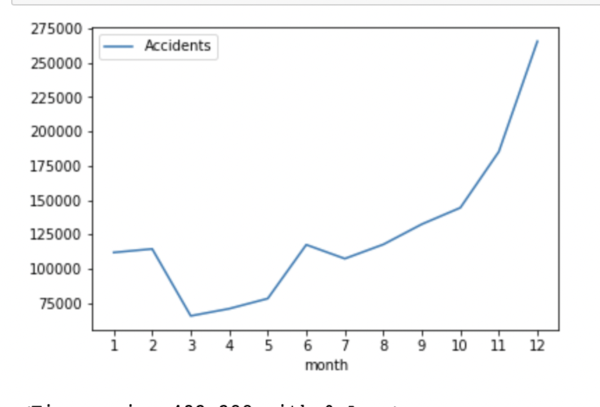
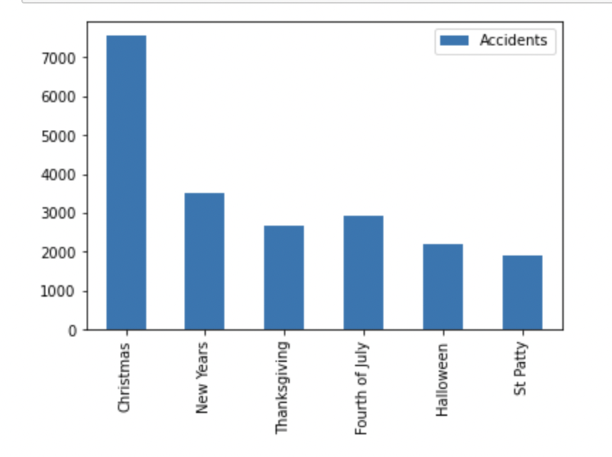
Data Analysis: Time
Spring experienced the least amount of accidents while winter had the most. This could be due to weather conditions of those months.
Matplotlib
Christmas presented double the amount of accidents compared to the rest of the holidays, while St. Patty’s had the least.
Matplotlib

Slide 12
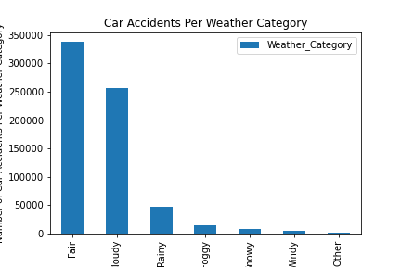
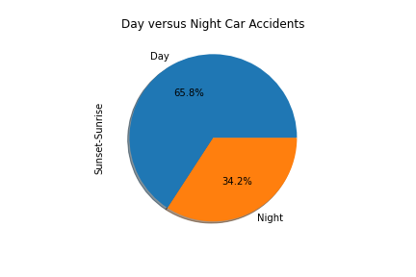
Data Analysis: Weather
Does bad weather play a role for car accidents?
Matplotlib
Do more car accidents happen at night?
Matplotlib

Slide 13
Discussion + Conclusion
Income?
Age?
Time?
Weather?
No correlation between income (or total population) and accidents per capita (by county).
The only visual change was to an area in OR and CA.
Other counties in MN and the East Coast show a move closer to median of the weights
Christmas and the months in winter experienced the most car accidents throughout the year.
Most car accidents happen in the day time and in fair weather conditions. However, the leading bad weather condition for car accidents is cloudy weather.

Slide 14
Post Mortem
Why did areas of OR, CA, and MN have such high rates of car accidents per capita?
Why is the original dataset missing data for June/July 2020? Why are there significant gaps in the 2020 dataset from certain regions?
Why do most car accidents happen in fair-condition weather? Can we adjust for the frequency of each weather category?
Would analyzing data over a larger range of time change our conclusions?

Slide 15
Questions ?

