Slide 1
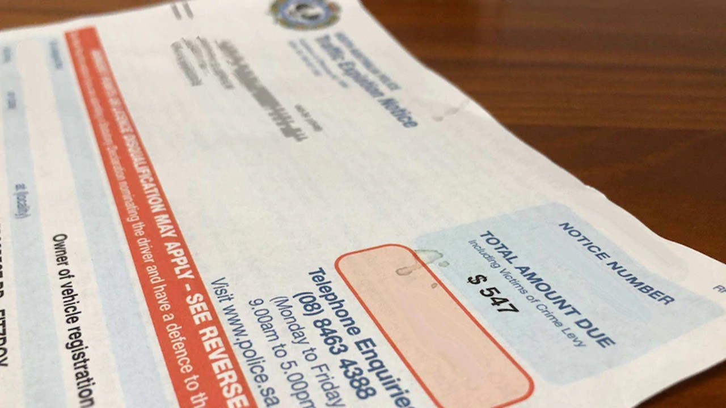
Traffic Camera offences and fines
Aravind Madineni

Slide 2
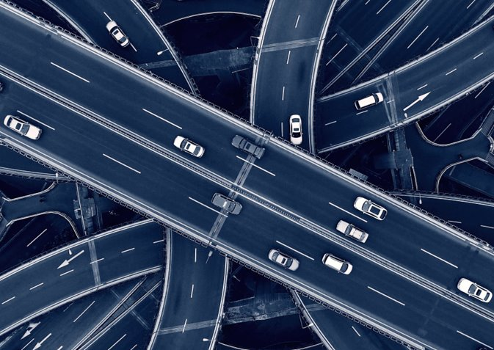
Background
48,592 people have died on Australian road since 1989.​
People driving has become rasher and has caused a lot of accidents.​
Every year millions of dollars are collected through traffic infringements by government.

Slide 3
Being capital of Australia traffic infringements are very expensive. ​
Infringements can cost from 300$ to 5000$.​
Me being a student can't afford to spend this much amount on fines and ACT has a population of 20% students.
Description

Slide 4
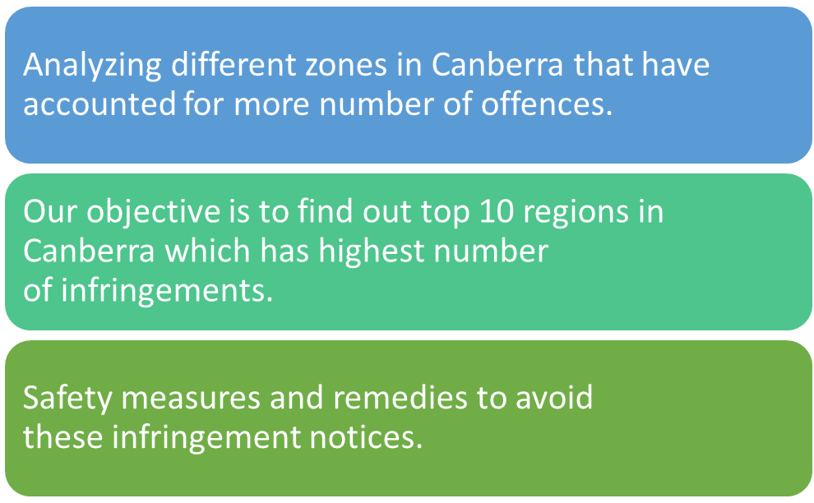
Objectives

Slide 5
Data was taken from ACT Government website.
This dataset contains information about traffic camera and fines.
Dataset is last updated on 14th October 2021, and it contains coverage from July 2010 to September 2021 on monthly basis.
This dataset contains monthly infringement count and value displayed by camera location, penalty, vehicle type and client type.
Data Description

Slide 6
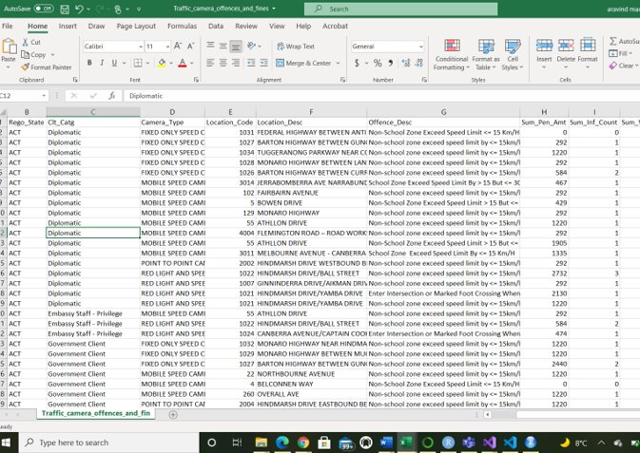
Traffic Fine Data
https://www.data.act.gov.au/Transport/Traffic-camera-offences-and-fines-data-lens-view/w2qf-tnrt

Slide 7
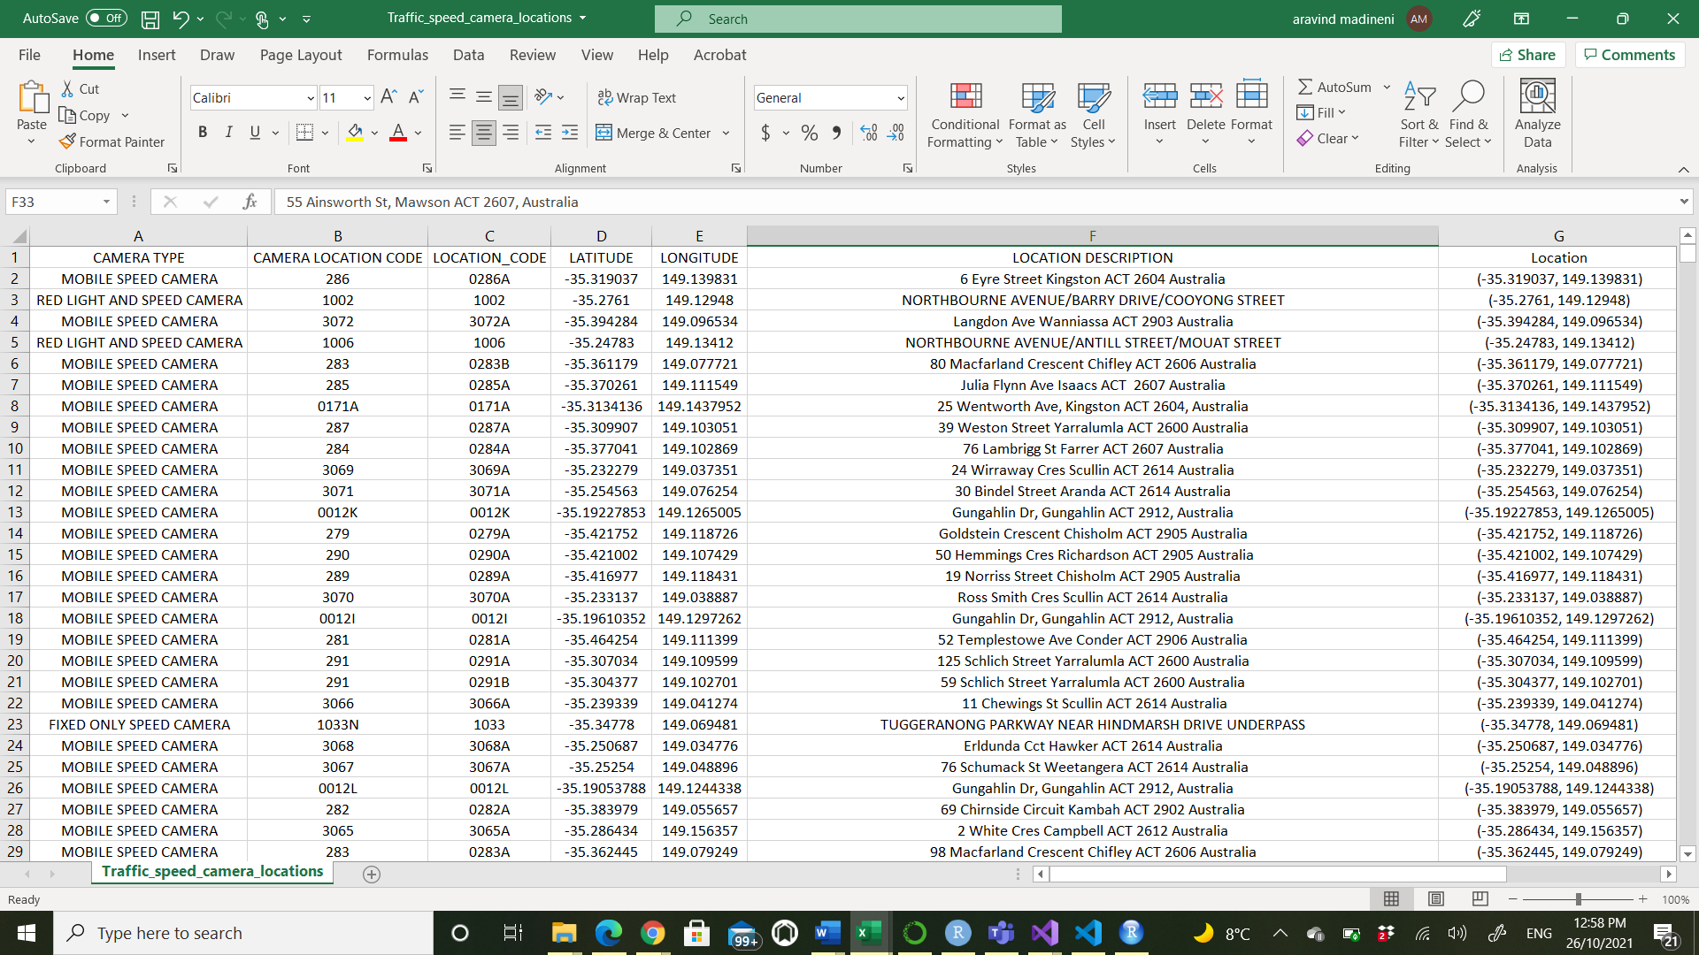
Traffic camera locations data
https://www.data.act.gov.au/Justice-Safety-and-Emergency/Traffic-speed-camera-locations/426s-vdu4/data

Slide 8
Traffic fines data set : 105104 observations with 11 variables​
Dropped some columns for better understanding​
Missing values accounted for around 7% and they have been omitted.​
Traffic locations data set: 1222 observations with 8 variables​
Removed a column due to missing data​
Filtered the data of ACT based on higher offences.
Data Preprocessing

Slide 9
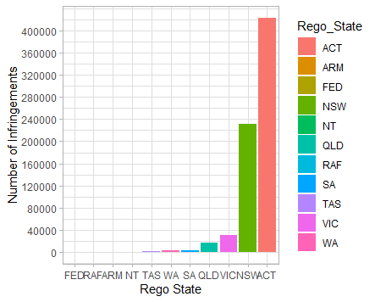
Infringement count by the registration of the vehicle involved in the offence

Slide 10
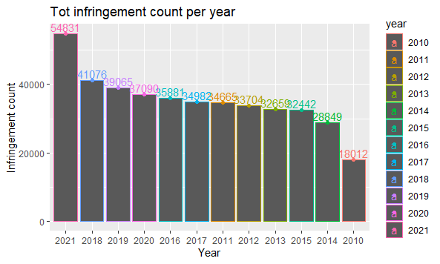
Year wise distribution of traffic
Infringements in ACT from 2010 to 2021

Slide 11
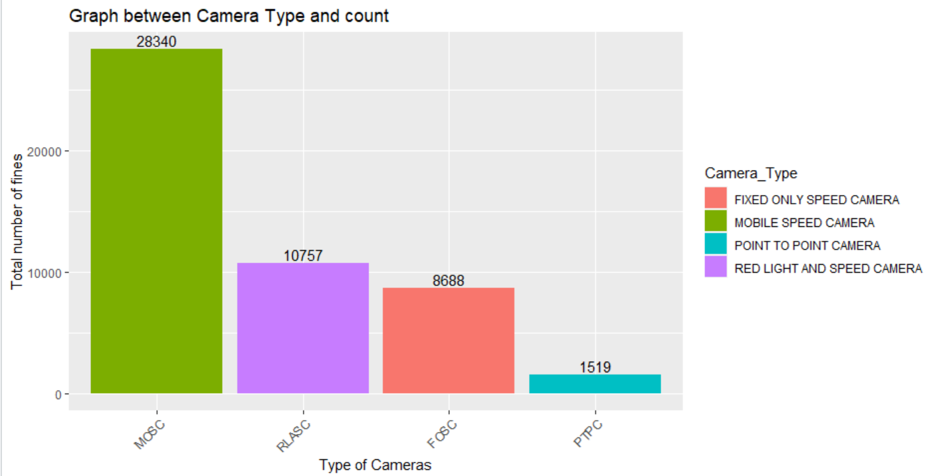
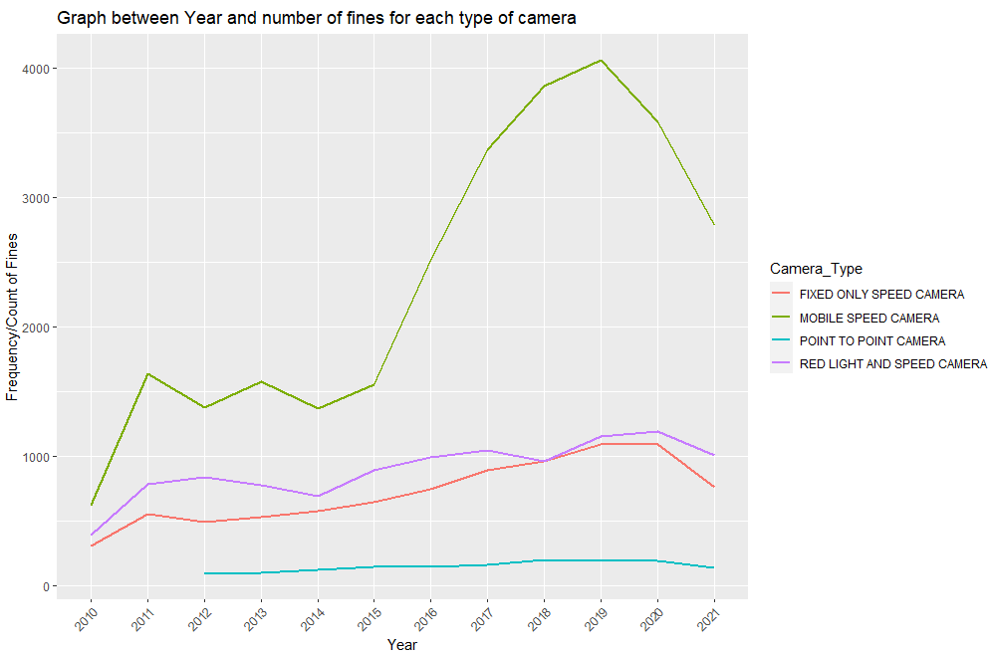
Type of Cameras
$9.5 million in fines in 2020
ACT have :
8 – MSC,13-FOSC , 13-RL&SC, 1-POPC
On an average MSC records 2 offences in an hour.
Reduce in accidents by 20%.

Slide 12
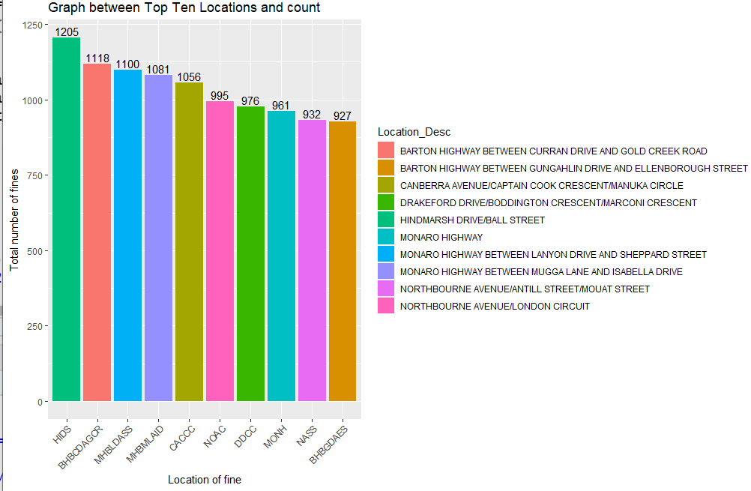
Top Locations-
Highways are prone to speeding.
Sudden change in speed.
Speed has been reduced for Barton highway in 2018

Slide 13
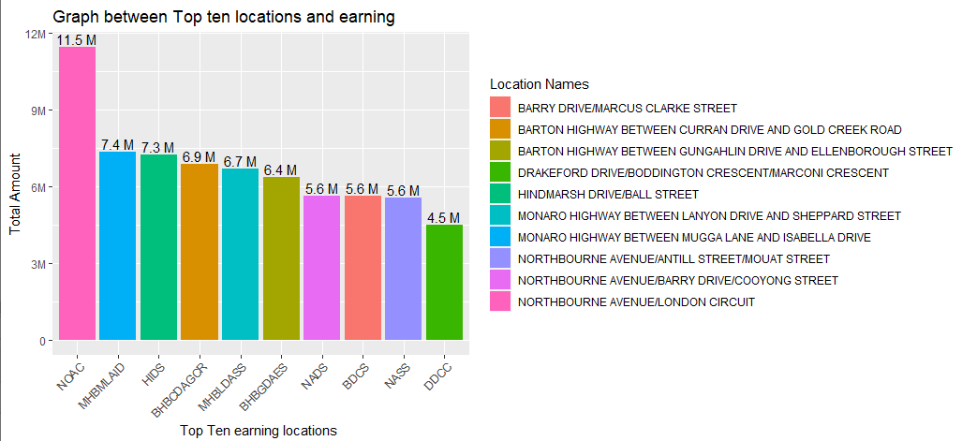
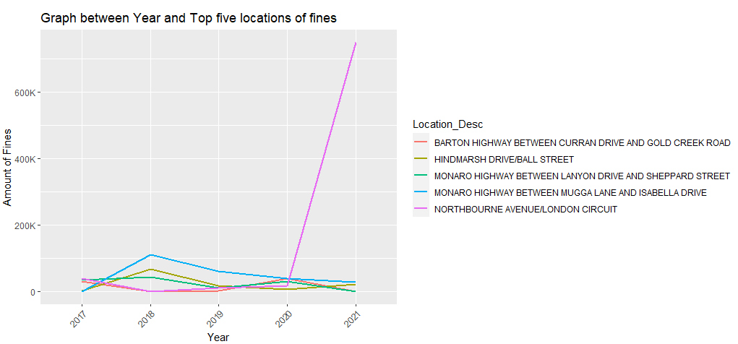
Top Ten Earning Locations
Northbourne avenue earned – 1.26millionv,erage
Barton highway earned- 2,312,296.
Monaro highway earned- 2,250,003

Slide 14
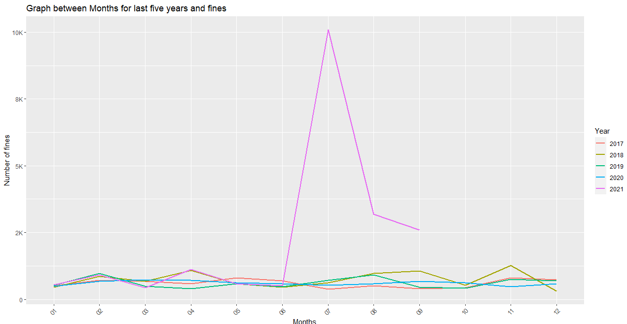
Month vise Fines for last five years
2021 has most of the fines.
More people moved from inter-state.
Scholar ship from universities.
Easy process to get PR.

Slide 15
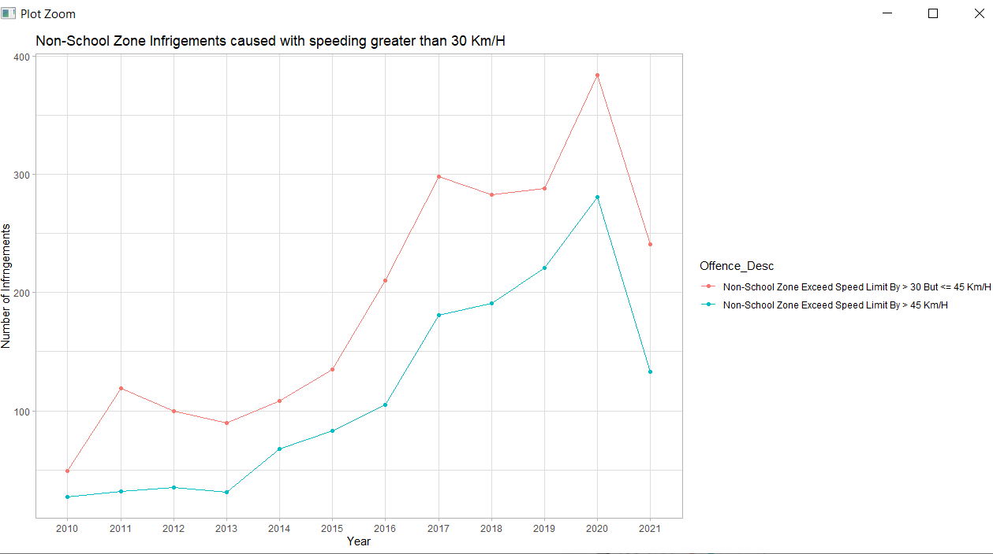
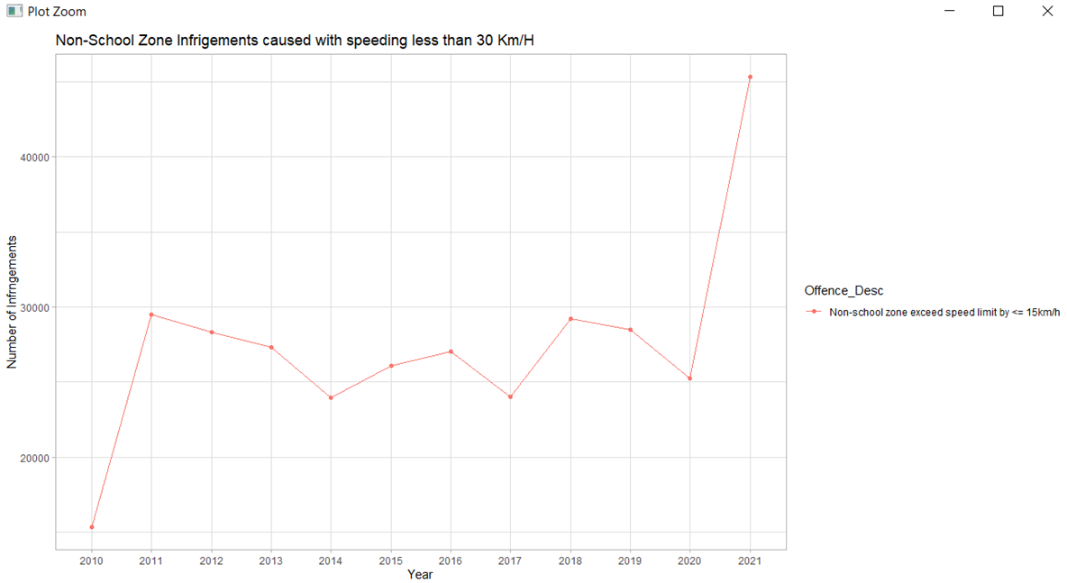
Non-School zone offences :
Image 1 : Speeding greater than 30Km/H
Image 2 : Speeding less than 30Km/H

Slide 16
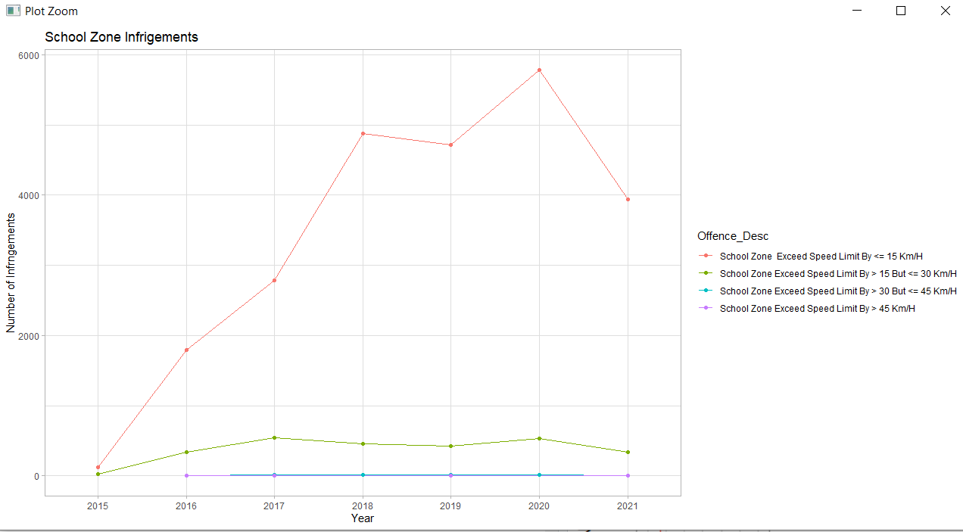
School zone offences
Minimum fine is 279$ with 1 demerit point.
Maximum is 2136$ with 6 demerit points or suspension of your license.

Slide 17
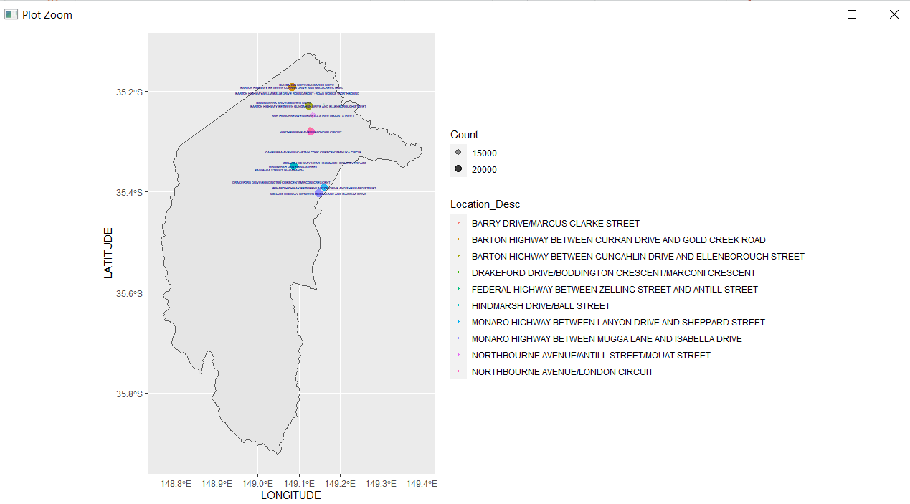
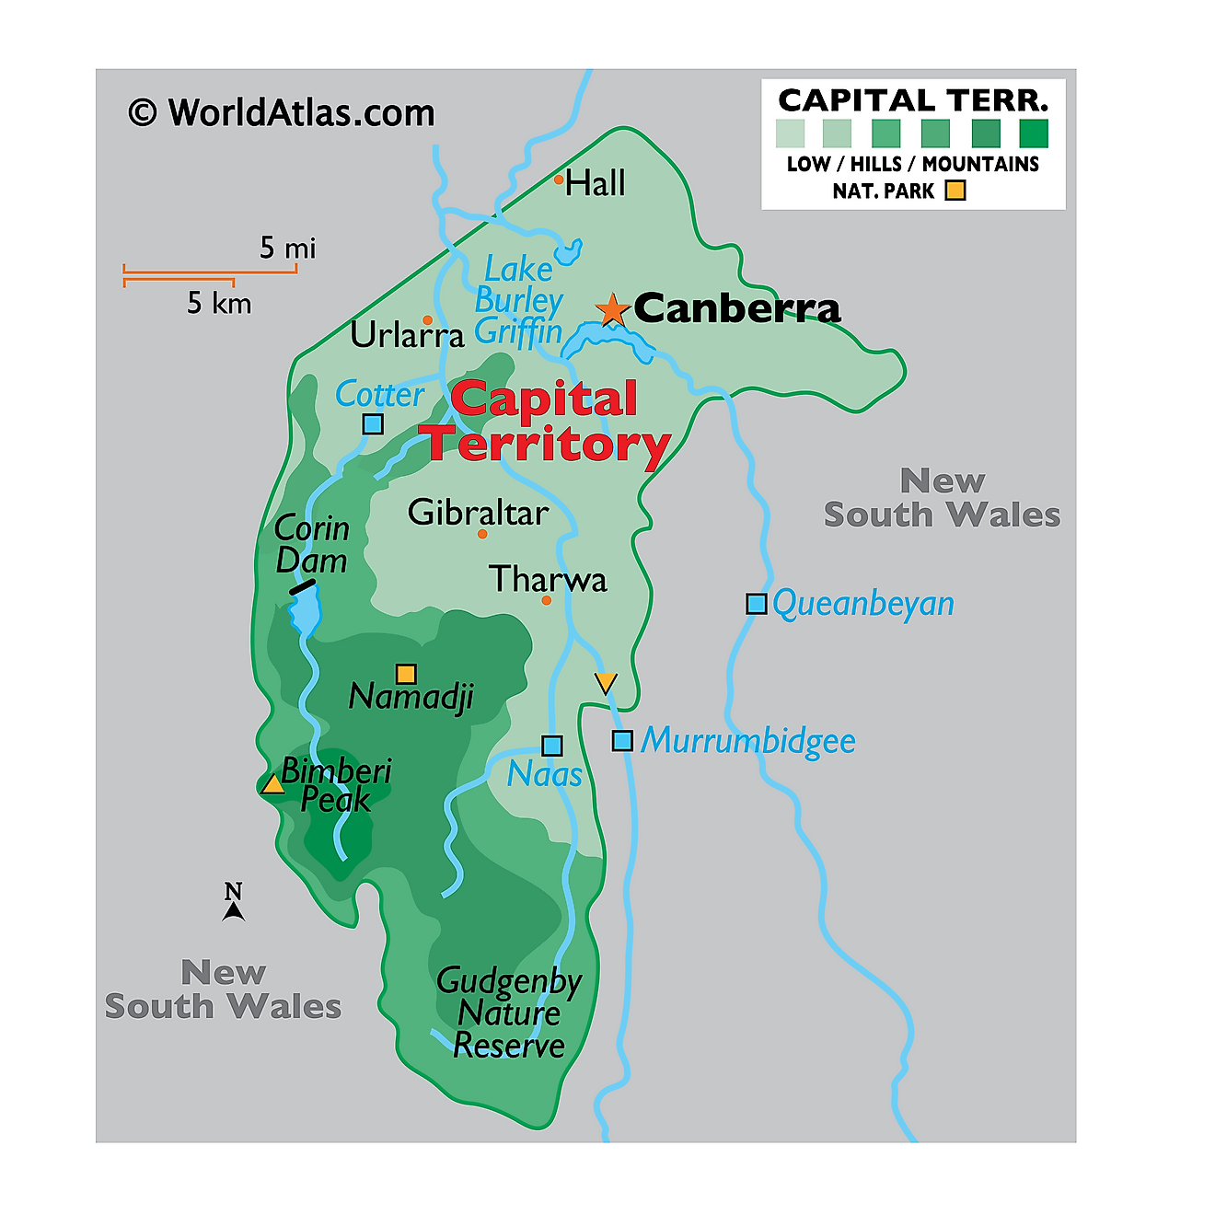
Mapping of locations

Slide 18
Increased the penalties.
Regulatory sign or warning signs should be installed.
Notification on Google maps regarding fine prone area.
Conclusion

Slide 19
Call of Action
Our message is for students which is our general audience to abide by the traffic rules.
Maintaining required speed limits is the necessity.
Government goals is not to earn money from us, but citizen should follow rules.

Slide 20
CarsGuide. 2021. Australia's most expensive fines: the single tickets that will break the bank. [online] Available at: <https://www.carsguide.com.au/car-advice/australias-most-expensive-fines-the-single-tickets-that-will-break-the-bank-57929> [Accessed 24 October 2021].​
Territory, A., Continents, A., America, N., America, C., America, S., & East, M. et al. (2021). Australian Capital Territory Maps & Facts. Retrieved 25 October 2021, from https://www.worldatlas.com/maps/australia/australian-capital-territory
References

