Slide 1

STUDENT DETAILS:
Name : Madineni Kamali U
Skill build email id: madinenikamali@gmail.com
College name : annamacharya institute of technology and sciences , tirupathi
College state :andhra pradesh
Internship domain : artificial intelligence [9/6/2023 - 6/7/2023]

Slide 2
Object recognition in image processing:
Object recognition is a computer vision technique used to identify, locate, and classify objects in digital images or real-life scenarios. It is an applied artificial intelligence approach that repurposes a computer as an object detector so it can scan an image or video from the real world.

Slide 3
AGENDA:
Introduction to Object Recognition
Traditional Approaches to Object Recognition
Deep Learning and Object Recognition
Training a CNN for Object Recognition
Future Trends and Developments

Slide 4
Purpose ,scope and objectives:
Purpose: Object recognition in AI aims to enable machines and computer systems to identify and understand objects in images or videos. The purpose is to replicate the human visual perception process, allowing machines to analyze and interpret visual data like humans do.
Scope:
Computer Vision
Autonomous Systems
Surveillance and Security
Medical Imaging
E-commerce and Retail
Objectives:
Objectives
Classification and Categorization
Recognition and Identification

Slide 5
End users of object recognition :
Automotive Industry
Retail and E-commerce
Surveillance and Security
Healthcare and Medical Imaging
Manufacturing and Robotics
Augmented Reality (AR) and Virtual Reality (VR)
Agriculture
Accessibility and Assistive Technologies

Slide 6
Solution and its value proposition:
The choice of solution depends on various factors, including the complexity of the problem, available data, computational resources, and specific application requirements. It's common to experiment with different techniques and frameworks to find the most suitable solution for a given object recognition task.
3D Object Recognition
Ensemble Methods
Data Augmentation and Pre-processing
Object Detection and Recognition Frameworks

Slide 7
Customize the project:
Focus on a Specific Domain
Integrate Multiple Modalities
Incorporate Contextual Information
Address Real-world Challenges
Emphasize Practical Applications
Implement Advanced Techniques

Slide 8
Modelling:
Feature-Based Methods
Template Matching
Machine Learning Algorithms
Deep Learning Architectures
Object Detection Frameworks
Transfer Learning
Ensemble Methods
Multi-modal Approaches
Post-processing Techniques
Evaluation Metrics

Slide 9
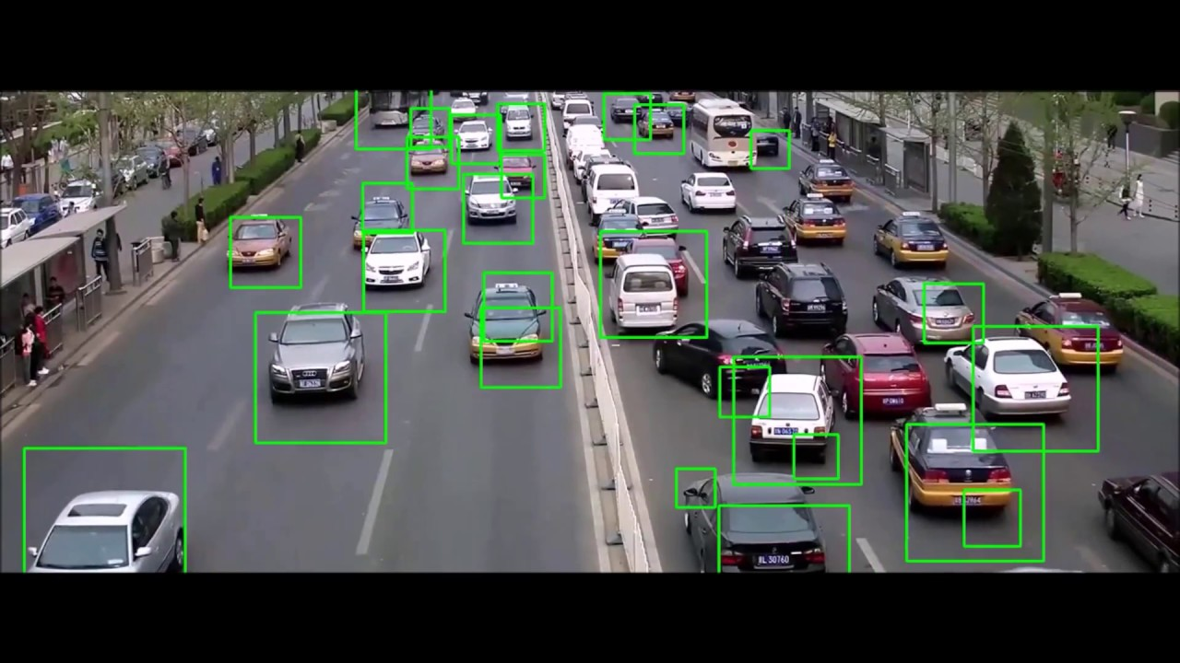
Result:
Object Recognition Result:
Detected Objects:
Class: Car, Confidence: 0.92, Bounding Box: (x: 120, y: 200, width: 180, height: 90)
Class: Traffic Light, Confidence: 0.86, Bounding Box: (x: 350, y: 80, width: 30, height: 60)
Class: Pedestrian, Confidence: 0.76, Bounding Box: (x: 400, y: 280, width: 30, height: 70)
Explanation:
Car: The system identified a car with a high confidence score of 0.92. The bounding box coordinates (x, y, width, height) indicate the location of the car within the image.
Traffic Light: The system also recognized a traffic light with a confidence score of 0.86. The bounding box represents the region where the traffic light is located.
Pedestrian: Additionally, the system detected a pedestrian with a confidence score of 0.76. The bounding box indicates the area where the pedestrian is present.

Slide 10
Links:
GitHub: https://github.com/madinenikamali/image.git
Website: https://ieeexplore.ieee.org/document/8187348

