Slide 1

Scatter plot
Data science

Slide 2

Agenda:
Introduction to Scatter Plots
What is a Scatter Plot?
Purpose of Scatter Plots
Scatter Plot Example
Scatter Plot Interpretation
Correlation Coefficient
Outliers and Clusters
Best Fit Line
Conclusion

Slide 3
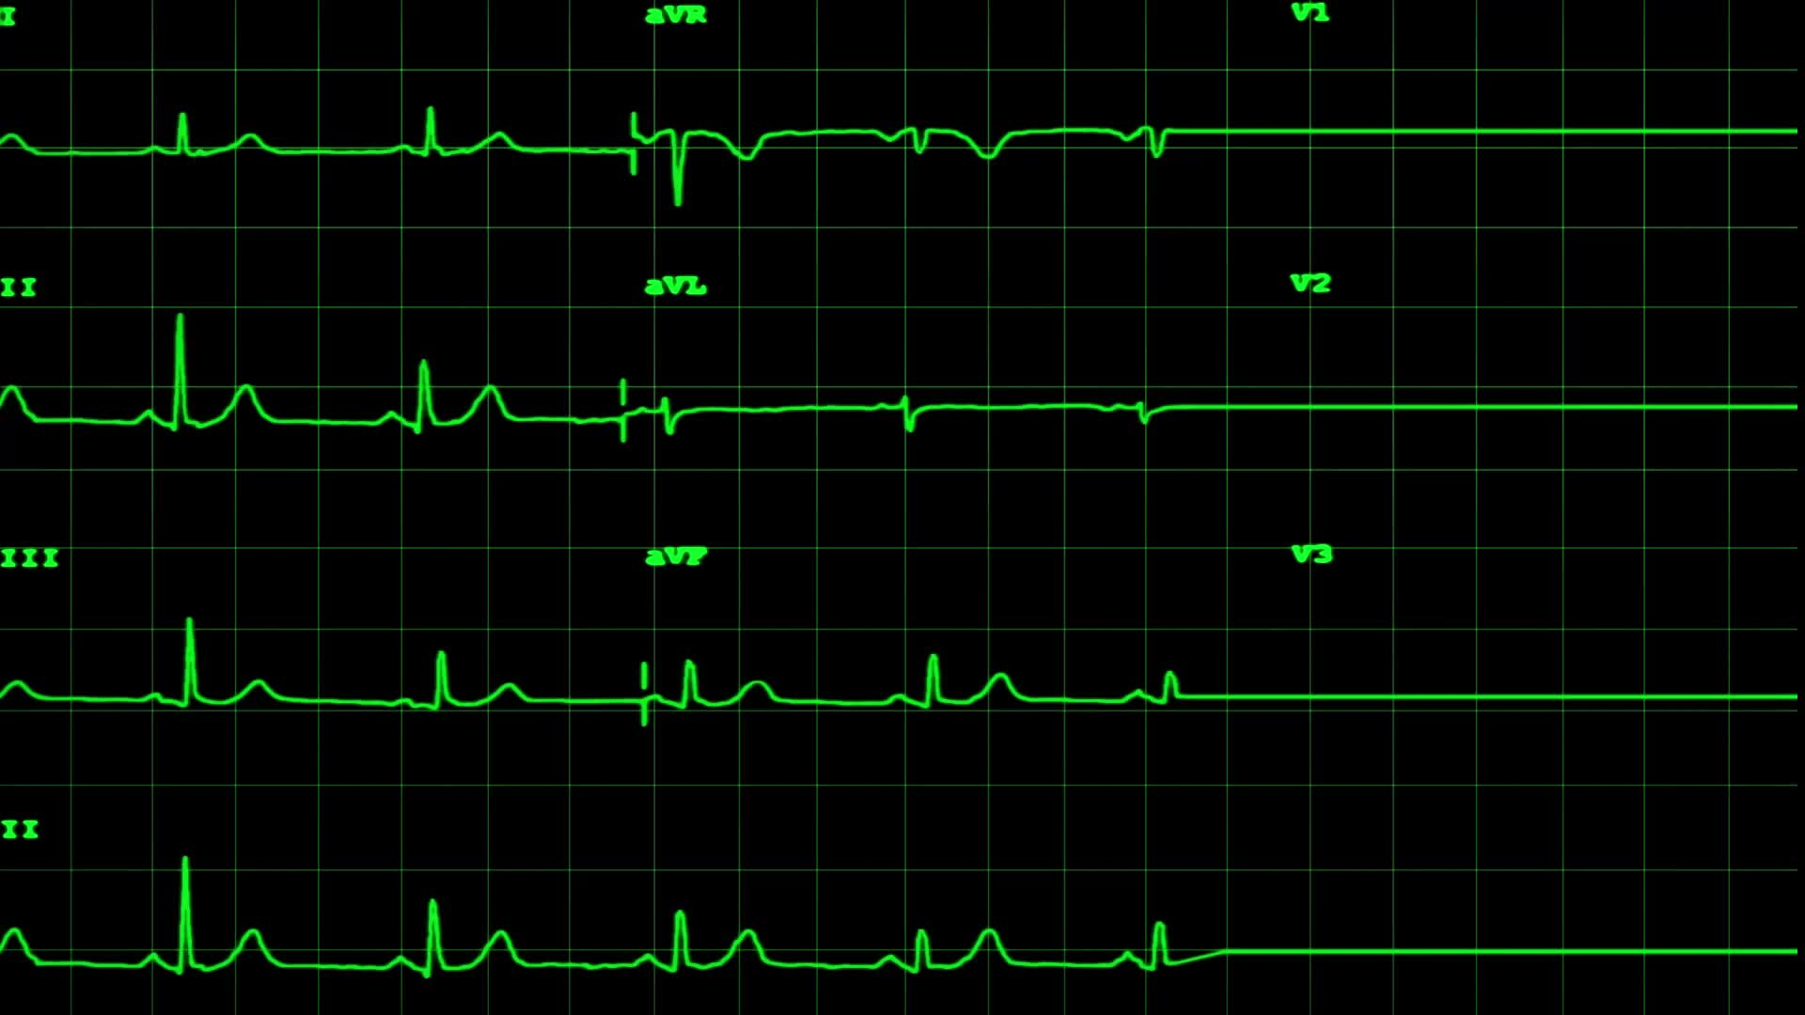
Introduction to Scatter Plots
Welcome to the presentation on Scatter Plots.
Scatter plots are graphical representations used to display the relationship between two variables.

Slide 4
What is a Scatter Plot?
A scatter plot is a type of plot that uses Cartesian coordinates to display values for two variables.
The values of one variable are represented on the x-axis, and the values of the other variable are represented on the y-axis.
Each point on the graph represents a single observation or data point.

Slide 5
Purpose of Scatter Plots
Scatter plots help us understand the relationship between two variables.
They can reveal patterns, trends, or correlations between the variables.
Scatter plots are especially useful for identifying the presence of outliers or clusters within the data.

Slide 6
Scatter Plot Example
Let's look at an example of a scatter plot.
Suppose we are analyzing the relationship between hours studied and test scores.
The x-axis represents the number of hours studied, and the y-axis represents the corresponding test scores.
Each point on the graph represents a student's data.

Slide 7
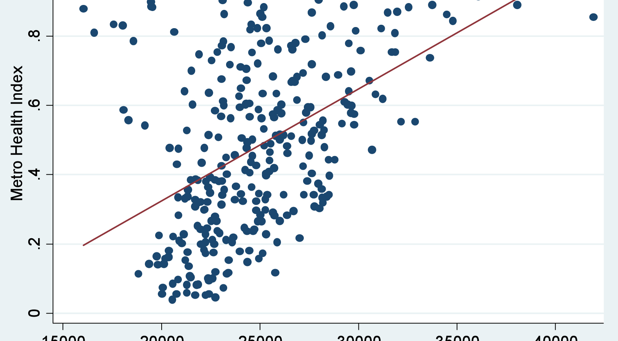

Slide 8
Scatter Plot Interpretation
Scatter plots allow us to interpret the relationship between variables.
If the points on the scatter plot show an upward trend, it indicates a positive correlation.
If the points show a downward trend, it indicates a negative correlation.
If the points are scattered randomly, it suggests no correlation between the variables.

Slide 9

Correlation Coefficient
The correlation coefficient quantifies the strength and direction of the relationship between two variables.
It ranges from -1 to +1.
A correlation coefficient close to +1 indicates a strong positive correlation, while a correlation coefficient close to -1 indicates a strong negative correlation.
A correlation coefficient close to 0 indicates no correlation.

Slide 10
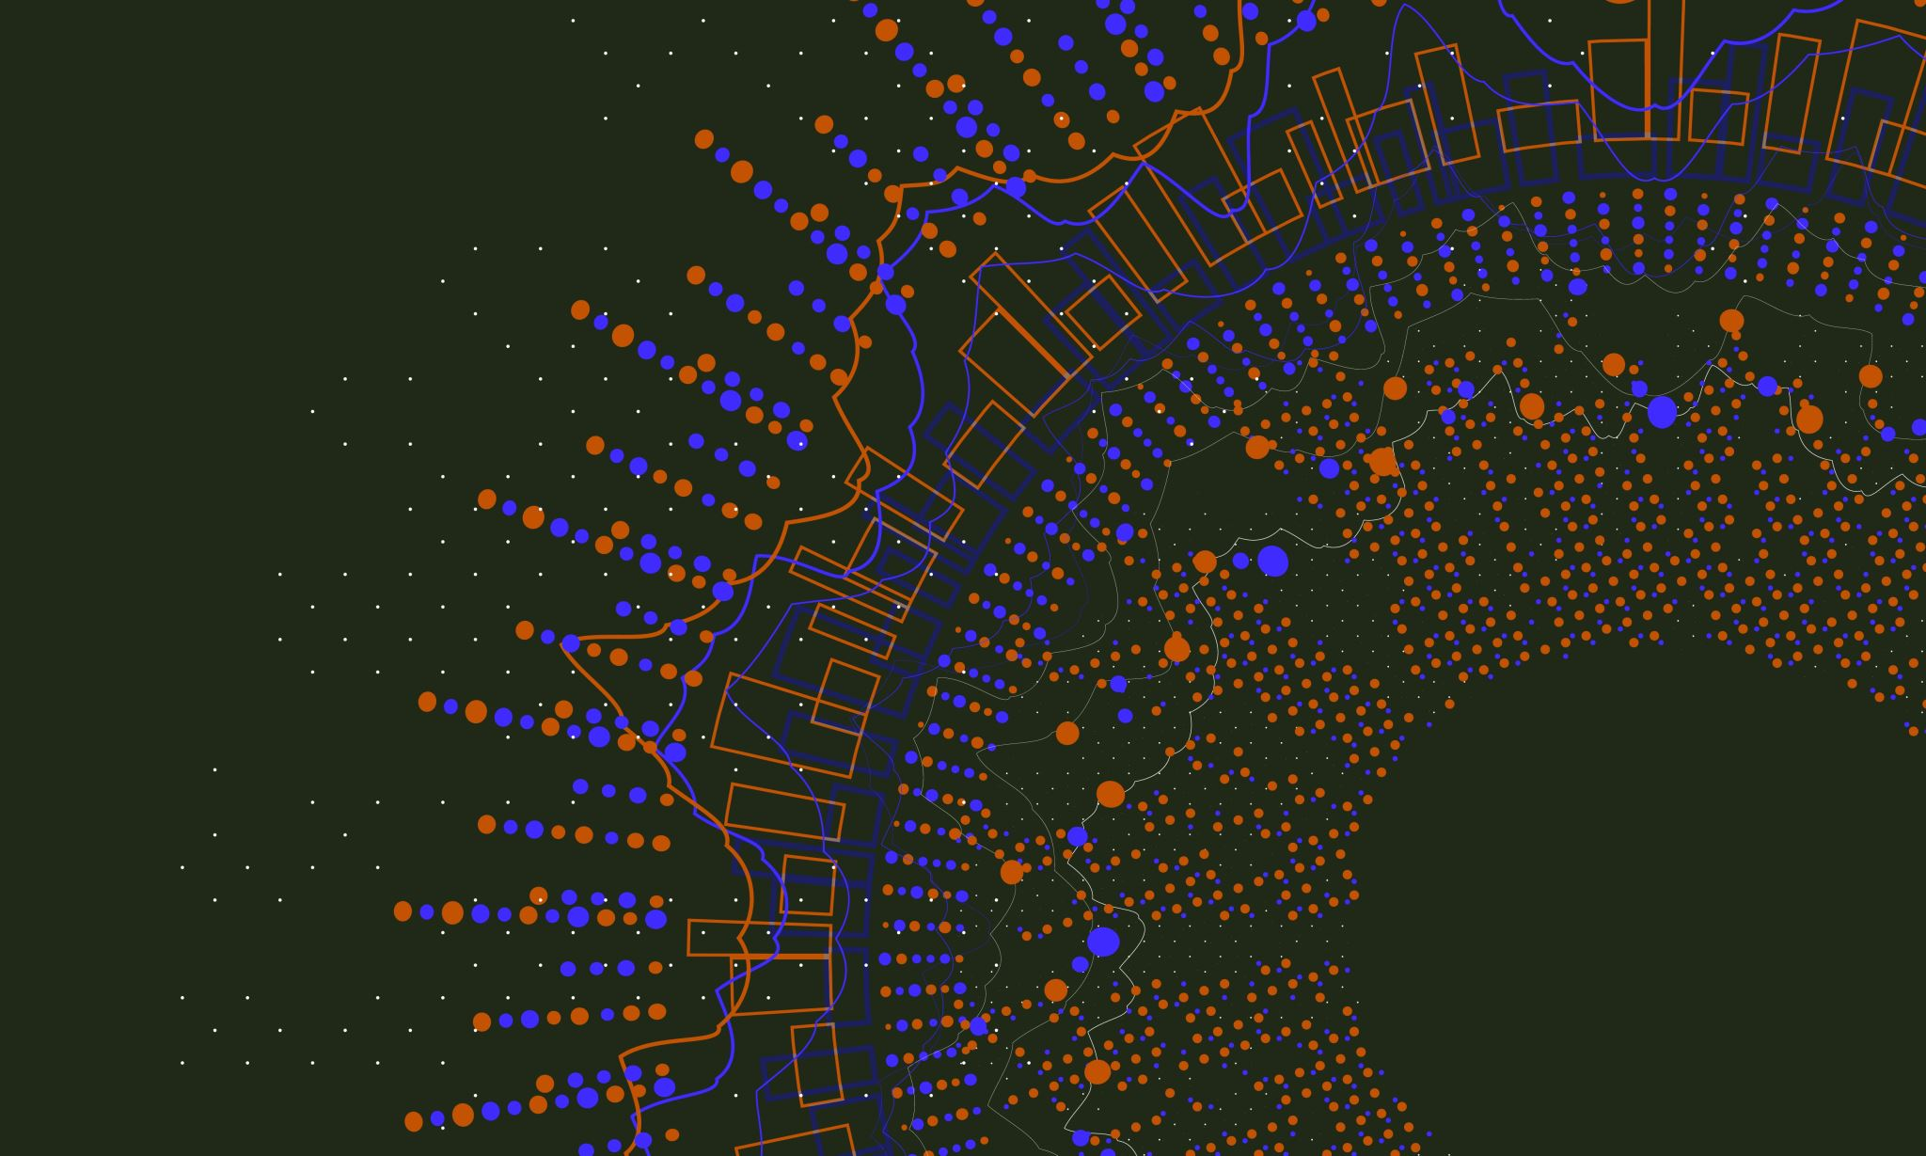
Outliers and Clusters
Scatter plots can help identify outliers and clusters within the data.
Outliers are individual data points that deviate significantly from the overall pattern.
Clusters refer to groups or concentrations of data points.
These observations can provide valuable insights into the dataset.

Slide 11

Best Fit Line
In scatter plots, a best fit line can be added to visualize the general trend between variables.
The line represents the best approximation of the relationship between the two variables.
It helps in making predictions or estimating values for a given input

Slide 12
Example code:
import matplotlib.pyplot as plt
x =[5, 7, 8, 7, 2, 17, 2, 9,
4, 11, 12, 9, 6]
y =[99, 86, 87, 88, 100, 86,
103, 87, 94, 78, 77, 85, 86]
plt.scatter(x, y, c ="blue")
# To show the plot
plt.show()

Slide 13
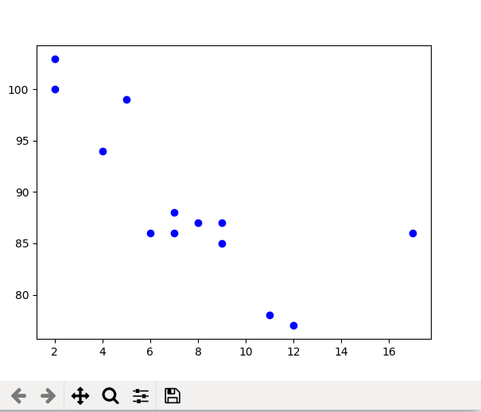
Out put:

Slide 14
Scatter plot projects:
Housing Market Analysis
Sales Performance Evaluation
Climate Change Study
Academic Performance Analysis
Stock Market Analysis

Slide 15
Conclusion:
Scatter plots are powerful tools for visualizing relationships between variables.
They allow us to identify patterns, trends, and outliers in the data.
By analyzing scatter plots, we can gain insights and make informed decisions based on the observed relationships.

Slide 16

Thank you

