Slide 1


Slide 2
FILM GENRE ANALYSIS TO INFORM FILM PRODUCTION DECISIONS

Slide 3
Overview
This is an analysis of historical movie data to identify patterns
associated with financial success and positive audience reception.

Slide 4
Business understanding
A company has come up with a new studio where they intend to create
movies.
They are new to the movie creation space and therefore need to know
the type of films that are doing the best at the box office.
This will help the head of the company’s new studio decide on the type of films to create.

Slide 5
Objectives
The project aims to analyze historical movie data to identify patterns
associated with financial success and positive audience reception.
This will be through the use of box office performance and audience
ratings.

Slide 6
Key questions
Which movie genres consistently perform best at the box office?
How does audience reception (ratings and engagement) relate to financial success?
What movie characteristics (such as runtime or release trends) are most associated with successful films?

Slide 7
Data Understanding

Slide 8
Data overview
This analysis made use of 3 key datasets;
https://www.boxofficemojo.com/
https://www.imdb.com/
https://www.themoviedb.org/
This well recognized sources of data ensured that different facets of
film production were considered, hence a well-rounded analysis.

Slide 9
Box Office Mojo Dataset
This dataset contains box office revenue data for movies.
These are movies that were released domestically and internationally.

Slide 10
IMDB dataset
The IMDB data is stored in a SQLite database.
The database contains multiple tables;however this analysis focuses on:
movie_basics
b) movie_ratings

Slide 11
The Movie Database
The TMDB dataset provides detailed information about movies,
including popularity metrics and audience ratings.
This dataset perfectly complements the IMDB and Box Office Mojo
datasets.

Slide 12
DATA ANALYSIS

Slide 13
Movie_basics dataset
All null values were removed from the movie_basics dataset.
The original_title column was removed as it held no significance in
the analysis.
The dataset did not contain any duplicates.

Slide 14
Movie_ratings dataset
The movie_ratings dataset did not contain any null values.
The movie_basics and movie_ratings were merged using the common
column being movie_id which resulted in rows with
matching movie_id to be chosen and resulted in
the merged_imdb dataset.

Slide 15
Box Office Mojo Dataset
All null values were removed from the gross dataset.
The domestic and foreign gross columns were merged and dropped
to form a total_gross column.

Slide 16
The Movie Database (TMDB)
This TMDB dataset did not contain any null values.
The IMDB and gross datasets were merged using the common
columns, title and year, found in both datasets.
The title column of the TMDB dataset was also merged.
The final merge resulted in 1424 rows and 9 handpicked columns.

Slide 17
VISUALIZATIONS

Slide 18
The visualizations are classified into 2 :
Financial performance
Market demand

Slide 19
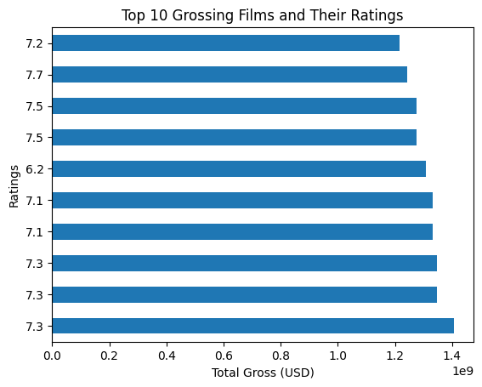
Financial performance
Ratings Against Gross

Slide 20
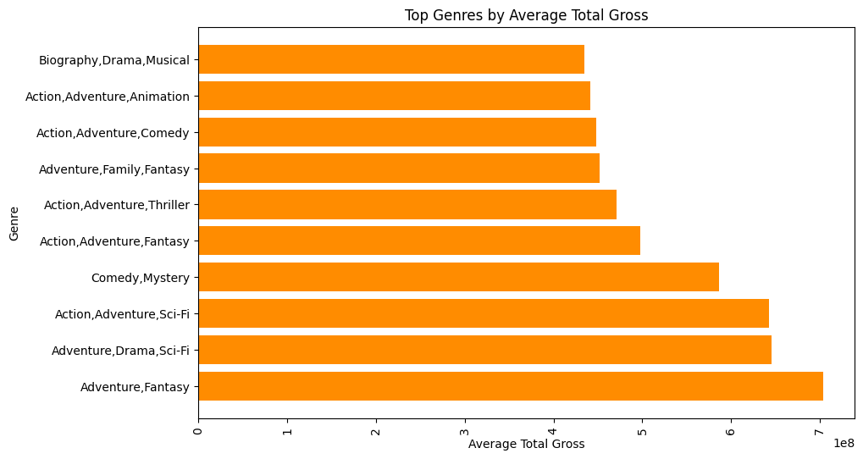
Genre against gross

Slide 21
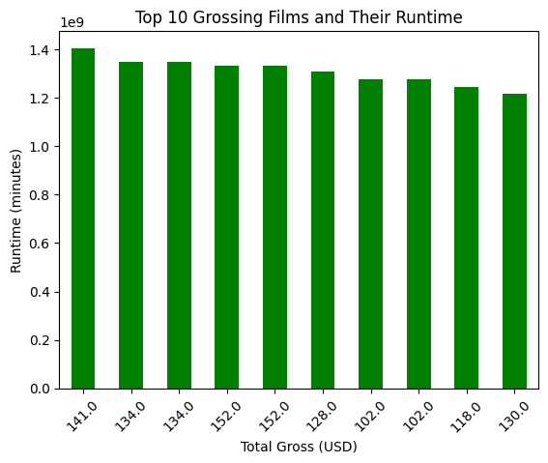
Runtime against Gross

Slide 22
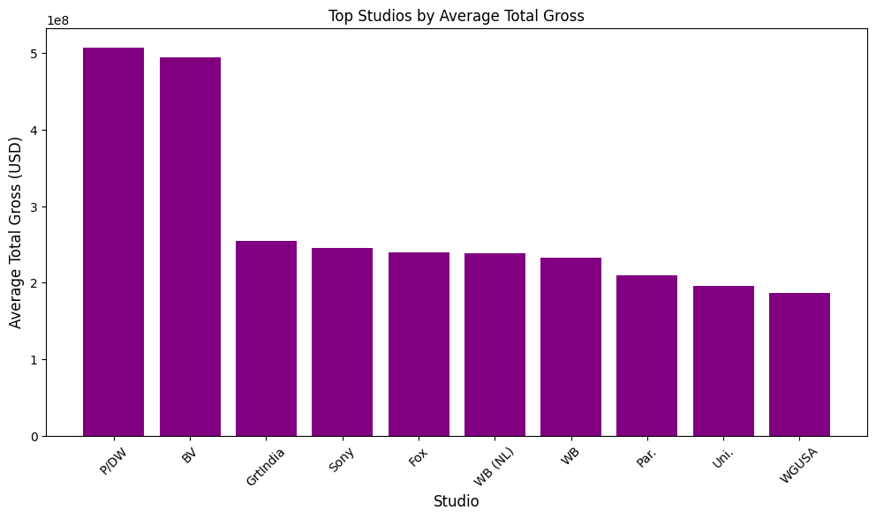
Studio against Gross

Slide 23
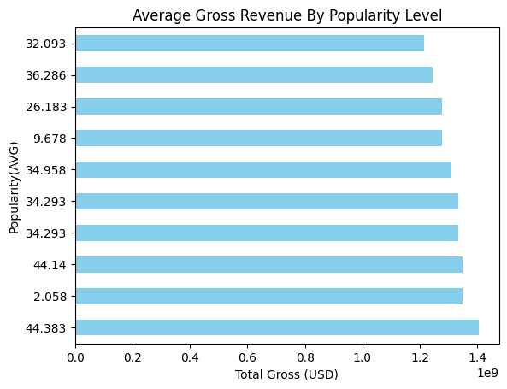
Popularity against gross

Slide 24
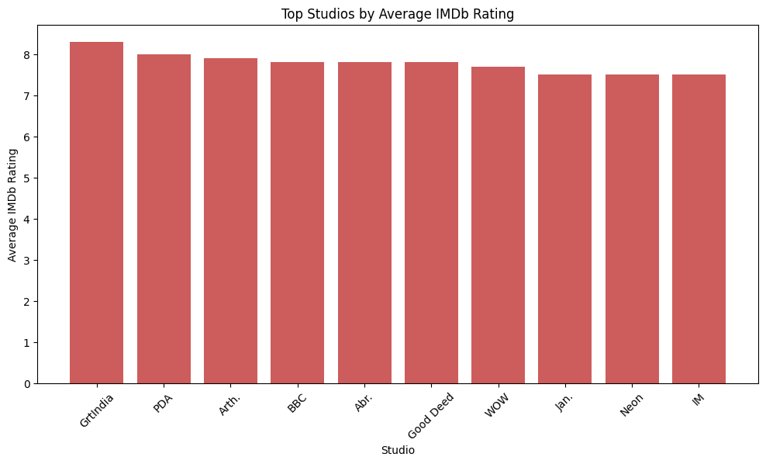
Market Demand
Studio against ratings

Slide 25
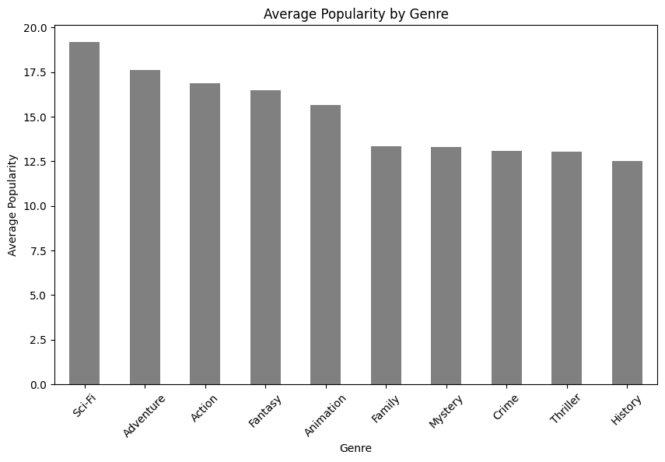
Genre against Popularity

Slide 26
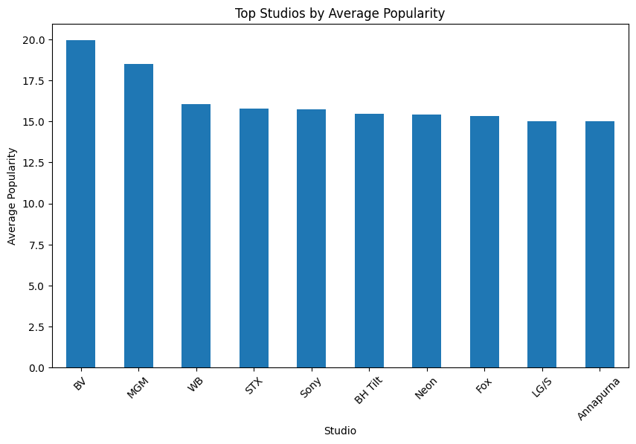
Studio against Popularity

Slide 27
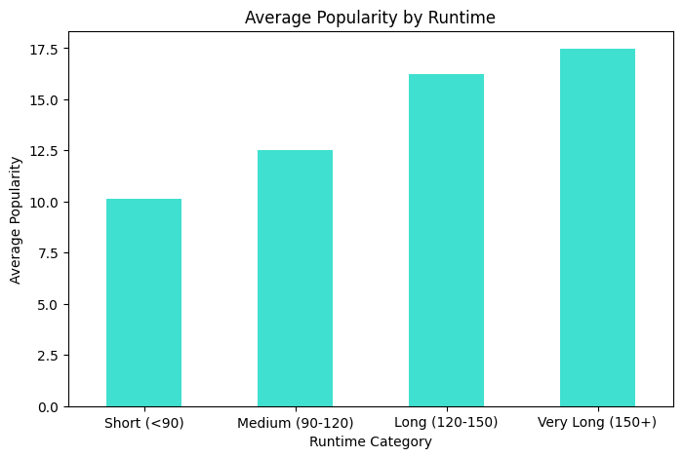
Runtime against Popularity

Slide 28
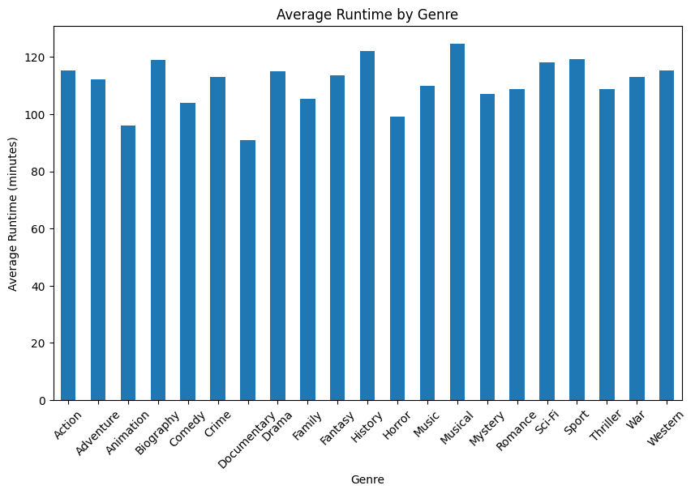
Genre against Runtime

Slide 29
RECOMMENDATIONS

Slide 30
Prioritize High Grossing Genres
The studio should prioritize producing films in these genres, particularly
for early releases, to maximize return on investment and attract
audiences.

Slide 31
Invest in quality to drive revenue
Allocate budget toward strong scripts, experienced directors, and
higher production quality to improve audience satisfaction rather than
focusing solely on quantity of releases.

Slide 32
Target Optimal Movie Runtime
The studio should aim to keep most productions over the 120 minute
range to balance storytelling, viewer attention, and production costs.

Slide 33
Learning From Top Studios
The studio should study their genre focus, franchise development,
marketing tactics and consider even partnerships or niche
differentiation.

Slide 34
Use Popularity Driven Data To Guide Greenlighting
The studio should incorporate pre-release popularity signals (social
buzz, early screenings, trailers, online engagement) into decision
-making when selecting projects.

Slide 35
Align Genre With Production Planning
The head of the studio and the executive should plan budgets and
schedules according to genre expectations (e.g., longer runtimes for
action, adventure and Sci-fi).

