Slide 1

INSURANCE
ANALYTICS

Slide 2
Shravya Madipadige
Team Members
Shanti Priya
Patro
Rajkonda
Nithya
Abdul Rahman Shaik
Shubha
Dorisetty

Slide 3
AGENDA
1
Branch Dashboard
Overview
4
Project Goal &
Introduction
5
Conclusion
2
Description
6
Recommendation
3
Key Performance
Indicators (KPIs)

Slide 4
Insurance
Policy
Overview :
The Insurance Project analyzes branch performance across sales, revenue, meetings, and targets. It focuses on three key areas — Cross Sell, New Business, and Renewals — to monitor achievements and opportunities.
Business Use :
Track total and open opportunities.
Measure achievement vs target performance.
Evaluate executive and invoice efficiency .
Analyze revenue stages and product distribution.
Purpose of Insights :
Improve sales performance and goal tracking
Enable data-driven decisions for growth
Identify high-value opportunities and gaps
Optimize budget and resource utilization
Overview :
The Policy Project provides insights into customer policies, claims, payments, and premium growth. It highlights how policies perform across customer segments and policy types.
Business Use :
Monitor policy distribution and customer demographics
Track claim status and payment outcomes
Analyze premium growth and renewal trend
Purpose of Insights :
Enhance customer satisfaction and retention
Identify profitable segments and risks
Support strategic decisions in policy planning
Strengthen overall policy management

Slide 5
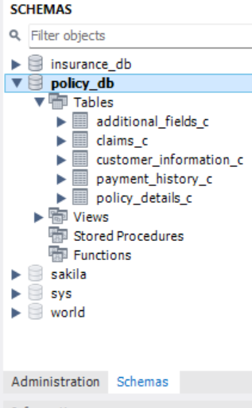
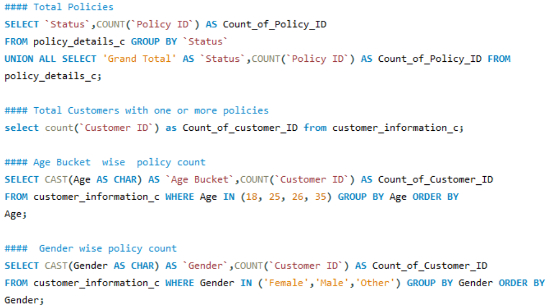
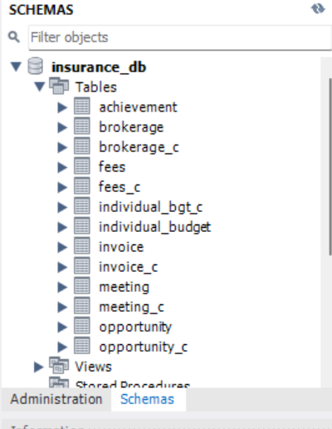
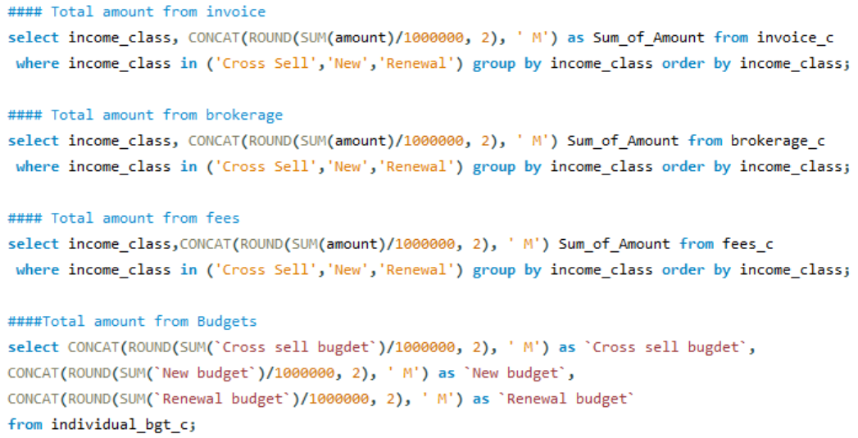
SQL
Schemas
&
Queries -

Slide 6
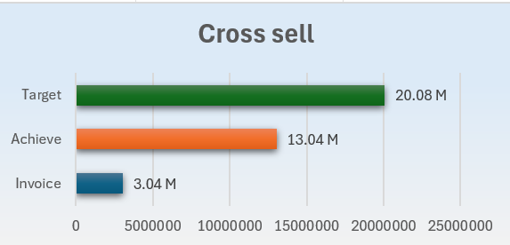
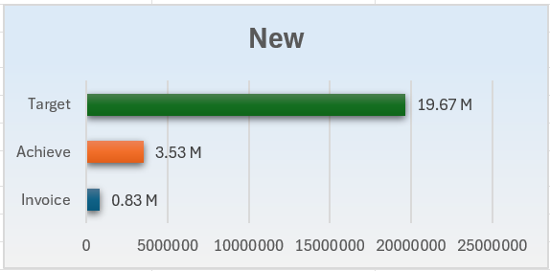
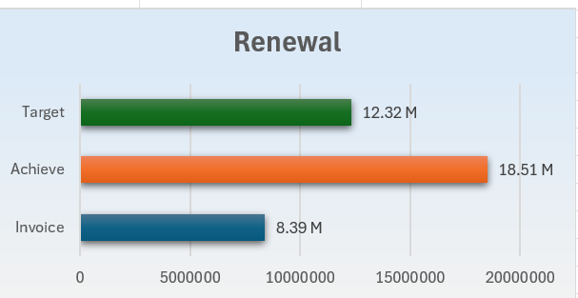
CROSS
NEW
RENEWAL
Cross sell performance evaluation using three metrics
Target-The goal set for cross-selling.
Invoice-The actual invoice amount.
Achieved-The revenue successfully achieved.
New Business Performance evaluation tracks performance for new business acquisitions
Target-The goal for new business revenue.
Invoice-The actual invoiced amount for new business.
Achieved-The revenue successfully realized from new business.
Renewal evaluates the renewal revenue performance.
Target-The expected renewal revenue.
Invoice-The billed amount for renewals.
Achieved-The ‘Achieved’ value is highest ,indicating strong renewal performance beyond the target.

Slide 7

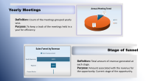
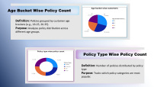
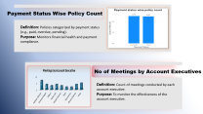
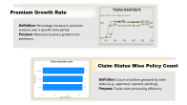

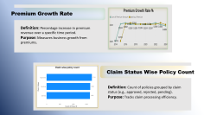

KPI’S 1-2
KPI’S 3-4
KPI’S 5-6
KPI’S 7-8

Slide 8
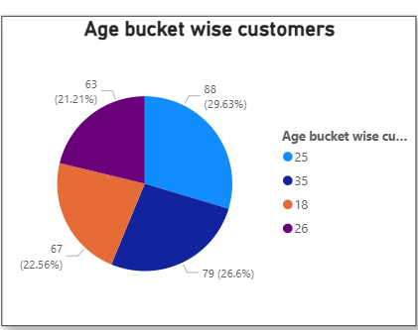
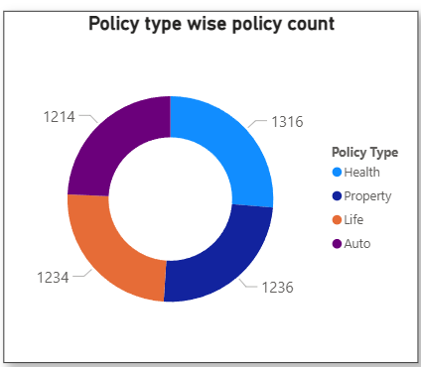
Age Bucket Wise Policy Count
Definition: Policies grouped by customer age brackets (e.g., 18-25, 26-35).
Purpose: Analyzes policy distribution across different age groups.
Policy Type Wise Policy Count
Definition: Number of policies distributed by policy type
Purpose: Tracks which policy categories are most popular.

Slide 9
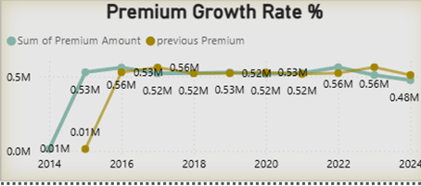
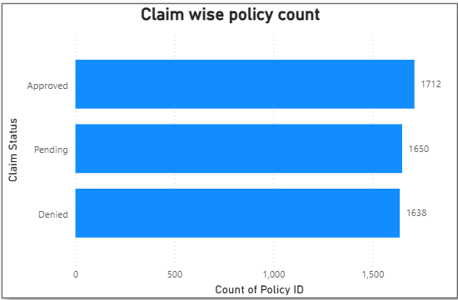
Premium Growth Rate
Definition: Percentage increase in premium revenue over a specific time period.
Purpose: Measures business growth from premiums.
Claim Status Wise Policy Count
Definition: Count of policies grouped by claim status (e.g., approved, rejected, pending).
Purpose: Tracks claim processing efficiency.

Slide 10
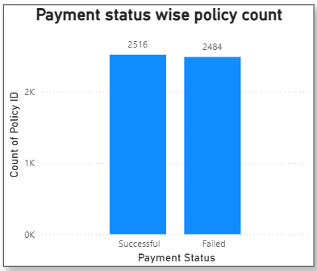
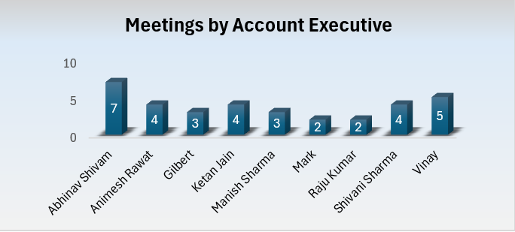
Payment Status Wise Policy Count
Definition: Policies categorized by payment status (e.g., paid, overdue, pending).
Purpose: Monitors financial health and payment compliance.
No of Meetings by Account Executives
Definition: Count of meetings conducted by each account executive.
Purpose: To monitor the effectiveness of the account executive.

Slide 11
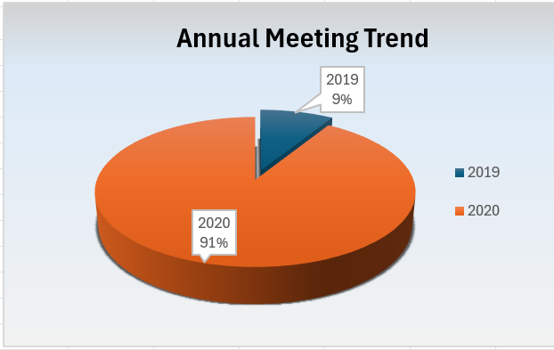
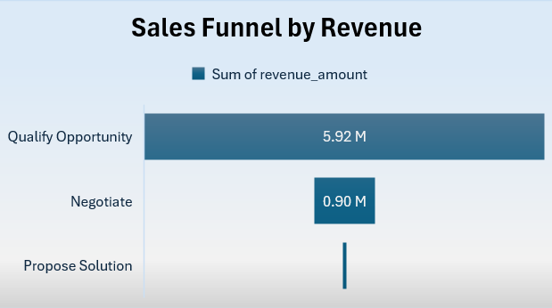
Yearly Meetings
Definition: Count of the meetings grouped yearly wise.
Purpose: To keep a track of the meetings held in a year for efficiency.
Stage of funnel
Definition: Total amount of revenue generated at each stage.
Purpose: Amount associated with the revenue for the opportunity. Current stage of the opportunity.

Slide 12
Dashboards

Slide 13
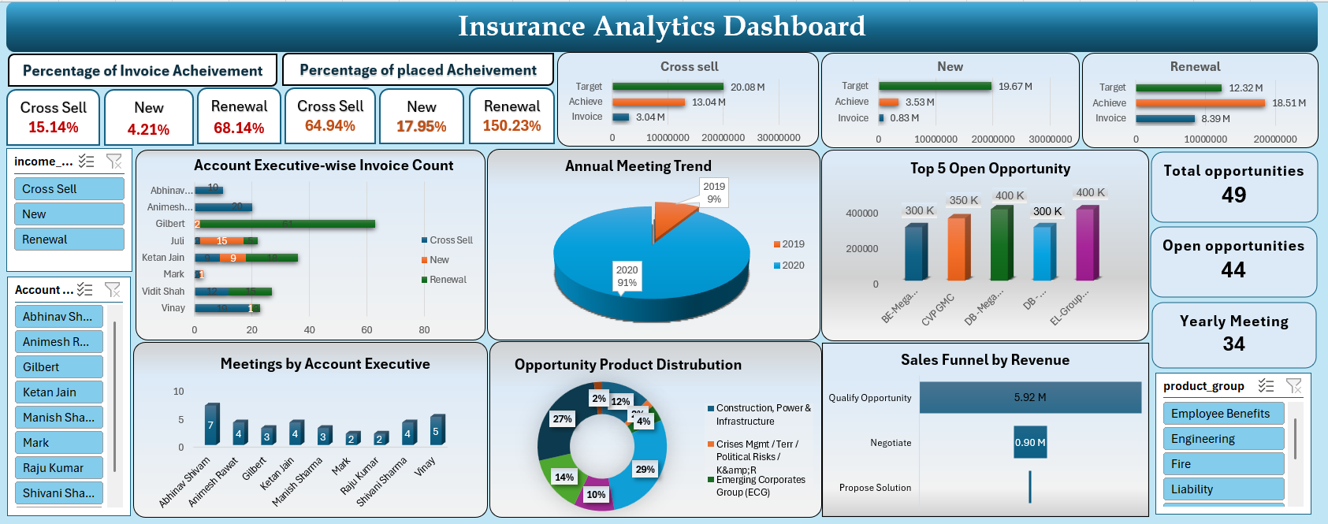
Excel

Slide 14
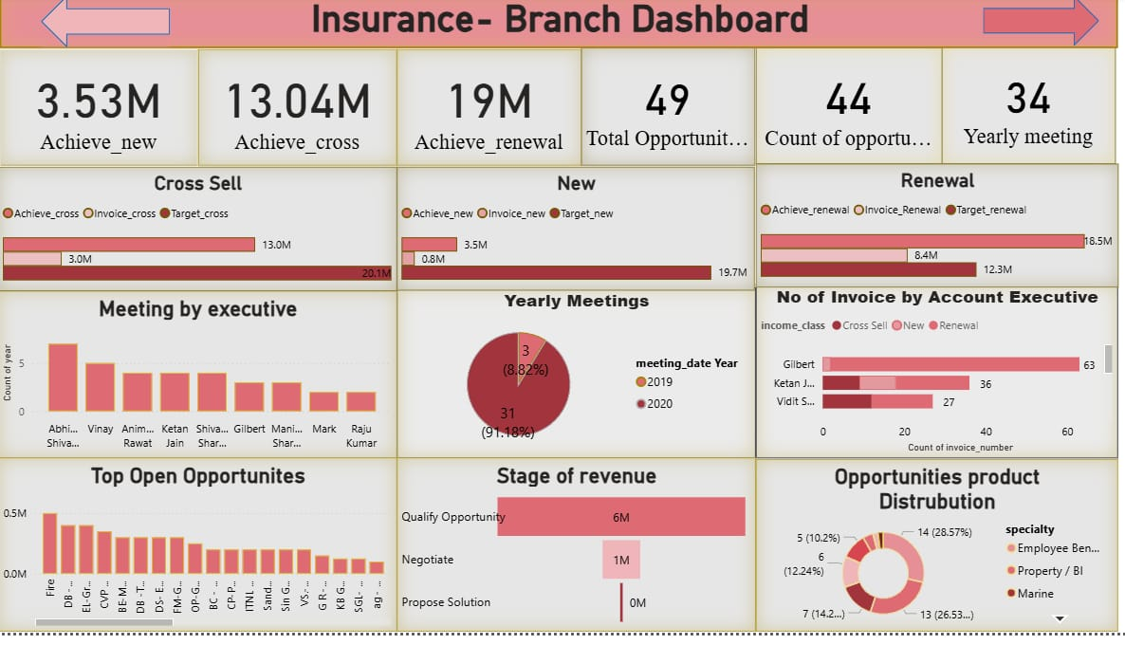
Power BI

Slide 15
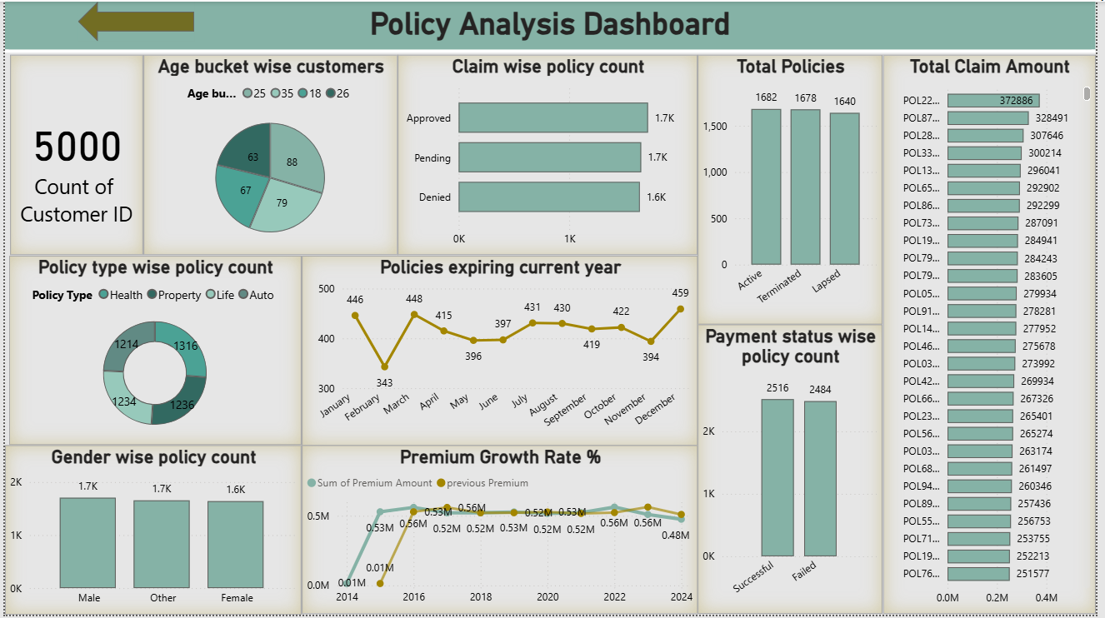
Power BI

Slide 16
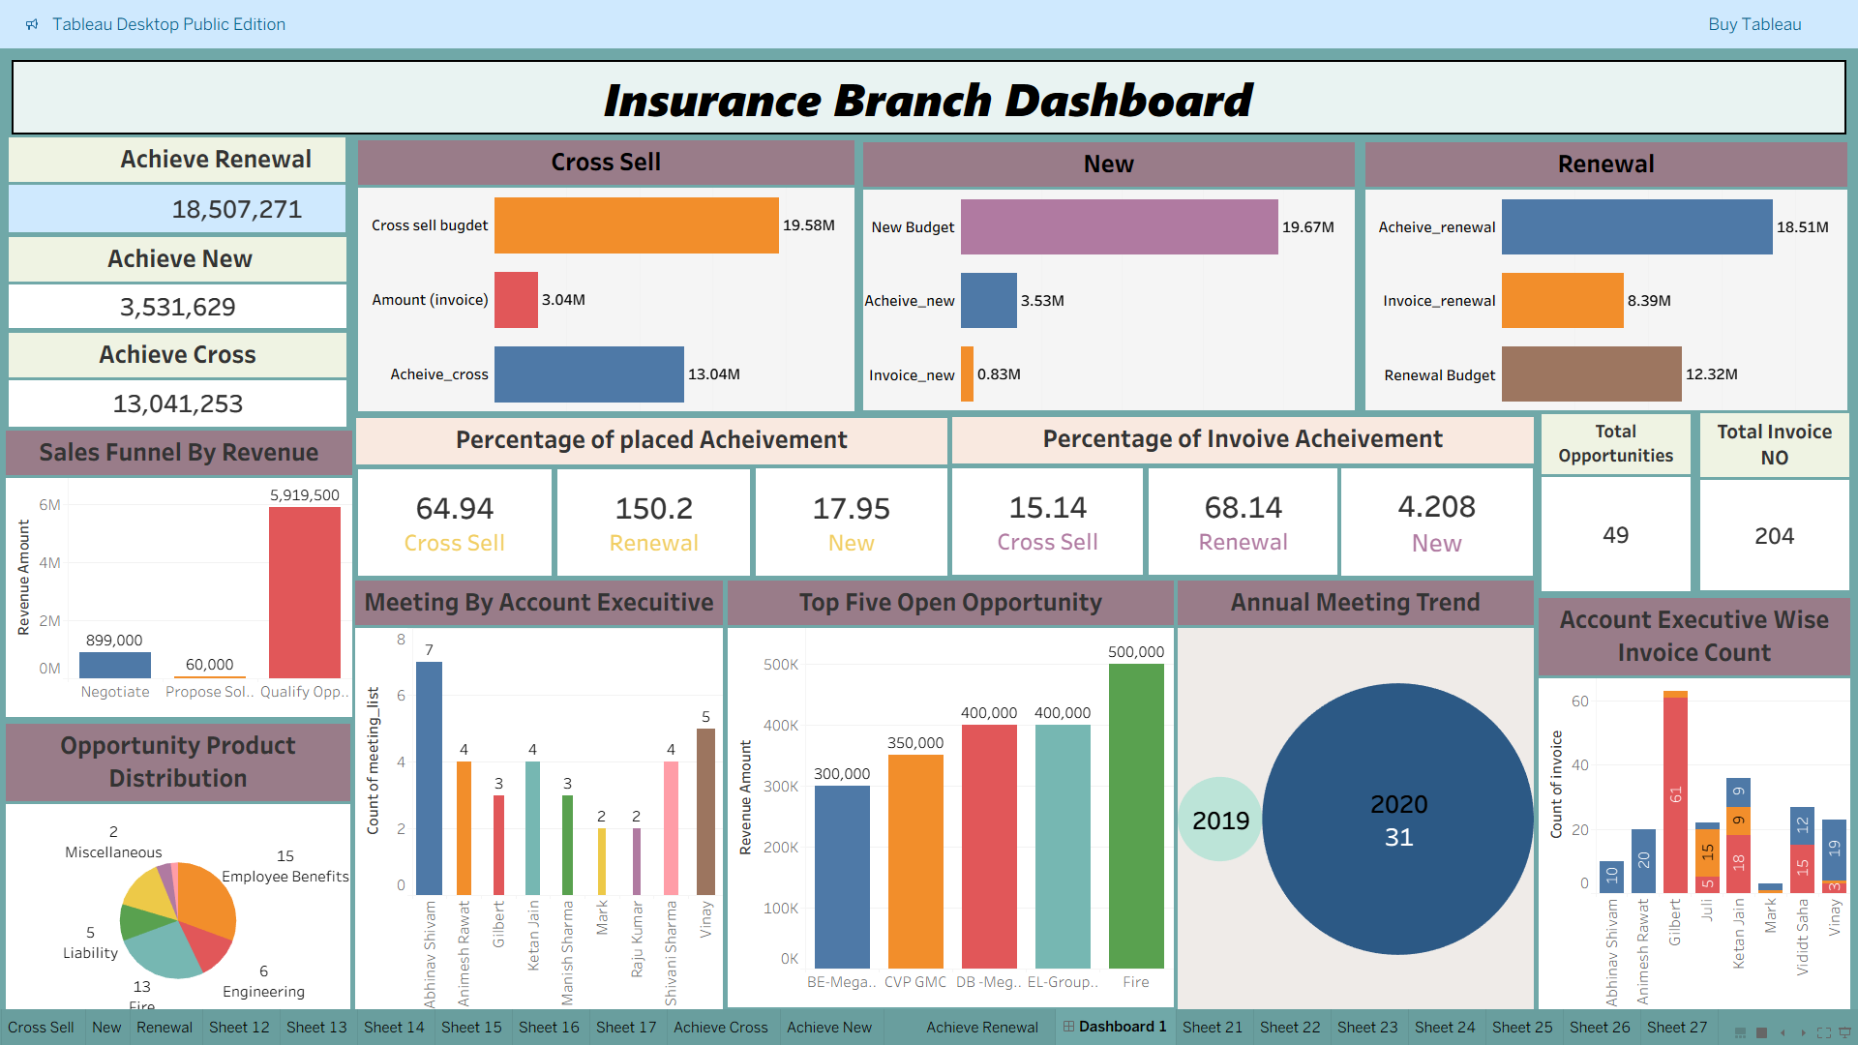
Tableau

Slide 17
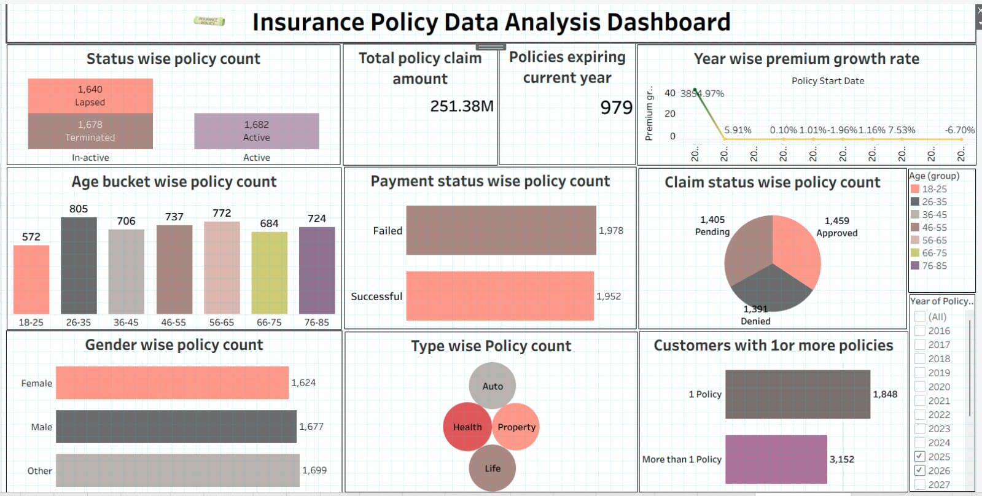
Tableau

Slide 18
CONCLUSION
Insurance Dashboard :
Provides a clear overview of branch performance across Cross Sell, New Business, and Renewal opportunities.
Enables tracking of achievements vs. targets, helping identify gaps and strong performers.
Supports data-driven decisions through insights on meetings, invoices, and revenue stages.
Future Scope Can be improved with real-time and predictive analytics to forecast future opportunities and revenue.
Policy Dashboard
Delivers valuable insights into customer policies, claims, and payment patterns.
Helps identify profitable policy types and customer demographics driving growth.
Strengthens customer retention and overall policy management efficiency.
Future Scope Future enhancements can include predictive modeling for policy lapse and claim risk forecasting.

Slide 19


