Slide 1


Continuous Integration Server

Slide 2
WHAT IS JENKINS?
Jenkins build on Java Platform
Jenkins is an open source automation server (recently acquired by Cloud Bees).
It helps automate the parts of software development related to building, testing, and deploying, facilitating continuous integration and continuous delivery. It is a server-based system that runs in servlet containers such as Apache Tomcat

Slide 3
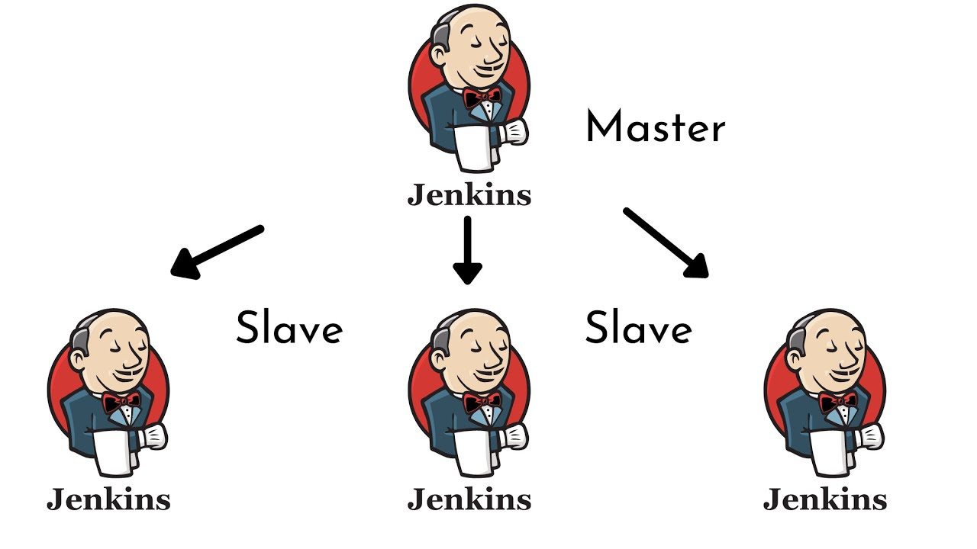
JENKINS ARCHITECTURE

Slide 4
Jenkins Master and Slave
Jenkins Master: The Jenkins master acts to schedule the jobs, assign slaves, and send builds to slaves to execute the jobs. It will also monitor the slave state (offline or online) and get back the build result responses from slaves and the display build results on the console output.
Jenkins Slave: Slave is a java executable which receives the build instructions from the central master node. Let’s do the Master-Slave Configuration on GCP by following below steps and instructions.

Slide 5
Master - Node Communication
Launching Agent with SSH from Master.
Launch Agent by connecting it to master.

Slide 6
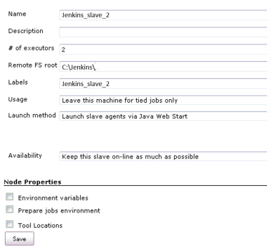

Slide 7
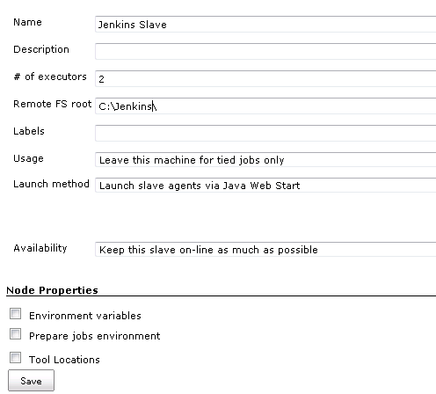

Slide 8
Node Components
Executors: The maximum number of concurrent builds that Jenkins may perform on this node.
Remote Root Directory: An agent needs to have a directory dedicated to Jenkins. Specify the path to this directory on the agent. It is best to use an absolute path, such as /var/jenkins or c:\jenkins . This should be a path local to the agent machine. There is no need for this path to be visible from the controller.
Labels: Labels (or tags) are used to group multiple agents into one logical group.
Usage: use node as much as possible & only build jobs with label expressions matching the node
Availability: Controls when Jenkins starts and stops this agent.
_x000b_

Slide 9
Master Node configuration
Step 1 − Go to the Manage Jenkins section and scroll down to the section of Manage Nodes.
Step 2 − Click on New Node
Step 3 − Give a name for the node, choose the Dumb slave option and click on Ok.
Step 4 − Enter the details of the node slave machine.

Slide 10
Jenkins Components
Job: A set of tasks that runs sequentially as defined by the user. Any automation implemented in Jenkins is a Jenkins Job. These jobs are a significant part of Jenkins's build process. We can create and build Jenkins jobs to test our application or project
Build: introduces a job type that lets you define an orchestration process as a script
Pipeline: Jenkins Pipeline (or simply "Pipeline") is a suite of plugins which supports implementing and integrating continuous delivery pipelines into Jenkins. A continuous delivery pipeline is an automated expression of your process for getting software from version control right through to your users and customers.

Slide 11

Types of Pipeline
Scripted Pipeline: Scripted Pipeline is a Domain Specific Language (DSL) based on Apache Groovy. Most functionality provided by the Groovy language is made available in Scripted Pipelines. This means Scripted Pipelines can offer flexibility and extensibility to users.
Declarative Pipeline: A declarative Pipeline provides a structured hierarchical syntax to simplify the creation of Pipelines and the associated Jenkins files. It is newer than scripted Pipeline. In its simplest form, a Pipeline runs on an agent and contains stages, while each stage contains steps that define specific actions.

Slide 12
Freestyle Project
Jenkins freestyle projects allow users to automate simple jobs, such as running tests, creating and packaging applications, producing reports, or executing commands. Freestyle projects are repeatable and contain both build steps and post-build actions.

Slide 13
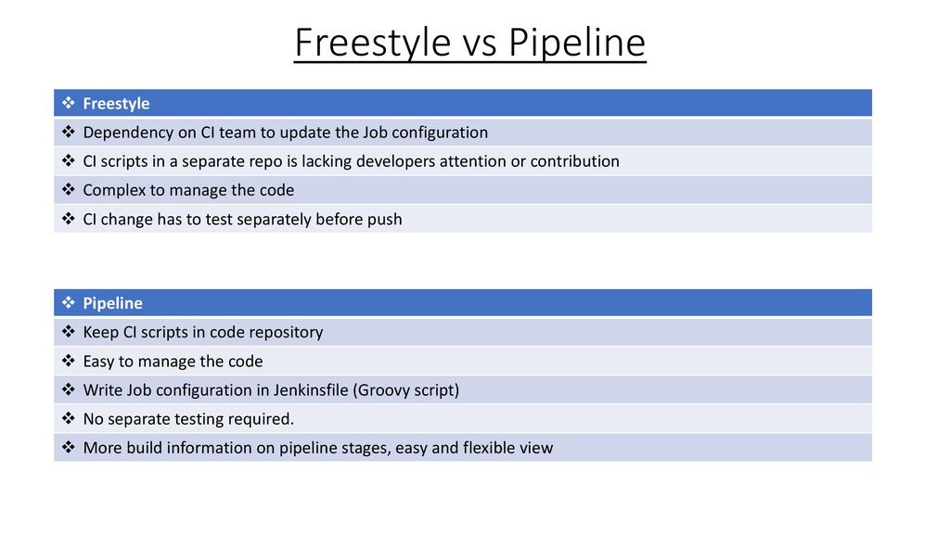

Slide 14
Sample scripted Pipeline
// This shows a simple build wrapper example, using the AnsiColor plugin.
node {
// This displays colors using the 'xterm' ansi color map.
ansiColor('xterm') {
// Just some echoes to show the ANSI color.
stage "\u001B[31mI'm Red\u001B[0m Now not"
}
}

Slide 15
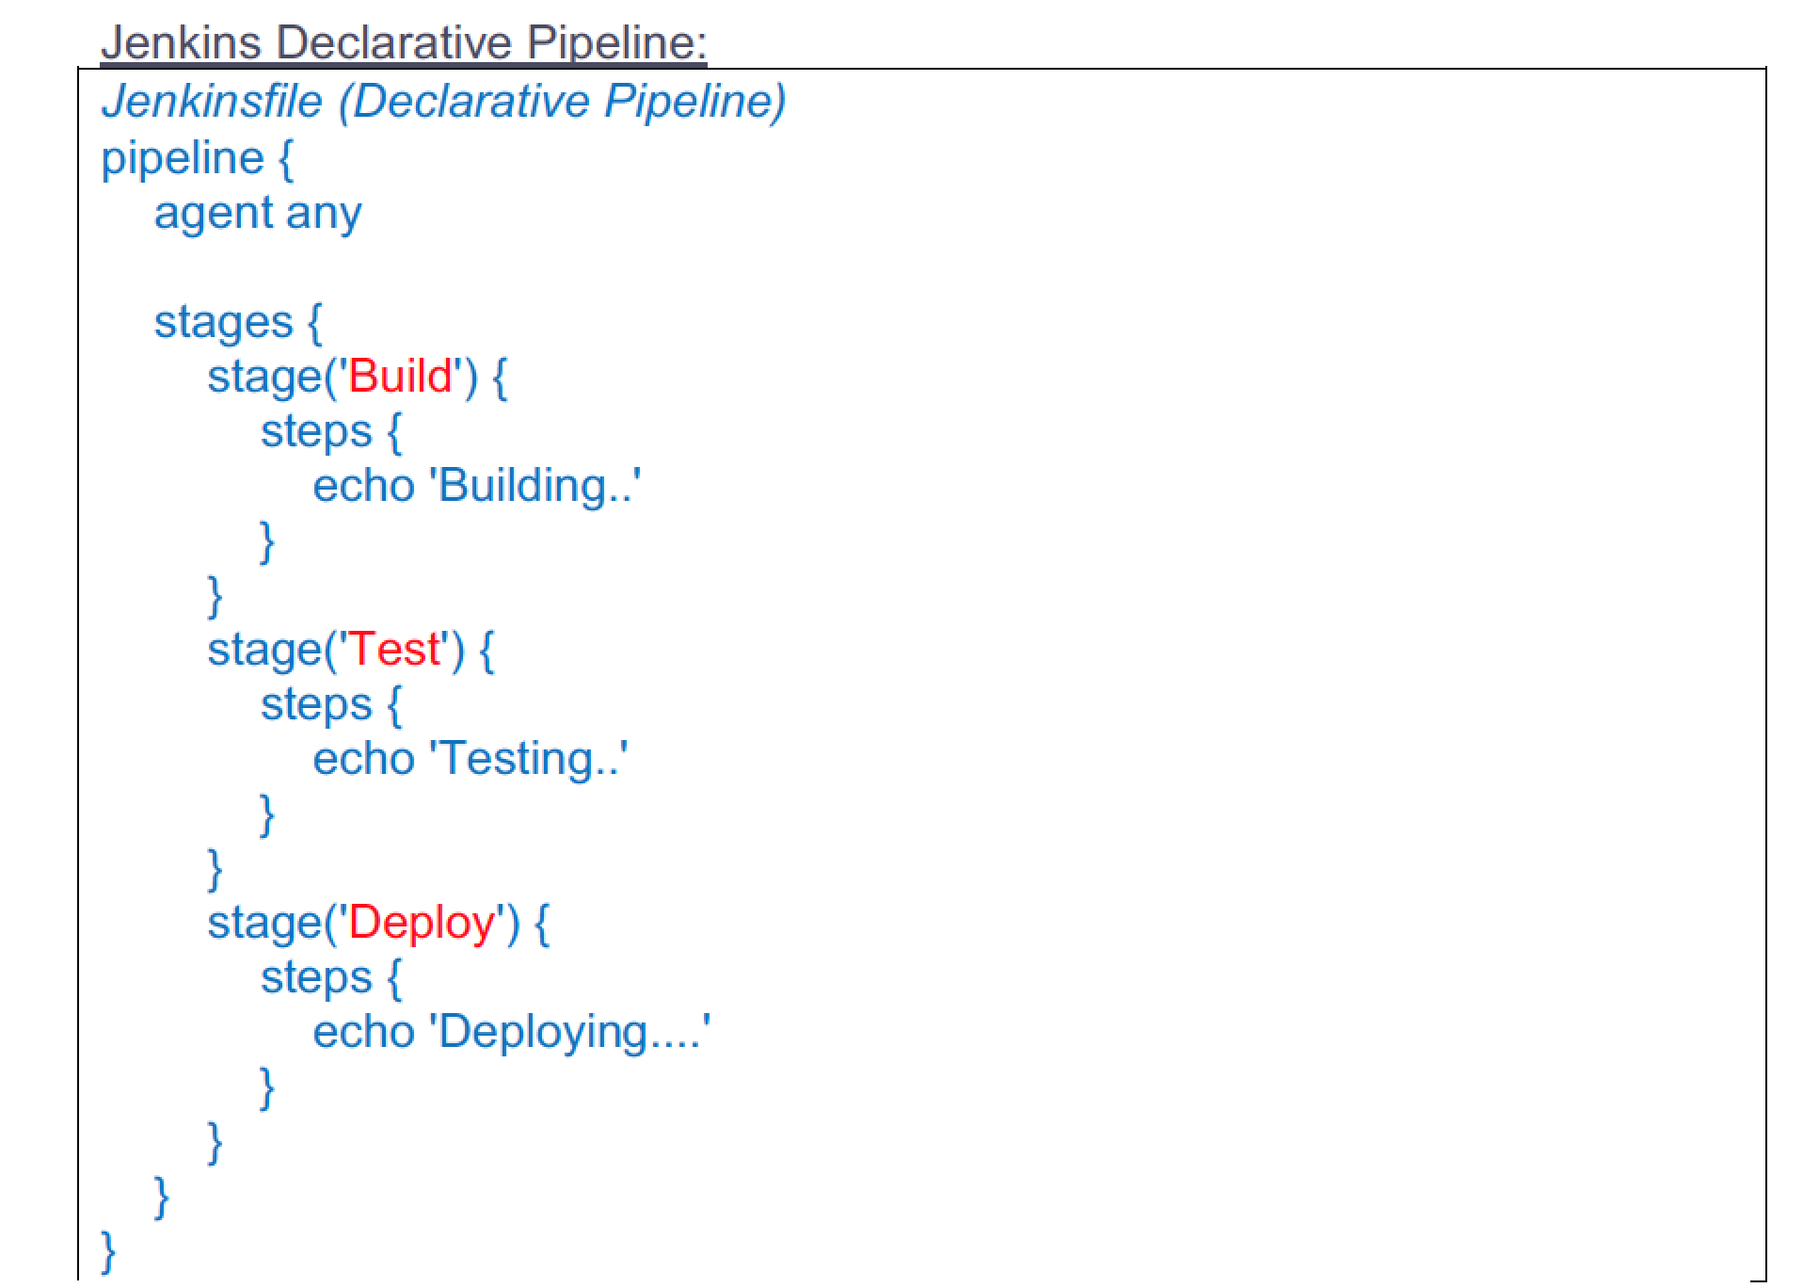

Slide 16
Multi-branch pipeline
The Multibranch Pipeline project type enables you to implement different Jenkins files for different branches of the same project. In a Multibranch Pipeline project, Jenkins automatically discovers, manages and executes Pipelines for branches which contain a Jenkins file in source control.

Slide 17
Jenkins File
A Jenkins file is a text file that contains the definition of a Jenkins Pipeline and is checked into source control. Consider the following Pipeline which implements a basic three-stage continuous delivery pipeline. Jenkins file (Declarative Pipeline)

Slide 18
Jenkins Plugins
Plugins are the primary means of enhancing the functionality of a Jenkins environment to suit organization- or user-specific needs. There are over a thousand different plugins which can be installed on a Jenkins controller and to integrate various build tools, cloud providers, analysis tools, and much more.
.

Slide 19
Most Commonly Used plugins:
Git Plugin.
Kubernetes Plugin.
Jira Plugin.
Docker Plugin
Maven Integration Plugin
Blue Ocean Plugin.
Amazon EC2 Plugin
Pipeline Plugin

Slide 20
Global Configuration Tool
The Global tool configurations is another sub-section under the System Configuration option. Subsequently, in this section, we can define configurations as well as installation information regarding global tools that we want to integrate with Jenkins like Maven, JDK, Git, Gradle as well as Ant

