Slide 1


SMART CANTEEN QUEUE & ORDER MANAGEMENT

Slide 2



PRESENTATION ROADMAP
Agenda
From operational friction to a faster, more connected canteen experience.
Current challenges
System overview
Workflow to impact
Where queues, fragmented processes, and limited visibility slow service down.
How the platform connects ordering, service flow, and operational control.
Implementation steps, expected benefits, and the next move toward rollout.
Set the context
See the solution
Move forward
Canteen operations platform
01

Slide 3


THE SERVICE GAP
Why Canteens Need a Smarter System
Every avoidable delay compounds when demand peaks.
The real cost is lost flow.
Where the current flow breaks
01
Long queues form at peak times
When ordering, payment, and preparation operate separately, every handoff adds delay.
Lunch and break demand quickly overwhelms the serving line.
02
Manual orders create avoidable friction
Errors and rework slow staff down exactly when speed matters most.
03
Slow payments hide demand signals
Bottlenecks disrupt service flow and obscure the preparation load ahead.
A smoother system starts with visibility.

Slide 4





SMART CANTEEN OPERATIONS
How the Smart System Works
One connected flow from customer order to prioritized kitchen pickup.
CUSTOMER JOURNEY
KITCHEN OPERATIONS
Order with ease
Cook by priority
1
Choose any channel
1
See every order live
Order through the mobile app, kiosk, or counter.
The kitchen receives a live order stream as demand arrives.
2
Know when to collect
2
Work in the right sequence
Receive a queue token and estimated pickup time, then track status on screens or your phone.
Orders are organized by priority to keep preparation coordinated and predictable.
Clear status. Less waiting. Better pickup timing.
A calmer line starts behind the counter.

Slide 5





CORE PLATFORM CAPABILITIES
A faster path from order to pickup
Connected experiences help customers move confidently while operators stay in control.
Smart ordering
Live queue tracking
Cashless checkout
Digital menus make browsing, customizing, and submitting every order simple.
Real-time status updates give customers a clear view of what happens next.
Secure digital payments close the loop with a fast, reliable confirmation.
•Personalized menu choices
•Visible progress from order to pickup
•Frictionless payment flow
•Clear order confirmation
•Fewer uncertain waits
•Confidence at handoff
Operations command center
An admin dashboard monitors demand, queue activity, and service status in one view.
Built for confident decisions

Slide 6


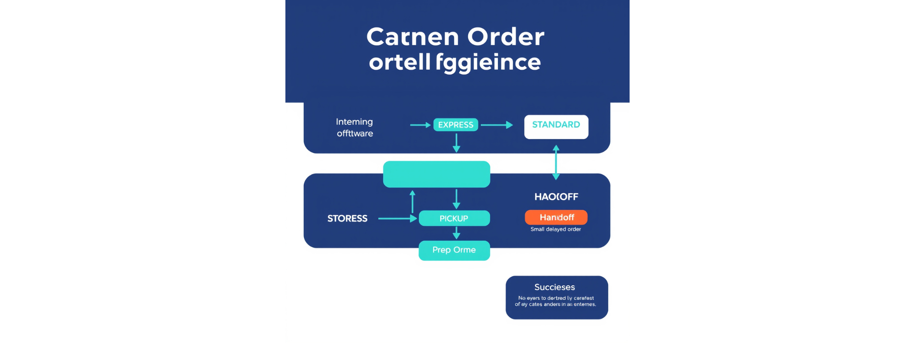





ORDER FLOW CONTROL
Queue Intelligence and Order Prioritization
A dynamic queue keeps every order moving through the right lane, service point, and alert state.
A queue that adapts in real time
LIVE QUEUE LOGIC
Two lanes, one clear rule
Prep time shapes priority; lane rules shape flow.
Express orders move fast; standard orders stay orderly.
Control when pressure rises
Balance workload across service points.
Alert teams before delays become misses.
The right order reaches the right station at the right moment.

Slide 7









Customer experience
Customer Experience Improvements
A smarter canteen turns waiting time into confidence and convenience.
Smart canteen
Traditional canteen
The streamlined experience
The friction customers feel
Shorter waiting
Longer waiting
Fewer physical lines keep service moving.
Physical queues slow the experience.
Clear order tracking
Limited visibility
Visibility builds customer confidence.
Uncertainty weakens confidence.
Self-service ordering
More service friction
Less friction from selection to pickup.
Manual steps make repeat use harder.
Faster service improves satisfaction and repeat usage.
FROM QUEUE TO CONFIDENCE

Slide 8








OPERATIONAL BENEFITS FOR STAFF
A smoother service shift, from entry to handoff
Digital ordering removes friction where kitchen teams feel it most: queues, rework, and peak-period pressure.
Operational gains
Legacy friction
Less manual entry and payment handling
Manual steps slow service at the busiest moments.
Staff spend more time preparing orders, not processing them.
Clearer workload visibility for the kitchen
Limited visibility makes errors and remakes harder to prevent.
Teams can see what is coming and organize the handoff.
Fewer mistakes, remakes, and peak-period bottlenecks
A cleaner flow supports faster, more reliable throughput.
The operational gap is felt behind the counter.
Recommendation
Prioritize the digital flow where staff workload and peak demand intersect.

Slide 9

ROLLOUT PLAN
Implementation Roadmap
Start focused, connect the operation, then scale with confidence.
01
Pilot the model
Pilot at one canteen outlet and validate the daily service flow.
Phase 1
02
Connect operations
Integrate payments and the kitchen display for seamless execution.
Phase 2
03
Optimize and scale
Add analytics and demand forecasting, then scale across campus or the organization.
Phases 3–4
A controlled rollout turns early learning into repeatable scale.

Slide 10



OPERATIONS SCORECARD
Success Metrics to Track
Measure the system where service speed, precision, and loyalty meet.
Average Wait Time
Order Accuracy
Peak-Hour Throughput
Reduce
Right-first
Process
Shorter queues signal a smoother service flow.
Pair accuracy with fulfillment to protect trust.
Track orders per hour, satisfaction, and repeat adoption.
The goal: faster service that customers choose again.
LIVE PERFORMANCE VIEW

Slide 11





RISK MANAGEMENT
Risks and Mitigation
Plan for friction early, so canteen operations stay fast, reliable, and trusted.
01 · PEOPLE
02 · CONTINUITY
03 · SCALE
Adoption resistance
System downtime
Peak overload
Train staff and make the benefits visible from day one.
Enable backup ordering options to keep service moving.
Use scalable cloud infrastructure for demand spikes.
Build confidence through practice
Keep a reliable fallback ready
Scale capacity when queues rise
Control layer
Secure access controls protect data while the service scales.

Slide 12



THE TAKEAWAY
Conclusion
Smarter queues mean faster service.
Digital ordering improves accuracy and control.
Start small, measure results, then scale.
Faster service
Greater control
Confident scale
A better queue is a better service experience.

