Slide 1
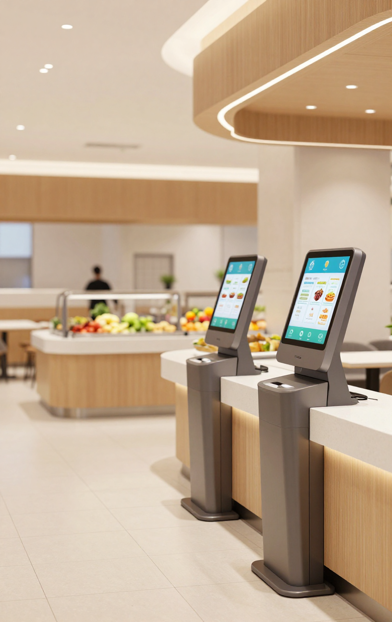
Smart Canteen Co.
2030
Smart Canteen
Queue & Order
//
01
Overview
09
Management
Faster Ordering, Shorter Queues, Happier Customers
A modern digital solution designed to streamline canteen operations, reduce wait times, and deliver a seamless ordering experience for staff and visitors alike.

Slide 2
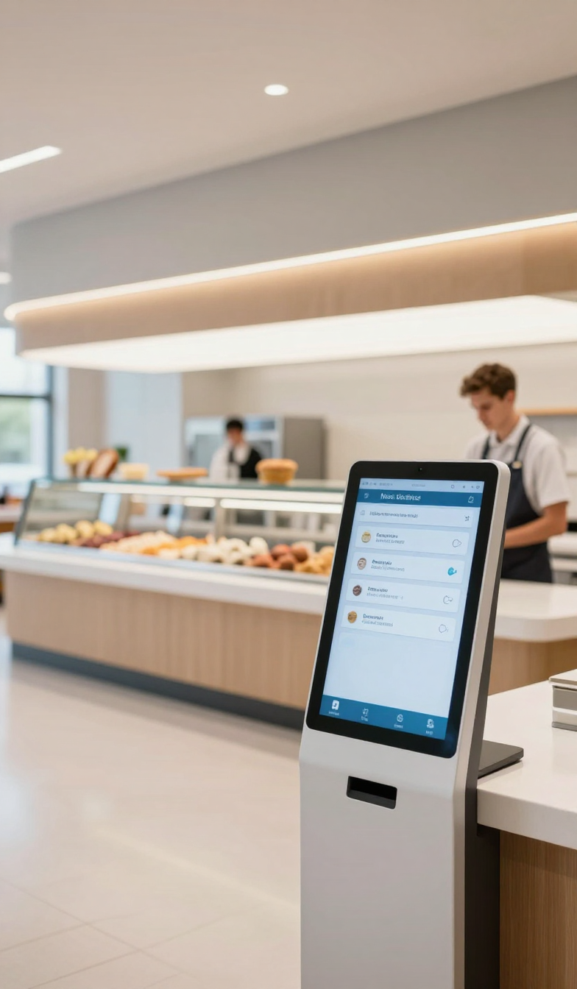
Smart Canteen Co.
2030
Vision & Mission.
We are transforming the canteen experience by digitizing ordering and queue management — empowering staff and customers with a smarter, faster, and more efficient food service platform.
Vision
Mission
To create a seamlessly connected canteen ecosystem where every customer enjoys a frictionless ordering experience, zero wait-time frustration, and personalized service — powered by intelligent digital technology that transforms traditional food queues into smart, data-driven workflows.
To deliver an intuitive queue and order management platform that digitizes canteen operations end-to-end — reducing wait times, minimizing order errors, optimizing staff efficiency, and providing real-time insights that help canteen operators serve more customers with greater accuracy and satisfaction.

Slide 3
Smart Canteen
2030
Why It's Important?
01
02
04
Virtual Queue Management
Digital Menu
& Ordering
Automated Notifications & Payments
Join a smart virtual queue without physically waiting in line. The system intelligently assigns queue positions, estimates wait times, and manages peak-hour load balancing to ensure a smooth and fair ordering experience for all.
Browse a dynamic digital menu with real-time item availability, nutritional info, and daily specials. Students and staff can place orders instantly from any device, reducing counter congestion and wait times significantly.
Receive instant push alerts when your order is ready for collection. Integrated cashless payment processing supports e-wallets, cards, and student IDs, streamlining checkout and eliminating cash-handling delays entirely.
03
Real-Time Order Tracking
Track your order status live from preparation to pickup. Visual dashboards display order progress at every stage, keeping customers informed and reducing unnecessary inquiries at the counter during busy lunch periods.

Slide 4
Smart Canteen System
04
Key Benefits for All Stakeholders
01
02
03
Canteen Operators
Smoother Workflows
Institutions
Visibility & Efficiency
Students & Staff
Convenient Ordering
Students and staff enjoy a seamless ordering experience — browse menus, place orders, and skip long queues. Pre-ordering and digital payments save time and reduce congestion during peak hours, making every meal break stress-free and efficient.
Canteen operators benefit from organized order queues, reduced errors, and faster service. Real-time order tracking and automated notifications help staff manage preparation efficiently, minimizing wait times and improving overall kitchen productivity.
Institutions gain full visibility into canteen operations with data-driven insights on peak hours, popular items, and service performance. Better resource planning and improved service quality enhance the overall campus experience for everyone.

Slide 5
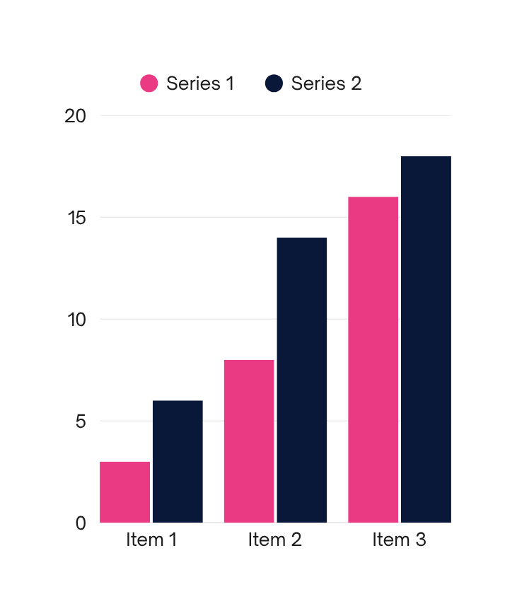
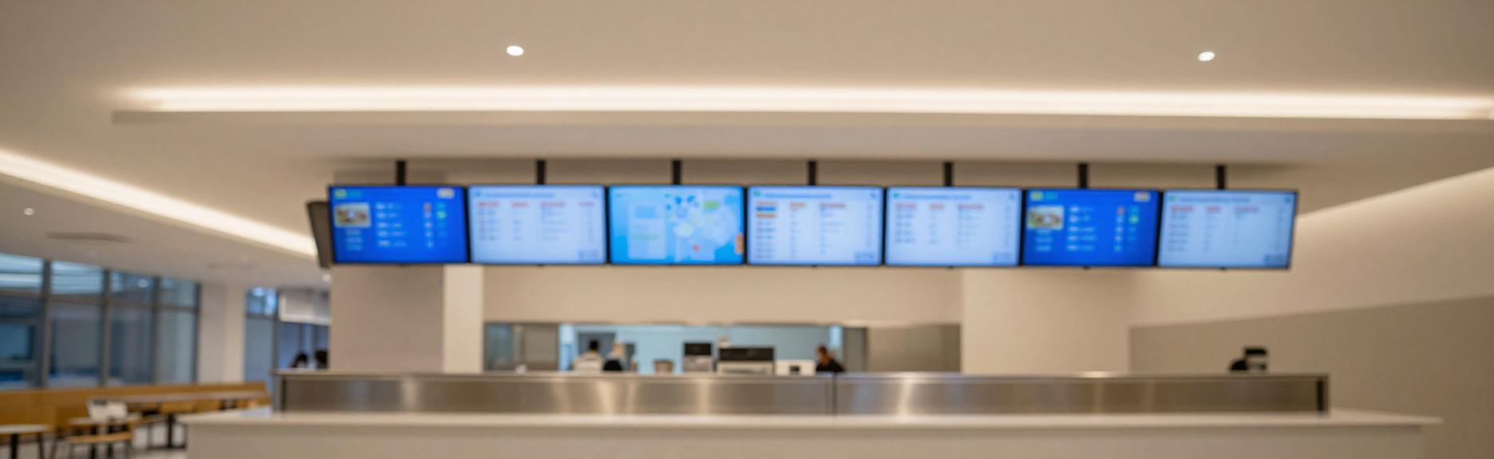
Smart Canteen Co.
2025
Operational Impact Metrics
Key Gains:
Challenges:
Wait time reduced by up to 60%. Order fulfillment speed improved by 45%. Order accuracy increased to 98.5%. Service capacity raised by 35%, handling 500+ orders per hour with minimal staff overhead.
Peak-hour demand spikes require robust queue algorithms. Staff adaptation to digital workflows needs structured training. System uptime and connectivity must be maintained to avoid service disruption during busy periods.

Slide 6

Smart Canteen
2030
Goal of Queue & Order Management
Goal 01
Goal 02
Reduce physical queues by enabling students and staff to pre-order meals digitally, minimizing wait times and eliminating crowding during peak canteen hours.
Optimize canteen operations through real-time order tracking, smart inventory management, and data-driven insights to improve service efficiency and reduce food waste.

Slide 7
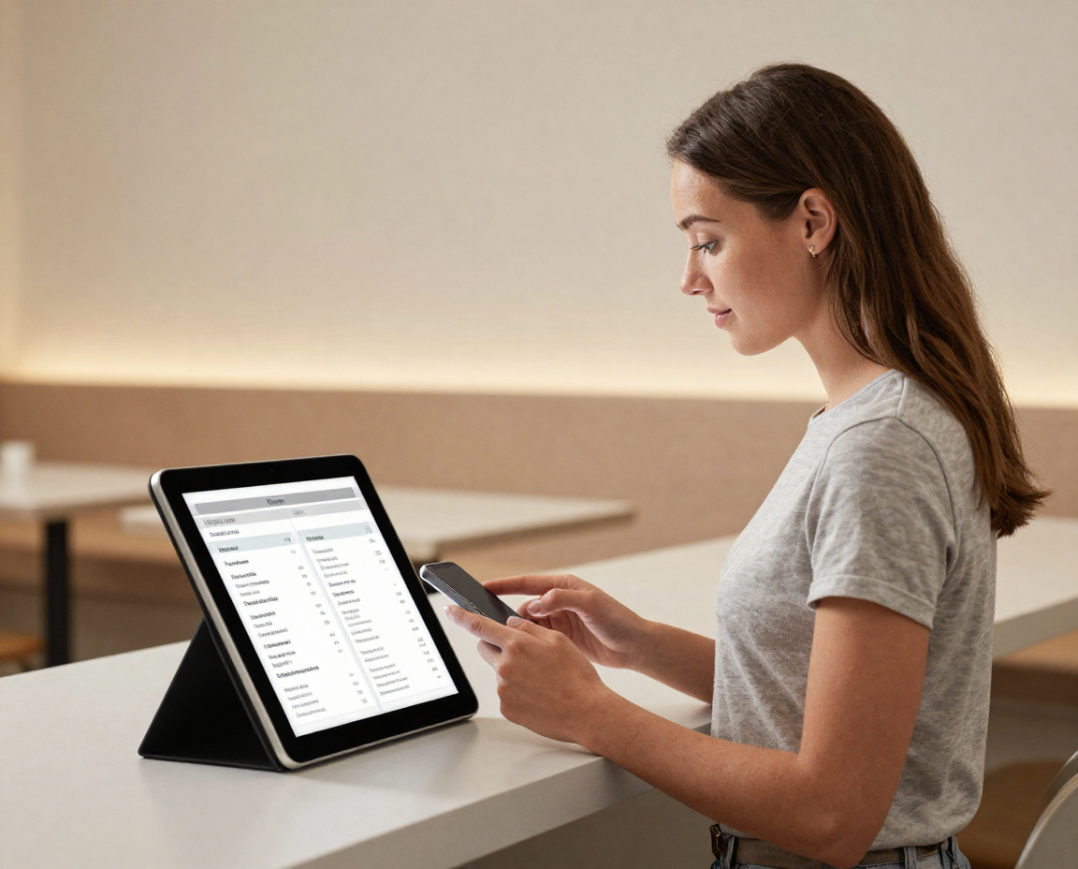
Smart Canteen
07
How It Works.
Ordering is simple and fast. Users browse the digital menu, select their desired meals, and complete payment securely through the app or kiosk. Once confirmed, the system instantly assigns a queue position and sends a real-time notification to the user's device, keeping them informed every step of the way.
As the kitchen prepares each order, the queue dashboard updates live so users can track their meal's progress. When the order is ready, a pickup alert is sent directly to the user. Meals are collected at a designated counter — no waiting in line, no confusion. The entire workflow is designed to minimize wait times and maximize canteen efficiency for everyone.

Slide 8



Smart Canteen
08
Meet Our Key System Users
Alex Rivera
Maria Santos
James Okafor
Canteen Customer
Canteen Staff
System Administrator
Browses the digital menu, places orders via mobile or kiosk, tracks queue status in real time, and receives notifications when their order is ready for pickup.
Receives and processes incoming orders through the staff dashboard, manages food preparation queues, updates order statuses, and coordinates efficient service delivery.
Oversees the entire canteen system, manages menus and pricing, monitors daily operations and analytics, and configures user access roles and system settings.

Slide 9




Smart Canteen System
2030
Thank
+123-456-7890
You!
smartcanteen@institution.edu
Canteen Block, Main Campus, ST 12345
Transform your canteen experience with smart ordering and real-time queue management. Join us in building a faster, smarter, and more efficient campus dining solution for everyone.

