Slide 1
Real-time application with ORTC
(Open Real-time Connectivity)

Slide 2
Getting data to website visitors
Usually requested by visitor
Solutions exist to simulate pushing data from server
polling
long polling
XMLSocket
Then there is WebSocket
meant to solve this problem
requires new implementation for each application
multiple versions of the protocol
maintaining the infrastructure
Notes:
Synchronous request-response mechanism
Flash video streaming connection to move data

Slide 3
Enter Realtime.co
Publish/Subscribe mechanism
Different configurations(next slide)
Implementations for different platforms
Proven to scale (they handle 1M messages per second with 300ms latency)
Notes:
Node,BrowserJavascript,ASP.net,Java,iOS,Android,Silverlight,WindowsPhone

Slide 4
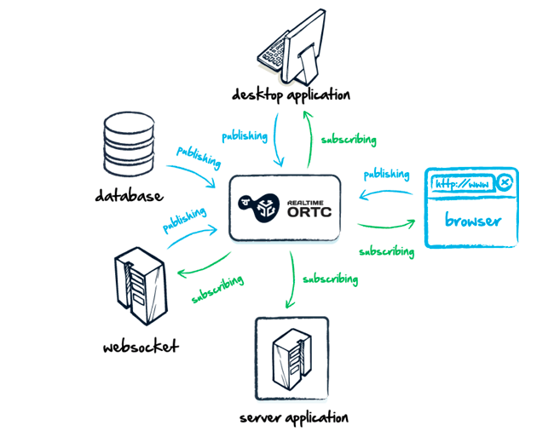

Slide 5
Downsides
Costs money
30,000 visits & 1M messages for free
0.7 cents for additional visit, $1 for 1M messages
but so does keeping your server infrastructure and developer time
Library is quite large (200kB minified version)
Can be difficult do debug and tests
Notes:
Difficult to develop & test – can not run in local machine

Slide 6
Alternatives
socket.io (for node.js)
degrades to different transport if specified one is not available
implemented on a event driven platform
scales well with high number of clients
Faye for Rails
can use socket.io or websockets directly
Notes:
websocket, htmlfile, xhr-polling, jsonp-polling, flash socket

Slide 7
Demo
Browser to browser push
Easy to handle different sources and destinations
Server -> Visitors
Visitor -> Visitor
Visitor -> Server
API -> Visitor
http://v.gd/omg_audience
http://v.gd/omg_speaker

Slide 8
Final thoughts
Good for hacking together something quickly
Website was filled with buzzwords and slogans
API documentation was badly formatted
Code was ugly
Seem to be targeted more for client side use
Nothing to make it secure – everything has to go through their servers
Authors are trying to show it as something new
Notes:
Buzzwords
Whole new era of internet
Develop real time, for real and in no time
A more robust documentation (show me the documentation, I’ll decide)
designed for web and mobile – how are these different(http://www.realtime.co/developers/ortc)
saying it’s secure without no explanation
ORTC (Open Real-time Connectivity) is a secure, fast and highly scalable cloud-hosted real-time many-to-many messaging system for web and mobile apps. – Come on, how many buzz words can you cram into one sentence?
With this, ORTC allows up to an unlimited number of concurrent users.
API
node libraries were out of date
bunch of marketing talk
actually in it only for the money
they can’t even publish their node package to npm
working open-source implementations exist for some time

Slide 9
Thank you for listening

