Slide 1
The Flying Koalas
Meenakshi Kommineni, Madison McClellan, Archana Ramasubramaniam

Slide 2
Under what circumstances do officers in the Chicago PD use force against civilians?

Slide 3
Relational Analytics
Methods:
Simple SQL queries, grouping by the different attributes we were interested in learning about
Limitation: difficult to draw conclusions from the results of SQL queries - we needed to visualize the results
Findings:
Use of force occurs disproportionately against young (early 20s), Black males
There are vast differences in use of force across districts
29,261 instances in the 11th district
4,275 instances in the 20th district
Despite differences in total use of force across different subject demographics and districts, different types of use of force are used proportionately
Verbal commands are the most commonly used type of force across different subject demographics and districts

Slide 4
Data Exploration
Methods:
Scatter plot to represent the number of TRRs and the number of CRs for each officer
Correlation matrix to represent firearm use in different lighting conditions and districts
Findings:
There is no correlation between the number of TRRs and the number of CRs against an officer
A majority of TRRs do not involve firearms, but rather more “mild” types of force (e.g. verbal commands)
When firearms are involved, they are typically discharged in good artificial lighting or daylight and in districts where there is a stronger police presence (e.g. 4th District)

Slide 5
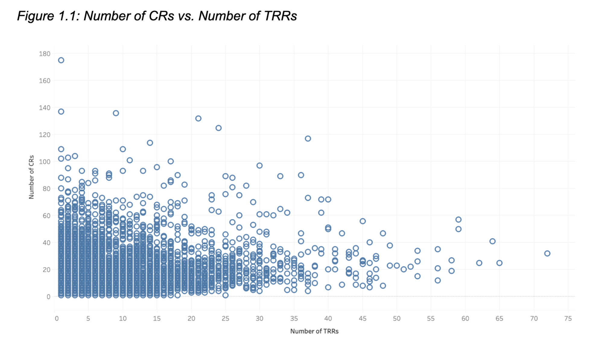
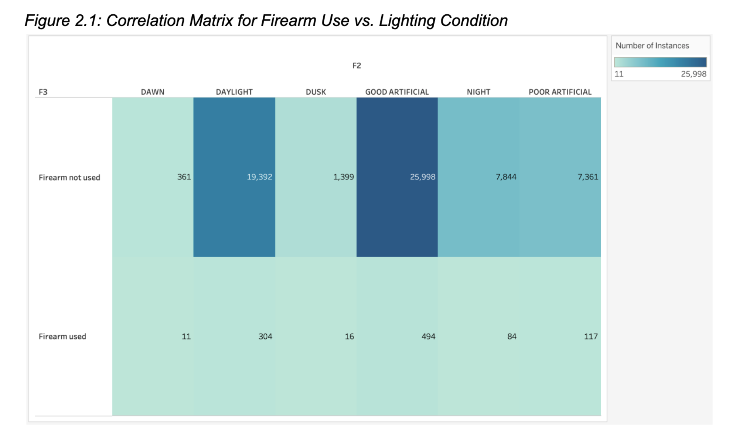

Slide 6
Interactive Visualization
Methods:
Bar chart representing frequency of action type with ability to filter data by district, subject age, subject race, lighting condition, whether the officer was on or off duty, and year
Bar chart representing top five action types for officers in different TRR percentile ranges
Findings:
Further validated our findings from Checkpoint 1 - the distribution of TRRs across action type is consistent across different districts, subject demographics (age and race), lighting conditions, whether the officer was on or off duty, and year
Officers who are more prone to using force use different types of force in the same proportions as those who are less prone to using force

Slide 7
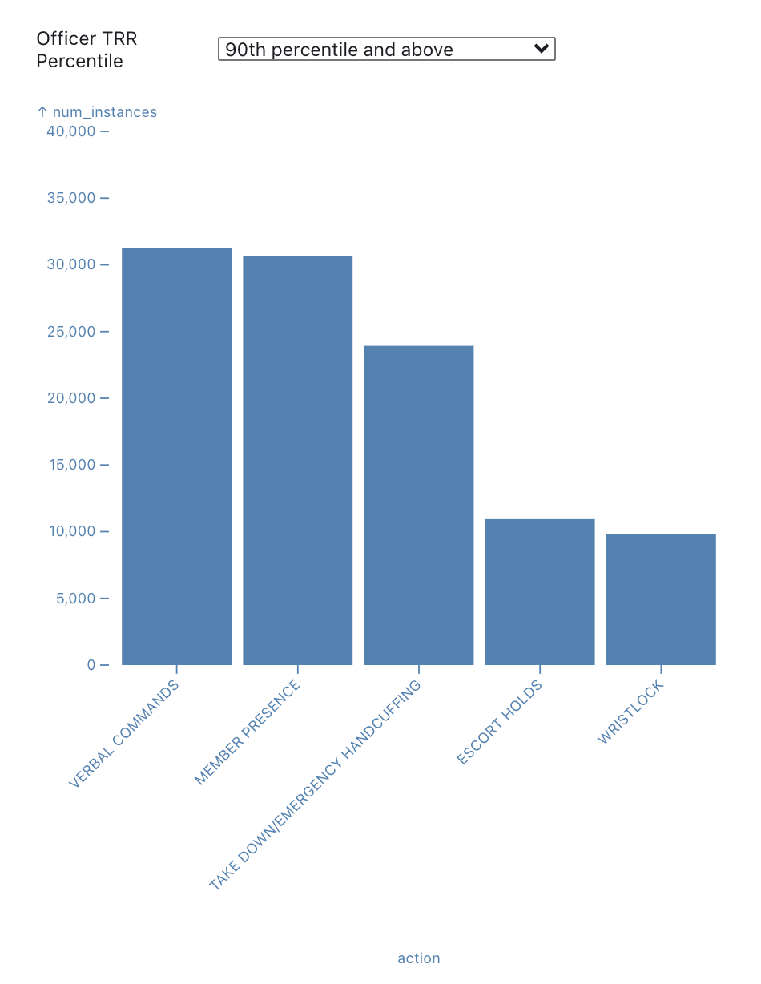
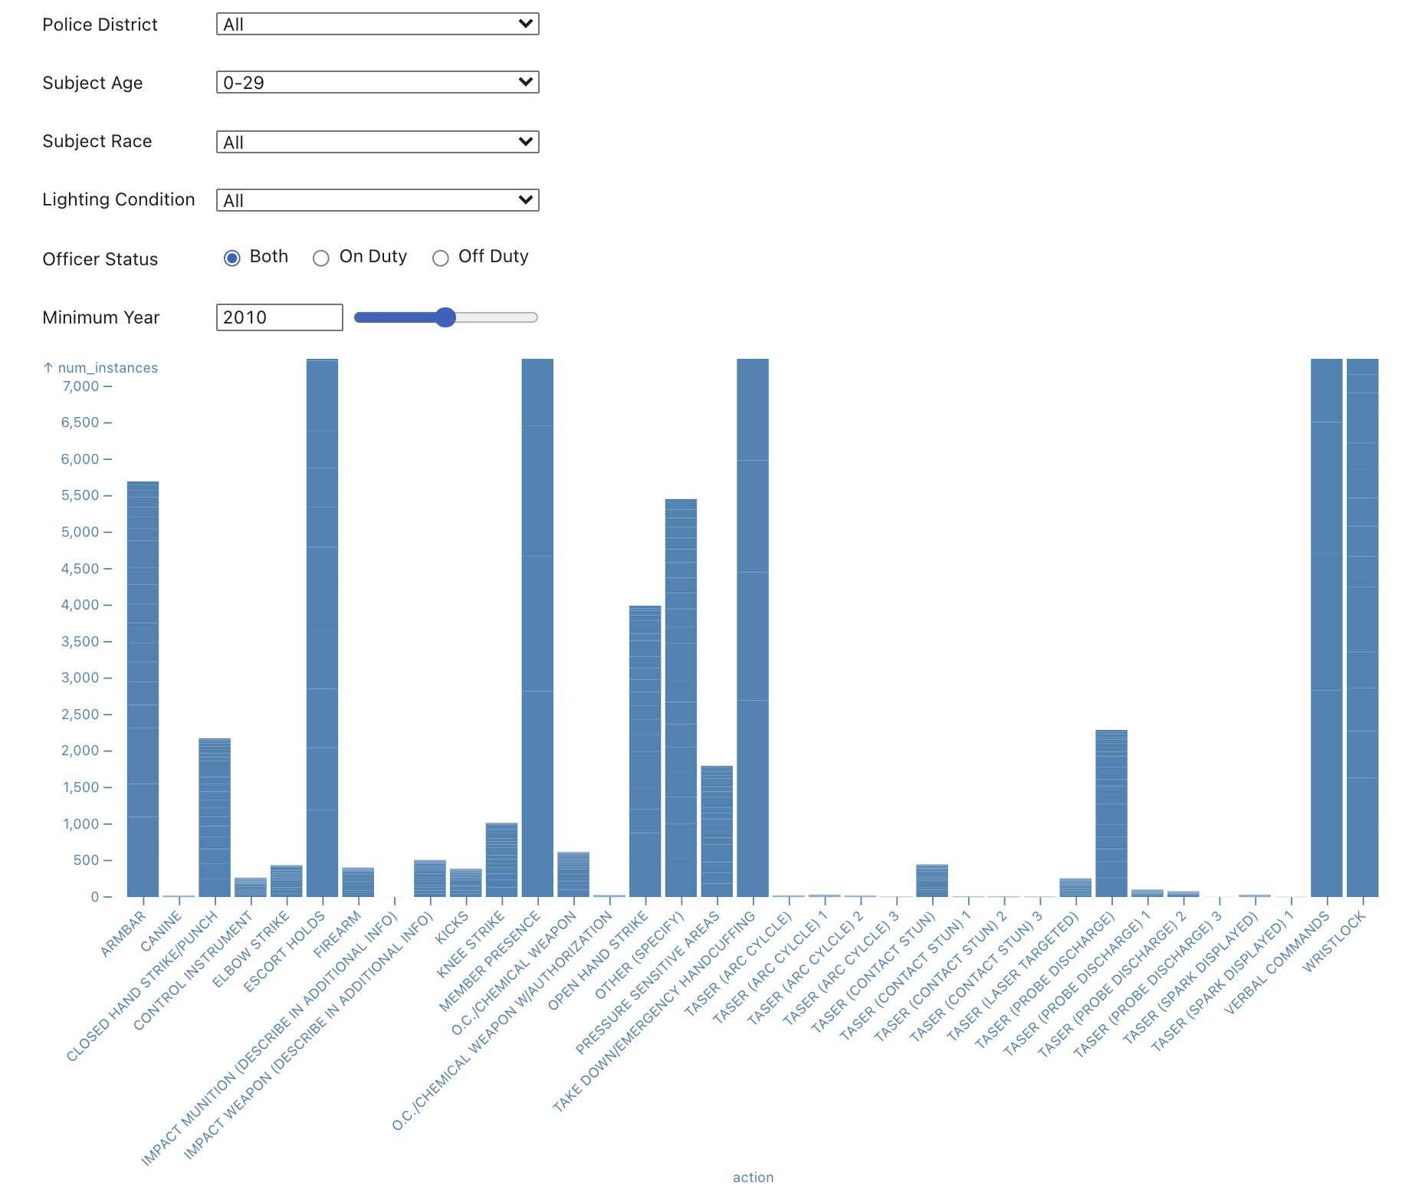

Slide 8
Graph Analytics
Methods:
Constructed two graphs, both with nodes representing individual officers, and one with edges representing a co-accused allegation and one with edges representing a co-accused TRR
PageRank and Triangle Count algorithms
Findings:
Officers are more often co-accused in allegations than they are in use of force incidents
The top 20 co-accused officers in allegations are all males born in or before 1951
These officers are not “outliers” - their PageRank values are not drastically higher than the values for officers lower in the ranking

Slide 9
Natural Language Processing
Methods:
Used Python’s Natural Language Toolkit (NLTK) for sentiment analysis
Two methods:
Train over all CRs then partition into >=90th <=50th percentile groups
Partition data into groups first then train separately
Limitation: relatively small sample (total: 3391, >=90th percentile: 1283, <=50th percentile 1105)
Findings:
Two methods achieved almost the exact same results
The CRs against officers in the >=90th percentile group and the <=50th percentile group have almost exactly the same proportion of positive and negative sentiment
11% of CRs have positive sentiment
89% of CRs have negative sentiment

Slide 10
Conclusion
Takeaways:
Use of force occurs disproportionately under the following conditions:
Against young, Black males
In districts with a greater police presence
Officers who are more prone to using force are not that “different” from officers who are less prone to using force
Use different types of force in the same proportions
CRs against them have equal positive and negative sentiment
Future Research Directions:
Can we identify “turning points” in officers’ careers where they begin to use force more frequently? Can we then look at a given officer’s current trajectory and predict whether they will become a high-offending officer?

