Slide 1

David Hoese

Slide 2
Outline
When and why should I rewrite my Python code?
When and why is Python slow?
Extensions with the Python C API
Ways to connect Python and C
Cython
Examples
Bonus Topics

Slide 3
Why should I rewrite my Python code?
Python is slow
Better resource usage goes a long way
Shared resources
Cheaper cloud machines
Hot spots, not the whole application
small areas of an application that make a big difference
Tight loops see biggest improvement
Profile!

Slide 4
When should I rewrite my Python code?
You probably shouldn't in most cases
Depend on low-level libraries like numpy/scipy/pandas/etc
Optimize/improve usage of those libraries (vectorize, reduce temporary arrays, etc)
Use cheap-ish options like dask, numexpr, numba, or multiprocessing
Is the development and maintenance time worth it?

Slide 5
Why is Python slow? An interpreted language
Python → Byte Code → Interpreter
.pyc
2 2 BUILD_LIST 0
4 STORE_FAST 2 (res)
3 6 LOAD_FAST 0 (one_list)
8 GET_ITER
>> 10 FOR_ITER 31 (to 74)
12 STORE_FAST 3 (x)
4 14 LOAD_FAST 1 (two_list)
16 GET_ITER
>> 18 FOR_ITER 26 (to 72)
20 STORE_FAST 4 (y)
5 22 LOAD_FAST 2 (res)
24 LOAD_METHOD 0 (append)
46 LOAD_FAST 3 (x)
48 LOAD_FAST 4 (y)
50 BINARY_OP 0 (+)
54 PRECALL 1
58 CALL 1
68 POP_TOP
70 JUMP_BACKWARD 27 (to 18)
4 >> 72 JUMP_BACKWARD 32 (to 10)
6 >> 74 LOAD_FAST 2 (res)
76 RETURN_VALUE
In [1]: import dis
In [2]: def my_func(one_list, two_list):
...: res = []
...: for x in one_list:
...: for y in two_list:
...: res.append(x + y)
...: return res
...:
In [3]: dis.dis(my_func)

Slide 6
Why is Python slow? An interpreted language
Python → Byte Code → Interpreter
2 2 BUILD_LIST 0
4 STORE_FAST 2 (res)
3 6 LOAD_FAST 0 (one_list)
8 GET_ITER
>> 10 FOR_ITER 31 (to 74)
12 STORE_FAST 3 (x)
4 14 LOAD_FAST 1 (two_list)
16 GET_ITER
>> 18 FOR_ITER 26 (to 72)
20 STORE_FAST 4 (y)
5 22 LOAD_FAST 2 (res)
24 LOAD_METHOD 0 (append)
46 LOAD_FAST 3 (x)
48 LOAD_FAST 4 (y)
50 BINARY_OP 0 (+)
54 PRECALL 1
58 CALL 1
68 POP_TOP
70 JUMP_BACKWARD 27 (to 18)
4 >> 72 JUMP_BACKWARD 32 (to 10)
6 >> 74 LOAD_FAST 2 (res)
76 RETURN_VALUE
CPython (machine code)
Byte Code
Lookup
.
.
.
.
.
.
Execute

Slide 7
Why is Python slow? Everything is an object
"wasted" space
Implemented as a C struct: PyObject, PyLongObject, etc.
Reference counting
"wasted" time
Allocation
Initialization
Reference counting/garbage collection

Slide 8
Why is Python slow? Global Interpreter Lock (GIL)
More on this later…

Slide 9
C is faster…let's use C - Compiled
#include <stdio.h>
int main()
{
// prints hello world
printf("Hello World");
return 0;
}
a.out/mylib.so
(machine code)
compiler

Slide 10
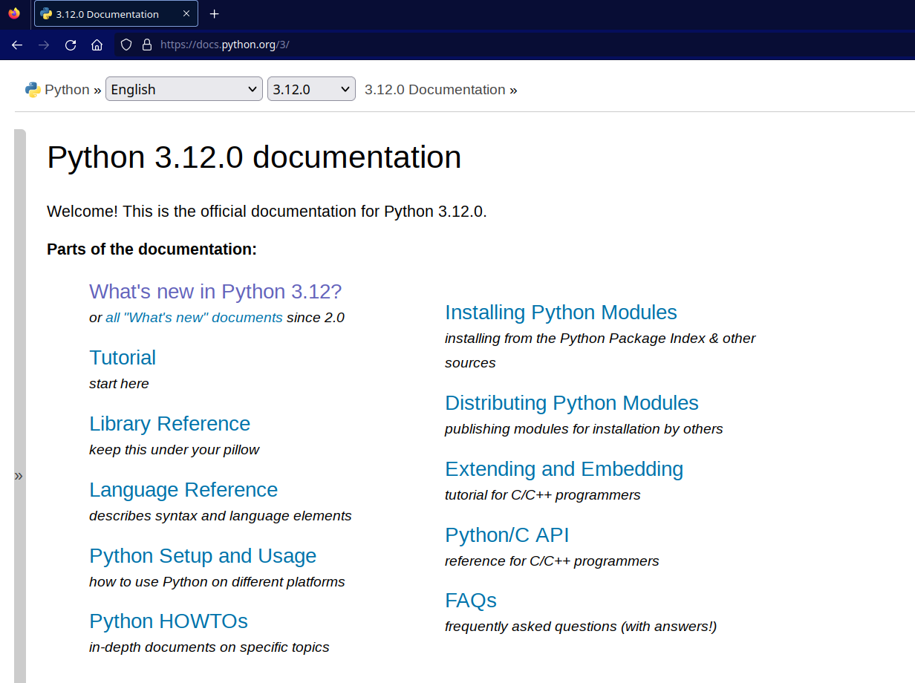
C is faster…let's use C - Python C API

Slide 11
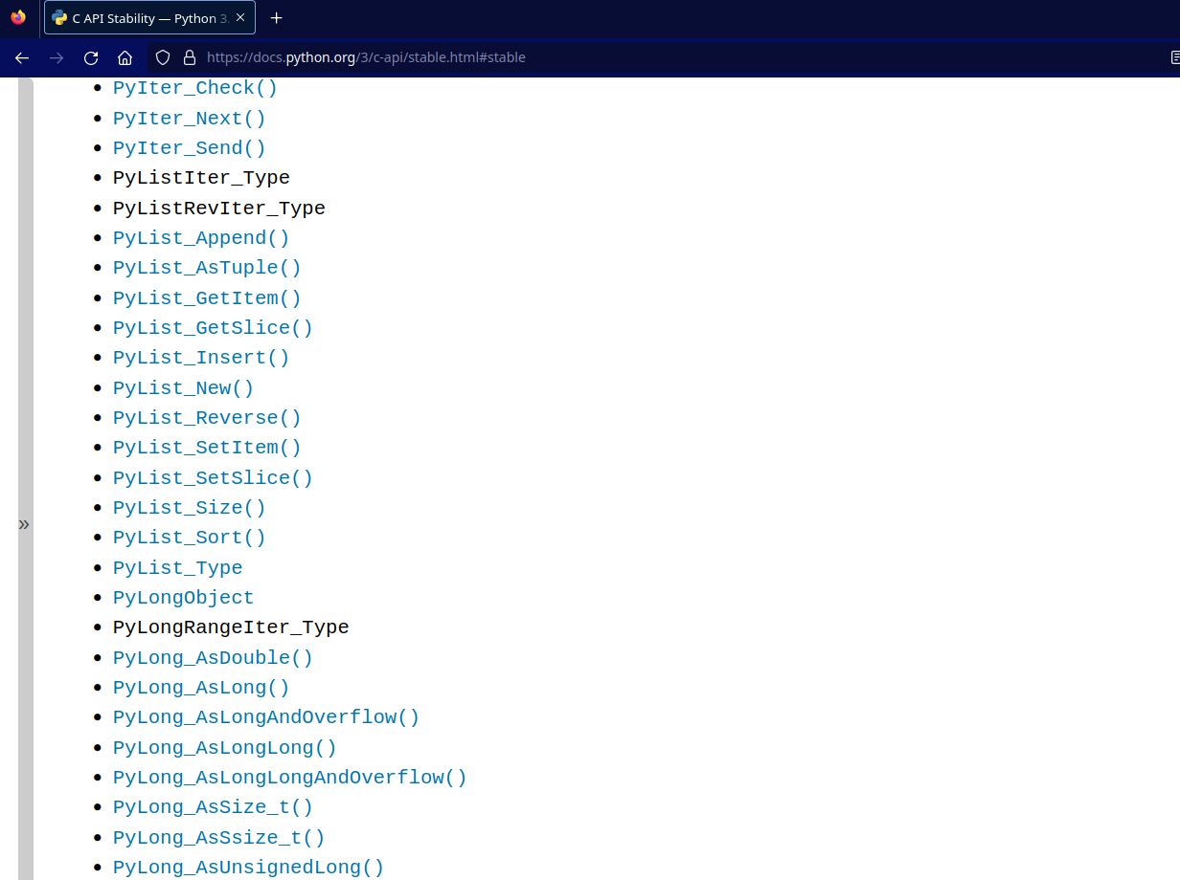
C is faster…let's use C - Python C API

Slide 12
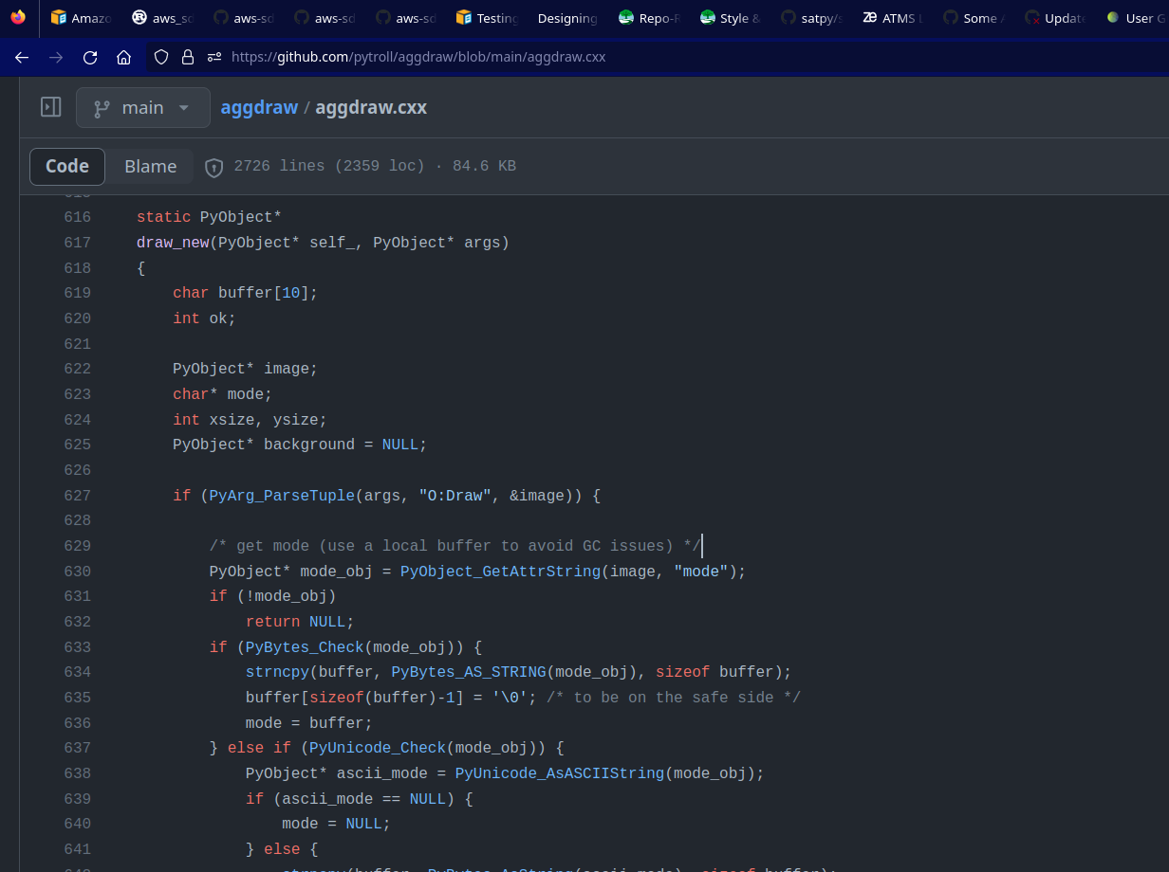
C is faster…let's use C - Python C API

Slide 13
Others ways to combine C and Python
ctypes
cffi
others…
Cython!

Slide 14
Cython...Do you mean Python? No!
Programming language and Tool
Transpiles Python-like Cython to C (or C++)
C is then compiled to an importable shared library
Write your own code or interface with external C/C++ libraries
Mix python and C/C++ operations in the same code
Cython language (.pyx) files or decorations/annotations in Python
Low-level control
Global interpreter lock
Treat exceptions as integers

Slide 15
Example 1 - _fast_stuff.pyx - source
def primes(int nb_primes):
cdef int n, i, len_p
cdef int[1000] p
if nb_primes > 1000:
nb_primes = 1000
len_p = 0 # The current number of elements in p.
n = 2
while len_p < nb_primes:
for i in p[:len_p]:
# Is n not prime?
if n % i == 0:
break
else:
# If no break occurred in the loop, we have a prime.
p[len_p] = n
len_p += 1
n += 1
result_as_list = [prime for prime in p[:len_p]]
return result_as_list

Slide 16
Example 1 - _fast_stuff.pyx - cythonize
$ cythonize -3 _fast_stuff.pyx
Compiling /tmp/_fast_stuff.pyx because it changed.
[1/1] Cythonizing /tmp/_fast_stuff.pyx
$ head _fast_stuff.c
/* Generated by Cython 3.0.6 */
/* BEGIN: Cython Metadata
{
"distutils": {
"name": "_fast_stuff",

Slide 17
Example 1 - _fast_stuff.c - source 1
static PyObject *__pyx_pf_11_fast_stuff_primes(CYTHON_UNUSED PyObject *__pyx_self, int __pyx_v_nb_primes) {
int __pyx_v_n;
int __pyx_v_i;
int __pyx_v_len_p;
int __pyx_v_p[0x3E8];
PyObject *__pyx_v_result_as_list = NULL;
int __pyx_7genexpr__pyx_v_prime;
PyObject *__pyx_r = NULL;
__Pyx_RefNannyDeclarations
int __pyx_t_1;
int *__pyx_t_2;
int *__pyx_t_3;
int *__pyx_t_4;
PyObject *__pyx_t_5 = NULL;
PyObject *__pyx_t_6 = NULL;
int __pyx_lineno = 0;
const char *__pyx_filename = NULL;
int __pyx_clineno = 0;
__Pyx_RefNannySetupContext("primes", 1);

Slide 18
Example 1 - _fast_stuff.c - source 2
/* "_fast_stuff.pyx":12
*
* n = 2
* while len_p < nb_primes: # <<<<<<<<<<<<<<
* for i in p[:len_p]:
* # Is n not prime?
*/
while (1) {
__pyx_t_1 = (__pyx_v_len_p < __pyx_v_nb_primes);
if (!__pyx_t_1) break;
/* "_fast_stuff.pyx":13
* n = 2
* while len_p < nb_primes:
* for i in p[:len_p]: # <<<<<<<<<<<<<<
* # Is n not prime?
* if n % i == 0:
*/
__pyx_t_3 = (__pyx_v_p + __pyx_v_len_p);
for (__pyx_t_4 = __pyx_v_p; __pyx_t_4 < __pyx_t_3; __pyx_t_4++) {
__pyx_t_2 = __pyx_t_4;
__pyx_v_i = (__pyx_t_2[0]);

Slide 19
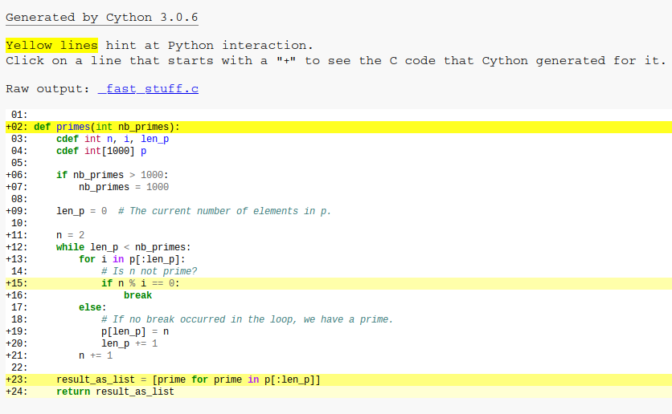
Example 1 - _fast_stuff.pyx - cythonize annotated
$ cythonize -3 -a -f _fast_stuff.pyx
[1/1] Cythonizing /tmp/_fast_stuff.pyx
$ firefox _fast_stuff.html

Slide 20
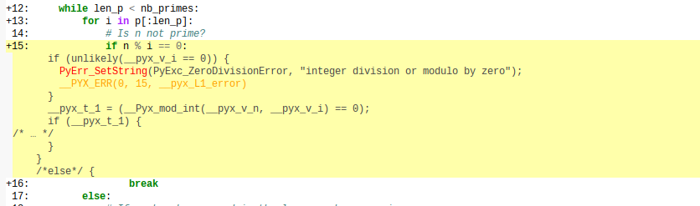
Example 1 - _fast_stuff.pyx - cythonize annotated

Slide 21
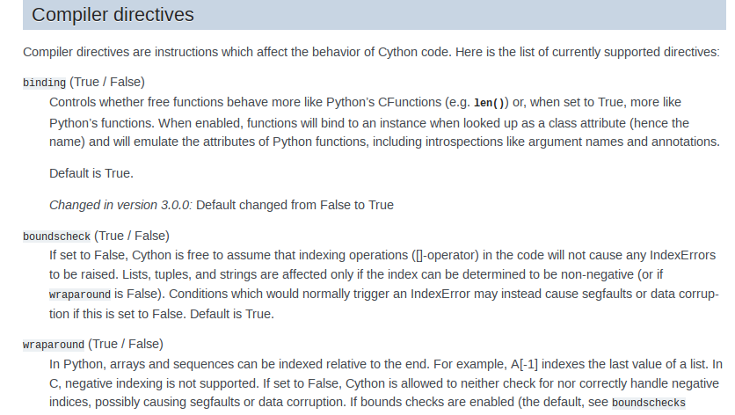
Example 1 - _fast_stuff.pyx - directives

Slide 22
Example 1 - _fast_stuff.pyx - Compiling
setup.py
from setuptools import setup
from Cython.Build import cythonize
setup(
ext_modules = cythonize("_fast_stuff.pyx", language_level="3")
)
$ python setup.py build_ext --inplace
Compiling _fast_stuff.pyx because it changed.
[1/1] Cythonizing _fast_stuff.pyx
running build_ext
building '_fast_stuff' extension
gcc -pthread -B <env>/compiler_compat -fno-strict-overflow -DNDEBUG -O2 -Wall -fPIC -O2 -isystem <env>/include -fPIC -O2 -isystem <env>/include -fPIC -I<env>/include/python3.12 -c _fast_stuff.c -o build/temp.linux-x86_64-cpython-312/_fast_stuff.o
gcc -pthread -B <env>/compiler_compat -shared -Wl,--allow-shlib-undefined -Wl,-rpath,<env>/lib -Wl,-rpath-link,<env>/lib -L<env>/lib -Wl,--allow-shlib-undefined -Wl,-rpath,/<env>/lib -Wl,-rpath-link,<env>/lib -L<env>/lib build/temp.linux-x86_64-cpython-312/_fast_stuff.o -o build/lib.linux-x86_64-cpython-312/_fast_stuff.cpython-312-x86_64-linux-gnu.so
copying build/lib.linux-x86_64-cpython-312/_fast_stuff.cpython-312-x86_64-linux-gnu.so ->

Slide 23
Example 1 - _fast_stuff.pyx - Importing
$ ipython
In [1]: import _fast_stuff
In [2]: _fast_stuff.primes(100)
Out[2]:
[2,
3,
5,

Slide 24
Not just speed - Memory too
Can connect to numpy C API
Can work on array "views"
Can work on per-pixel calculations without temporary arrays
mask = a > 2
result[mask] = np.sqrt(a[mask] ** 2 + b[mask] ** 2)

Slide 25
Example 2 - _fast_arrays.pyx
cimport cython
from cython cimport floating
from libc.math cimport sqrt, round
cimport numpy as np
import numpy as np
np.import_array()
def do_something(np.ndarray[floating, ndim=1] arr1, np.ndarray[floating, ndim=1] arr2):
cdef int res
cdef floating[::1] a1_view = arr1
cdef floating[::1] a2_view = arr2
with nogil:
res = _do_something(a1_view, a2_view)
return res

Slide 26
Example 2 - _fast_arrays.pyx
@cython.boundscheck(False)
cdef int _do_something(floating[::1] arr1, floating[::1] arr2) noexcept nogil:
cdef Py_ssize_t i, j
cdef int total = 0
cdef int tmp
for i in range(arr1.shape[0]):
for j in range(arr2.shape[0]):
if arr1[i] > arr2[j]:
continue
tmp = int(round(sqrt(arr1[i]**2 + arr2[j]**2)))
if tmp > 10:
total += tmp
return total

Slide 27
Example 2 - _fast_arrays.pyx
from setuptools import setup
from Cython.Build import build_ext
from Cython.Distutils import Extension
import numpy as np
setup(
cmdclass={"build_ext": build_ext},
ext_modules=[
Extension(
name="_fast_arrays",
sources=["_fast_arrays.pyx"],
cython_directives={"language_level": "3"},
define_macros=[("NPY_NO_DEPRECATED_API", "NPY_1_7_API_VERSION")],
include_dirs=[np.get_include()]
)
],
)

Slide 28
Example 2 - quick test
import _fast_arrays
import numpy as np
a = np.arange(5.0)
b = np.arange(30.0)
print(_fast_arrays.do_something(a, b))
# Result: 1916

Slide 29
Example 2 - slow_arrays.py - just a few elements
import numpy as np
def do_something(a, b):
a_grid, b_grid = np.meshgrid(a, b)
tmp = np.sqrt(a_grid ** 2 + b_grid ** 2).round().astype(np.int64)
tmp[tmp <= 10] = 0
return tmp.sum()
In [5]: a = np.arange(5.0)
In [6]: b = np.arange(30.0)
In [9]: %%timeit
...: slow_arrays.do_something(a, b)
27.5 µs ± 392 ns per loop (mean ± std. dev. of 7 runs, 10,000 loops each)
In [10]: %%timeit
...: _fast_arrays.do_something(a, b)
1.78 µs ± 28.8 ns per loop (mean ± std. dev. of 7 runs, 1,000,000 loops each)

Slide 30
Example 2 - slow_arrays.py - more!
import numpy as np
def do_something(a, b):
a_grid, b_grid = np.meshgrid(a, b)
tmp = np.sqrt(a_grid ** 2 + b_grid ** 2).round().astype(np.int64)
tmp[tmp <= 10] = 0
return tmp.sum()
In [11]: a = np.random.random(10000) * 100
In [12]: b = np.random.random(20000) * 100
In [13]: %%timeit
...: slow_arrays.do_something(a, b)
2.09 s ± 34 ms per loop (mean ± std. dev. of 7 runs, 1 loop each)
In [14]: %%timeit
...: _fast_arrays.do_something(a, b)
797 ms ± 10.3 ms per loop (mean ± std. dev. of 7 runs, 1 loop each)

Slide 31
Example 2 - slow_arrays.py - MORE!
import numpy as np
def do_something(a, b):
a_grid, b_grid = np.meshgrid(a, b)
tmp = np.sqrt(a_grid ** 2 + b_grid ** 2).round().astype(np.int64)
tmp[tmp <= 10] = 0
return tmp.sum()
In [16]: a = np.random.random(10000) * 100
In [17]: b = np.random.random(100000) * 100
In [18]: %%timeit
...: slow_arrays.do_something(a, b)
24 s ± 4.34 s per loop (mean ± std. dev. of 7 runs, 1 loop each)
In [19]: %%timeit
...: _fast_arrays.do_something(a, b)
4.05 s ± 47.6 ms per loop (mean ± std. dev. of 7 runs, 1 loop each)
~25GB memory

Slide 32
Cython - Pros and Cons
Pros
Fast compared to pure Python (ex. loops)
More memory efficient for some work loads
GIL control
OpenMP compatibility for C-level multi-threading
Build-time dependency (versus runtime)
No runtime overhead
Cons
Not as fast as numpy if calculation is numpy-friendly
vectorized and limited temporary arrays
Numpy has SIMD (Single Instruction, Multiple Data) optimizations
Much more complicated build process than pure python
sdist (.tar.gz) - typically .py only + metadata [+ .pyx]
binary wheels (.whl) - .py + .so + metadata

Slide 33
Bonus Topics and Questions
GIL and Dask
python-geotiepoints GIL changes
Pyresample gradient_search GIL bug fix
Extensions in other languages
pyo3 - rust + python
Questions?
Notes:
Python-geotiepoints GIL changes: https://github.com/pytroll/python-geotiepoints/pull/38#issuecomment-1290766255
Gradient search GIL fix:https://github.com/pytroll/pyresample/pull/455#issuecomment-1297214367

Slide 34
Example 3 - _fast_arrays.rs (src/lib.rs) - 1
use numpy::{PyArray1, IntoPyArray};
use numpy::ndarray::{ArrayView1};
use numpy::{PyReadonlyArray1};
use pyo3::prelude::{pyfunction, pymodule, Py, PyModule, PyResult, Python};
use pyo3::wrap_pyfunction;
#[pyfunction]
fn do_something(py: Python, arr1: PyReadonlyArray1<f64>, arr2: PyReadonlyArray1<f64>) -> PyResult<u64> {
let arr1 = arr1.as_array();
let arr2 = arr2.as_array();
Ok(_do_something(arr1, arr2))
}
/// A Python module implemented in Rust.
#[pymodule]
fn rust_arrays(_py: Python, m: &PyModule) -> PyResult<()> {
m.add_function(wrap_pyfunction!(do_something, m)?)?;
Ok(())
}

Slide 35
Example 3 - _fast_arrays.rs (src/lib.rs) - 2
fn _do_something(arr1: ArrayView1<f64>, arr2: ArrayView1<f64>) -> u64 {
let mut total: u64 = 0;
for &val1 in arr1.iter() {
for &val2 in arr2.iter() {
if val1 > val2 {
continue;
}
let tmp = ((val1.powi(2) + val2.powi(2)).sqrt().round() as u64);
if tmp > 10 {
total = total.wrapping_add(tmp);
}
}
}
total
}

Slide 36
Example 3 - Cargo.toml (from "maturin init")
[package]
name = "rust_arrays"
version = "0.1.0"
edition = "2021"
# See more keys and their definitions at https://doc.rust-lang.org/cargo/reference/manifest.html
[lib]
name = "rust_arrays"
crate-type = ["cdylib"]
[dependencies]
pyo3 = "0.20.0"
numpy = "0.20"
ndarray = "0.15.6"

Slide 37
Example 3 - pyproject.toml (from "maturin init")
[build-system]
requires = ["maturin>=1.4,<2.0"]
build-backend = "maturin"
[project]
name = "rust_arrays"
requires-python = ">=3.8"
classifiers = [
"Programming Language :: Rust",
"Programming Language :: Python :: Implementation :: CPython",
"Programming Language :: Python :: Implementation :: PyPy",
]
dynamic = ["version"]
[tool.maturin]
features = ["pyo3/extension-module"]

Slide 38
Example 3 - Compile
maturin develop --profile release

Slide 39
Example 3 - Import
In [1]: import rust_arrays
In [2]: import numpy as np
In [3]: a = np.random.random(10000) * 100
In [4]: b = np.random.random(20000) * 100
In [5]: %%timeit
...: rust_arrays.do_something(a, b)
1.09 s ± 38.5 ms per loop (mean ± std. dev. of 7 runs, 1 loop each)

