Slide 1


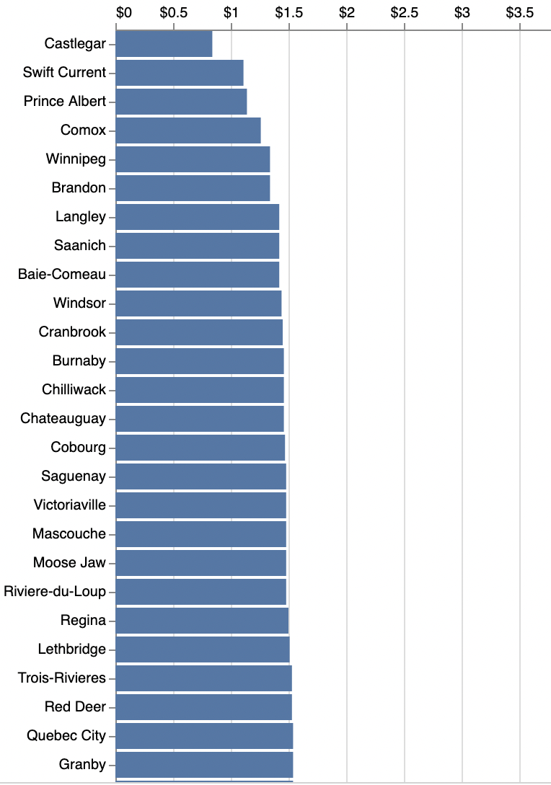
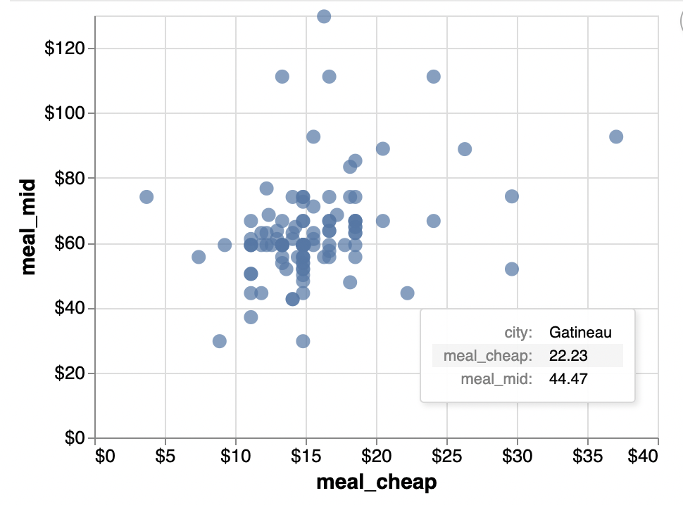




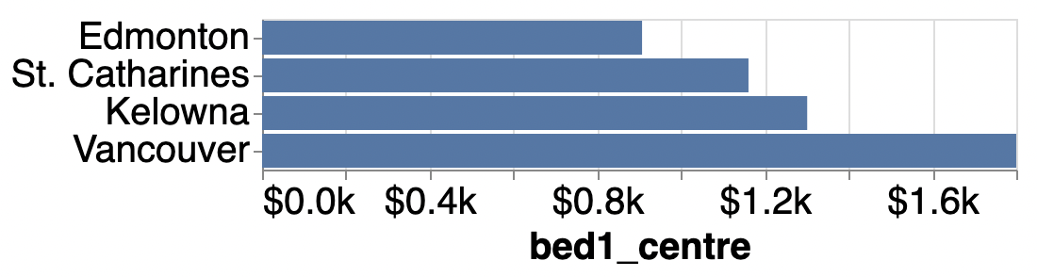
Where do You want to live?
drop downs
Rank Cities by Variable
Compare Variable and Variable
tool tip
Cost of Living Dashboard
Filter by Province
check boxes
All Provinces Nova Scotia
Alberta Nunavut
British Columbia Ontario
Manitoba PEI
New Brunswick Quebec
Newfoundland & Labrador Saskatchewan
Northwest Territories Yukon
scroll bar
drop downs
Compare Variable for Cities
Filter by City Population
5000
>2 000 000
slide bar

