Slide 1
Week 10 Updates
Madison Jones
Master’s Project
Spring 2026

Slide 2
Agenda
Data Scaling
Parallel Trends Assumption
Next Steps

Slide 3
Data Scaling

Slide 4
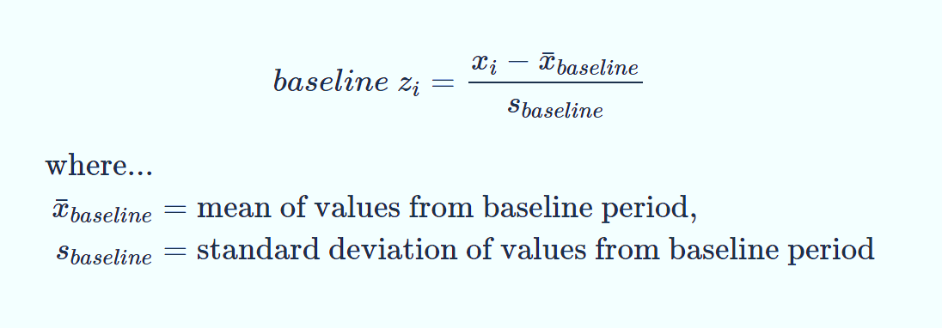
Data Scaling
Incorporation of years 2018 and 2023
2023 test scores different and “incomparable” to years 2018-2022
Baseline z-score standardization, where 2019 values are used as a baseline
Equation image from https://bookdown.org/anta8363/fluoR_bookdown/stand.html

Slide 5
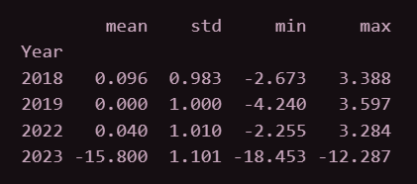
Data Scaling
Unfortunately, the data scaling did not work for the year 2023
The difference in scores for 2023 is still obvious
Inclusion of 2018 should be acceptable

Slide 6
Parallel Trends Assumption

Slide 7
Assumption Validation
Parallel Trends Assumption: in the absence of treatment, the difference between the ‘treatment’ and ‘control’ group is constant over time*
The best method of testing this assumption is a placebo test in the pre-period
2018 becomes the new “pre-period” and 2019 the new “post-period”
Execute placebo model with new pre and post
Assessing trends from 2018 to 2019
*Definition from https://www.publichealth.columbia.edu/research/population-health-methods/difference-difference-estimation

Slide 8
Assumption Validation
Grade | Coef. | P-value | Assumption Met?
All | -0.0009 | 0.8371 | Yes
3 | 0.0230 | 0.0182 | No
4 | 0.0289 | 0.0036 | No
5 | -0.0058 | 0.5272 | Yes
6 | -0.0395 | 0.0011 | No
7 | -0.0396 | 0.0040 | No
8 | -0.0007 | 0.9570 | Yes
Based on p-value, if insignificant then assumption is met
Validated PTA: All grades, Grade 5, and Grade 8

Slide 9
What’s Next

Slide 10
Going Forward
Investigation of what to do if parallel trends assumption isn’t met
A More Credible Approach to Parallel Trends, Rambachan & Roth (2023)*
Former research about the parallel trends assumption is binary, met or isn’t met
Researchers suggest broadening that spectrum with sensitivity analysis, essentially asking “how large of a violation does it need to be to affect results?”
*Rambachan & Roth (2023), A More Credible Approach to Parallel Trends chrome-extension://efaidnbmnnnibpcajpcglclefindmkaj/https://www.jonathandroth.com/assets/files/HonestParallelTrends_Main.pdf

Slide 11
Going Forward
Rambachan & Roth (2023) developed a package called HonestDID to assess sensitivity for parallel trends
Some issues with this:
HonestDID package is strictly for R and Stata
Export from Python into R for results
Would be converted into an event study
Inclusion of poverty data for 2022
Assessing pre vs post trends; in other words, how much did comprehension scores get better/worse in the post-period compared to the trends in the pre-period

Slide 12
Tentative Models
Model 1: Pooled Ordinary Least Squares, baseline model without time or group fixed effects
Pooled OLS: treats all observations as independent, ignores panel structured data
Model 2: TWFE, with HonestDID sensitivity analysis
Model 3: TWFE, with the inclusion of demographic control variables

