Slide 1
Week 7: Modeling
Madison Jones
Master’s Project
Spring 2026

Slide 2
Python Packages
linearmodels, pyfixest, diffindiff
Why PanelOLS within linearmodels?
  Simplest to use regarding TWFE in combination with DID
  Built to handle panel data
  Allows for weights

Slide 3
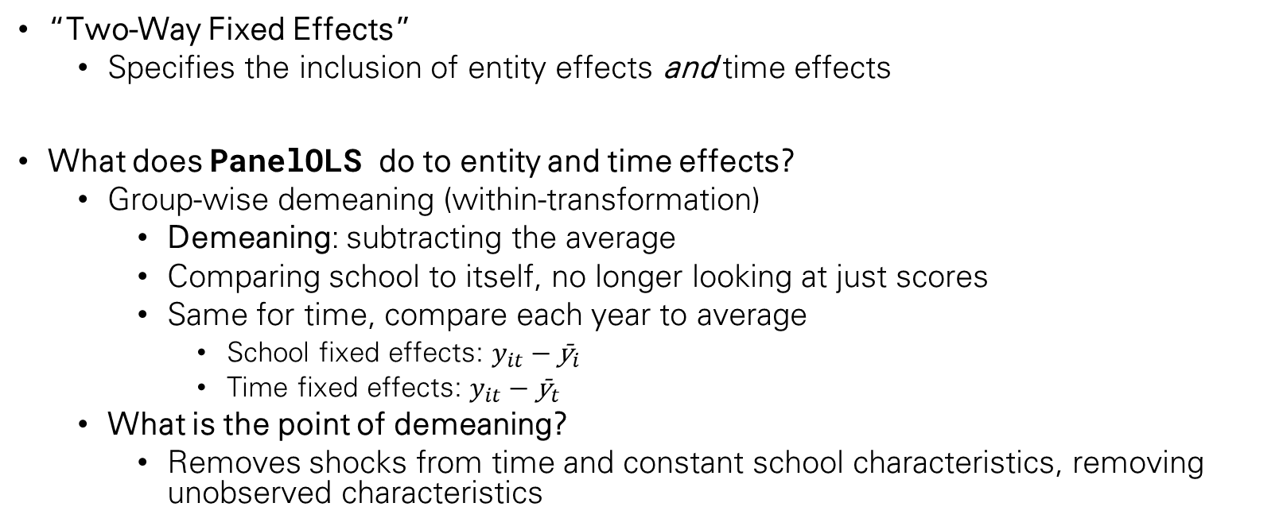
How the Model Works
“Two-Way Fixed Effects”
  Specifies the inclusion of entity effects and time effects
What does PanelOLS do to entity and time effects?
  Group-wise demeaning (within-transformation)
    Demeaning: subtracting the average
    Comparing school to itself, no longer looking at just scores
    Same for time, compare each year to average
      School fixed effects: $y_{it}−{\text{ȳ}}_{i}$
      Time fixed effects: $y_{it}−{\text{ȳ}}_{t}$
  What is the point of demeaning?
    Removes shocks from time and constant school characteristics, removing unobserved characteristics

Slide 4
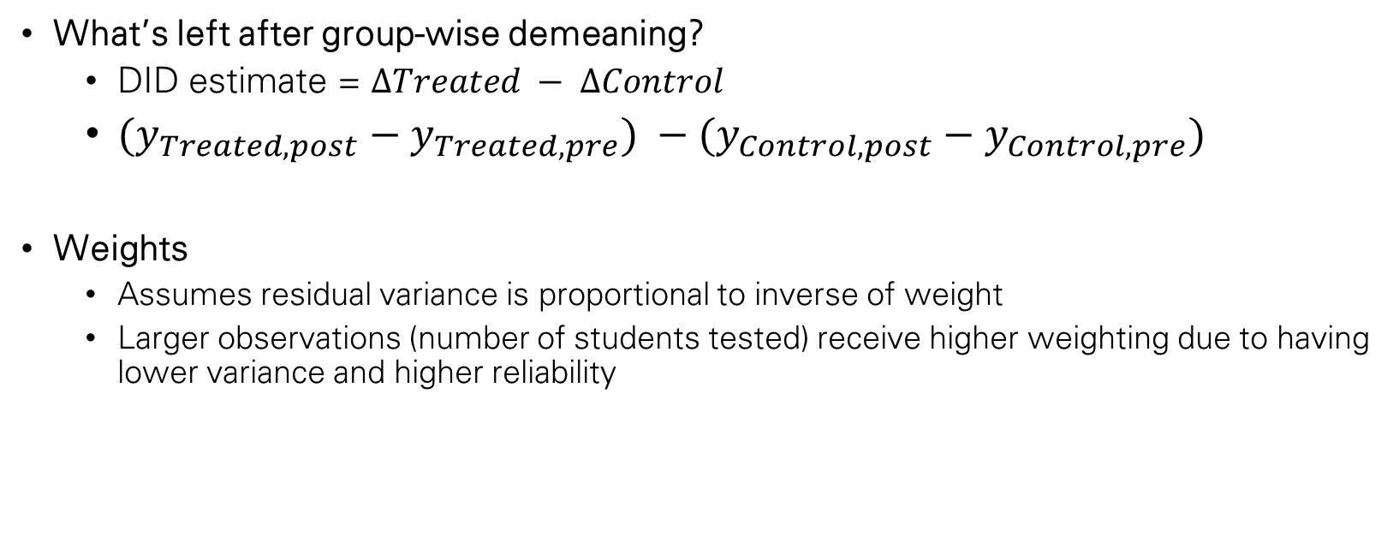
How the Model Works, cont.
What’s left after group-wise demeaning?
  DID estimate = $ΔTreated − ΔControl$
  ${(y}_{Treated,post} −{ y}_{Treated,pre}) −(y_{Control,post}−y_{Control,pre})$
Weights
  Assumes residual variance is proportional to inverse of weight
  Larger observations (number of students tested) receive higher weighting due to having lower variance and higher reliability
Notes:
T - C

Slide 5
Poverty Categorization
Currently, comparing against the mean of NYC (74% of households in poverty.
Options:
  Compare poverty % to DOE poverty cutoff for Title I eligibility, which is 60%
  New York Student Economic Need Index
    Estimate of students facing economic hardship. Accounts for temporary housing, public assistance eligibility, and Census poverty rates. Compared to citywide average.

Slide 6
What’s next?
Determining the best possible treatment categorization
  Title I eligibility seems to be the best
Applying models to all grades
Incorporation of comprehension levels
Investigation of an “All Grades” model

Slide 7
Pipeline
Inputs
Processing
Model
Tuning
Outputs
Time effects
Group (school) effects
Group and time effects added to index, respectively
DID (interaction term)
Treatment: poverty % within school, converted to binary compared to avg.
DID: calculated beforehand, using treated binary and post period
TWFE DID, simply using group and time fixed effects.
Inclusion of weights for number of students tested for fair comparison
Split models based on grades and comprehension levels.
Model that accurately displays DID value, as well as validation metrics (errors, CI, p-value, etc.)

Slide 8
Sources
https://www.youtube.com/watch?v=NOFucoEhT5A
https://www.aeaweb.org/conference/2022/preliminary/paper/s38GffaD
https://bashtage.github.io/linearmodels/panel/panel/linearmodels.panel.model.PanelOLS.html#linearmodels.panel.model.PanelOLS.__init__.weights
https://www.chalkbeat.org/newyork/2023/3/29/23660678/nyc-schools-title-i-poverty-calculation-funding-budget/
https://tools.nycenet.edu/dashboard/#dbn=01M020&report_type=EMS&view=City
https://data.cccnewyork.org/data/bar/1371/student-economic-need-index#1371/a/1/1622/127

