Slide 1
Week 9: Updates and Going Forward
Madison Jones
Master’s Project
Spring 2026

Slide 2
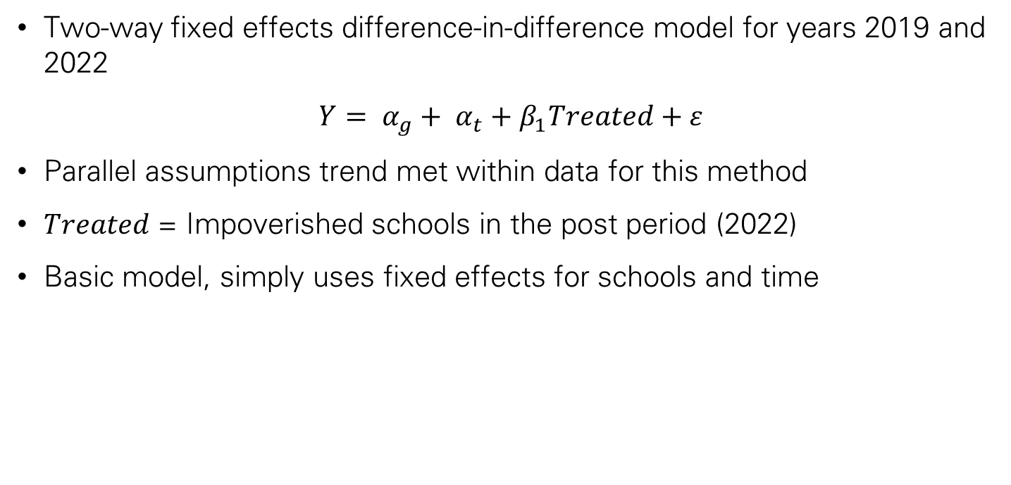
Current Model & Review
Two-way fixed effects difference-in-difference model for years 2019 and 2022
$$Y= α_{g}+ α_{t}+β_{1}Treated+ε$$
Parallel assumptions trend met within data for this method
$Treated$ = Impoverished schools in the post period (2022)
Basic model, simply uses fixed effects for schools and time

Slide 3
Adjustments
The largest issue with this project was the binary poverty variable.
Concerned about information loss, shifted to a continuous treatment variable.
More valuable – measures intensity

Slide 4
Difference in Results
Grade | Model v1 (Binary treatment) | Model v2 (Continuous treatment)
3 | -1.5384 | -0.0450
4 | -2.7106 | -0.0675
5 | 0.1975 | 0.0210
6 | 3.2894 | 0.1022
7 | 2.5115 | 0.0910
8 | -0.1553 | 0.0042
Model v1
Simply compares high vs. low
Grade 3, for example: High poverty schools saw scores drop -1.54 more than low poverty schools (accounting for time and school FE)
Model v2
Compared from 0 - 100
For every 1 percentage point increase in poverty, a school’s mean ELA score dropped 0.045 points between 2019 and 2022

Slide 5
Years
Currently using 2019 and 2022
According to the codebook for the data, years 2018 – 2022 can be compared
This testing range cannot be compared to years prior to 2018 or 2023
New York State Department of Education temporarily rescaled the exams to account for a change in test administration from 2018-2022
May incorporate 2018, unsure what the difference in scale is for 2023

Slide 6
What’s next?
Incorporation of exogenous variables, such as demographics
Need to be careful, it is important that exogenous variables are not incorporated with school fixed effects, could cause bias
Would have to do correlation test for new demographic variables with already existing treatment, but would be added as more controls
Inclusion of year 2018 to verify parallel trends assumption

Slide 7
Thank you!

