Slide 1

Impact of COVID-19 on ELA Student Achievement in New York City Public Schools
Madison Jones
May 8th, 2026
Master’s Project Final Presentation
56:219:603:91

Slide 2
Executive Summary
Problem & approach
Disruption in education due to the pandemic widened pre-existing achievement gaps, especially for schools with a lack of resources
Goal is to quantify these gaps using English Language Arts test score data in New York City public schools
Two-way fixed effects difference-in-difference model

Slide 3
Executive Summary
Results & impact
Impact: This project examines how pre-existing school poverty influenced post-pandemic learning loss
Insights:
Schools with higher poverty rates before the pandemic experienced further declines in ELA standardized test scores following the pandemic
Third and fourth grade students proved to be the most negatively affected
The findings suggest that pre-existing educational disparities intensified the pandemic’s impact on education

Slide 4
Problem & Motivation
Problem:
This project investigates whether pre-existing poverty in individual schools contributed to a widened achievement gap after the COVID-19 pandemic.
Who is this for?
Policymakers, school administrations, researchers, and communities who wish to better understand which students are most affected by academic disruptions. These findings can act as a guide for future resource funding decisions and support programs
What does success look like?
Identifying statistically significant relationships between school poverty levels and academic outcomes following the pandemic.

Slide 5
Problem & Motivation
Constraints & Assumptions
This project is limited to public schools in New York City. These findings may not reflect on national effects.
The data is missing critical years, 2020 and 2021, due to cancelled and optional testing.
Assumption of parallel trends
Project Evolution
Many model adjustments, feature engineering, and incorporation of pre-period information
The hypothesis remains the same

Slide 6
Data Overview

Slide 7
Data Structure & Description
Data from New York City OpenData, provided by the NYC Department of Education
English Language Arts (ELA) Test Scores 2013-2023 Dataset
Citywide, borough, district, and school-level information
Includes mean standardized testing scores, grade-level breakdowns, number of students tested, and comprehension levels
Certain rows were compressed if 5 or less students took the exam, these rows were removed
Demographic Snapshot 2017-2022
Demographic information at the school level
Primarily interested in poverty rates and Economic Need Index

Slide 8
Dataset Information
1121 Schools
6 Grades
3 Years

Slide 9
Exploratory Data Analysis

Slide 10
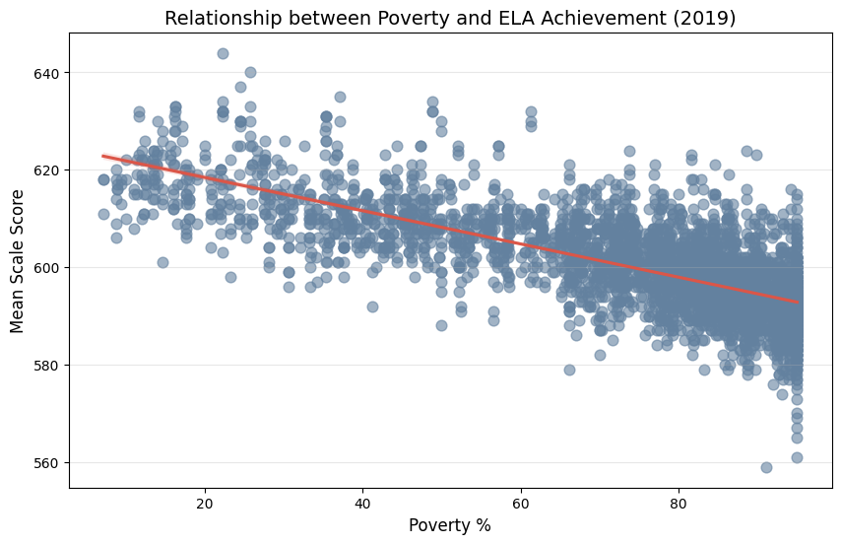
Exploratory Data Analysis
Poverty & Academic achievement
Relationship between poverty % and ELA test scores
As poverty % increases, test scores fall
Information in graph is just from 2019, proving that there were significant pre-existing correlations
How were achievement gaps widened post-pandemic?

Slide 11
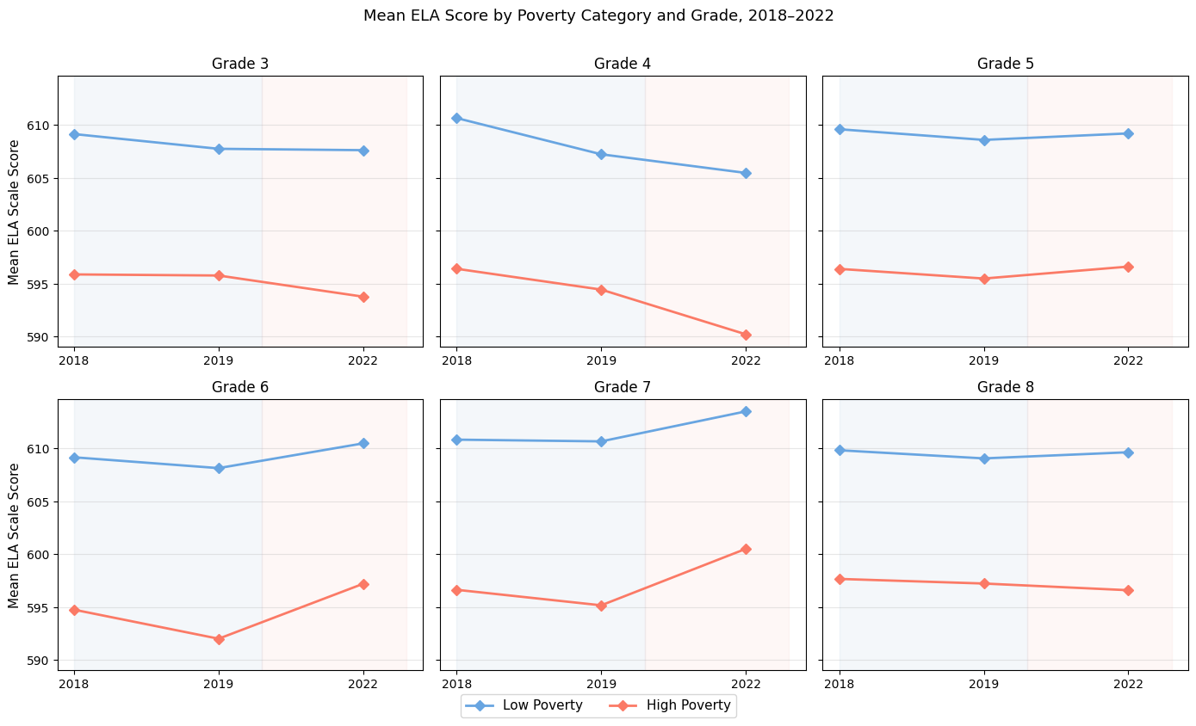
Exploratory Data Analysis
Grade Level trends
Plot shows some insight on upcoming results
Binary variable using 60% cutoff
>60%: High poverty schools
<60%: Low poverty schools
Third and fourth graders showing significant declines
Some upward trends for older grade levels

Slide 12
Modeling Approach

Slide 13
Modeling Overview
Model equations
Two-way fixed effects difference-in-difference models
Fixed effects refer to unobserved school specific characteristics and time-invariant shocks
Incorporation of more pre-period information requires the validation of the parallel trends assumption
In the absence of treatment, treatment and control groups would trend the same way over time
Modeling performed using Python’s linearmodels package with the PanelOLS function
All models used the number of students tested as a weight

Slide 14

Initial Modeling Approach
Model equations
Initial Model:
$${Mean Scale Score}_{i,t}= α_{i}+α_{t}+β_{1}({Post}_{t}∗{ Treated}_{i})+ε_{i,t}$$
Where:
$α_{i}$ = school fixed effects
$α_{t}$ = time fixed effects
$β_{1}$ = interaction term, coefficient of interest
Post = 2022, binary variable
Treated: Binary poverty classification using 60% threshold

Slide 15
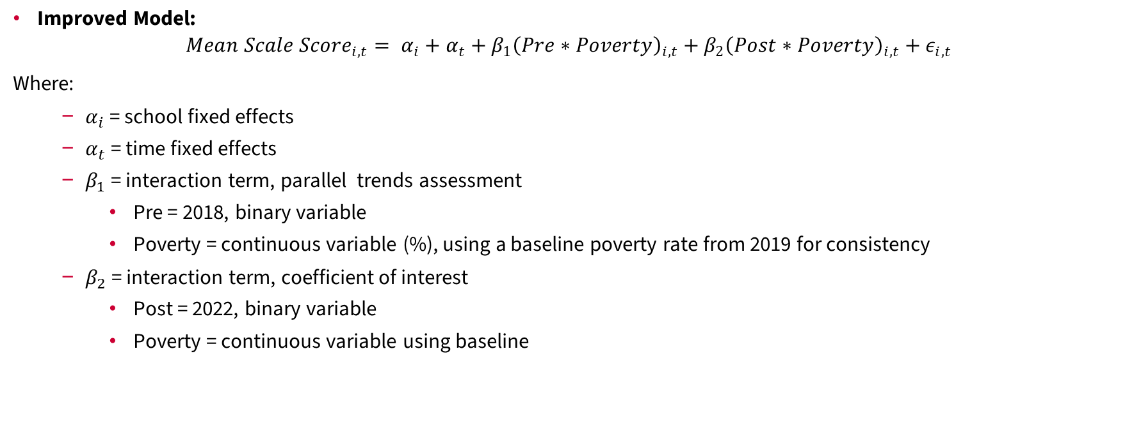
Improved Modeling Approach
Model equations
Improved Model:
$${Mean Scale Score}_{i,t}= α_{i}+α_{t}+β_{1}{\left(Pre∗Poverty\right)}_{i,t}+β_{2}{\left(Post∗Poverty\right)}_{i,t}+ε_{i,t}$$
Where:
$α_{i}$ = school fixed effects
$α_{t}$ = time fixed effects
$β_{1}$ = interaction term, parallel trends assessment
Pre = 2018, binary variable
Poverty = continuous variable (%), using a baseline poverty rate from 2019 for consistency
$β_{2}$ = interaction term, coefficient of interest
Post = 2022, binary variable
Poverty = continuous variable using baseline

Slide 16
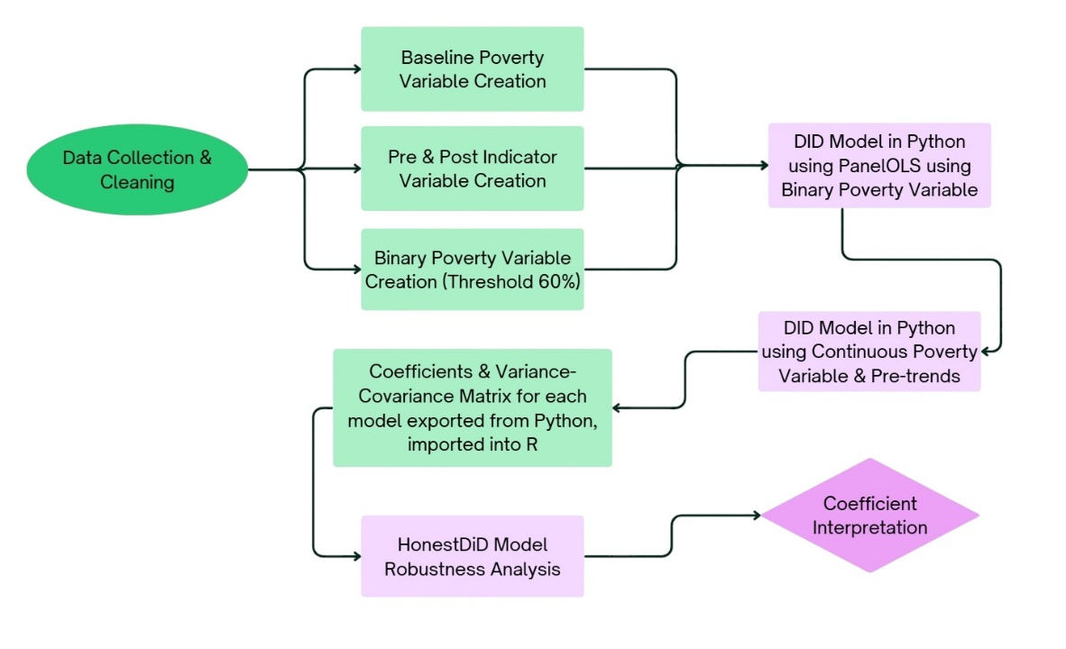
Modeling Approach
Project pipeline
Project begins with feature engineering
Transitions from initial model to improved model
Sensitivity analysis is performed for the improved model using HonestDiD framework

Slide 17
Initial Model

Slide 18
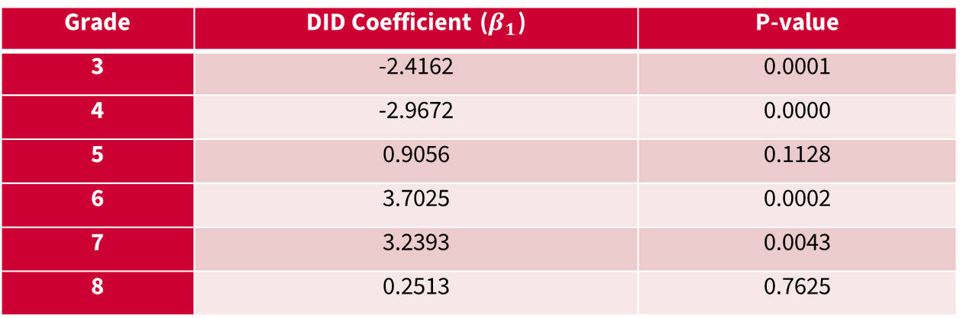
Initial Model
Results
Grade | DID Coefficient ($β_{1}$) | P-value
3 | -2.4162 | 0.0001
4 | -2.9672 | 0.0000
5 | 0.9056 | 0.1128
6 | 3.7025 | 0.0002
7 | 3.2393 | 0.0043
8 | 0.2513 | 0.7625
Almost all coefficients are statistically significant
Coefficients for third and fourth graders are negative and statistically significant
Schools with high poverty experienced an additional decline of 2.42 and 2.97 points on ELA exams for third and fourth graders, respectively

Slide 19
Initial Model
Strengths & weaknesses
Strengths
Simple model to dissect trends from pre- to post-pandemic
Weaknesses
Does not allow for inspection for variation in poverty rates
Does not account for pre-trends

Slide 20
Iteration & Improvement

Slide 21
Model Improvement
Adjustment of binary poverty classification variable
Continuous poverty percentage
Used a baseline value to avoid post-COVID shocks in poverty rate
Incorporation of 2018 information
New interaction term added to the equation to assess pre-trends
Parallel trends validation using HonestDiD framework (how much of a violation can the model withstand?)

Slide 22
Model Comparisons
Model | Years | Parallel Trends Assumption Checked? | Treatment Type | Poverty Rate
Original Model | 2019, 2022 | No, not necessary. | Binary Poverty Variable (1: High Poverty School, 0: Low Poverty School), threshold >60% | 2019 Poverty Rate as baseline
Improved Model | 2018, 2019, 2022 | Yes. | Continuous Poverty Variable | 2019 Poverty Rate as baseline

Slide 23
Improved Model

Slide 24
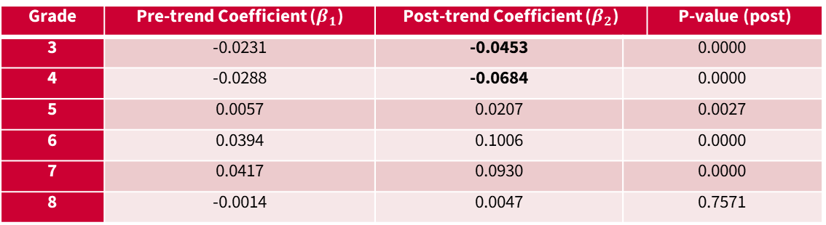
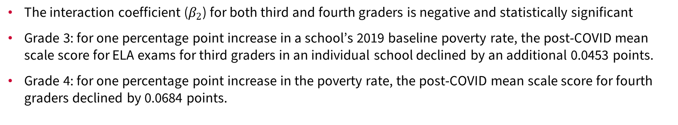
Improved Model
Results
Grade | Pre-trend Coefficient ($β_{1}$) | Post-trend Coefficient ($β_{2}$) |  | P-value (post)
3 | -0.0231 | -0.0453 | 0.0000
4 | -0.0288 | -0.0684 | 0.0000
5 | 0.0057 | 0.0207 | 0.0027
6 | 0.0394 | 0.1006 | 0.0000
7 | 0.0417 | 0.0930 | 0.0000
8 | -0.0014 | 0.0047 | 0.7571
The interaction coefficient ($β_{2}$) for both third and fourth graders is negative and statistically significant
Grade 3: for one percentage point increase in a school’s 2019 baseline poverty rate, the post-COVID mean scale score for ELA exams for third graders in an individual school declined by an additional 0.0453 points.
Grade 4: for one percentage point increase in the poverty rate, the post-COVID mean scale score for fourth graders declined by 0.0684 points.

Slide 25
Improved Model
Robustness check
Grade | Magnitude | Conclusion
3 | 1.5
4 | 1
5 | 0
6 | 0
7 | 0
8 | 0
Results show that findings for post-COVID effects still hold despite potential violations of the parallel trends assumption for third and fourth graders.
Grades 5-8 report a magnitude 0, meaning models were statistically insignificant even in the event of perfect parallel trends

Slide 26
Discussion
Interpretability & discussion
Result Interpretation
The model shows that schools with higher baseline poverty rates experienced larger declines in ELA test scores, especially for third and fourth grade students.
Results suggest that pre-existing disparities amplified pandemic effects, and such disparities contribute significantly to student success
What should be done with these results?
These conclusions can be used for targeted recovery programs and educational intervention. Additional academic support for younger grades would aim to close any post-pandemic achievement gaps.
Who should act?
School administrators and policymakers may use these findings to make informed decisions on educational recovery initiatives. Education researchers may use these results to build on further research that addresses academic inequalities.

Slide 27
Final Thoughts

Slide 28
Limitations
Pandemic Data
Data surrounding the pandemic poses unique challenges with data structure and consistency
ELA data lacked important information for some of the most critical years (2020 & 2021)
Score Scaling
Change in test score scaling caused significant information loss. An expanded time frame would benefit deeper analysis on pre- and post-pandemic trends.
Geographic Implications
New York City has a very complex school system and is one of the largest cities in the world
These results are unique to New York City and may not encompass the full impact of the pandemic on widening achievement gaps across the country.

Slide 29
Conclusion & Future Directions
Implications
This project required a large amount of model tuning and adjustments but nevertheless, achieved the desired results
Continuation may include the expansion into different school systems around the country.
For New York City, specifically, an analysis of comprehension levels would allow for a more in-depth assessment of student achievement trends.

Slide 30
Thank you!

Slide 31
Appendix

Slide 32
GitHub Link

Slide 33
Count of Grade Level Observations per Year
Grade | Years | Count
3 | 2018 2019 2022 | 764 774 776
4 | 2018 2019 2022 | 750 764 770
5 | 2018 2019 2022 | 743 756 775
6 | 2018 2019 2022 | 474 476 474
7 | 2018 2019 2022 | 466 467 469
8 | 2018 2019 2022 | 466 464 465

Slide 34
Summary Statistics of Mean Scale Score, Number of Students Tested, and Poverty Rate
 | Year | Mean | Standard Deviation |  | Min. | Max.
Mean Scale Score | 2018 2019 2022 | 600.549 599.727 600.061 |  | 9.982 10.143 10.583 | 558 559 567 | 639 644 635
Number Tested | 2018 2019 2022 | 102.776 101.322 82.662 |  | 86.004 86.498 74.930 | 6 6 6 | 745 737 696
Poverty Rate (%) | 2018 2019 2022 | 76.035 74.805 74.376 |  | 21.822 21.796 21.198 | 5.6 7.2 6.1 | 95 95 95

Slide 35
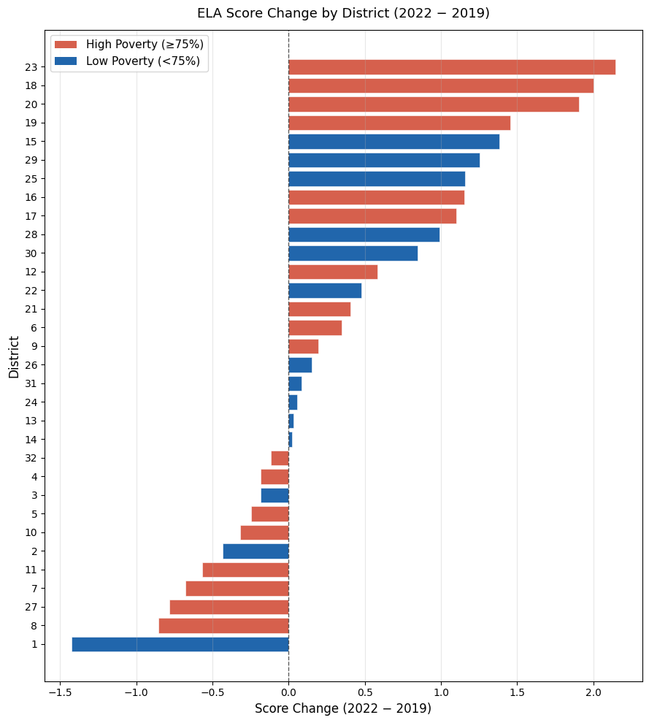
Exploratory Data Analysis
District-level Trends
Why school-level information and not school district-level?
School districts have very arbitrary borders
District-level information does not capture community diversity

Slide 36
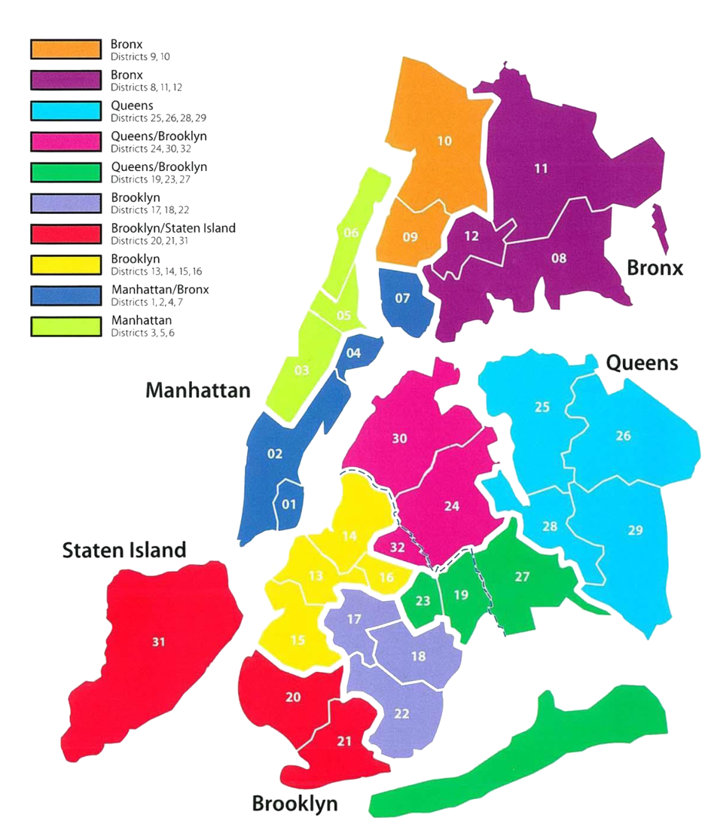
New York City School District Map

