Slide 1
Week 11 Updates
Madison Jones
Master’s Project
Spring 2026

Slide 2
HonestDID R Analysis
HonestDID package: Robustness check for model bias due to parallel trends assumption
Developed by Rambachan & Roth (2023)
Based on magnitude, M, on 0 – 2 scale
M = 0 – 1: fragile model, results explained by pre-trend
M = 1 – 2: moderate robustness
M > 2: strong model

Slide 3
HonestDID R Analysis
Exported coefficients and variance-covariance matrices from Python PanelOLS models
Ran relative magnitudes for each model using coefficients and matrices

Slide 4
HonestDID R Analysis Conclusions
Grade | Magnitude (M) | Conclusion
3 | 1.2 | ✅
4 | 1.5 | ✅
5 | 0 | ❌
6 | 0 | ❌
7 | 0 | ❌
8 | 0 | ❌
Based off HonestDID analysis, models for grades 3 and 4 are robust.
Models for grades 5 – 8 are not, despite placebo test saying otherwise
Parallel trends is a very hard thing to test according to research on event studies and DID!

Slide 5
Models
Grade | Post Period Coef. | Significant?
3 | -0.0511 | ✅
4 | -0.0715 | ✅
5 | 0.0180 | ❌
6 | 0.0867 | ❌
7 | 0.0769 | ❌
8 | -0.0106 | ❌
For every 1 percentage point increase in poverty, a school’s mean ELA score dropped 0.051 points between 2018 and 2022

Slide 6
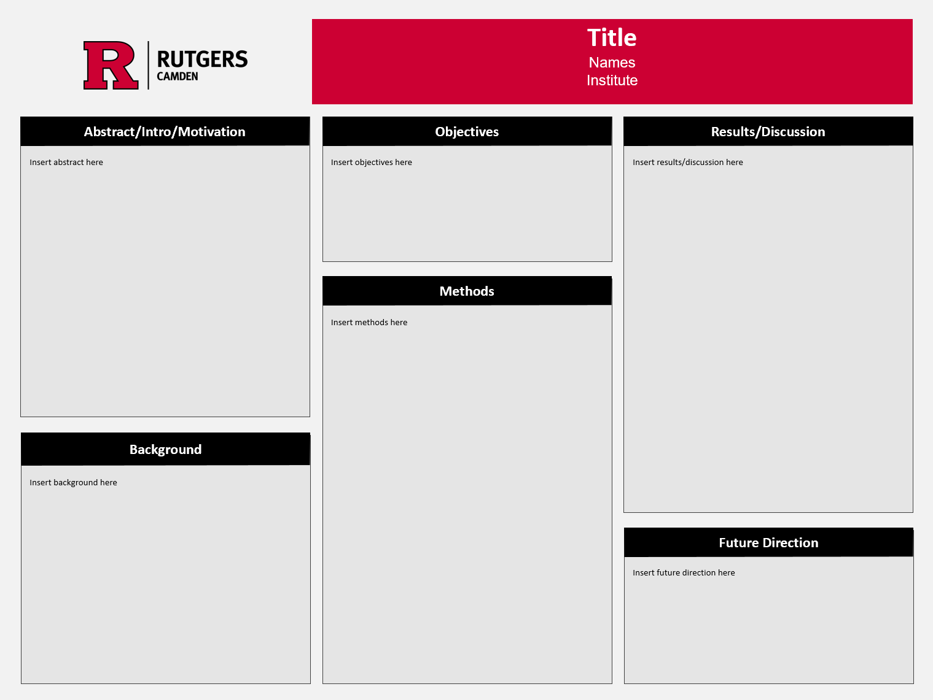
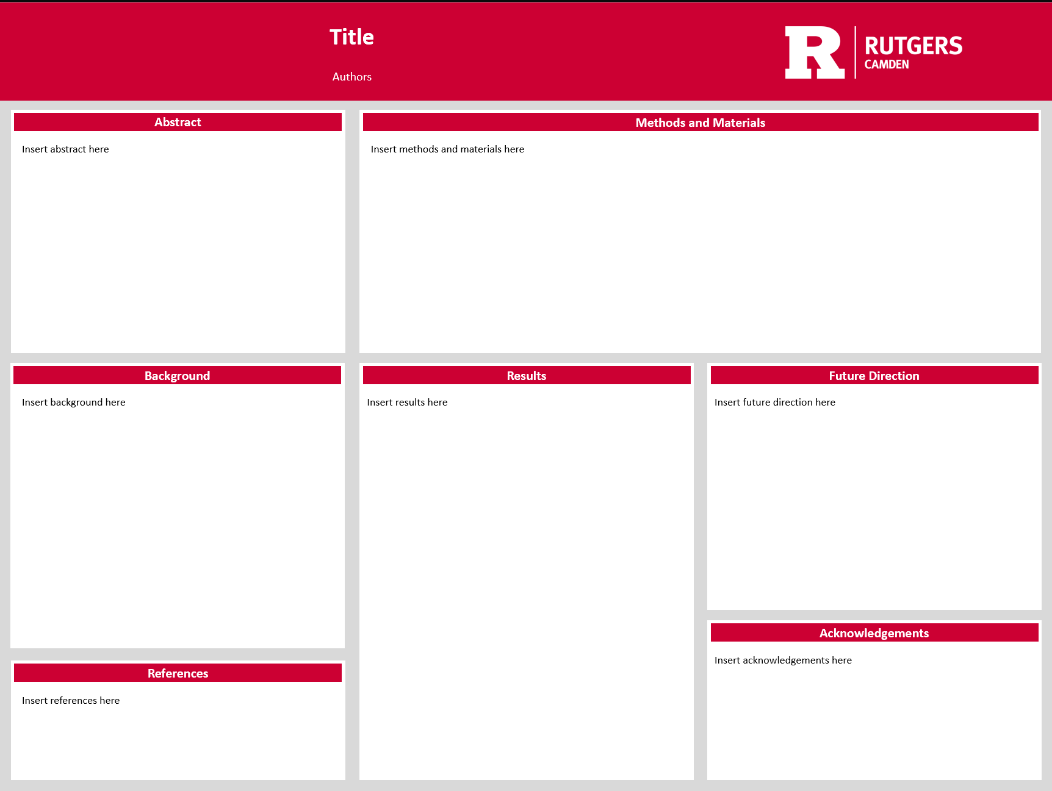
Poster
Option 1 or Option 4 template
Some EDA graphs, results charts in discussion section, magnitude graphs from R

