Slide 1
Impact of COVID-19 on ELA Student Achievement
Madison Jones
Master’s Project
Spring 2026

Slide 2
Problem, Motivation, and Impact
Analyzed impacts of COVID-19 on education, particularly ELA scores
How COVID-19 broadened the gap in education and learning-loss
Hypothesize scores will decrease in post-COVID school years, particularly in low-income, disadvantaged communities
  The “homework gap”: school-aged children lacking resources (i.e. the internet) to complete assignments
___________________________________________________________________
Shows discrepancies in different public-school systems
Can influence resource allocation
Notes:
Pew research center

Slide 3
Data Description
NYC OpenData ELA scores from 2013-2023
  Due to consistency, years 2018-2022 will be compared
  No testing during COVID, optional testing in 2021
Data
  School name, grade, year
  Level 1 (# and %): Not meeting learning standards
  Level 2 (# and %): Partially meeting learning standards
  Level 3 (# and %): Meeting learning standards
  Level 4 (# and %): Meeting learning standards with distinction

Slide 4
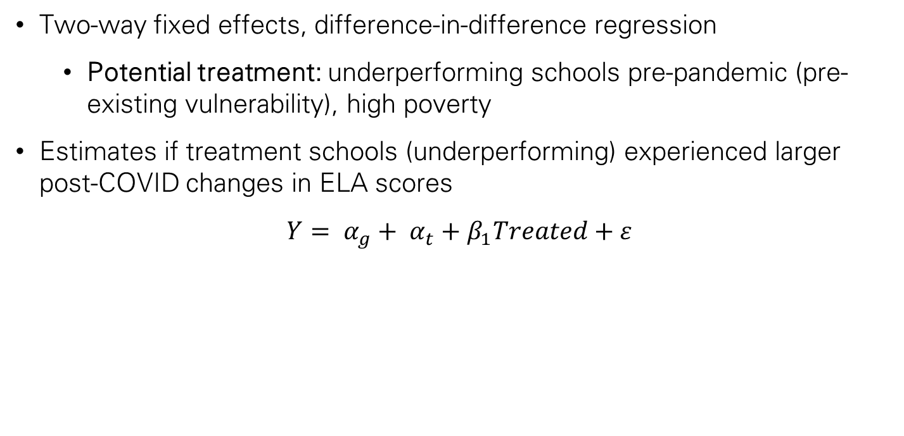
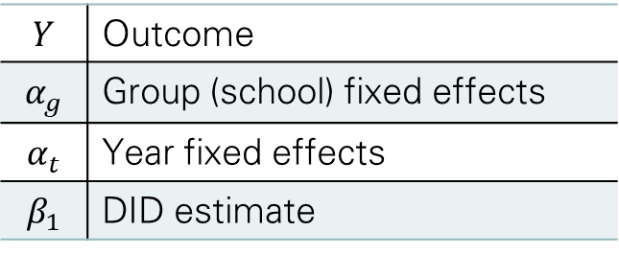
Methodology and Evaluation
Two-way fixed effects, difference-in-difference regression
  Potential treatment: underperforming schools pre-pandemic (pre-existing vulnerability), high poverty
Estimates if treatment schools (underperforming) experienced larger post-COVID changes in ELA scores
$$Y= α_{g}+ α_{t}+β_{1}Treated+ε$$
$$Y$$ | Outcome
$$α_{g}$$ | Group (school) fixed effects
$$α_{t}$$ | Year fixed effects
$$β_{1}$$ | DID estimate
Notes:
Outcome could be mean ELA score, % of level 1-4 (done individually or lumped together by 1 2 or 3 4)
With hundreds of schools, DID averages the differences from treated and untreated schools which then gets the DID estimate
- Dif Y = Ypost – Ypre
Fixed effects: controlling for things that don’t change over the years
Group fixed effects: controls for things that don’t change over time (ex. Neighborhood)
Year (time) fixed effects: fixed effects for time period you’re in (pre-COVID & post-COVID)

Slide 5
Deliverables, timeline, and milestones
Timeline:
Data compiled and prepared for EDA by mid-February
Analysis beginning mid/end of February
Key Deliverables:
Report and poster containing EDA, methodology, and results

Slide 6
Challenges and limitations
Data from 2020-2021 difficult to find/use
Changes in standardized testing make years outside of 2018-2022 incomparable

Slide 7
Thank you

Slide 8
Sources
www.pewresearch.org/short-reads/2020/03/16/as-schools-close-due-to-the-coronavirus-some-u-s-students-face-a-digital-homework-gap/.
https://theeffectbook.net/ch-DifferenceinDifference.html
Data:
https://data.cityofnewyork.us/Education/English-Language-Arts-ELA-Test-Results-2013-2023/iebs-5yhr/about_data

