Slide 1
Impact of COVID-19 on ELA Student Achievement
Madison Jones
Master’s Project Proposal, cont.
Spring 2026

Slide 2
Recap
How COVID-19 broadened the gap in education and learning-loss in English Language Arts (ELA)
Hypothesize scores will decrease in post-COVID school years, particularly in low-income, disadvantaged communities
  The “homework gap”: school-aged children lacking resources (i.e. the internet) to complete assignments
Shows discrepancies in different public-school systems
Can influence resource allocation and affect education policy

Slide 3
Data & Variables Recap
NYC OpenData ELA scores from 2013-2023
  Due to consistency, years 2018-2022 will be compared
  No testing during COVID, optional testing in 2021
Variables
  School name, school ID, grade, year, number of students tested
  Level 1 (# and %): Not meeting learning standards
  Level 2 (# and %): Partially meeting learning standards
  Level 3 (# and %): Meeting learning standards
  Level 4 (# and %): Meeting learning standards with distinction

Slide 4
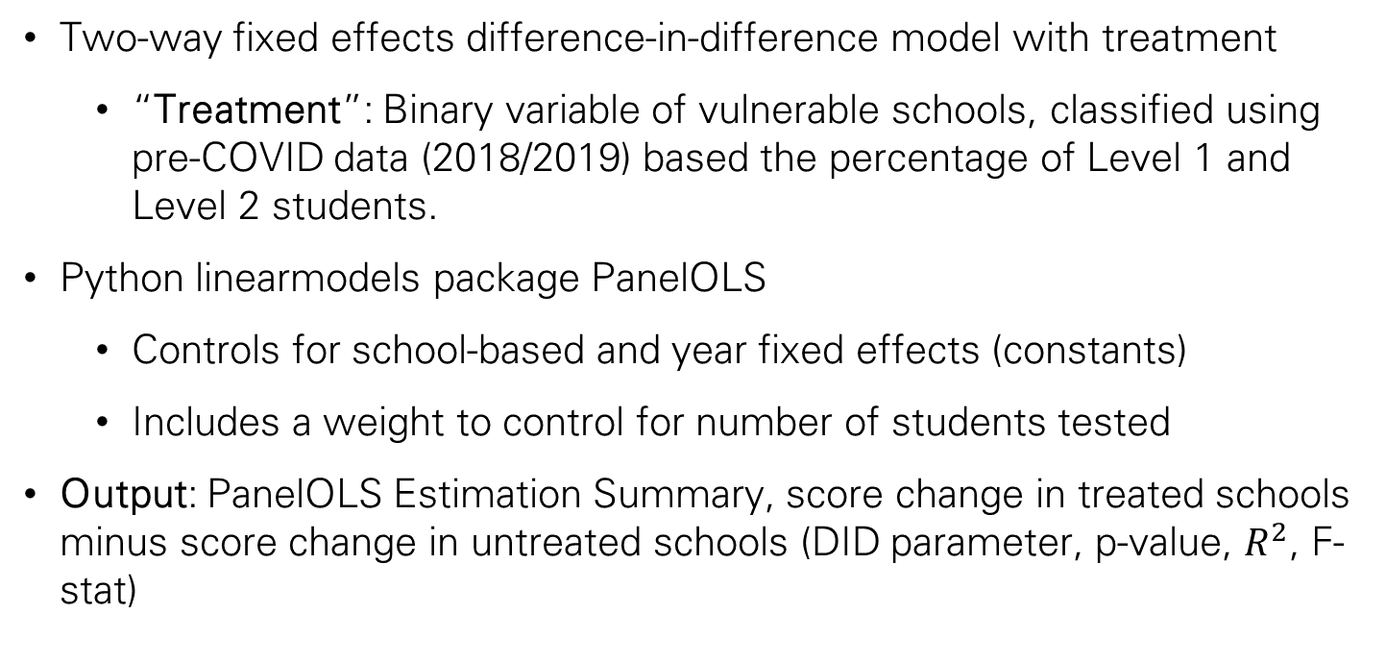
Methodology
Two-way fixed effects difference-in-difference model with treatment
  “Treatment”: Binary variable of vulnerable schools, classified using pre-COVID data (2018/2019) based the percentage of Level 1 and Level 2 students.
Python linearmodels package PanelOLS
  Controls for school-based and year fixed effects (constants)
  Includes a weight to control for number of students tested
Output: PanelOLS Estimation Summary, score change in treated schools minus score change in untreated schools (DID parameter, p-value, $R^{2}$, F-stat)

Slide 5
Methodology, cont.
What is the PanelOLS Estimation Summary telling us?
  This summary shows the DID parameter, standard error, t-statistic, p-value, and confidence interval, as well as a few descriptive statistics.
What about grade levels?
  The goal is to perform similar models, filtered by grade levels. As a reminder, this data is grades 3 through 8. Younger children may be more affected by learning-loss during the pandemic!
What about testing levels (Levels 1-4)?
  I am planning on performing the same test with the levels as the outcome to evaluate changes in performance in a different way.

Slide 6
Data Source
Source:
  Data is from NYC OpenData. The data is cleaned and ready for use.
Usefulness
  Data contains all necessary information for analysis and data manipulation.
Concerns:
  No testing in 2020, optional testing in 2021.
  Might include 2021 due to weight being included in model, may not include based on outcome and potential data availability.

Slide 7
Timeline & Deliverables
Timeline:
Data compiled and prepared for EDA by second week of February
Analysis beginning mid/end of February
Key Deliverables:
Report and poster containing EDA, methodology, and results

Slide 8
Thank you!
Questions?

