Slide 1
CS 1301 Computation Complexity or Big O

Slide 2
The following link provides helpful material to understand these concepts.
http://interactivepython.org/runestone/static/pythonds/SortSearch/toctree.html

Slide 3
Computation Complexity
Measuring the efficiency of an algorithm in terms of space(memory) and time(speed)
Efficiency is expressed a function of the input size
“Big-O” notation -- O(f(n))
Generally looks at worst case, longest time and most space used

Slide 4
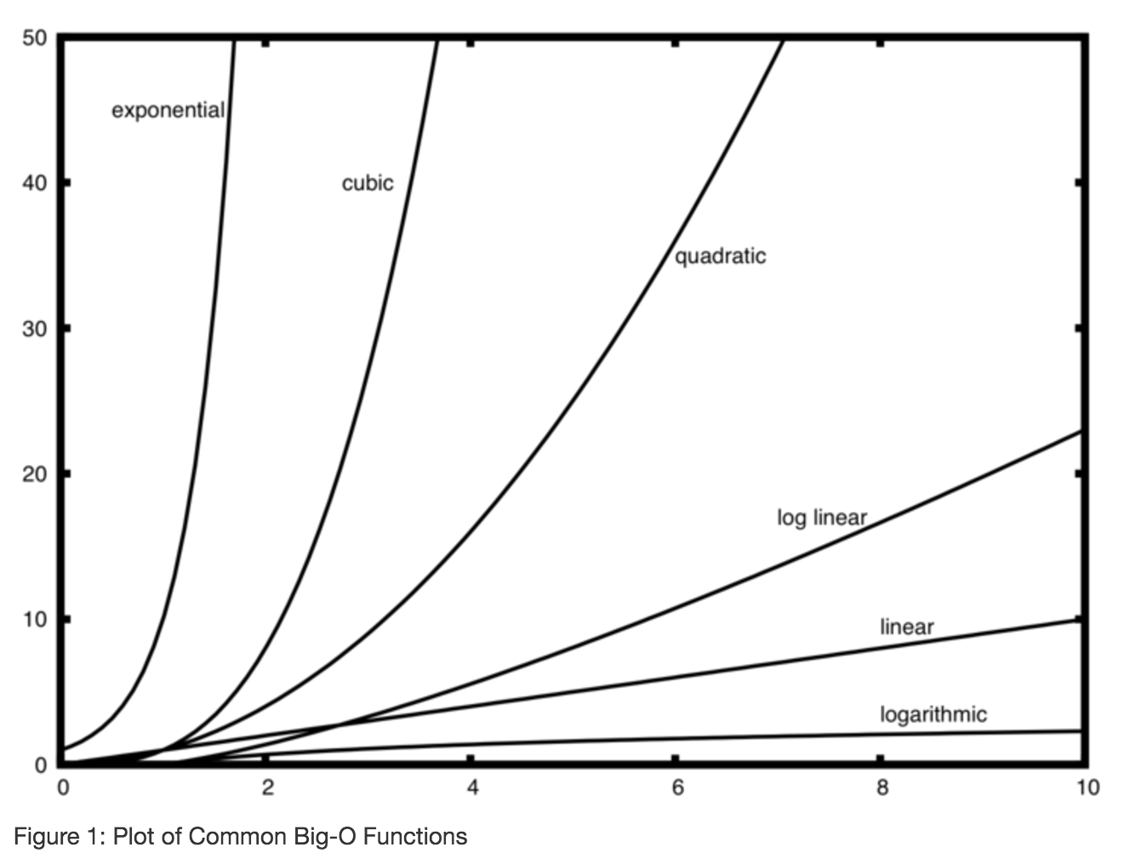
Complexity Classes:
O(1)
O(log n)
O(n)
O(n log n)
O(n^2)
O(n^3)
O(2^n)

Slide 5
Time complexity
Tends to be looked at as more important than space
Assume that each operation takes one unit of time to process.
Measuring:
Additive Property: O(m) + O(n) = O(max(n,m))
Multiplicative Property: Loops the sum of the statements inside the loop

Slide 6
Complexity of Loops Example
for num1 in range(0,n):
for num2 in range(0,n):
x = x + 1
O(n*n) = O(n^2)

Slide 7
Big O - Puts algorithms into categories
O(1) – constant time - the program always takes the same of time, regardless of the amount of data it’s working on. example – looking for the smallest item in a sorted list
O(log n) – logarithmic time – the program takes log base 2 of the number of items there are in order to work – example guess a number within a range
O(n) –linear time - the program get slower in proportion to the amount of data elements n – searching for something by looking at all the items
O(n^2) – quadratic time- the program gets slower as a square of the amount of data elements n – for each item, must look at all the other items each time – a loop within a loop
O(n * log(n)) – the program gets slower as a bit bigger than linear growth in n – for each item, must go through log of the items – a loop within a loop where one loop only has log n occurrences

Slide 8
Typical Big O's
O(1): Finding the minimum value of a sorted list
O(log n): Binary Search – divide and conquer
O(n): Sequential Search – look at all words in dictionary
O(n log n): Merge Sort, Quicksort
O(n²): Bubble Sort, Insertion Sort, Selection Sort

Slide 9
Searching Algorithms
Sequential Search (not efficient) – O(n)
Binary Search (efficient) – O(log n)

Slide 10
Real world example: Finding something in a novel
O(n) algorithm
Start from the beginning.
Check each page, until you find what you want.
Not very efficient
Best case: O(1) first word
Worst case: O(n) not in there
Average case: O(n/2)

Slide 11
Real world example: Finding something in a textbook
O(n) algorithm
Start from the beginning.
Check each element, until you find what you want.
Not very efficient
Best case: One step
Worst case: n steps where n = number of elements
Average case: n/2 steps

Slide 12
Implementing a sequential search algorithm
1 def sequentialSearch(alist, item):
2 pos = 0
3 found = False
4
5 while pos < len(alist) and not found:
6 if alist[pos] == item:
7 found = True
8 else:
9 pos = pos+1
10
11 return found

Slide 13
Real world example: Finding a name in a directory using binary search
O(log n) algorithm
*Start in the middle – look at the middle entry
If you have found the item, you are done!
If what you are looking for comes before this item go back to the * using only the first half of the directory
Otherwise, go back to * using only the last half of the directory.
More efficient
Best case: One step
Worst case: log n steps
Average case: (log n)/2 steps

Slide 14
What is log n?
In computer science log is referring to log base 2.
A logarithm is the opposite of an exponent so it grows much slower.
log base 2 of 1 is 0 log base 2 of 32 is 5
log base 2 of 2 is 1 log base 2 of 64 is 6
log base 2 of 4 is 2 log base 2 of 128 is 7
log base 2 of 8 is 3 log base 2 of 256 is 8
log base 2 of 16 is 4 log base 2 of 512 is 9 etc.

Slide 15
Implementing a binary search algorithm
1 def binarySearch(alist, item):
2 first = 0
3 last = len(alist)-1
4 found = False
5
6 while first<=last and not found:
7 midpoint = (first + last)//2
8 if alist[midpoint] == item:
9 found = True
10 else:
11 if item < alist[midpoint]:
12 last = midpoint-1
13 else:
14 first = midpoint+1
15
16 return found

Slide 16
Practice Exam Question: Match Big O's and Algorithms
Big O
Algorithm
O(1)
O(log n)
O(n²)
O(n)
2 Nested for loops
Sequential Search
Binary search
Min value in sorted array

Slide 17
Sample binary search exam question
Show items that would be examined when searching the following sorted list for the value 33.
Assume that you always round down when dividing by two as in the formula (first + last) // 2
[2, 3, 8, 9, 10, 11, 15, 22, 99]
10, 15, 22, 99

Slide 18
Solution to binary search exam question
Show items that would be examined when searching the following sorted list for the value 7.
Assume that you always round down when dividing by two as in the formula (first + last)//2
[2, 3, 8, 9, 10, 11, 15, 22, 99]
10, 3, 8

