Slide 1
EconOptics: Committed to a Better Tomorrow
$
Founded By:
Madison Souder and Jonathan Colon

Slide 2
Who are we?
Mission Statement:
Economic analytics and consulting company
Goals:
To find the most effective economic spending breakdowns
To identify the optimal economy for optimal citizen happiness
This company was founded on the belief that everyone should be able to live financially stress-free. Economic household spending breakdowns should be optimized to promote overall well-being and peace of mind. No one should be forced to live above their means to survive in this global economy. These beliefs should not infringe on individual countries economic growth and the freedom of their citizens.

Slide 3
Data
Gathering & Collection
Cleaning
Publicly Available Data
World Happiness Report
Government Economic Reports
International Monetary Fund
Regional Cost of Living Analysis Data – Kaggle
Future: Surveys
Python through Jupyter Notebook
ETL
Removed NaNs, columns with extra information
Matching entries by county and year
Quality Checks
Usage Agreements
Before entered into the database
Checks on NaN values, Nulls, typos
Public Access
No personal or private information will be on the database

Slide 4

Database storage
Data warehouse stored on a server
Accessible to the public
Company: MySQL to store and manage
Public: Google cloud platform to access the data warehouse
ETL
Sources
Jupyter Notebook
MySQL Warehouse
Google cloud platform

Slide 5
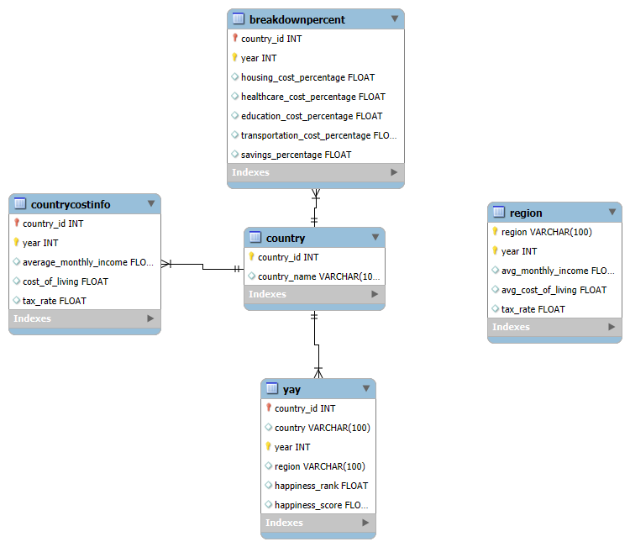
Database design
Notes:
Design a database schema to model to show how your data interacts. What kind of schema works best for your data?
Define all fact/dimension tables, primary keys, foreign keys, and established relationships between entities within the diagram.

Slide 6
What Countries have the highest happiness score?

Slide 7
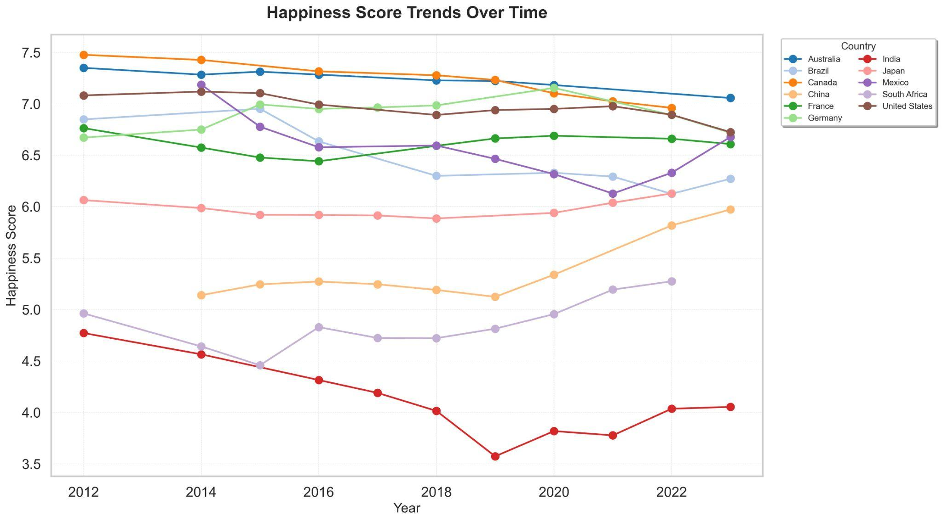

Slide 8
What are the average economic breakdowns for the happiest countries?
Notes:
The breakdowns are after taxes

Slide 9
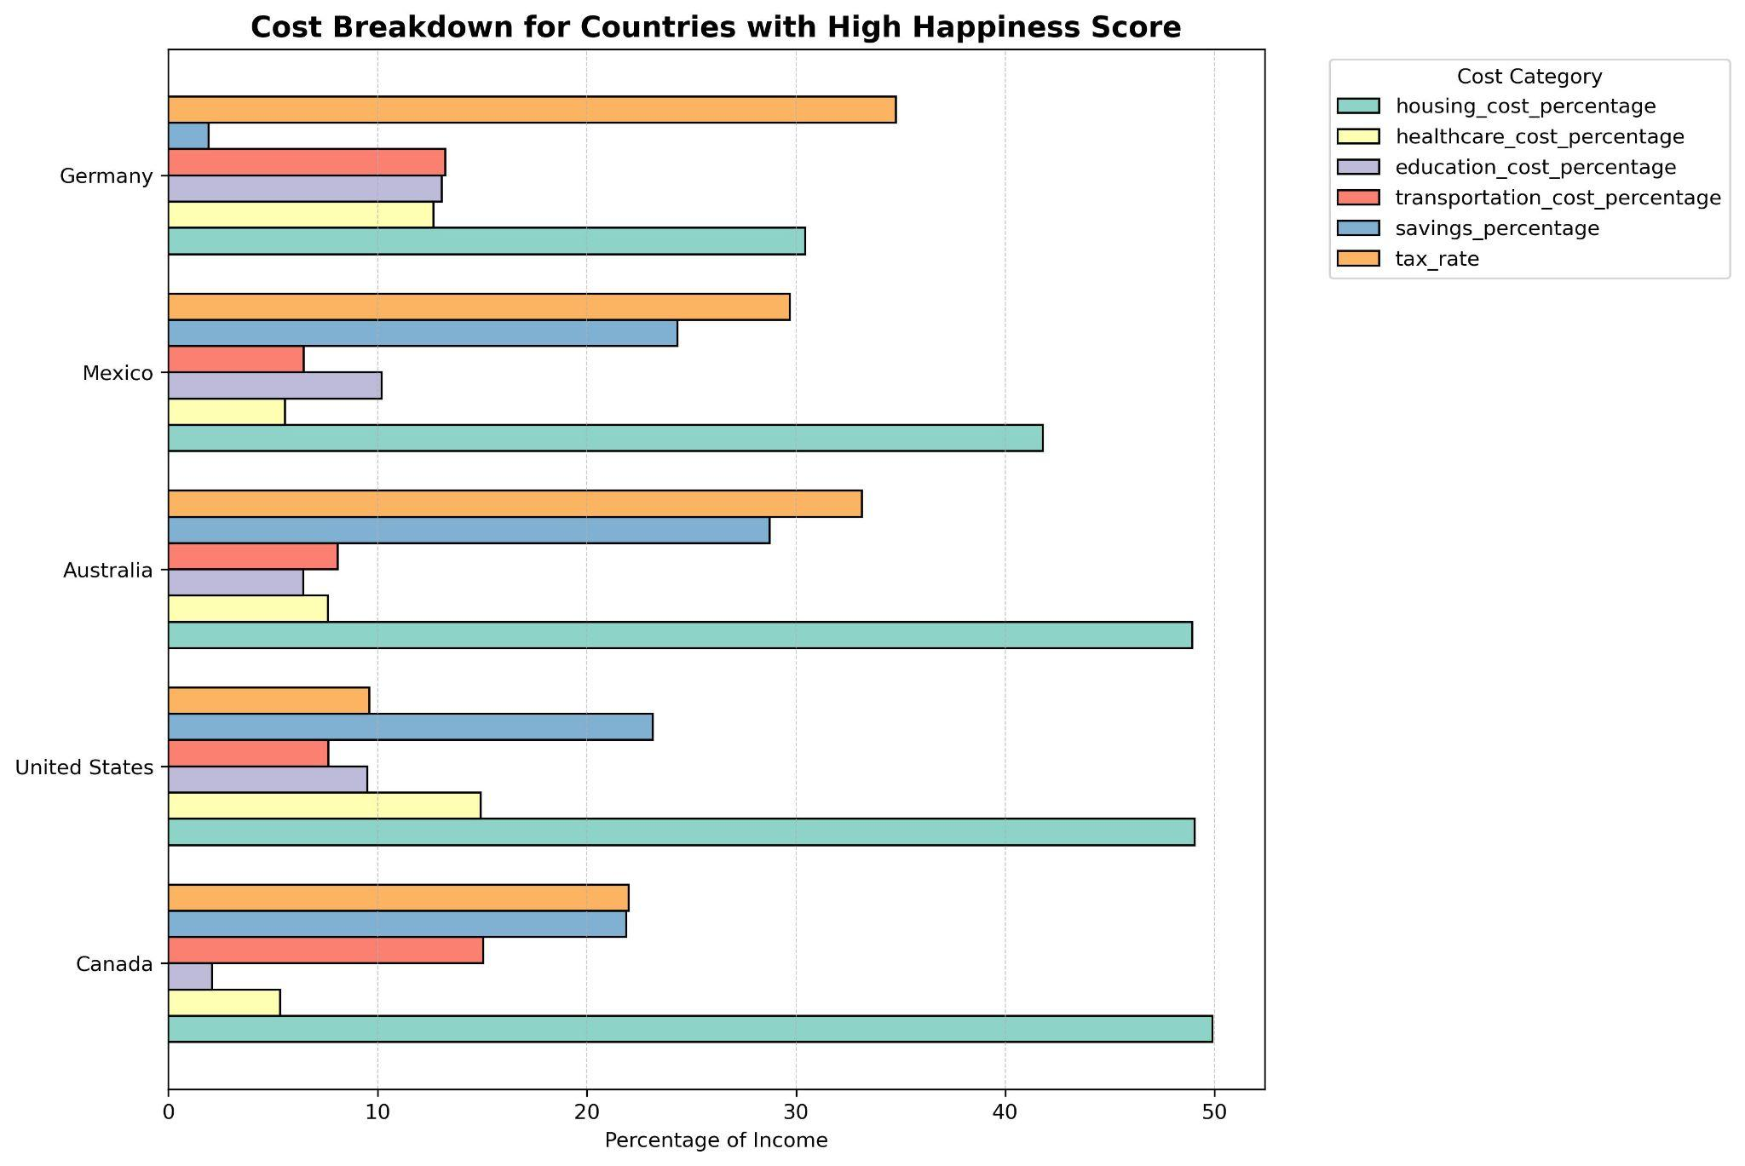

Slide 10
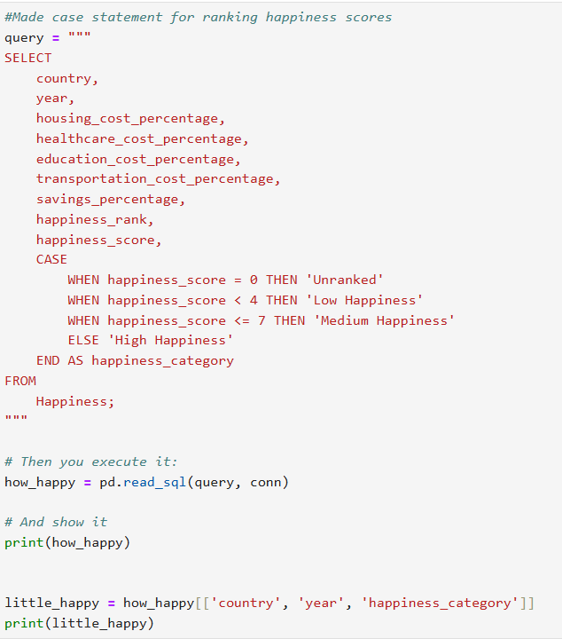
Conclusion
Optimization of societal structures can be possible as we analyze this data
Higher overall happiness = happier and less stressed citizens of the world
What factors dictate the highest return of happiness?
i.e Housting_cost_percentage

Slide 11


Thank You
Check out our github repository
Jonathan Colon :
Madison Souder:
madison-souder madisonsouder
Jonathan Colon
Jonathan-Colon

