Slide 1


Prevention and Protection: The Impact of Vaccines
By: Madison Souder

Slide 2
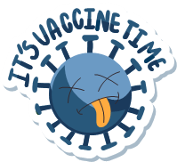

Background
History
Safety and Effectiveness
15th Century – Intentionally exposing people to smallpox
1796 – Physician Edward Jenner creates the first successful vaccine
1945 – Influenza vaccine is approved for United States military use
Vaccines go through rigorous tests and clinical trials before they are declared safe
The safety of vaccines is continuously monitored
Vaccines have saved over 154 million lives
Vaccines have reduced infant deaths by 40%
Notes:
Vaccinations have been the foundation for preventive health since the 19th century, and Vaccines have successfully prevented contagious, dangerous, deadly diseases.
(A Brief History of Vaccination)
Preventive medicine has been around since at least the 15th century
Cowpox – which makes people mildly ill – protects against smallpox
The following year, it is approved for civilian use
(Vaccines and immunization: Vaccine safety 2025)

Slide 3
A Look Into Vaccination Rates and Reported Cases
Notes:
But vaccination rates are declining rapidly as parents no longer believe that vaccinations are safe and effective
Therefore, I investigated declining vaccination rates, and the number of reported cases of vaccine-preventable diseases to develop models to predict the future of vaccination compliance and reported cases.

Slide 4
Methodology
Centers for
Disease Control
and Prevention
World Health Organization
R and RStudio
Kindergarten Vaccination Rates for School-Mandated Vaccines
Polio
MMR
Varicella
Hepatitis B
Tdap, and DTP, DTaP, or DT
National Vaccination Rates
Polio
Measles
Rubella
Hepatitis B
DTP
Reported Cases of Vaccine-Preventable Diseases
Diphtheria, Tetanus, and Pertussis
Measles, Mumps, and Rubella
Not applicable entries were omitted
Columns with no entries
Coverage column
Averaged HepB birth dose total and HepB birth dose (given within 24 hours of birth)
Notes:
CDC was the source for the original project data
WHO was the source for the additional data collected
Only used R and RStudio for both projects

Slide 5

https://madisonsouder.shinyapps.io/Data_practicum/
Notes:
Introduce my Shiny App - the layout follows my presentation and adds an interactive element.
Started to introduce my data exploration project on Kindergarten Vaccination Rates – it inspired this project

Slide 6
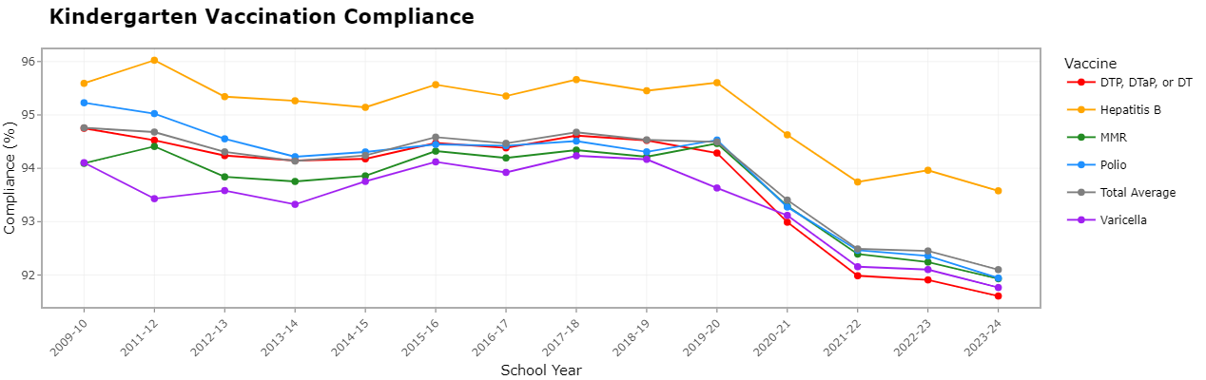
Notes:
Note this is from the old project
The decline starts during the 2020-2021 school year, the first full pandemic school year

Slide 7
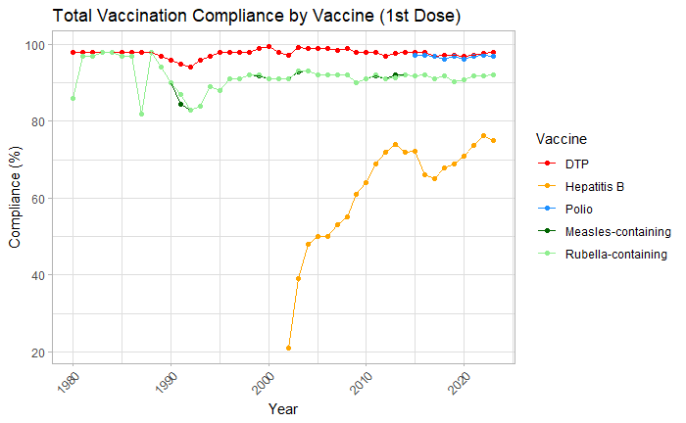
Notes:
Compounding, which can make it deceiving
DTP -> 0% change
HepB -> 263.48% increase
Birth dose was first officially recommended in 1991
Advised to vaccinate before leaving the hospital in 2005
MR
Low in 1987 -> 82%
High in 1983 -> 98%

Slide 8
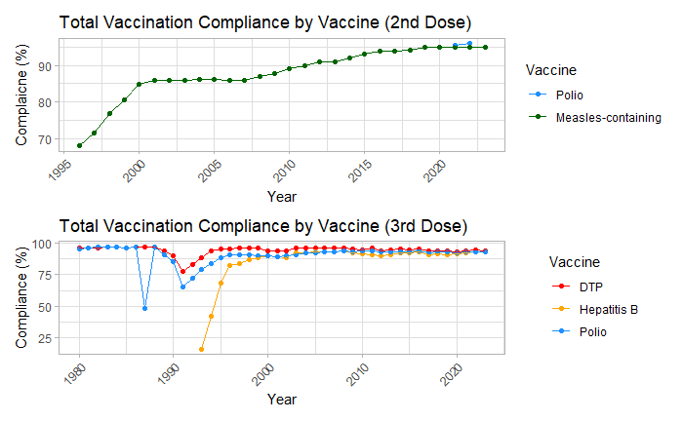
Notes:
Compounding also deceiving
Measles -> 39.71% increase
DTP -> 2.08% decrease
Hep -> 481.25% increase
Polio
Low in 1987 -> 48.33%

Slide 9
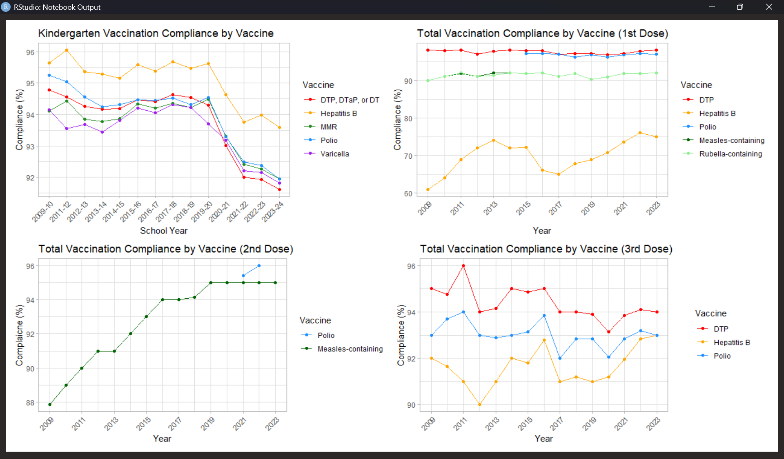
Notes:
Parents are more reluctant to vaccinate their children

Slide 10

What Do These Vaccination Rates Mean?

Slide 11
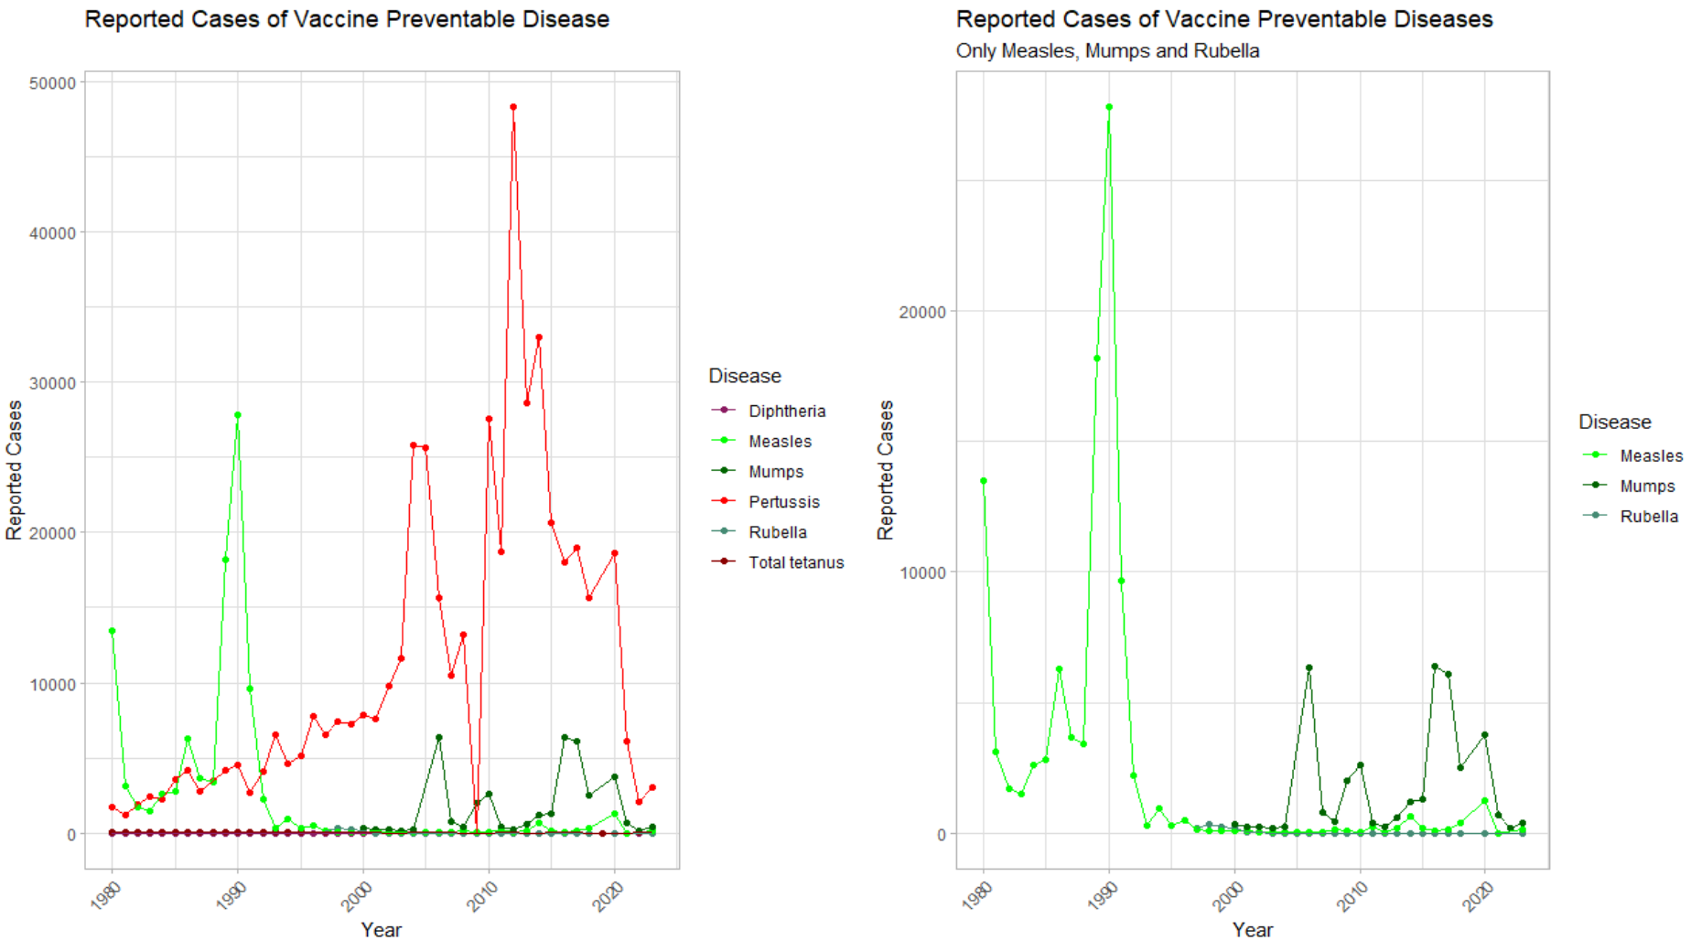
DTP Vaccine: the 1st Dose Compliance was 97% in 2012, but only 94% for the 3rd dose
Measles-containing Vaccine Compliance was 90% in 1990
Notes:
Compounding
Newborns are extremely susceptible to pertussis, but do not get the first dose of the DTP vaccine until 2 months old
2012 pertussis cases → 48,277
The DTP vaccine requires boosters every ten years and is especially important for pregnant women and those around infants (Pertussis vaccination recommendations 2024)
1990 measles cases → 27,786

Slide 12
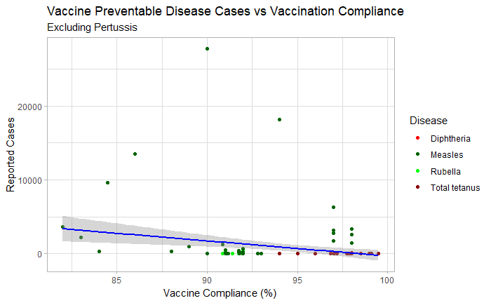
Spearman’s Rank Correlation: -0.4216704
p-value = 5.689 x 10⁻⁸
Notes:
Shapiro Test for Normality showed both sets of data were not normal
Spearman’s Rank Correlation
0.4216704 → Moderate negative correlation
P-value = 5.689e-08 → statistically significant

Slide 13

What Does the Future Hold?
Notes:
If trends continue the way they are going?

Slide 14
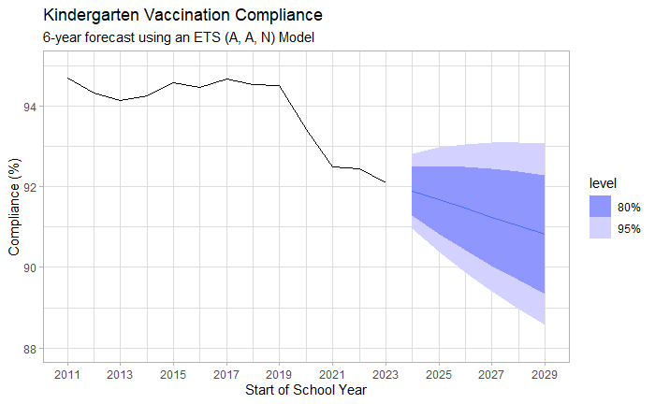
93.06%
AICc = 27.39
BIC = 21.65
90.82%
88.57%

Slide 15
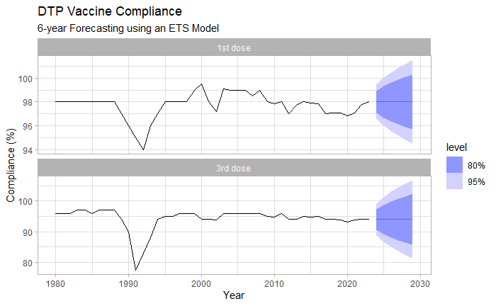
AICc = 98.57
BIC = 102.59
98%
94.5%
94%
AICc = 256.85
BIC = 261.60
81.27%
Notes:
1st Dose -> ANN
3rd Dose -> ANN
Herd immunity threshold: 75% - 80%
Plans-Rubió, P. (2012). Evaluation of the establishment of herd immunity in the population by means of serological surveys and vaccination coverage. Human Vaccines & Immunotherapeutics, 8(2), 184–188. https://doi.org/10.4161/hv.18444
Not easily spread

Slide 16
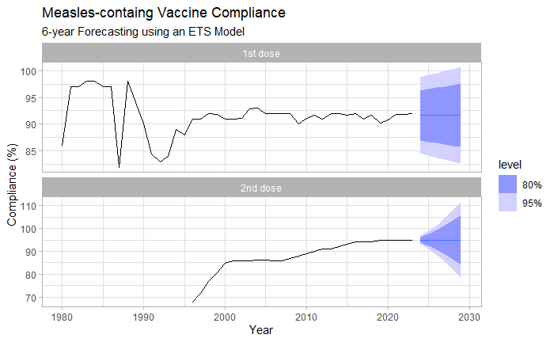
AICc = 284.30
BIC = 289.06
91.65%
82.68%
95%
AICc = 98.57
BIC = 102.50
78.35%
Notes:
1st Dose -> MNN
2nd Dose -> AAN
Herd immunity threshold: 91 – 94%
Plans-Rubió, P. (2012). Evaluation of the establishment of herd immunity in the population by means of serological surveys and vaccination coverage. Human Vaccines & Immunotherapeutics, 8(2), 184–188. https://doi.org/10.4161/hv.18444

Slide 17
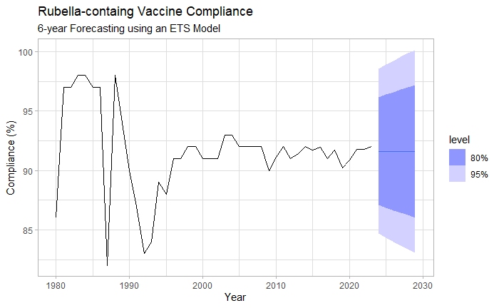
100.16%
AICc = 282.63
BIC = 287.28
91.62%
83.09%
Notes:
MNN

Slide 18
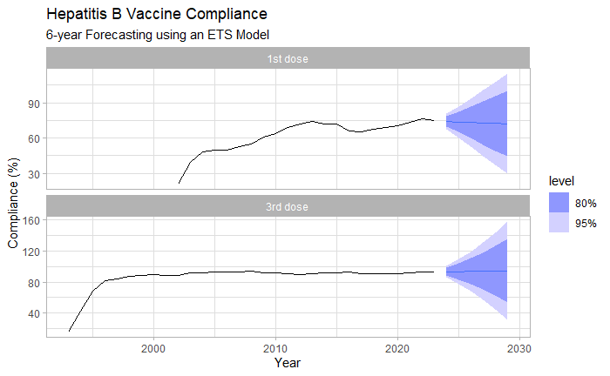
AICc = 133.75
BIC = 134.69
72.12%
29.57%
AICc = 191.35
BIC = 196.12
94.63%
31.61%
Notes:
1st dose -> A, Ad, N
3rd dose -> MAN

Slide 19
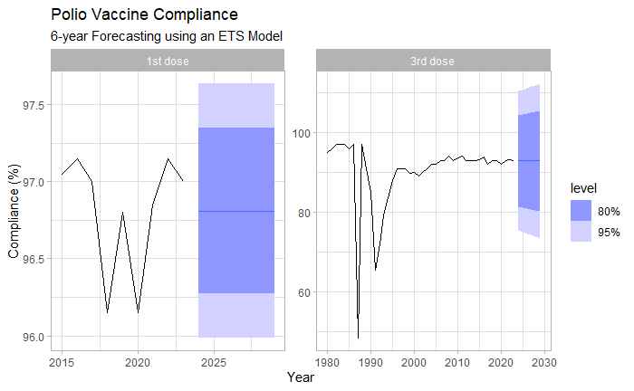
AICc = 12.69
BIC = 8.48
97.63%
AICc = 361.31
BIC = 366.06
92.86%
96.81%
73.44%
95.99%
Notes:
1st dose -> MNN
3rd -> MNN

Slide 20
Prediction Models
Diphtheria = lm(case ~ year + 1st dose coverage + 3rd dose coverage)
p-value = 0.0012 | MAE = 1.029 |  | RMSE = 1.46
1st Dose = 98% | Predicted Cases: 0 | 1st Dose = 94.55% |  | Predicted Cases: 1.62
3rd Dose = 94% |  | 3rd Dose = 81.27%
Total Tetanus = lm(cases ~ year + 1st Dose Coverage + 3rd Dose Coverage)
p-value = 1.586e-08 |  | MAE = 9.59 |  | RMSE = 11.29
1st Dose = 98% | Predicted Cases: 8.57 |  | 1st Dose = 94.55% |  | Predicted Cases: 7.66
3rd Dose = 94% |  |  | 3rd Dose = 81.27%
Pertussis = lm(cases ~ year + 3rd Dose Coverage + Under Herd Immunity
p-value = 0.0095 |  | MAE = 9174.499 |  | RMSE = 14481.07
1st Dose = 98% | Predicted Cases: 20,766.46 |  | 1st Dose = 94.55% |  | Predicted Cases: 18,623.25
3rd Dose = 94% |  |  | 3rd Dose = 81.27%

Slide 21
Prediction Models
Measles = lm(case ~ 1st dose coverage)
p-value = 0.1917 | MAE = 173.73 |  | RMSE = 229.82
1st Dose = 91.65% | Predicted Cases: 327.48 | 1st Dose = 82.68% |  | Predicted Cases: 1123.45
2nd Dose = 95% |  | 3rd Dose = 78.35%
Rubella = lm(cases ~ year + 1st Dose Coverage)
p-value = 0.01255 |  | MAE = 60.07 |  | RMSE = 100.69
1st Dose = 91.62% | Predicted Cases: 0 |  | 1st Dose = 83.09% |  | Predicted Cases: 0

Slide 22

Conclusion
Parents are reluctant to vaccinate their children
The fall in vaccination rates will only lead to more vaccine-preventable diseases cases
More accurate models can be made with additional data
Location
Population density
Age
Notes:
Nothing in the future is certain
Our path can be changed if we can acknowledge the problems we have

Slide 23
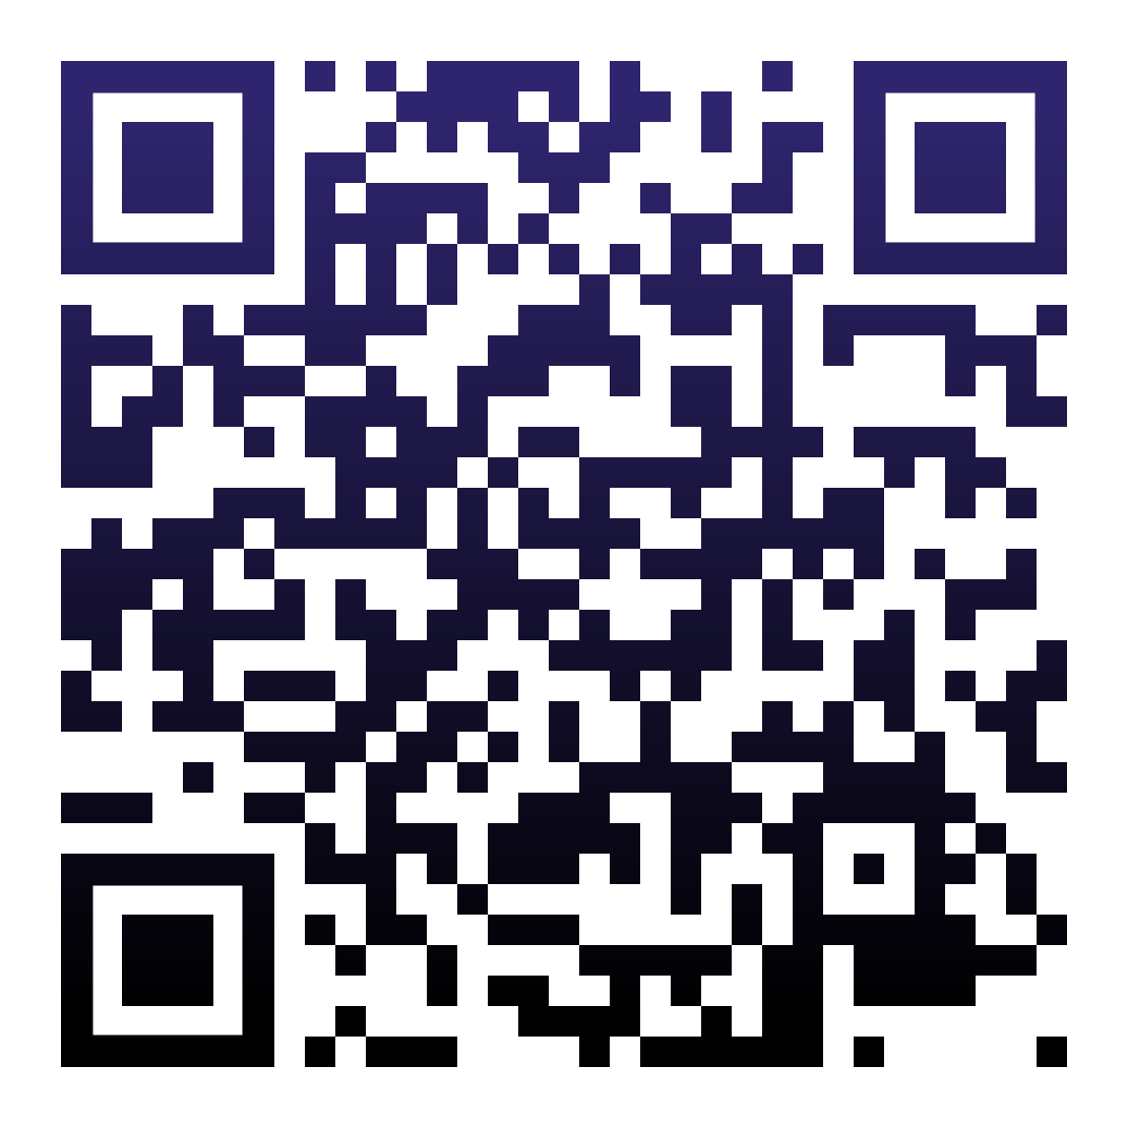

Questions?
madison-souder
madisonsouder
Please keep this slide for attribution

Slide 24
References
Health Care Providers. (2024, October 31). Pertussis vaccination recommendations. Centers for Disease Control and Prevention. https://www.cdc.gov/pertussis/hcp/vaccine-recommendations/index.html
Plans-Rubió, P. (2012). Evaluation of the establishment of herd immunity in the population by means of serological surveys and vaccination coverage. Human Vaccines & Immunotherapeutics, 8(2), 184–188. https://doi.org/10.4161/hv.18444
World Health Organization. (2025, March 25). Vaccines and immunization: Vaccine safety. World Health Organization. https://www.who.int/news-room/questions-and-answers/item/vaccines-and-immunization-vaccine safety
World Health Organization. (n.d.). A Brief History of Vaccination. World Health Organization. https://www.who.int/news-room/spotlight/history-of-vaccination/a-brief-history-of-vaccination

