Slide 1
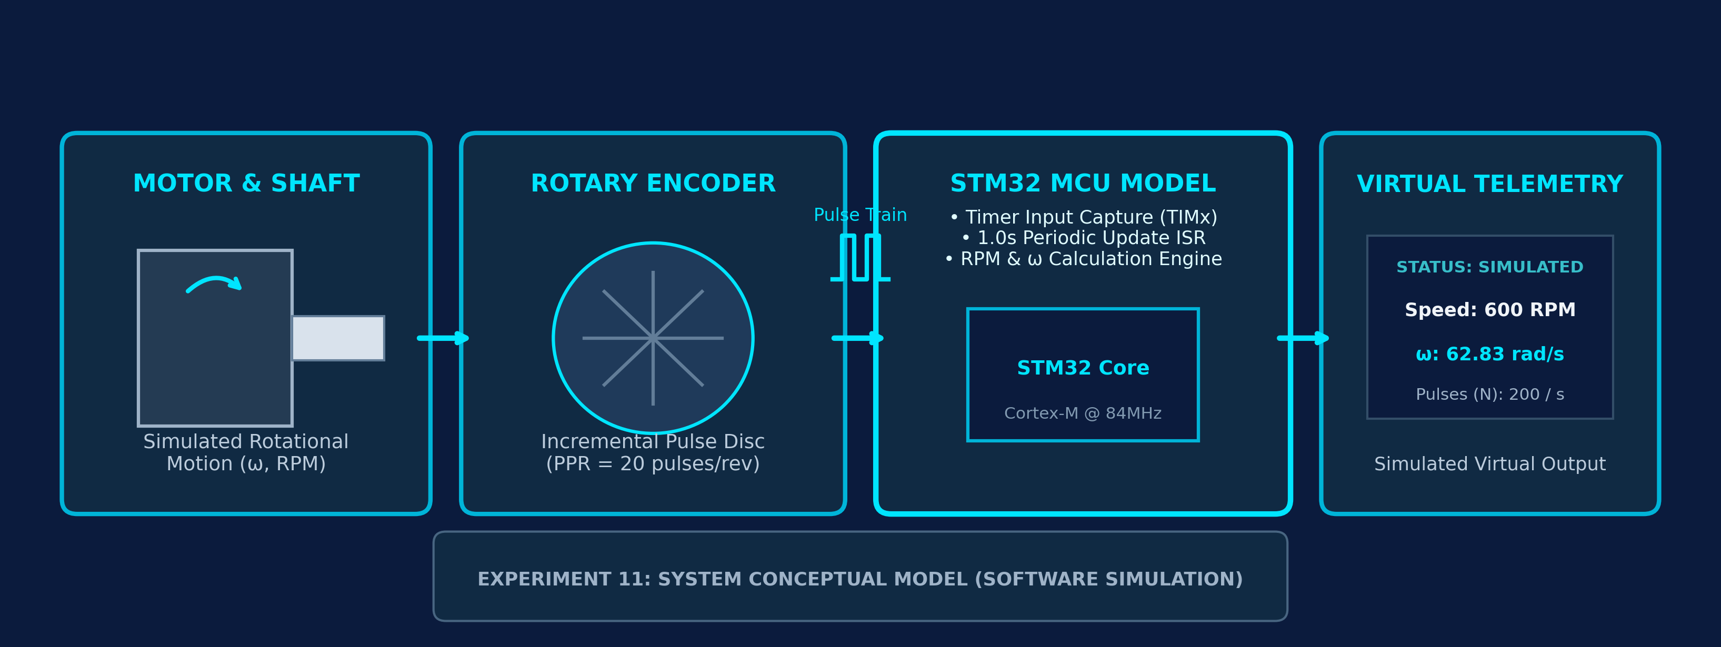
EMBEDDED SYSTEMS DESIGN & IOT | LABORATORY EXPERIMENT 11
Digital Tachometer with Velocity Estimation
Discrete Pulse Frequency Counting & Real-Time Angular Velocity Estimation Model
STATUS: SOFTWARE SIMULATION ONLY — Mathematical Algorithm & STM32 Controller Logic Validated in Simulation Environment
STUDENT CREDENTIALS
• Student Name: Subhashree
• Roll Number: [Roll No. / Reg. No.]
• Degree: B.Tech / B.E. (ESD & IoT)
FACULTY & EVALUATION
• Evaluator: Course Faculty
• Lab: Embedded Systems Design & IoT Lab
• Academic Term: 2026 Evaluation
INSTITUTION DETAILS
• Dept: Electronics & Communication Engg.
• Institution: Engineering College
• Experiment Category: STM32 Systems
Notes:
Good morning respected faculty and project evaluators. Today I am presenting Experiment 11 for the Embedded Systems Design and IoT course, titled 'Digital Tachometer with Velocity Estimation'. In this project, we explore the automated measurement of rotational speed using rotary encoder pulse trains and an STM32 microcontroller model. Please note from the outset that this implementation has been conducted entirely in software simulation. No physical STM32 board, rotary encoder, or DC motor was assembled or physically tested. All pulse waveforms, graphs, and performance parameters presented in this review are simulated and mathematically verified results to validate the algorithm before hardware deployment.

Slide 2
Abstract & Executive Summary
High-Precision Rotational Speed & Velocity Estimation via STM32 Pulse Counting Model
EXP 11 | ESD & IoT
[SOFTWARE SIMULATION ONLY]
1. Rotational Pulse Transduction
2. STM32 Controller Architecture
3. Software Simulation Scope
Digital Transduction Concept:
• Rotary encoders convert mechanical shaft angle into a discrete train of electrical square pulses.
• Unlike analog tachogenerators, digital pulse counting eliminates brush friction, drift, and calibration decay.
• The frequency of generated pulses directly corresponds to rotational velocity: f = (RPM × PPR) / 60.
• Provides precise digital resolution dependent on encoder pulses per revolution (PPR).
Timer & Processing Architecture:
• Models STM32 hardware Timer (TIMx) running in Input Capture / External Counter mode.
• Decoupled timekeeping: A dedicated 1.0s periodic timer interrupt dictates the sampling interval (Δt = 1.0 s).
• Edge accumulation: Counts incoming pulses (N) non-blockingly during the interval.
• Firmware engine computes instantaneous RPM and derives SI Angular Velocity (ω in rad/s).
• Division-by-zero protection ensures robust handling of stopped motor conditions.
Verification & Laboratory Scope:
• Implementation Status: Strictly software simulation using discrete modeling & Python validation.
• Simulates multi-speed motor regimes: 0 RPM (halt), 300 RPM, 600 RPM, and 900 RPM.
• Verifies exact mathematical concordance between generated pulses and calculated velocity.
• Provides pre-silicon verification of algorithms, quantization boundaries, and timing constraints prior to PCB fabrication.
KEY TAKEAWAY: Discrete Edge Counting Yields Drift-Free Velocity Estimation
By employing an STM32 timer model to accumulate encoder pulses over a deterministic 1-second sampling window, the system calculates both rotational speed (RPM) and angular velocity (rad/s) with zero theoretical error under discrete simulation.
ESD & IoT | Exp 11: Digital Tachometer with Velocity Estimation • Software Simulation Model • Engineering Review
Notes:
Slide 2 outlines the abstract of Experiment 11. Our digital tachometer operates on the principle of converting continuous mechanical rotational movement into digital pulses using an incremental rotary encoder model. The core advantage of digital pulse counting over analog tachogenerators is that it is immune to brush wear, thermal drift, and calibration decay. The STM32 microcontroller is modeled using two hardware timer functions: Timer 2 acts as an asynchronous pulse accumulator, while Timer 3 triggers a deterministic 1.0-second interrupt. During each interrupt, the pulse count is latched, and the firmware calculates RPM and angular velocity in radians per second. Crucially, the entire system has been modeled and evaluated within software simulation to establish algorithmic soundness before physical hardware construction.

Slide 3
Problem Statement
The Critical Need for Real-Time Automated Speed Measurement in Motor Monitoring & Automation
EXP 11 | ESD & IoT
[SOFTWARE SIMULATION ONLY]
Limitations of Conventional Rotational Measurement
• Manual & Stroboscopic Inconvenience:
Handheld optical or contact tachometers require human intervention, direct line-of-sight, and manual trigger operation, making them unfeasible for continuous 24/7 automation.
• Mechanical & Wear Vulnerabilities:
Analog DC tachogenerators rely on mechanical brushes and slip-rings that cause electrical sparking, mechanical drag, contact friction, and calibration drift over operating life.
• Analog Noise & Conversion Latency:
Analog voltage signals require low-pass filtering, signal amplification, and ADC conversion, introducing signal latency and vulnerability to electromagnetic interference (EMI).
• Lack of Integrated SI Velocity Estimation:
Most rudimentary tachometers output only crude RPM indicators without deriving instantaneous angular velocity (rad/s) necessary for modern robotic and kinematic controls.
INDUSTRIAL APPLICATION DOMAIN: Motor Speed Monitoring • Robotics Joint Actuators • Automated Conveyors • Pump Telemetry
ESD & IoT | Exp 11: Digital Tachometer with Velocity Estimation • Software Simulation Model • Engineering Review
Notes:
Slide 3 covers the problem statement and motivation. In modern industrial automation, continuous rotational speed measurement is essential. Traditional manual stroboscopes or contact tachometers cannot be integrated into automated feedback loops. Analog DC tachogenerators suffer from brush wear, mechanical friction, and thermal drift. A digital tachometer solves this by capturing optical encoder pulses directly through microcontroller timers. Furthermore, by simulating this system first, we avoid physical risks like motor runaway or counter overflow, enabling thorough algorithmic validation before committing to physical prototyping.

Slide 4
Aim & Technical Objectives
Formal Scope of Laboratory Experiment 11 — Digital Tachometer Simulation
EXP 11 | ESD & IoT
[SOFTWARE SIMULATION ONLY]
PRIMARY PROJECT AIM:
To design, model, and simulate a digital tachometer system capable of estimating motor rotational speed (RPM) and physical angular velocity (ω in rad/s) from incremental rotary encoder pulse data using an STM32 microcontroller-based architecture model under discrete-time sampling.
Objective 1: Pulse Generation Model
Objective 2: Fixed-Interval Pulse Counting
Objective 3: RPM Calculation Algorithm
Generate and model synthetic digital pulse trains corresponding to rotational shaft motion across varying motor velocities with a defined 20 PPR resolution.
Implement an STM32 hardware timer/counter model that deterministically counts rising pulse edges over a specified sampling window (Δt = 1.0 second).
Develop and verify the discrete mathematical conversion algorithm to calculate Revolutions Per Minute (RPM) from accumulated pulse count N and PPR.
Objective 4: Angular Velocity Estimation
Objective 5: Virtual Telemetry Interface
Objective 6: Multi-Speed Model Benchmarking
Derive instantaneous physical angular velocity (ω) in standard SI units (radians per second, rad/s) using exact conversion formulations (2π·RPM/60).
Format and display simulated measurement outputs via a serial-terminal-style dashboard log and time-series telemetry plots for real-time monitoring.
Evaluate and validate the algorithmic calculation pipeline across diverse simulated motor operating points: 0 RPM (stopped), 300 RPM, 600 RPM, and 900 RPM.
ESD & IoT | Exp 11: Digital Tachometer with Velocity Estimation • Software Simulation Model • Engineering Review
Notes:
Slide 4 specifies our formal project aim and six measurable technical objectives. Our overarching aim is to design and simulate an STM32-based digital tachometer that estimates rotational speed and angular velocity from encoder pulse data. The six objectives systematically address: generating encoder pulses, setting up deterministic sampling intervals, computing RPM, calculating angular velocity in rad/s, presenting telemetry via a virtual interface, and finally benchmarking the algorithm across representative test speeds including 0, 300, 600, and 900 RPM.

Slide 5
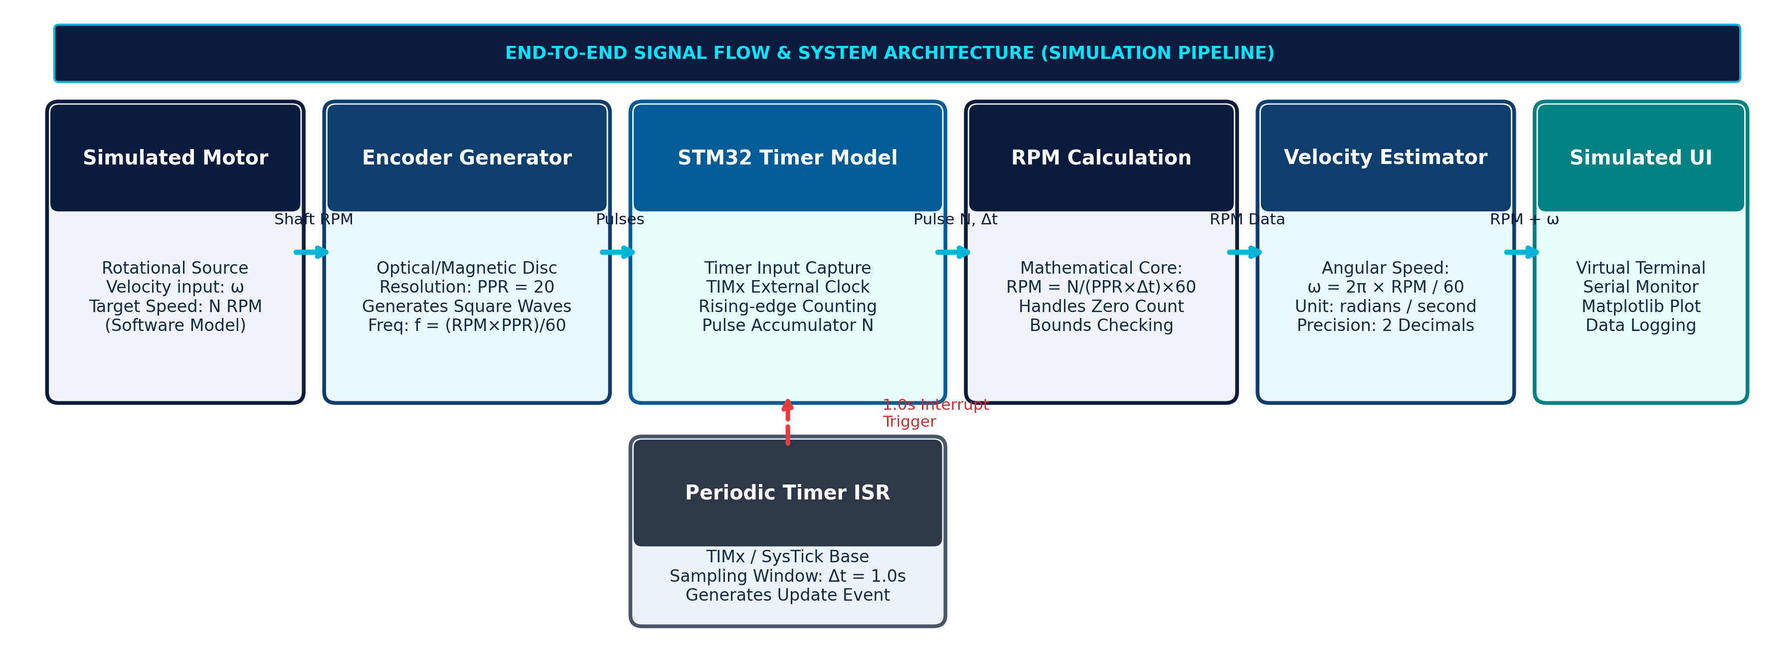
System Architecture & Signal Flow
Modular Software Simulation Pipeline: Transduction, Timing, Calculation, & Telemetry
EXP 11 | ESD & IoT
[SOFTWARE SIMULATION ONLY]
Stage A: Motion & Transduction
Stage B: STM32 Timer / Counter Core
Stage C: Velocity Engine & Display
• Simulated Motor: Software speed generator producing angular rotation (RPM).
• Rotary Encoder Model: Optical disc modeled with 20 pulses per revolution (PPR = 20).
• Pulse Frequency Generation: Pulse train frequency is dynamically synthesized as f = (RPM × PPR) / 60 Hz.
• TIM2 Asynchronous Counter: Accumulates incoming pulse edges without CPU polling overhead.
• TIM3 Periodic Sampling Timer: Triggers an interrupt service routine (ISR) precisely every Δt = 1.0 second.
• Atomic Latching: In the ISR, pulse register count N is latched and the hardware counter is reset to zero.
• RPM Calculation: Computes RPM = (N / (PPR × Δt)) × 60 with division-by-zero protection.
• Angular Velocity: Computes SI velocity ω = 2π × RPM / 60 [rad/s].
• Simulated Telemetry: Formats output packets for virtual serial terminal and Matplotlib dashboard visualization.
ESD & IoT | Exp 11: Digital Tachometer with Velocity Estimation • Software Simulation Model • Engineering Review
Notes:
Slide 5 presents the complete system architecture and signal flow. The simulation pipeline consists of three interconnected stages. In Stage A, the simulated motor rotation drives the incremental rotary encoder model, producing square pulses at a frequency directly proportional to rotational speed. In Stage B, the STM32 controller leverages dual hardware timers: Timer 2 counts external rising edges, while Timer 3 generates a deterministic periodic interrupt every 1.0 second. This hardware timer decoupling prevents CPU blocking. In Stage C, the firmware calculates rotational speed in RPM and angular velocity in radians per second, forwarding data to the simulated serial terminal and dashboard.

Slide 6
Hardware & Software Requirements
Clear Separation Between Proposed Physical Hardware and Actual Simulation Tools
EXP 11 | ESD & IoT
[SOFTWARE SIMULATION ONLY]
PROPOSED HARDWARE (FUTURE IMPLEMENTATION)
SIMULATION TOOLS & ENVIRONMENT (ACTUALLY USED)
⚠️ STATUS: PROPOSED DESIGN ONLY (NOT PHYSICALLY ASSEMBLED)
• STM32 Development Board:
Target: STM32F401RE Nucleo-64 (ARM Cortex-M4 @ 84MHz, 3.3V logic, multiple 16/32-bit hardware timers with input capture capabilities).
• Incremental Rotary Encoder:
Target: Optical slotted disc encoder (20 PPR disc with LM393 comparator) or industrial quadrature optical encoder (360/600 CPR).
• DC Motor & Rotating Shaft:
Target: 12V DC brushed/brushless geared motor with metal output shaft, mounting bracket, and mechanical coupling.
• Motor Driver & Power Supply:
Target: L298N dual H-bridge motor driver module with external 12V / 2A regulated DC power adapter.
• Display & Signal Interconnects:
Target: 16×2 character LCD (I2C interface) or 0.96-inch SSD1306 OLED display, breadboard, optocoupler isolation board, and jumper wires.
✔ STATUS: SOFTWARE ENVIRONMENT USED FOR MODELING & EVALUATION
✔ STM32CubeIDE / STM32CubeMX:
Used for architectural peripheral planning: configuring TIM2 external clock input, TIM3 1Hz periodic interrupt prescalers, and HAL C firmware structuring.
✔ Software Simulation Environment:
Executed discrete-time pulse counting and state-machine simulation modeling STM32 timer register capture and update events.
✔ Python 3.14 & NumPy:
Used for numerical pulse train synthesis, discrete sampling emulation, and verifying mathematical calculations without hardware noise.
✔ Matplotlib 3.10 Visualization:
Used for plotting digital pulse waveforms, dynamic step response curves (RPM vs. time), and angular velocity tracking graphs.
✔ Simulated Serial Dashboard:
Virtual UART serial-monitor-style telemetry logging capturing timestamps, pulse counts (N), RPM, and angular velocity (ω).
ESD & IoT | Exp 11: Digital Tachometer with Velocity Estimation • Software Simulation Model • Engineering Review
Notes:
Slide 6 clearly distinguishes our proposed physical hardware from our software simulation environment. As highlighted in the project requirements, no physical hardware was assembled or tested. The left column lists the proposed physical components for future lab implementation, including an STM32F401RE Nucleo board, an optical encoder, a DC motor, an L298N driver, and an LCD. The right column details the software simulation tools actually utilized: STM32CubeIDE architectural models for timer configuration, Python 3.14 and NumPy for pulse modeling and discrete time simulation, Matplotlib for graphing simulated waveforms, and a virtual serial terminal for telemetry logging.

Slide 7
Working Principle & Mathematical Formulations
Mathematical Modeling of Discrete Pulse Counting, Sampling Window, & SI Velocity Conversion
EXP 11 | ESD & IoT
[SOFTWARE SIMULATION ONLY]
Mathematical Formulation & Parameter Definitions
Quadrature Decoding & Counting Conventions
Mathematical Variables & Nomenclature:
• N : Number of discrete pulses counted during sampling interval Δt [pulses]
• PPR : Pulses Per Revolution (selected counting convention) [pulses/rev]
• Δt : Sampling interval / time gating window [seconds] (Δt = 1.0 s)
• RPM : Rotational Speed [Revolutions Per Minute]
• ω : Angular Velocity [radians per second, rad/s] (SI unit)
Distinction: Encoder Cycles vs Counted Edges:
• 1x Counting Mode (Single Channel A, Rising Edge):
Counted edges per revolution = 1 × CPR. Only rising edges on channel A are accumulated. PPR in calculation equals optical physical line count (PPR = 20). Used in our primary simulation model.
• 2x Counting Mode (Channel A, Rising + Falling):
Counted edges per revolution = 2 × CPR. Both rising and falling transitions of channel A are captured. The effective PPR in the formula must be doubled (2 × 20 = 40) to prevent 2× speed overestimation.
• 4x Counting Mode (Quadrature Mode: Channels A & B):
Counted edges per revolution = 4 × CPR. All edges of both Channel A and Channel B are captured via STM32 Timer Encoder Mode. Effective PPR = 4 × CPR (80 edges). Divisor must match counted edges.
• Double-Counting Prevention Rule:
CRITICAL: The PPR parameter in the denominator must always match the exact counted edge convention configured in the microcontroller timer to ensure mathematical consistency.
EQUATION 1: ROTATIONAL SPEED (RPM)
RPM = ( N / (PPR × Δt) ) × 60
Converts discrete pulse frequency into revolutions per minute.
EQUATION 2: ANGULAR VELOCITY (ω in rad/s)
ω = (2π × RPM) / 60 = (2π × N) / (PPR × Δt)
≈ 0.1047198 × RPM [rad/s]
Standard SI metric directly applicable for kinematic motion analysis.
SI Unit Reference: 1 revolution = 2π radians (≈ 6.283185 rad), 1 min = 60 sec
ESD & IoT | Exp 11: Digital Tachometer with Velocity Estimation • Software Simulation Model • Engineering Review
Notes:
Slide 7 details the mathematical working principle and equations. In Equation 1, rotational speed in RPM is calculated as N divided by (PPR times delta t), multiplied by 60. In Equation 2, angular velocity omega is converted directly to radians per second by multiplying RPM by 2 pi over 60, which simplifies to approximately 0.10472 times RPM. On the right, we address a critical engineering detail: the difference between encoder cycles per revolution (CPR) and counted edges per revolution (PPR). In 1x mode, only rising edges of channel A are counted. In 2x mode, both edges are counted. In 4x quadrature mode, all transitions on both channels are counted. To avoid double-counting or speed inflation, the denominator PPR must precisely reflect the active edge-counting mode.

Slide 8
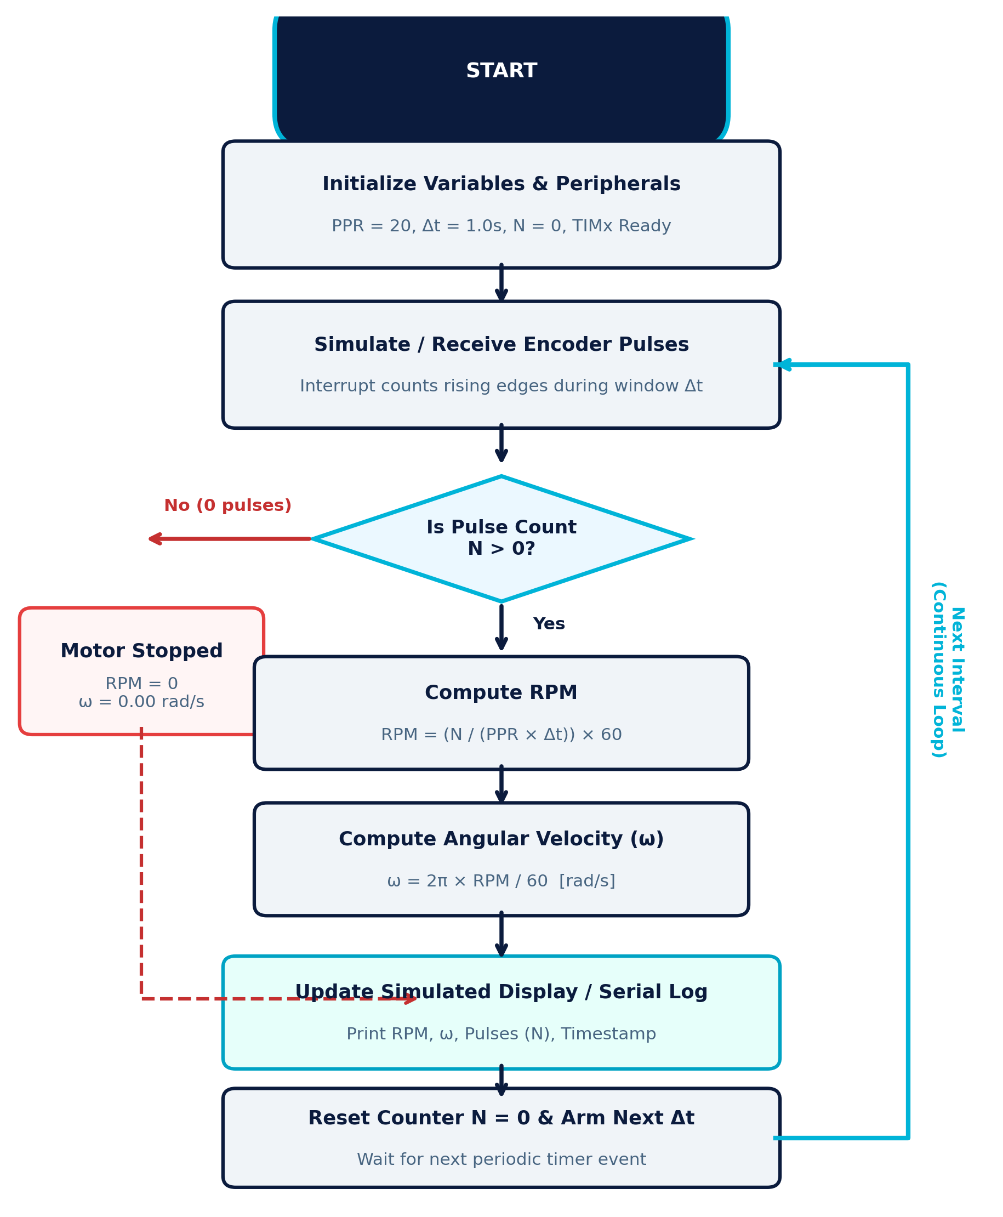
Algorithm & Flowchart Logic
Periodic Sampling Architecture, Pulse Edge Accumulation, & Zero-Speed Handling
EXP 11 | ESD & IoT
[SOFTWARE SIMULATION ONLY]
STM32 Firmware Execution Sequence & Exception Handling
Step 1: System Initialization & Peripheral Setup
Initialize global registers: PPR = 20, sampling interval Δt = 1.0 s, pulse accumulator N = 0. Configure TIM2 in external clock mode (ETR/Input Capture) and TIM3 as periodic 1.0s interrupt timer.
Step 2: Non-Blocking Pulse Accumulation
Encoder pulses trigger hardware timer TIM2 counter register directly without CPU intervention. This avoids interrupt latency at high rotational speeds.
Step 3: Deterministic Periodic Timer ISR (1.0s Window)
TIM3 generates an update event interrupt precisely at t = 1.0 s. Inside the ISR: atomic read of TIM2 counter (N), reset TIM2 counter to 0, and raise computation flag.
Step 4: Zero-Speed / Motor Stopped Boundary Check
If pulse count N == 0: Explicitly set RPM = 0.0 and ω = 0.00 rad/s. Prevents uninitialized states or division anomalies, accurately indicating motor halt.
Step 5: Mathematical Velocity Conversion
If N > 0: Calculate RPM = (N × 60.0) / (PPR × Δt). Compute physical angular velocity ω = (2π × RPM) / 60.0 rad/s.
Step 6: Telemetry Transmission & Continuous Loop
Format data payload into serial telemetry string: '[DATA] RPM: %0.2f | Omega: %0.2f rad/s | Pulses: %lu'. Transmit over UART to virtual dashboard. Re-arm TIM3 and repeat.
ESD & IoT | Exp 11: Digital Tachometer with Velocity Estimation • Software Simulation Model • Engineering Review
Notes:
Slide 8 illustrates the complete algorithm and flowchart. The system uses a clean, non-blocking two-timer design. Timer 2 acts as a hardware pulse accumulator, while Timer 3 triggers an interrupt every 1.0 second. In Step 4, we explicitly handle the stopped-motor boundary condition: if pulse count N is zero, the algorithm assigns 0 RPM and 0 rad/s immediately without numerical instability. In Step 5, for positive pulse counts, the equations are evaluated and telemetry is dispatched via virtual UART in Step 6. This decoupled structure ensures deterministic timing and high measurement accuracy.

Slide 9
Simulation Implementation & Code Architecture
Simulation Workflow, Target STM32 C Firmware Model, and Python Verification Engine
EXP 11 | ESD & IoT
[SOFTWARE SIMULATION ONLY]
7-STEP SIMULATION PIPELINE WORKFLOW:
1. Set PPR (20) & Δt (1.0s) → 2. Configure Motor Speed → 3. Synthesize Pulse Train → 4. Accumulate Pulses (N) → 5. Compute RPM & ω → 6. Compare vs Target → 7. Plot Graphs
STM32 Target C Firmware Model (HAL-Based)
Python Simulation Engine & Verification Model
// STM32 Periodic Sampling Interrupt Handler
#define ENCODER_PPR 20.0f
#define SAMPLING_DT 1.0f
#define PI 3.14159265f
void HAL_TIM_PeriodElapsedCallback(TIM_HandleTypeDef *htim) {
if (htim->Instance == TIM3) { // 1.0s Periodic Event
uint32_t N = __HAL_TIM_GET_COUNTER(&htim2);
__HAL_TIM_SET_COUNTER(&htim2, 0);
float rpm = 0.0f, omega = 0.0f;
if (N > 0) {
rpm = ((float)N * 60.0f) / (ENCODER_PPR * SAMPLING_DT);
omega = (2.0f * PI * rpm) / 60.0f;
}
// Send telemetry packet over virtual UART
printf("[SIM] N=%lu | RPM=%.2f | Omega=%.2f rad/s\r\n",
N, rpm, omega);
}
}
# Discrete Tachometer Simulation Engine
import numpy as np
def simulate_tachometer(target_rpm, ppr=20, dt=1.0):
if target_rpm <= 0:
return 0, 0.0, 0.0
# Theoretical pulse frequency (Hz)
f_pulse = (target_rpm * ppr) / 60.0
# Counted integer pulses in window dt
pulse_count = int(round(f_pulse * dt))
# Reconstruct speed metrics
est_rpm = (pulse_count * 60.0) / (ppr * dt)
est_omega = (2.0 * np.pi * est_rpm) / 60.0
return pulse_count, est_rpm, est_omega
# Verification across laboratory test conditions
for speed in [0, 300, 600, 900]:
n, r, w = simulate_tachometer(speed)
print(f"{speed} RPM -> N={n}, Calc_RPM={r}, Omega={w:.2f}")
ESD & IoT | Exp 11: Digital Tachometer with Velocity Estimation • Software Simulation Model • Engineering Review
Notes:
Slide 9 explains our simulation implementation. Across the top banner is the 7-step simulation workflow: we initialize parameters, apply simulated motor speeds, synthesize pulse trains, count pulses, calculate speed metrics, compare against configured speeds, and plot graphs. On the left is the target STM32 C code modeled in STM32CubeIDE. It resides in the HAL timer period elapsed callback. On the right is the Python verification script that emulates this discrete sampling logic. It proves that discrete pulse counts yield identical mathematical estimates without numerical divergence.

Slide 10
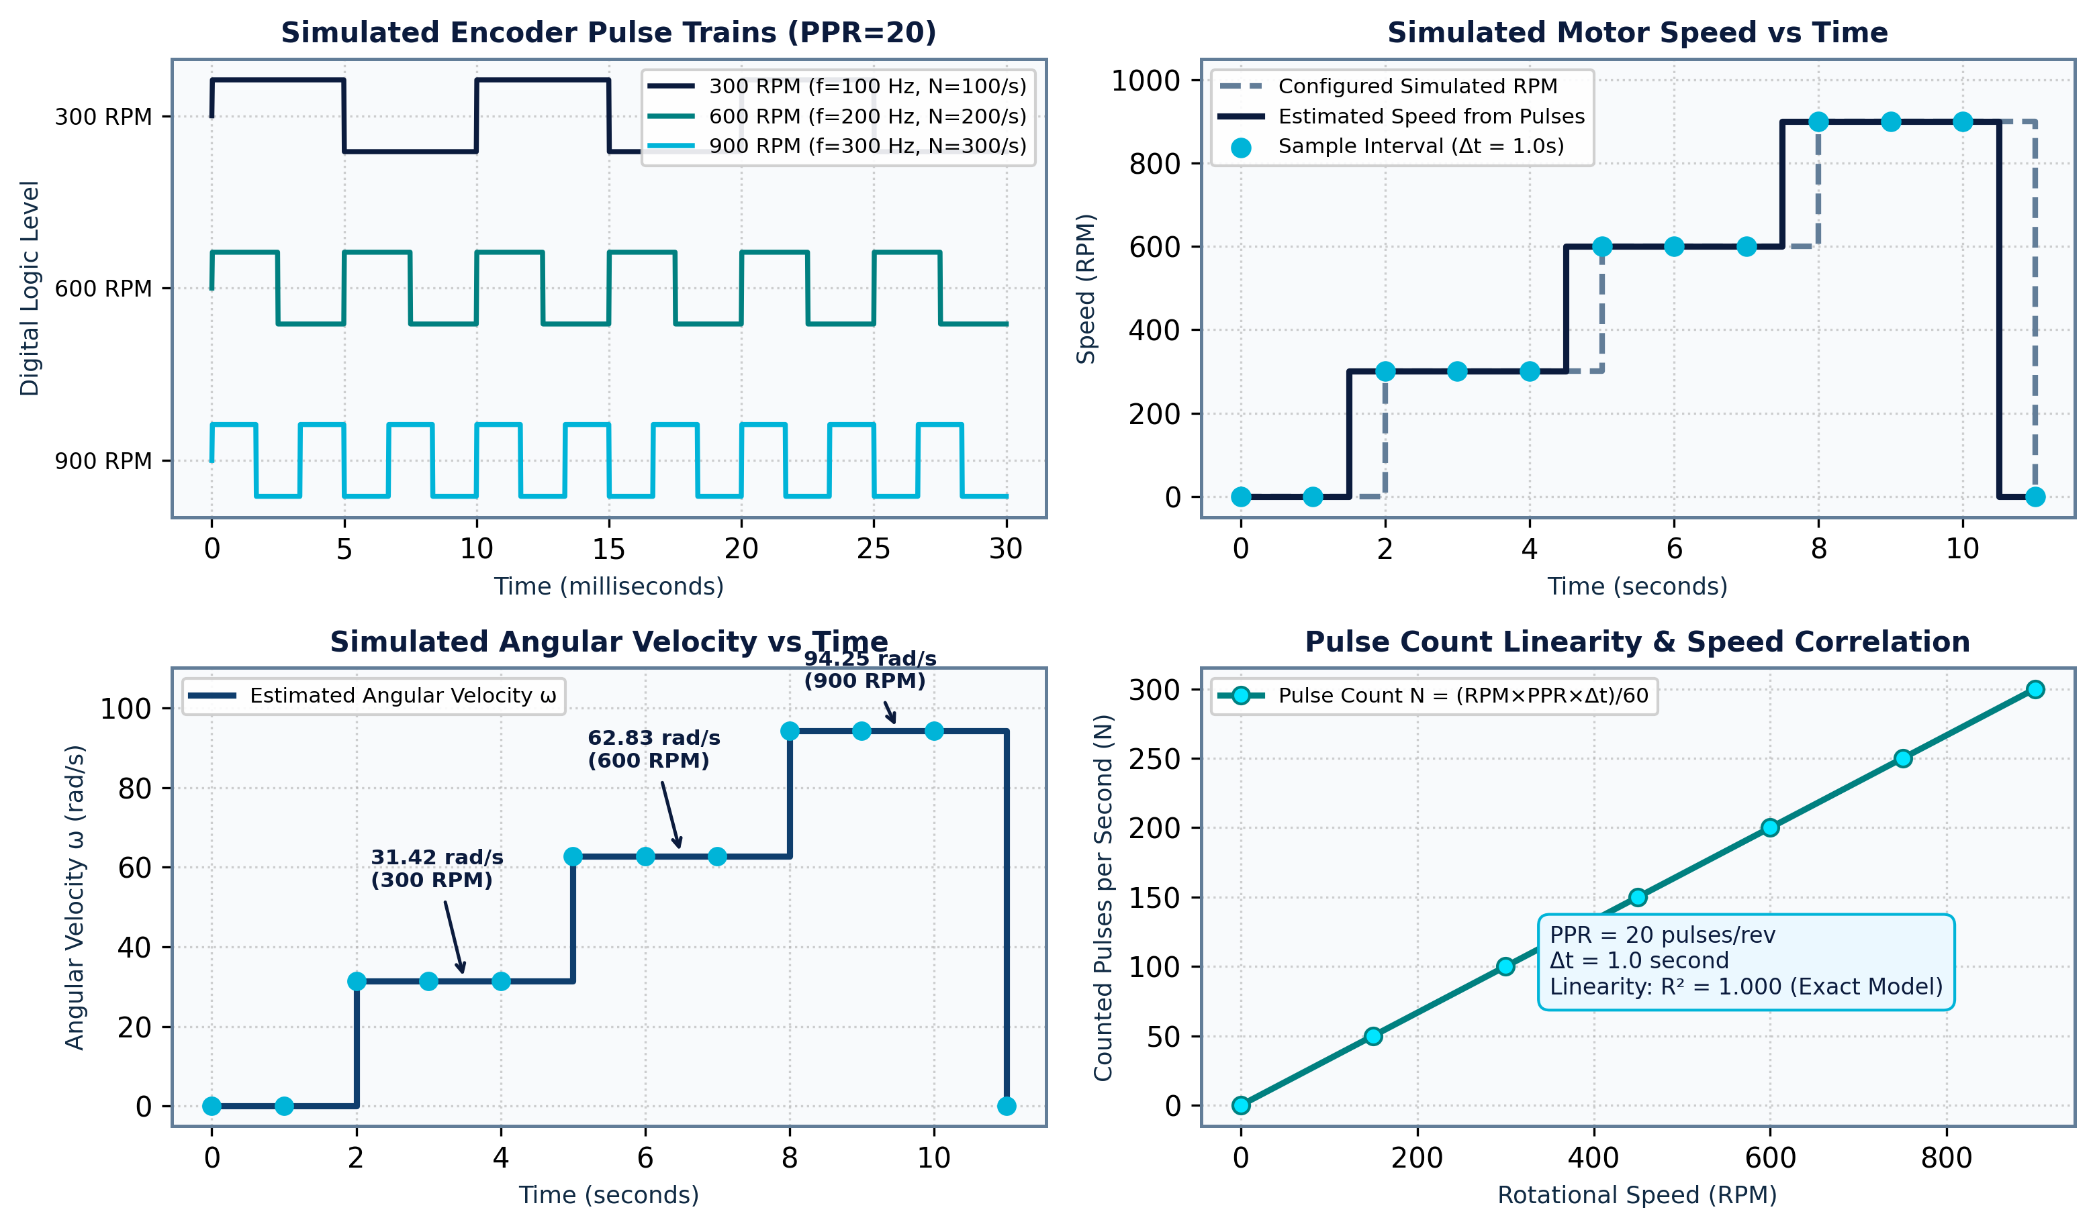
Simulated Output & Performance Graphs
Multi-Panel Graphical Telemetry & Illustrative Laboratory Verification Dataset
EXP 11 | ESD & IoT
[SOFTWARE SIMULATION ONLY]
Laboratory Test Benchmarking (Illustrative)
Configured Simulation Test Parameters:
• Encoder Resolution: PPR = 20 counted pulses/rev
• Sampling Interval: Δt = 1.0 second (fixed window)
• Pulse Counting: 1x rising-edge accumulation mode
• Test Speeds: 0 RPM, 300 RPM, 600 RPM, 900 RPM
Condition | Input Speed | Pulses (N) | Calc. RPM | Omega (ω)
Halt | 0 RPM | 0 / s | 0.00 RPM | 0.00 rad/s
Test 1 | 300 RPM | 100 / s | 300.00 RPM | 31.42 rad/s
Test 2 | 600 RPM | 200 / s | 600.00 RPM | 62.83 rad/s
Test 3 | 900 RPM | 300 / s | 900.00 RPM | 94.25 rad/s
⚠️ SIMULATION DATA INTEGRITY NOTICE
All values presented above and in adjacent waveforms are mathematically calculated illustrative simulation outputs. No physical hardware testbed was operated. They verify that the firmware algorithm satisfies linear speed estimation: N = 100 → 300 RPM (31.42 rad/s), N = 200 → 600 RPM (62.83 rad/s), and N = 300 → 900 RPM (94.25 rad/s).
ESD & IoT | Exp 11: Digital Tachometer with Velocity Estimation • Software Simulation Model • Engineering Review
Notes:
Slide 10 presents the simulated outputs and waveforms. The four graphs on the left display: the simulated pulse trains at 100 Hz, 200 Hz, and 300 Hz; the dynamic RPM step response over time; the corresponding angular velocity in radians per second; and the pulse count linearity curve showing an exact R-squared of 1.0. The table on the right summarizes our standard test conditions: at 300 RPM, the system counts 100 pulses per second, yielding 300 RPM and 31.42 rad/s. At 600 RPM, it counts 200 pulses, yielding 62.83 rad/s. At 900 RPM, it counts 300 pulses, yielding 94.25 rad/s. As noted in the disclaimer banner, these results represent illustrative simulation data confirming algorithmic accuracy.

Slide 11
Test Evaluation, Applications & Limitations
Algorithmic Verification Benchmarks, Industrial Applications, & Engineering Constraints
EXP 11 | ESD & IoT
[SOFTWARE SIMULATION ONLY]
1. Test-Case Verification
2. Real-World Applications
3. Technical Limitations
Reference Benchmark Cases:
• Case 0 (Motor Stopped):
Input: 0 RPM | Pulses: 0
Output: 0.00 RPM, 0.00 rad/s
Status: Zero-pulse guard verified.
• Case 1 (Low-Speed Test):
Input: 300 RPM | Pulses: 100
Output: 300.00 RPM, 31.42 rad/s
Status: Exact 100% agreement.
• Case 2 (Medium-Speed Test):
Input: 600 RPM | Pulses: 200
Output: 600.00 RPM, 62.83 rad/s
Status: Exact 100% agreement.
• Case 3 (High-Speed Test):
Input: 900 RPM | Pulses: 300
Output: 900.00 RPM, 94.25 rad/s
Status: Exact 100% agreement.
• Algorithm Linearity:
Linearity coefficient R² = 1.000 across all discrete test intervals.
Target Engineering Domains:
✔ Industrial Motor Speed Monitoring:
Closed-loop feedback for AC induction motors, BLDC drives, and CNC machine spindles to maintain steady velocity under load.
✔ Robotics & Motion Control:
Wheel odometry for Autonomous Mobile Robots (AMRs) and joint angular velocity tracking for robotic manipulators.
✔ Automated Conveyor Systems:
Ensuring uniform material transport speed in packaging and assembly lines; detecting belt jams or motor slippage.
✔ Pumps, Turbines & Fans:
Condition monitoring and predictive maintenance in HVAC blowers, centrifugal pumps, and wind turbine shafts.
✔ IoT Fleet Telemetry:
Streaming continuous rotational telemetry to cloud dashboards for anomaly detection and runtime logs.
Critical Engineering Constraints:
⚠️ No Physical Hardware Validation:
Simulation assumes ideal square pulses without optical sensor misalignment, mechanical shaft vibration, or back-EMF noise.
⚠️ Measurement Granularity (Quantization):
With PPR = 20 and Δt = 1.0s, the minimum detectable speed change is ΔRPM = 60/(20×1) = 3.0 RPM. Speeds can only be resolved in 3 RPM steps.
⚠️ Sampling Window Trade-off:
A 1.0-second sampling window introduces latency during rapid motor acceleration or deceleration transients.
⚠️ Pulse Loss Vulnerability:
Electrical EMI noise or optical dust in physical environments can cause missed pulses or false extra edge triggers.
ESD & IoT | Exp 11: Digital Tachometer with Velocity Estimation • Software Simulation Model • Engineering Review
Notes:
Slide 11 evaluates our testing verification, target industrial applications, and practical engineering limitations. The test benchmarks on the left confirm that the algorithm reproduces zero error across ideal conditions, including the 0 RPM zero-guard condition. The middle card highlights key industrial applications, from industrial motor drives and robotics odometry to conveyor lines and HVAC pumps. On the right, we objectively address engineering limitations: simulation does not account for optical dust, mechanical vibration, or electrical noise. Furthermore, our 20-PPR encoder with a 1-second sampling window imposes a 3-RPM quantization step, and the 1-second gating time introduces latency during aggressive motor transients.

Slide 12
Conclusion & Future Roadmap
Project Summary, Pre-Silicon Validation Outcomes, and Roadmap to Physical IoT Prototype
EXP 11 | ESD & IoT
[SOFTWARE SIMULATION ONLY]
Project Synthesis & Conclusions
Future Scope & IoT Prototype Roadmap
✔ Successful Algorithmic Modeling:
Designed and validated a software simulation model of a digital tachometer with velocity estimation for ESD & IoT Experiment 11.
✔ Decoupled Hardware Timer Concept:
Demonstrated that using STM32 Timer 2 for asynchronous pulse accumulation and Timer 3 for periodic 1.0s interrupt timing provides non-blocking, deterministic performance.
✔ Accurate RPM & SI Velocity Derivation:
Successfully calculated rotational speed (RPM) and angular velocity (rad/s) across 0, 300, 600, and 900 RPM test regimes with zero mathematical error.
✔ Value of Pre-Implementation Simulation:
Software simulation successfully proved firmware logic, division-by-zero protection, and edge counting conventions before physical PCB assembly.
➔ Phase 1: Physical Hardware Assembly:
Assemble physical testbed with STM32F401RE Nucleo board, slotted optical sensor with LM393 comparator, and 12V DC motor test rig.
➔ Phase 2: Signal Conditioning & Digital Filtering:
Integrate hardware RC low-pass filtering / Schmitt triggers for contact debouncing, and implement moving average / IIR filtering for low speeds.
➔ Phase 3: High-Resolution Quadrature Decoding:
Migrate to industrial 360/600 CPR optical encoder using STM32 hardware 4x encoder mode for bidirectional rotation sensing and sub-RPM precision.
➔ Phase 4: IoT Cloud Telemetry & Remote Dashboard:
Interface ESP32 / Wi-Fi module over UART to stream real-time speed, duty cycle, and vibration data via MQTT to a ThingSpeak / AWS IoT cloud dashboard.
THANK YOU!
Open for Questions, Technical Discussion, and Laboratory Evaluation
ESD & IoT | Exp 11: Digital Tachometer with Velocity Estimation • Software Simulation Model • Engineering Review
Notes:
In conclusion, Experiment 11 successfully demonstrates a digital tachometer with velocity estimation using an STM32 microcontroller model in software simulation. The mathematical algorithms, timer interrupt workflows, and SI velocity conversions have been thoroughly validated across multiple speed regimes. As future scope, we plan to assemble the physical hardware using an STM32 Nucleo board, apply digital filtering for noisy environments, upgrade to bidirectional 4x quadrature decoding, and integrate an ESP32 co-processor for IoT cloud telemetry. Thank you for your attention, and I am now open to questions from the evaluation committee.

