Slide 1
Final Web Project

Slide 2
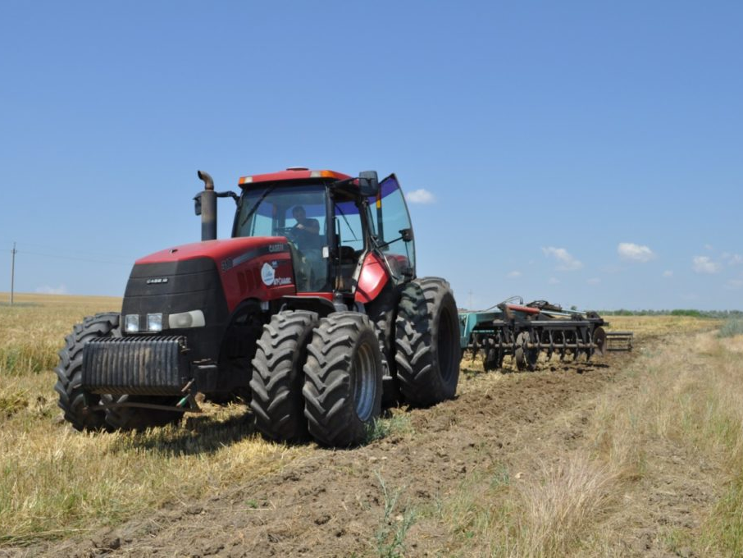

Slide 3
About project
Theme: AgriCulture
Advertising site of Enbek-07
Aim of the site: to introduce people with company and attract people

Slide 4
design requirement
Presence of blocks: about us, productions, scheme of work and also contacts
Type:landing page
Also required logo

Slide 5
A familiar layout was chosen for the site structure main menu and classic page layout content;
Two-level navigation, with the semantic division into major and minor sections;
A modular grid of 16 columns is used.

Slide 6
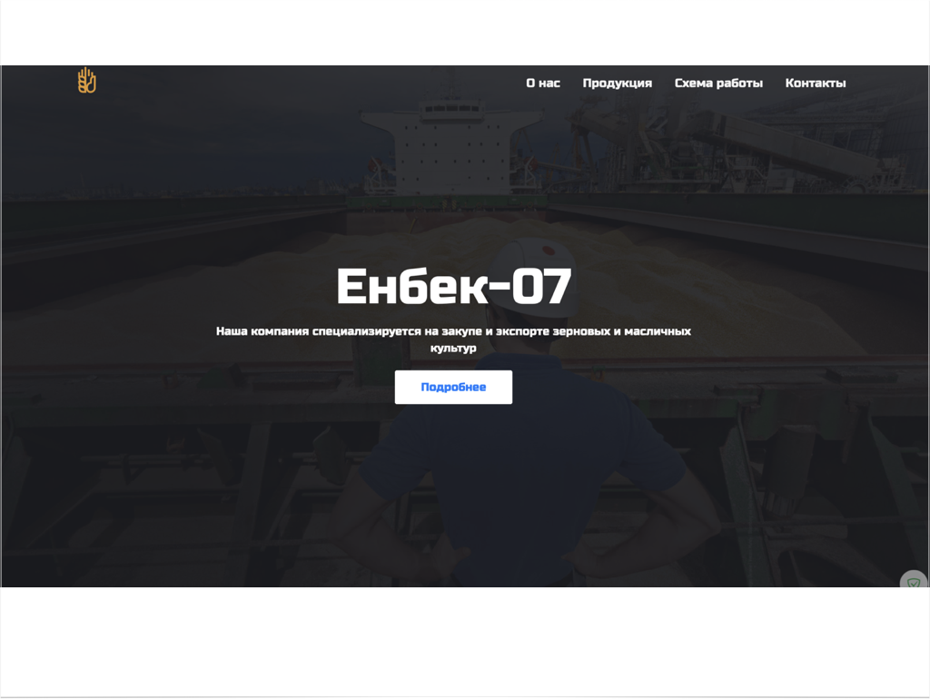

Slide 7

Logo Development
On this logo you can see the hand, also in a hand there are a wheat this is shows that company work hard with wheat

Slide 8
Used font
Russo one

