Slide 1
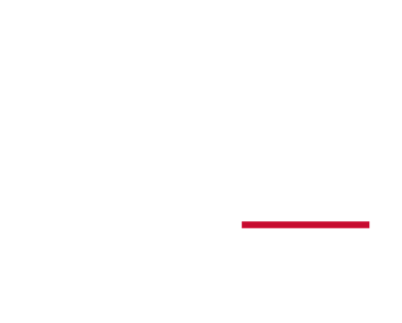
TailOR: An automated Mouse Behavior Tagging and Extraction
Madhu Sudhan Reddy Konda
002847774
04/24/2025

Slide 2
Introduction
It is important to track maternal care behaviors in mice models, especially in the context of early-life stress research conducted in neuroscience Labs.
Manually scoring maternal care behaviors using event logging software such as BORIS for behavior tagging takes a lot of human resources and time.
The laborious process of manual scoring requires significant human resources and training.
Objective of the project: To develop an automated system or algorithm for streamlined tracking of maternal care behaviors in mice models.

Slide 3
Target Behaviors
Off-Nest
When the adult mouse is away from the nesting area and engages in activities like exploring the cage, foraging, and interacting with other mice.
Eating and Drinking
The mouse consumes food and water from designated areas in the cage, including food pellets, seeds, and water bottles or dispensers.
Nest Building
Mice construct nests using bedding materials like paper or cloth to create a comfortable and secure shelter for themselves and their offspring.

Slide 4
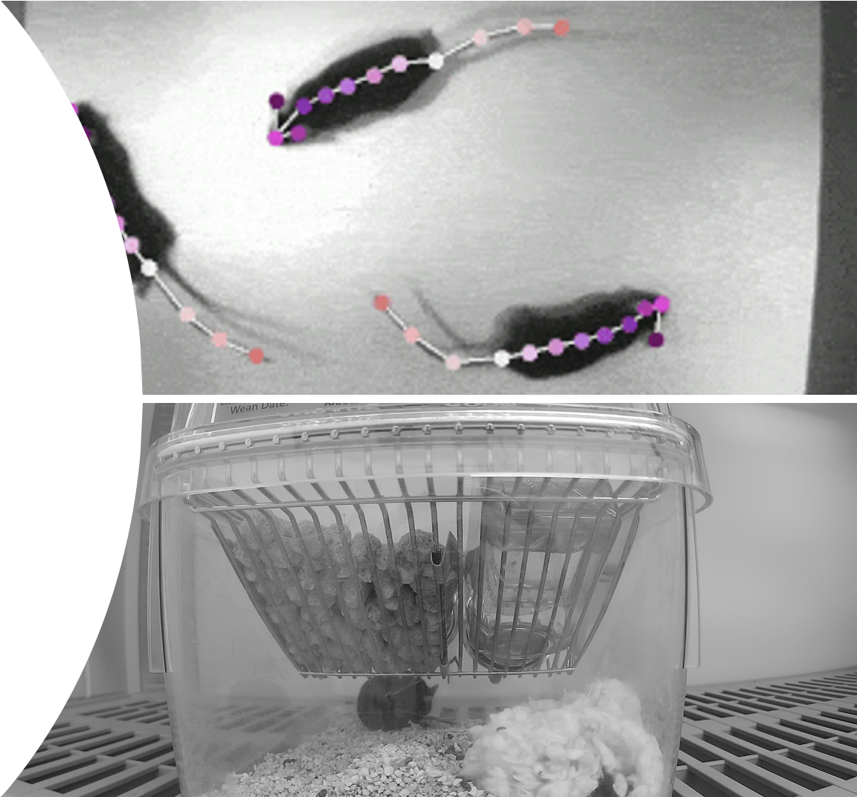
Background
Available tools like SimBA are primarily used on videos with the Top angle view, which is impossible for maternal care due to Food and water storage in the home cage.
The animal gets occluded by the nesting and reemerges during the runtime of the experiment, which is difficult to track.
May not be sophisticated enough for certain behavior classifications, like distinguishing Eating and Off-nest.

Slide 5
Dataset
Video of mouse.
Boris labelling of video.
Fps = 30

Slide 6
Methodology
We leverage state-of-the-art algorithms and computer vision techniques to automate behavior tagging with minimal human feedback.
Breakdown:
Object Detection
Utilizes segmentation models(SAM2) to generate masks for identifying animals and key objects.
Extracts geometric features such as centroids, speed, and displacement metrics for analysis.
Animal Pose Detection
Uses DeepLabCut to estimate animal poses and extract posture-related features.
Behavior Tagging
Applies predefined thresholds and motion-pattern rules to classify behaviors automatically.
Employs a random-forest algorithm for robust behavior classification..
Ensures adaptability across species by focusing on generalizable movement characteristics.

Slide 7
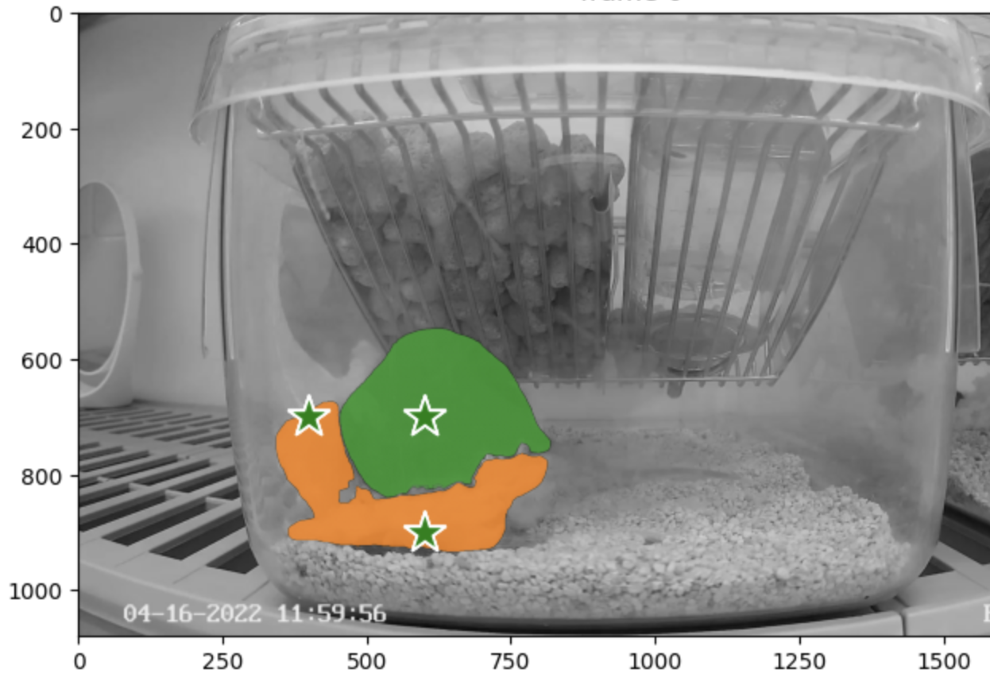
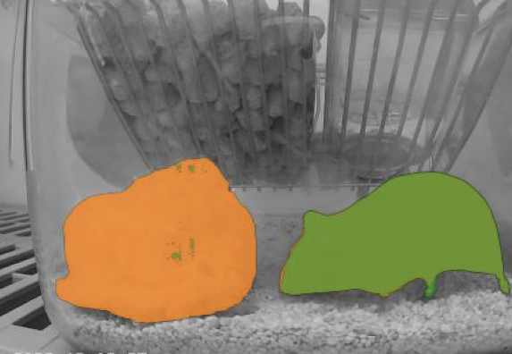
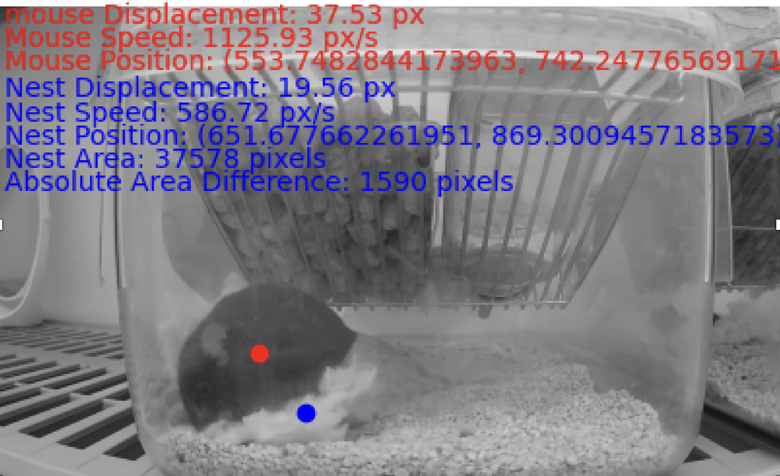
Object Detection
Computer Vision Integration: Apply SAM2 to generate precise behavioral masks.
Metric Extraction: Derive Geometric metrics from the generated masks for detailed analysis.
The centroids of the mouse and nest masks were calculated based on the generated SAM2 masks.
These centroids are essential for calculating displacement across frames, allowing us to observe motion for both the mouse and nest.
Displacement is detected by comparing centroids at specific intervals, such as between Frame 1 and Frame 10, and continuing this approach throughout the video.

Slide 8
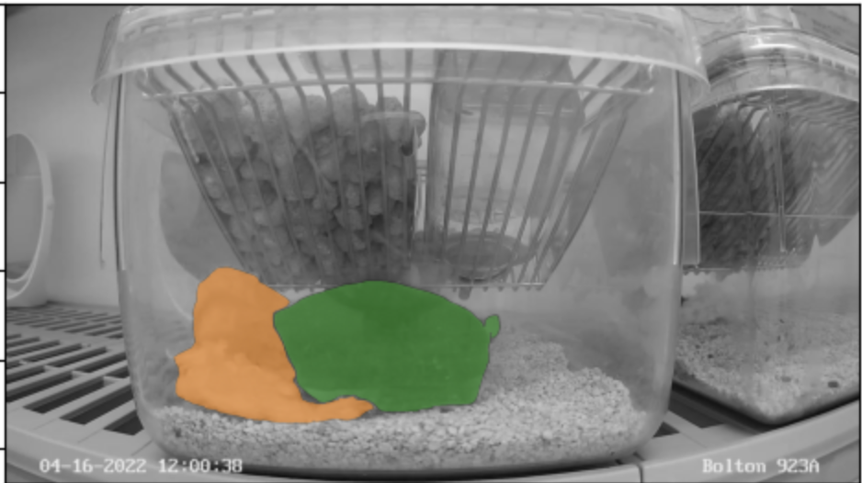
Geometric metrics
C1
C1
C2
Cage
Nest
Mouse
C4
C3

Slide 9
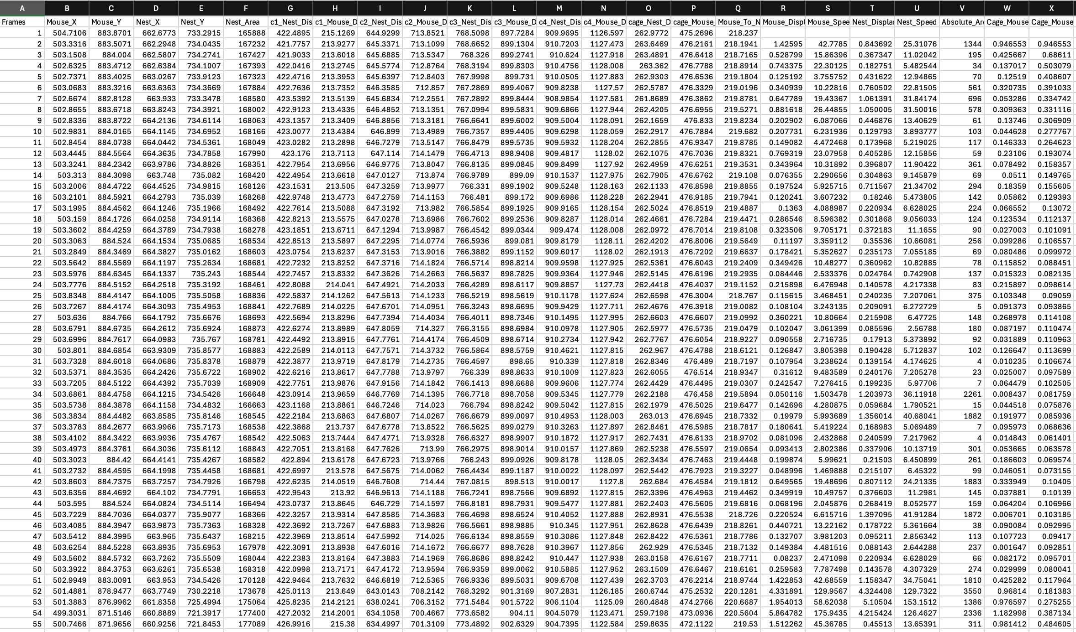
Geometric metrics

Slide 10
Behavior Tagging
Defining thresholds:
Nest Building:
If nest displacement is greater than NEST_THRESHOLD.
If the Euclidean distance between the mouse and the nest is less than Distance_Threshold, transition to this activity.
Mouse Off-Nest:
If the Euclidean distance between the mouse and the nest is greater than or equal to Distance_Threshold.
If the nest displacement is less than or equal to NEST_THRESHOLD and the mouse displacement exceeds MOUSE_THRESHOLD_Offnest, transition to this activity.
Mouse Eating or Drinking:
If the Euclidean distance between the mouse and the nest is greater than or equal to Distance_Threshold.
If the nest displacement is less than or equal to NEST_THRESHOLD and the mouse displacement is less than or equal to MOUSE_THRESHOLD_eating, transition to this activity.
Pose analysis is necessary to differentiate between sleeping and eating.
Activity Classification Enhancement: To differentiate between similar activities (e.g., eating vs. off-nest), we incorporate posture analysis alongside SAM2-derived displacement metrics.
Posture-Based Disambiguation: By analyzing the shape and orientation of the mouse within the mask, we can classify behaviors more accurately, distinguishing between actions like eating and general off-nest movement.

Slide 11
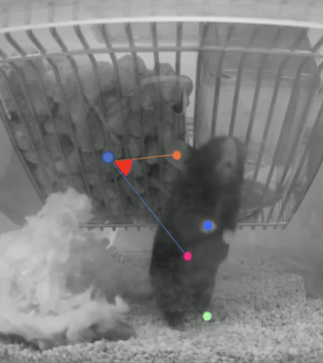
Animal Pose Detection
Investigated available pose estimation tools like DeepLabCut and SLEAP.
We found DeepLabCut produces better results per our requirements and data.
Points Detected:
Head
Ears
Front Paws
Hind Paws
Back

Slide 12
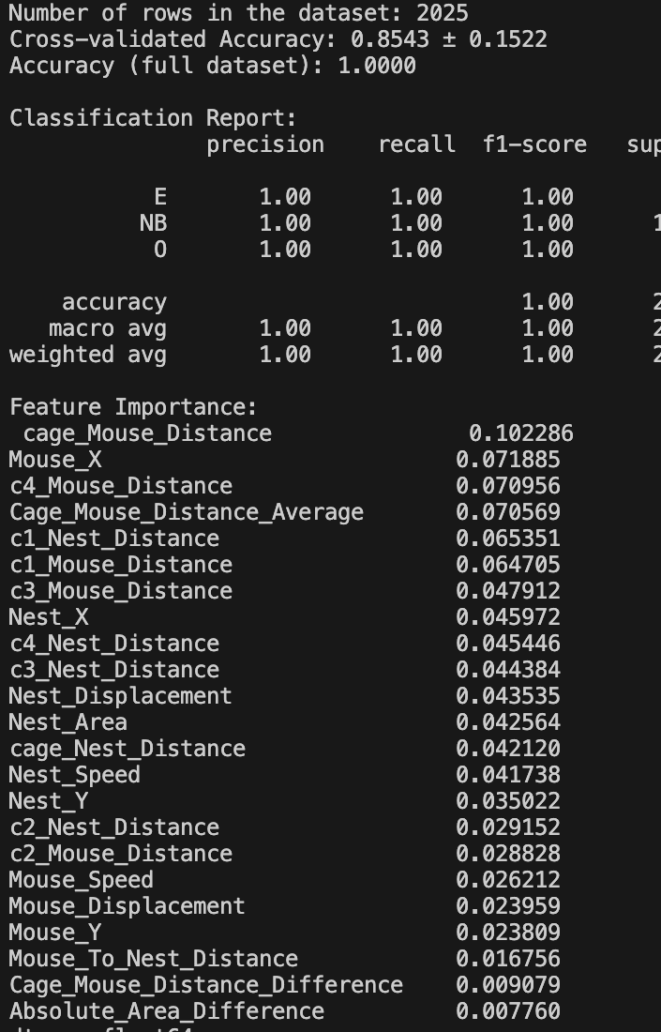
Random forest for Decision tree
Decision Tree generated using Random Forest Algorithm on 10-minute video for three activities:
Eating
Off-Nest
Nest Building

Slide 13
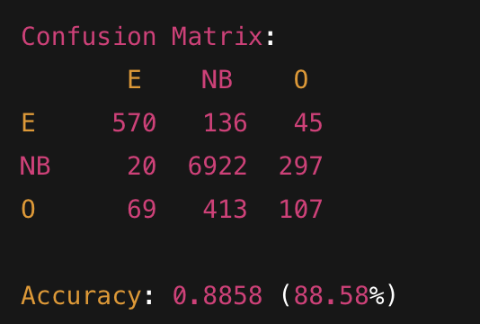
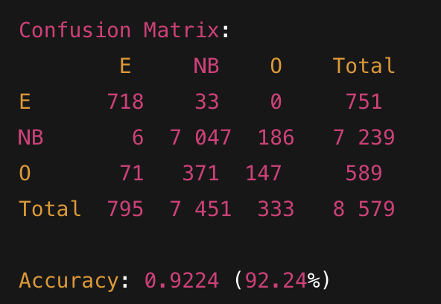
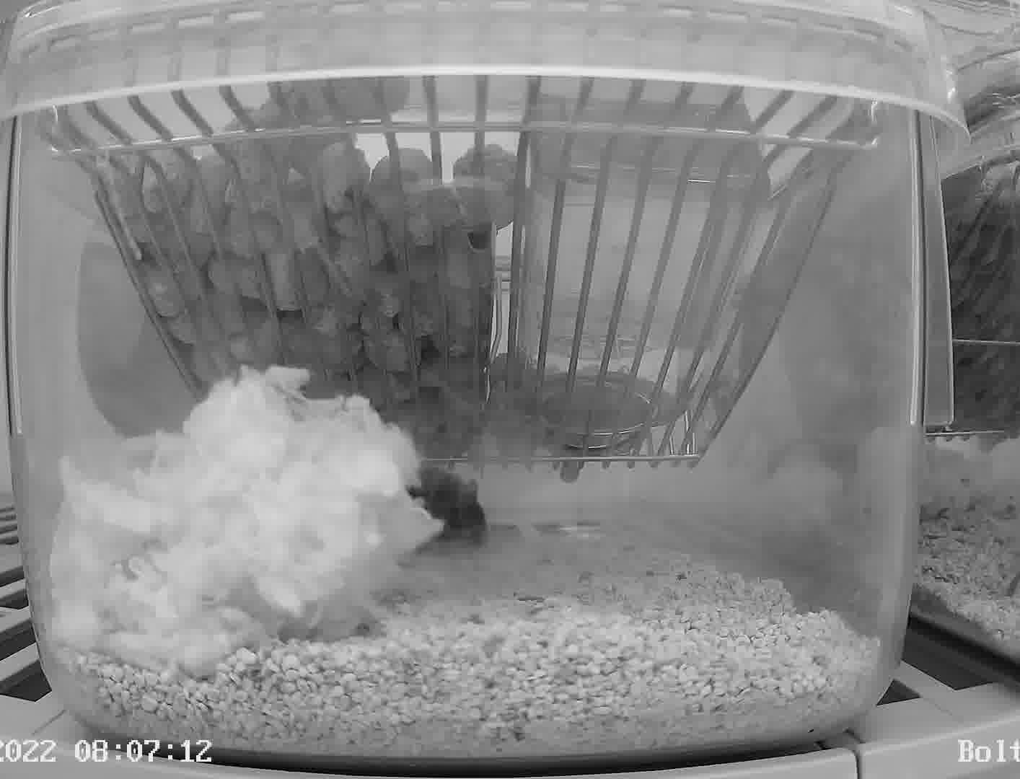
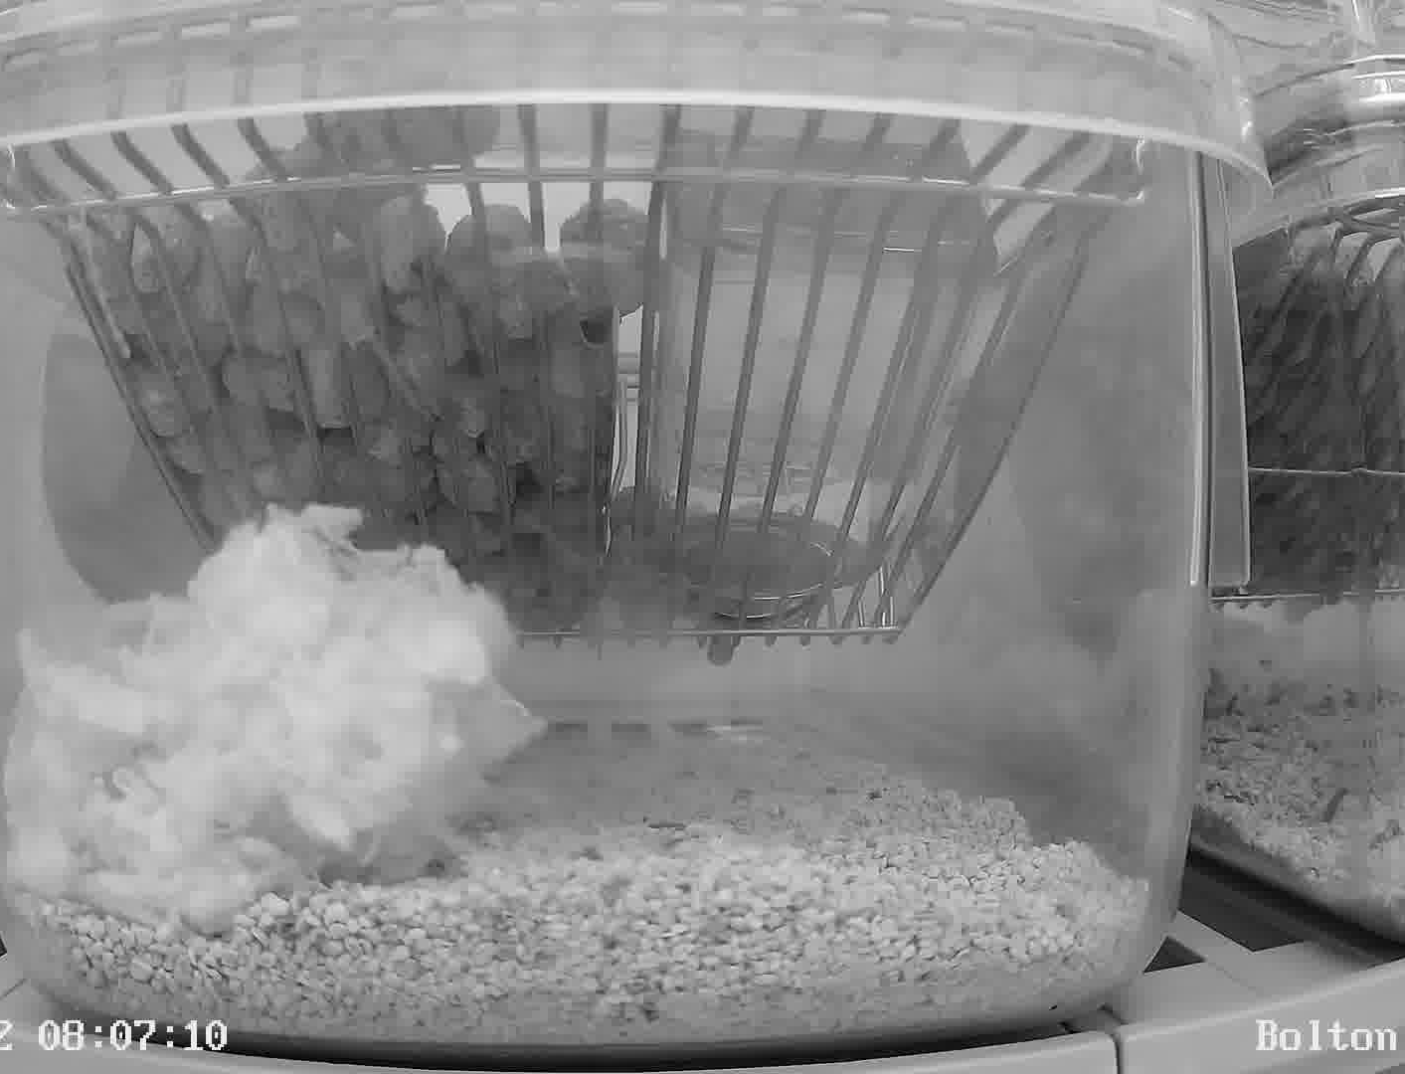
Ran decision tree on new video ( 1 hour)
From frame 1285 till frame 1413.
Actual activity: Off Nest
Detected Activities: Off Nest, Eating, Nest Building
Since SAM2 was unable to segment the mouse in these frames, I applied forward fill to handle the missing values.

Slide 14
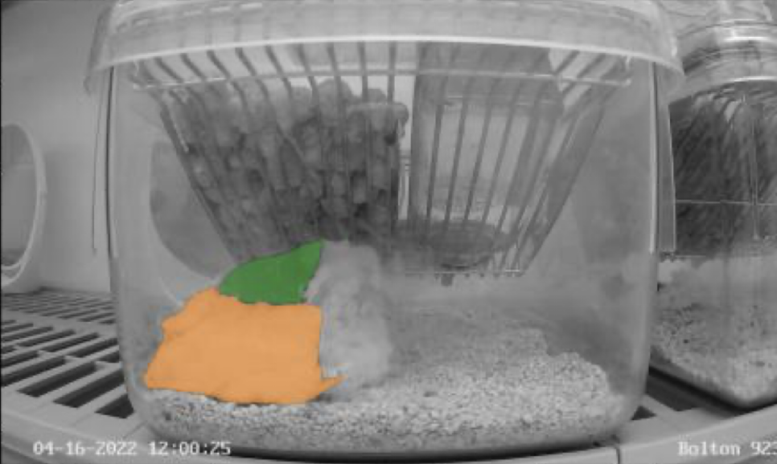
Challenges
When the nest gets separated into two parts, a mask for the second part is not generated.
Missing values in the CSV file are due to the mouse being occluded by the nest.
Despite labeling 175 frames with each body part at least 75 times, random pose estimations persisted, and cage corners were occasionally misidentified as the "back" body part.
Possible causes include color limitations in videos or insufficient training epochs (100k).
Training took 2-3 days, while analyzing a 60-minute video required around half a day.

Slide 15
Future Work
Nursing Pups
The mother mouse provides milk and nourishment to her pups through nursing, vital for their growth and development.
Licking and Grooming
Adult mice groom or lick other mice, often their pups, to maintain social bonds, hygiene, and comfort. It also aids in circulation and debris removal.
Carrying Pups
The adult mouse carries its pups in its mouth or nest, ensuring their safety and regulating their temperature, an essential maternal care behavior.

Slide 16
Conclusion
Developed an end-to-end, automated pipeline that combines SAM2 segmentation, DeepLabCut pose estimation, and a Random Forest classifier to identify behavioral transitions and measure their time intervals without manual annotation.
Our approach eliminates the need for labor-intensive human labeling, dramatically reducing researcher workload and turnaround time.
By focusing on generalizable geometric and posture features, the system remains adaptable across different species.

Slide 17

Q&A

