Slide 1
Madlene Hamilton MADLENEH@gmail.com Pragyansmita Nayak pragyansmita@gmail.com (Ideas also contributed by Tammy Barbie)
Tech “Pen” PALS
Women in Tech Demo Day (Angel Hack, Capital One)
27th August, 2016

Slide 2
Problem
According to Deloitte, in 2015, less than 25% of IT jobs were held by women globally.
Four Major Reasons:
EDUCATION PIPELINE
Recruiting and hiring processes
Paying and promoting
Retention

Slide 3
LEAKEY EDUCATION PIPELINE
“Linkedin” for girls who are interested in technology but may not know it yet.
Build relationships between unlikely allies
Matches girls in emerging, rural, and remote areas to technology professionals
Educate girls on professional and market opportunities in technology
STEM/Coding Project Platform
Provide hands on real world exposure to technology jobs
Go beyond social and incorporates educational tools

Slide 4
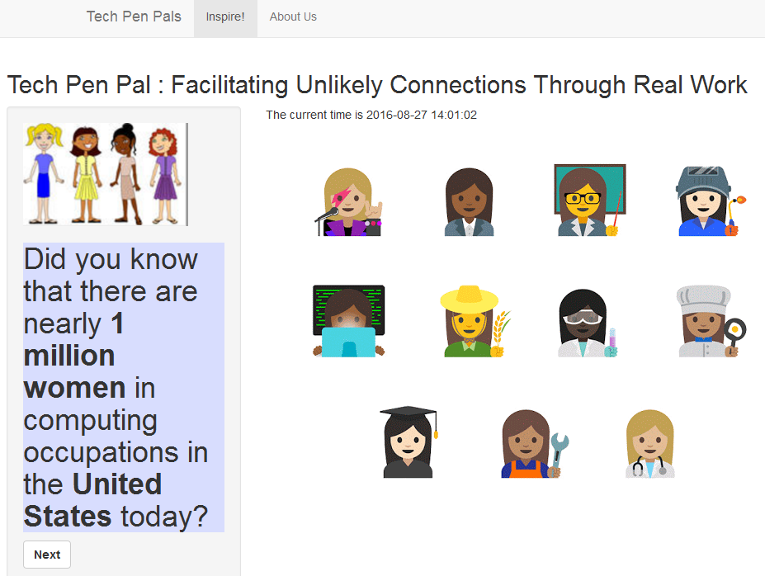

Slide 5
Market (US, International)
Potential Partners
Potential Customers
Corporations
Governments
NGOs
Tech Accelerators/Incubators
Schools (Career counselors)
Organization (Black Girls Code, At The Well
Her Mind Rocks)

Slide 6
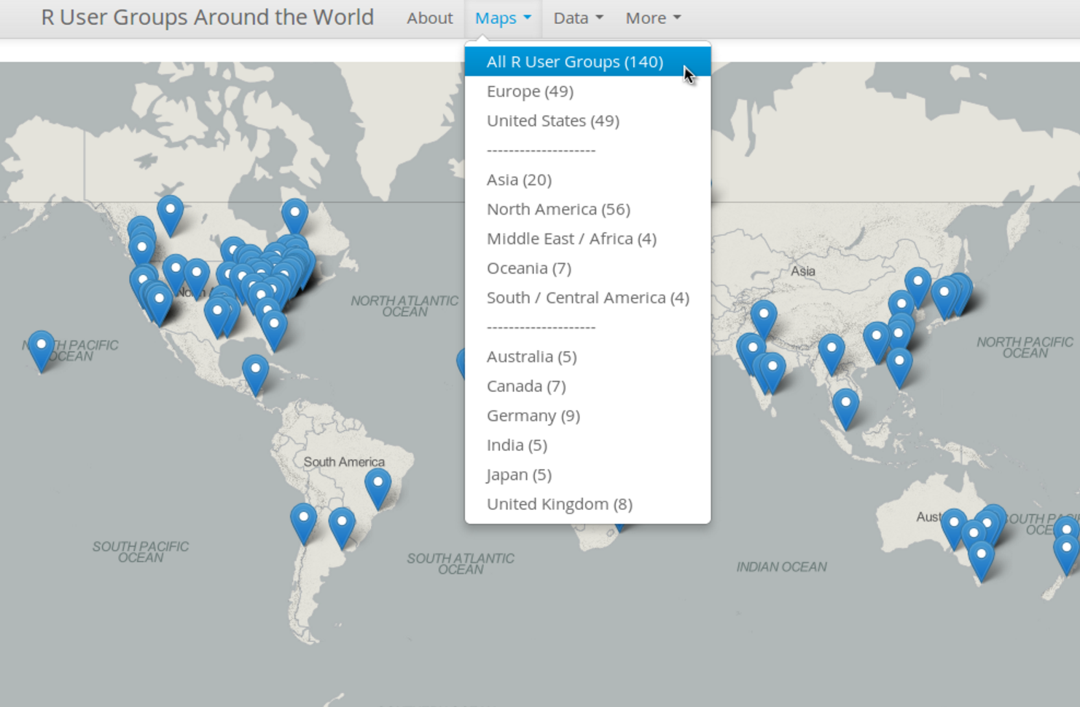
Next Steps
Immediate
Long Term
Complete the application
Database of software occupations
Database of mentors
Pilot the application in the US (Potential: Women who code, Girls who code, Black Girls Code)
Optimize the app to work with different types of net connectivity

Slide 7
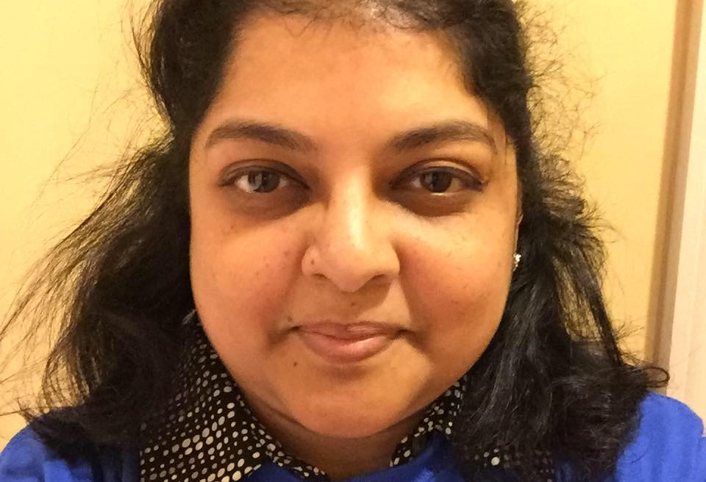

“Every child deserves an opportunity to be exposed to technology”
Pragyansmita Nayak, Ph.D
Madlene hamilton, Ph.D

