Slide 1

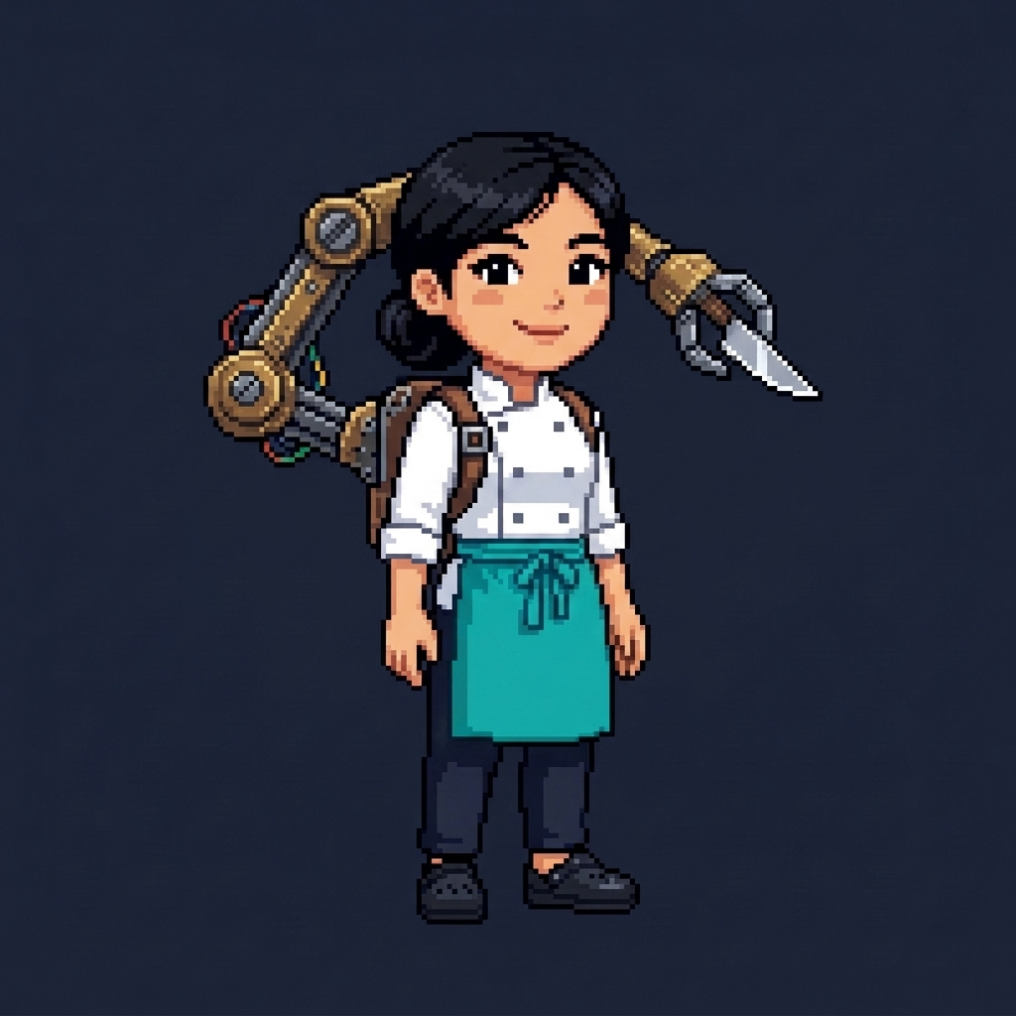
TWO LADLES
A Vietnam–Korea Kitchen Story
Korea Game Week 2026 (KGW2026) Official Competition Entry
Genre: 2-Player Local Wi-Fi Co-Op Cooking Simulator | Platform: Unity (Android + PC)

Slide 2
EXECUTIVE SUMMARY
Core Gameplay & Design Philosophy
Design Philosophy
• "Easy to play badly. Difficult to play efficiently. Extremely satisfying to master."
• True 2-Player Local Co-Op: Two human chefs working together over local Wi-Fi / LAN.
• Solo Mode: play alone with an AI partner chef (Assistive / Standard / Challenge difficulty).
• Cross-Kitchen Reliance: Linh and Jiwon are dependent on each other to fulfill orders.
• Tactile & Satisfying: Rhythm chops, heat timing, and rapid pass counter handoffs.
Competition Alignment (KGW2026)
• Developed in Unity C# targeting Landscape Android & Desktop PC playtesting.
• Celebrates Vietnam–Korea Cultural Friendship through authentic cuisine & collaboration.
• Original Gameplay: custom code and systems built for this entry; traditional dishes credited as traditional.
• Dynamic Shift Tension: High-pressure service shifts, Kitchen Flow meter, and Rush Rhythm bursts.
• Broad Appeal: Casual pick-up-and-play mobile touch controls + competitive co-op mastery.

Slide 3
NARRATIVE & PROTAGONISTS
Two Exhausted Professionals, One Shared Culinary Venture
Linh — The Systems Optimizer
• Nationality: Vietnamese | Former Career: Software Engineer.
• Background: Left tech burnout and sprint pressure to return home and reopen her family's food stall in rural Vietnam.
• Playstyle: Process optimization, chopping cadence, and stove timing (flour, rice, toboki, eggs).
• Home Base: West Zone (Fridge, Shelf, 2 Stoves, 3 Self-Assembly Holding Tables).
• Signature Ability: Execution Specialist — one extra 'third arm' speeds her work (+8% at Tier 2, +15% at Tier 3).
Jiwon — The Operations Leader
• Nationality: Korean | Former Career: Corporate Business Executive.
• Background: Left corporate boardroom exhaustion for a sabbatical in Vietnam; partnered with Linh to build a food venture.
• Playstyle: Service pacing, delegation, and grill/wok heat management.
• Home Base: East Zone (Fridge, Shelf, Grill, Wok, 2 Self-Assembly Holding Tables).
• Signature Ability: "Call in the Crew" — spends coins to hire part-time prep helpers who chop ingredients.

Slide 4
SPATIAL TOPOLOGY
Asymmetric Kitchen Layout: Built-In Mutual Reliance
West Zone (Linh)
• Fridge (Meat / Radish / Egg / Toboki) & Shelf (Gochujang / Flour / Rice).
• Prep Table: chop with [F] in a discrete 4-strike cadence.
• 2 Stoves: cook flour, rice, toboki & eggs.
• 3 Self-Assembly Holding Tables: combine finished parts with [E].
Center Pass Counter
• 3-Slot Shared Handoff Station connecting West and East.
• Coordinated Handoff Bonus: +15 Kitchen Flow when partner retrieves item within 4 seconds.
• Anti-Exploit Protection: self-retrieval gives 0 Flow; max 1 bonus per order.
• Shared Trash Can for burnt or wrong items.
East Zone (Jiwon)
• Fridge (Raw Meat / Radish / Egg / Toboki) & Shelf (Gochujang / Flour / Rice).
• Prep Table: cuts raw meat once (Korean BBQ meat) or twice (bulgogi).
• Grill (BBQ beef, bulgogi) & Wok (Tteokbokki, rice, egg).
• 2 Self-Assembly Holding Tables.

Slide 5
THE MENU
5-Day Menu: Traditional Dishes & a Fusion Finale
Day 1 — Tteokbokki
• Traditional Korean
• Rice cakes (toboki) + gochujang, cooked together.
• 115 pts | Patience 60s.
Day 2 — Bột Chiên
• Traditional Vietnamese
• Saigon fried rice-flour cake: cook flour, add egg, cook again.
• 125 pts | Patience 65s.
Day 3 — Korean BBQ on Rice
• Traditional Korean
• Cut raw meat -> grill BBQ beef -> combine with cooked rice.
• 140 pts | Patience 65s.
Day 4 — Cơm Tấm
• Traditional Vietnamese
• Broken rice with grilled beef & egg, combined in any order.
• 155 pts | Patience 70s.
Day 5 — Bulgogi Bánh Mì
• Two Ladles fusion twist
• Baguette + pickled radish/carrot + bulgogi.
• 3-minute high-score finale | 180 pts | Patience 75s.
Menus build up day by day (Day 2 = Tteokbokki + Bột Chiên, Day 4 = all four). Days 1–4 are traditional dishes; only Day 5 is our fusion take.

Slide 6
STATION GAMEPLAY
Tactile Mechanics Without Generic Progress Bars
Prep & Cooking
• Preparation Counter: 4-strike discrete rhythm cadence (0.45s ideal interval). Graded PERFECT, GOOD, or MISS.
• Miss Non-Blocking: rhythm misses never freeze workflow, preserving game feel.
• Cooking Station: 5-state heat machine (RAW -> COOKING -> OPTIMAL -> OVERCOOKED -> BURNT).
• Optimal timing awards +20% score bonus; overcooking reduces score; burning wastes ingredient.
Assembly & Handoff
• Self-Assembly: no plates or bowls — combine finished parts at any holding table with [E], in any order.
• Rejects invalid combinations with clear sound/visual feedback without destroying items.
• Pass Counter: Central 3-slot relay counter.
• 4-Second Handoff Window: Rapid cross-kitchen coordination rewarded with team Flow.
Serving & Throwing
• Serving: finished dish is matched against the active ticket queue.
• Patience Tip Bonus: Fast service yields higher restaurant tips.
• Throw (Q / right-click): toss an item to your partner, a free holding table, the pass counter or the trash.
• Ingredient Flow: fridge/shelf -> chop -> cook -> combine -> serve. No dishwashing.

Slide 7
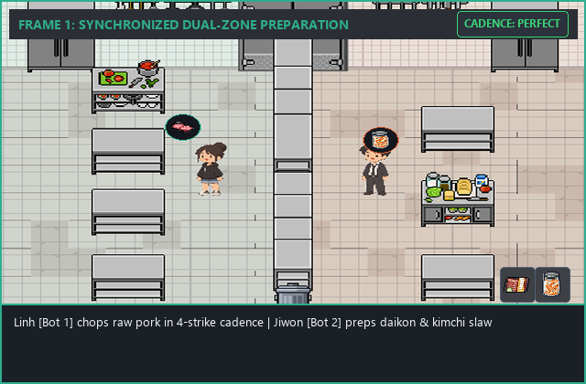
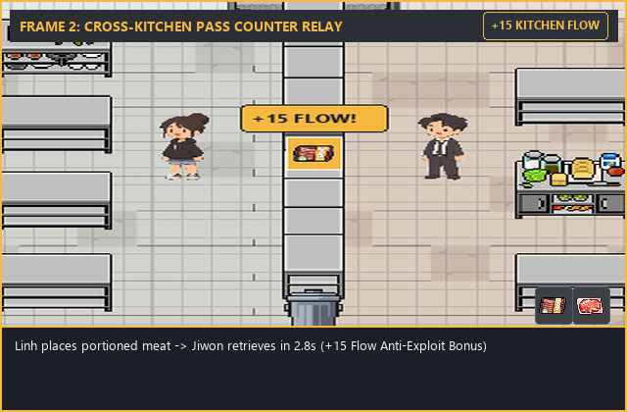
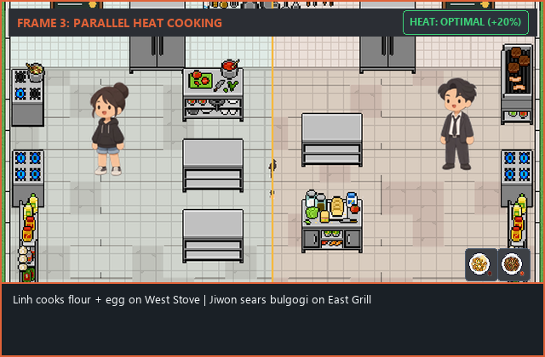
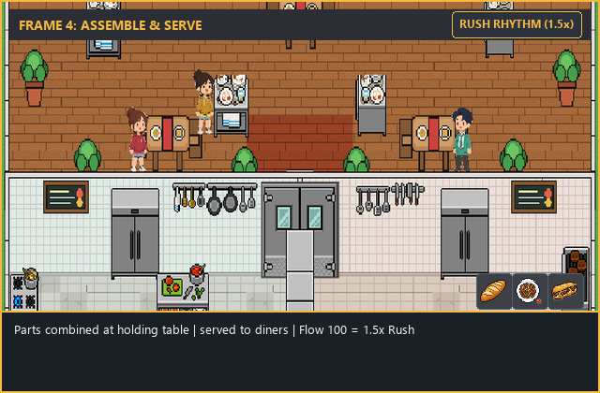
QA BOT GAMEPLAY (ILLUSTRATIVE)
How the 2-Bot Test Run Plays a Shift: 4-Stage Co-Op Loop
1. Cadence Prep
• Jiwon [Bot 2]: cuts raw meat twice into bulgogi at the East prep table.
• Linh [Bot 1]: cuts radish/carrot for pickled veg.
• PERFECT strike timing awards rhythm cadence bonus.
2. Pass Counter Relay
• Central 3-slot relay counter connects Linh & Jiwon.
• One chef places an item -> the partner picks it up within 4s.
• +15 Kitchen Flow awarded (Anti-Exploit protected).
3. Parallel Cooking
• Jiwon sears bulgogi on the East Grill.
• Linh cooks flour + egg dough into a baguette on a West Stove.
• 5-state heat machine: OPTIMAL window gives +20% score.
4. Assemble & Serve
• Parts combined at a holding table with [E], any order.
• 100 Kitchen Flow activates 15s RUSH RHYTHM (1.5x score).
• Bots replay any day with all upgrades for QA.

Slide 8
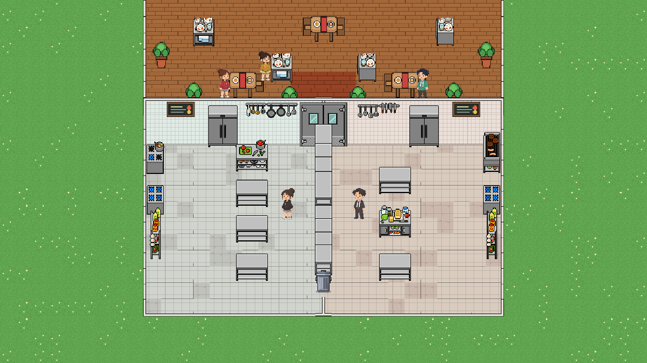
IN-GAME ENVIRONMENT
Complete 2.5D Kitchen Environment & Dining Patio View
Live Visual Topology
• Flat 2D Floor: the kitchen floor sits flat behind the chefs, removing the old perspective tilt.
• Dynamic 2.5D Depth Sorting: Automatic z-index calculates (500 - Z*50) so chefs naturally render in front/behind counters.
• Asymmetric West/East Layout: Linh runs the stoves (flour, rice, toboki, egg); Jiwon runs prep, grill and wok.
• 3-Slot Pass Counter: Central stainless steel relay counter with trash disposal bin.
• Exterior Dining Patio: Customer tables with placemats and real-time waiting diners.
• 2-Bot QA Autoplay: bots can replay any day with all upgrades unlocked.

Slide 9
MOMENTUM ENGINE
Kitchen Flow (0–100) & High-Scoring Rush Rhythm
Kitchen Flow Dynamics
• Flow Meter (0 to 100): Represents kitchen rhythm, speed, and harmony.
• +15 Flow: Coordinated Pass Counter handoff within 4 seconds.
• +20 Flow: Serving an OPTIMAL quality dish.
• +12 Flow: Serving a STANDARD quality dish.
• -15 Flow: Customer order expires unfulfilled.
• -10 Flow: Burnt ingredient / kitchen waste.
• Anti-Exploit: Max 1 handoff bonus per order; self-retrieval gives 0 Flow.
Rush Rhythm Mode
• Activation: Reaching 100 Kitchen Flow immediately activates Rush Rhythm.
• Meter Reset: Flow resets to 0 upon trigger.
• 1.5x Multiplier: All customer orders served during the 15-second window earn 1.5x base score.
• Paused Generation: Flow accumulation is paused while Rush Rhythm is active.
• Dynamic Atmosphere: Screen border glow, lively audio tempo, and celebratory kitchen feedback.

Slide 10



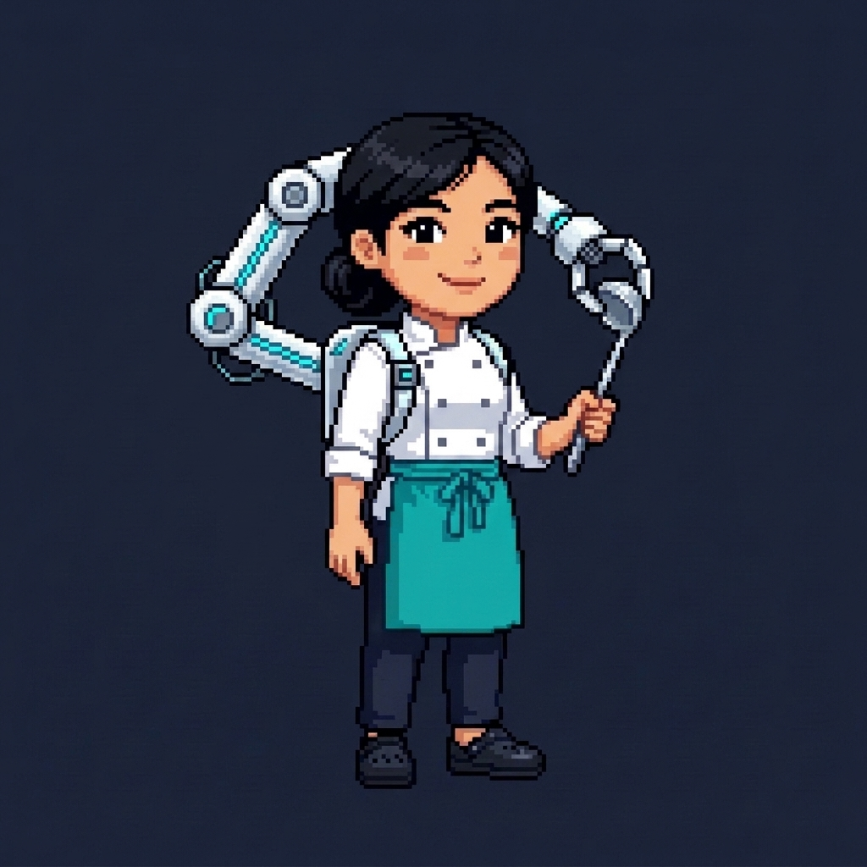
CHARACTER ABILITIES
Distinct Thematic Progression Across 3 Evolution Tiers
Linh — Execution Specialist
• Tier 1 (Ordinary Chef): chef uniform, normal speed, no extra arm.
• Tier 2 (Workshop Engineer): ONE rustic brass third arm, ~8% faster.
• Tier 3 (Precision Engineer): ONE sleek white & blue third arm, ~15% faster.
• Unlocks: Tier 2 after Day 3, Tier 3 after Day 5.
Jiwon — "Call in the Crew"
• Signature Ability: Spends restaurant coins to hire part-time prep helpers.
• Tier 1 (Burnt-out Exec): casual clothes + kitchen apron, 0 helpers.
• Tier 2 (Manager): rolled-sleeve shirt, 1 helper | Tier 3 (Business Operator): suit & tie, 2 helpers. One Part-Timer button [H] hires every free slot at once.
• Balancing: 20 coins hire cost, 20s contract, 45s agency cooldown.

Slide 11
GAME MODES
5-Day Campaign & Endless Rush Mode
5-Day Campaign Progression
• Day 1: Tteokbokki only — learn chop, cook and serve.
• Day 2: adds Bột Chiên (cook flour, add egg, cook again).
• Day 3: adds Korean BBQ on Rice. Clearing it unlocks Character Tier 2!
• Day 4: adds Vietnamese Cơm Tấm — all four dishes on the menu.
• Day 5: Bulgogi Bánh Mì 3-minute high-score finale. Clearing it unlocks Character Tier 3!
Endless Rush Mode
• Continuous Escalation: Unlimited shift duration toggled in lobby.
• Dynamic Difficulty: Order spawn interval accelerates from 14s to 6.5s; order concurrency expands from 2 to 4.
• Failure Condition: 3 missed customer tickets ends shift.
• Personal Best Tracking: Persistent career high score, orders served, and survival duration.
• Kitchen Upgrades: Sharp Santoku Knives, Chef Speed Boots, Turbo Wok Burners.

Slide 12
TECHNOLOGY & ARCHITECTURE
Modern Unity C# Stack Targeting Android & PC
Unity Engine Architecture
• Engine: Unity 2022.3.62f3 LTS, statically typed C#. Pixel-art sprites on a flat 2D floor with a 2.5D orthographic camera.
• Cross-Platform: Landscape Android APK + Windows PC (Windows host and Android client can play together).
• Authoritative Host Topology: Peer 1 governs order timers, cooking transitions, pass counter handoffs, flow, and scoring.
• Dual Input Schemes: Responsive Android touch D-pad & action buttons + PC WASD/Arrow & Space/E/F keyboard controls.
• Persistent Storage: JSON save/load (Application.persistentDataPath).
LAN Multiplayer & Netcode
• Transport: raw .NET UdpClient sockets, no third-party networking library.
• Ports: UDP 24567 gameplay sync (30Hz movement, 4Hz host state) + UDP 24568 LAN room discovery.
• Character Exclusivity: Mutual exclusion enforced in lobby (Linh vs Jiwon).
• Readiness Reset: Changing character or perks resets Ready state to prevent race conditions.
• Wi-Fi Scan: auto-finds the host on the same Wi-Fi; START needs 2 chefs, both READY.
• Unit tests: 19 suites, 261/261 assertions passed (2026-11-10).
• Full-gameplay QA (separate): 2-bot autoplay with selectable test day and all upgrades.

Slide 13
PRODUCTION ROADMAP
Current Status & Next Development Milestones
Milestones 0–3 (Verified)
• ✔ 5-Day Menu & Cross-Prep Interdependence.
• ✔ Self-Assembly Holding Tables & Throwing.
• ✔ Pass Counter 4s Handoff & Anti-Exploit (+15 Flow).
• ✔ Rush Rhythm (15s, 1.5x score).
• ✔ Linh Tiers 1-3 & Jiwon Crew Hiring.
• ✔ 5-Day Campaign & Endless Mode.
• ✔ Unit tests: 19 suites, 233/233 passed.
• ✔ 2-Bot Autoplay QA + Solo AI partner.
Milestone 4 (Visual & Audio)
• ✔ 2D pixel-art chef & food sprites integrated (beef, noodles, flour added).
• ✔ Flat 2D kitchen floor, depth-sorted chefs, 15° walk sway.
• ✔ Lobby, cleaned-up HUD & station prompts.
• ✔ Story phone chats & day-night lighting.
• ✔ Upbeat bistro music & kitchen SFX (code-synthesized).
• ✔ Touch controls for Android.
Milestone 5 (Competition)
• ✔ Android APK build (TwoLadles.apk).
• ✔ Windows Standalone PC build (TwoLadles.exe).
• ✔ Two-Bot Autoplay QA Test Runner & Metrics.
• • Gameplay demo video capture.
• • Final LAN + Windows/Android cross-play check.
• • Final submission to Korea Game Week 2026.

Slide 14
SUBMISSION DETAILS
Korea Game Week 2026 Entry Information
Official Competition Submission
• Game Title: TWO LADLES: A Vietnam–Korea Kitchen Story
• Email Recipient: btc.koreagameweek@gmail.com
• Subject Line: [Dự thi Lập trình game KGW2026]
• Concept Document: docs/two_ladles_concept.pptx (PowerPoint Format - Included)
• Game Engine: Unity C# (Android Platform + PC Testable)
• Deliverables: Presentation Deck (*.pptx) + Playable APK / PC Build + Demo Video
• Copyright Statement: The game features original gameplay systems and development work. All third-party assets, where applicable, are used in accordance with their respective licenses. See Asset Credits (next slide).

Slide 15
ASSET CREDITS
Third-Party Assets & Sources
Third-Party Art (Licensed)
• Professional Kitchen Set (32x32) by 0_mem0ry — 0-mem0ry.itch.io/professional-kitchen-set-free (free, commercial use & modification allowed).
• Pixel Mart by ghostpixxells — ghostpixxells.itch.io/pixel-mart (free, commercial use permitted).
• Additional food and customer sprites: see docs/ASSET_LICENSES.md for sources and licenses.
Original & Traditional
• In-game chef sprites: created for Two Ladles.
• Deck character illustrations: AI-assisted concept art made for this presentation.
• Gameplay code & systems: written for Two Ladles in Unity C#.
• Recipes: Tteokbokki, Bột Chiên, Korean BBQ and Cơm Tấm are traditional dishes; Bulgogi Bánh Mì is a well-known fusion style used as our finale.
• Engine: Unity 2022.3 (Unity Personal license).

