Slide 1
FRONTEND DEVELOPMENT FOR WEBSITE CLONING
-by Yogesh Giri

Slide 2
Phase 1 –Research for a good website
My initial target was to search for a good website on which I can work upon for further development and designing .I found Flipkart with the most easy and flexible interface that’s why it was my first choice to work upon and without any delay I started working upon it.

Slide 3
SELECTED FLIPKART
Made blueprint afterwards.

Slide 4
ATTACH FAVICON AND GAVE SIMILAR TITLE
TITLE:-
<title>Online Shopping Site for Mobiles, Electronics, Furniture, Grocery, Lifestyle, Books &amp; More. Best Offers!
</title>
FAVICON:-
<link rel="icon" href="https://img1a.flixcart.com/www/promos/new/20150528-140547-favicon-retina.ico">

Slide 5
STYLING INSIDE HEAD
<style>
.sigma
{
background-color: #2874f0;
}
</style>
This is just a demo to see ,how style is attached in the head part.Here sigma is a class made for tags.

Slide 6
CONTAINER FLUID
Most of the tag used in the whole project is container –fluid as it was in the main need .It contains different size of content in different sizes and then styling is implemented upon it.
E.g:-
<div class="container-fluid sigma Header">
<div class="row py-2 d-flex">
<div class="col logo ">
<a href="#">
<img width="75" src="yyy/ad/flipkart-plus_8d85f4.png"
alt="Flipkart" title="Flipkart">
</a>
<a href="#"><i>Explore <span>Plus</span></i>
<sup><img width="10" src="yyy/ad/plus_aef861.png"></sup>
</a>
</div>

Slide 7
COMPARISON BETWEEN ORIGINAL AND CLONE

Slide 8
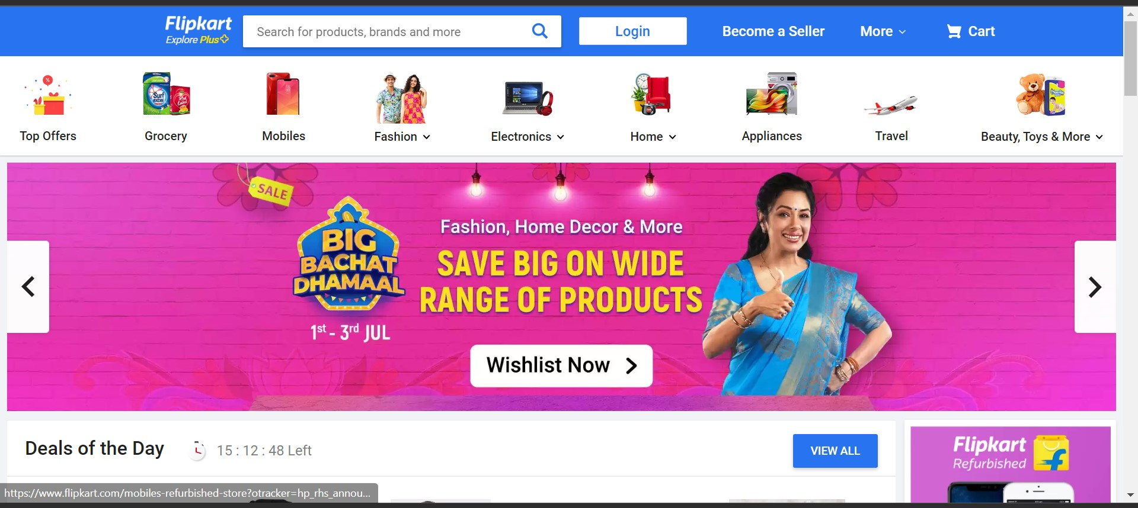
ORIGINAL

Slide 9
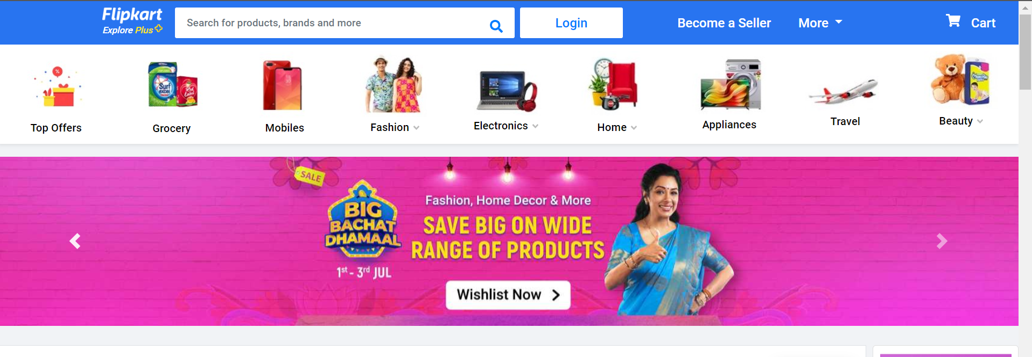
CLONE

Slide 10
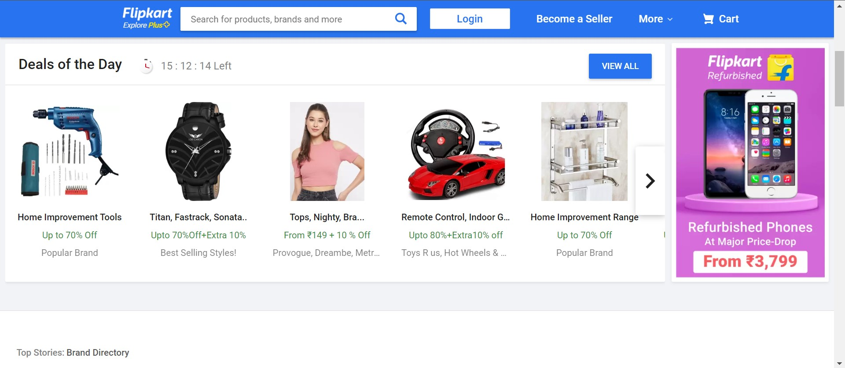
ORIGINAL

Slide 11
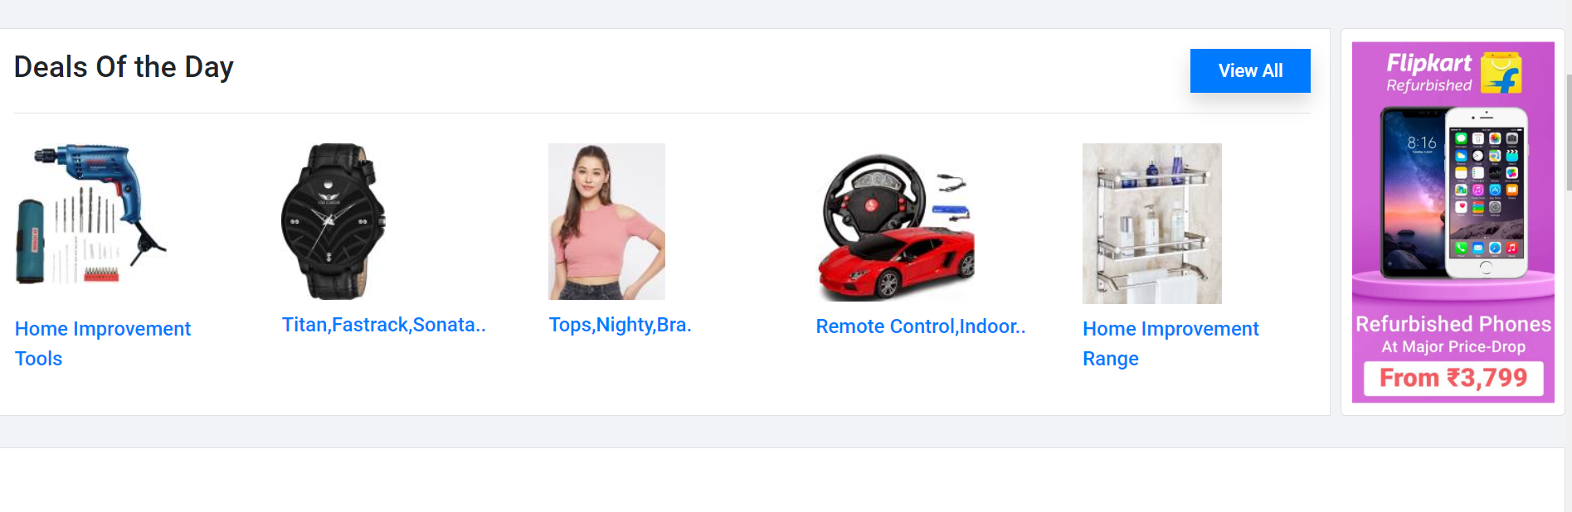
CLONE

