Slide 1

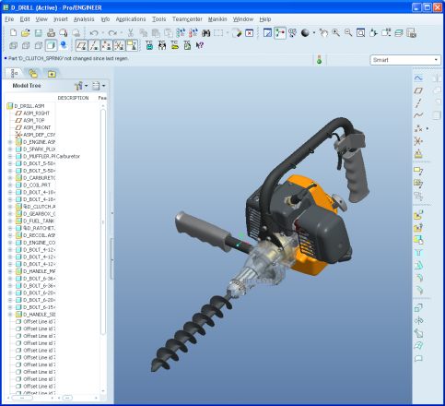





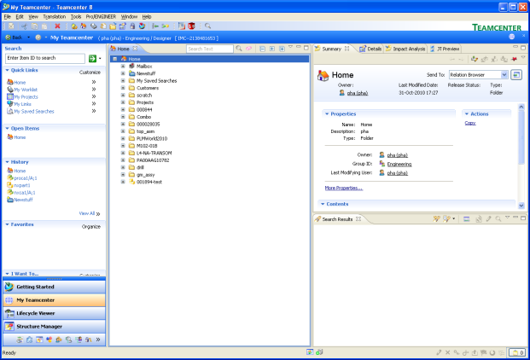
Design & architecture
TC server(s)
Common Teamcenter interface through SOA
Client-only CAD specific logic
FSC
Integration client
HTTP
Pro/E session
SolidWorks session
WebApp (e.g. WebLogic
SOA Client
HTTP
IIOP
JLink
Tcserver pool
Java
Java
C
Libtxd
Toolkit
C#
C dll
C# dll
HTTP
TC rich client
FCC
Config
Integration client reads server connnection information from RAC settings
JRE (optional)
Notes:
This slide shows a 4 tier configuration, which is what most customers using the newer software versions decide to deploy. 4 tier offers advantages in scalability and maintenance costs
A 2 tier picture would involve the same processes (minus the Web application), running in different locations
On the server, there is no difference between the Pro/ENGINEER and the SolidWorks integrations. There is a single libtxd shared library that contains a small set of server-based functions for both integrations. This dll executes CAD-specific logic triggered by actions outside of the CAD session, for example, revise, baseline, save as.
Both integrations have a java client, and both call the same set of SOA services through a client library
At this point, the architecture diverges. The Pro/ENGINEER integration communicates with the CAD session mostly through Jlink, with just a few native Toolkit calls. These are mostly to maintain compatibility with WF3.0, because at that Pro/E level the Toolkit API was not completely ported over to Jlink. The SolidWorks integration communications with the CAD session through C#.

