Slide 1
Teamcenter Integration for SolidWorks
Refile using Task Scheduler

Slide 2
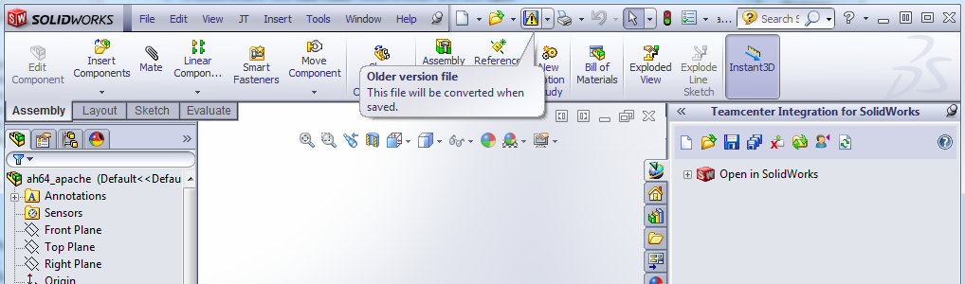
Refile using Task Scheduler
Why is refile needed?
Because allowing SolidWorks to convert “on the fly” causes a performance issue for the CAD designers
Because SolidWorks does not guarantee upward compatibility for more than 2 consecutive releases
Important note: The following is a solution outline based on very limited testing. It is not a recommendation nor is it a procedure supported by GTAC or by Siemens in general. Customers are responsible for conducting the necessary level of testing in their own environments, before deploying a solution based on this outline

Slide 3
Refile using Task Scheduler
Customers have requested that Siemens provide a refile capability for SolidWorks data, similar to NX refile
ER1860120: Need to have a need to have swim refile available
ER1899152: Request for enhancement related to SWIM refile utility
It is possible instead to leverage the OOTB SolidWorks Convert Files functionality, to update the CAD files directly in the Teamcenter volumes
This is the same tool used by PDMWorks Workgroup to update the CAD files in the PDMWorks vaults
Task Scheduler is used to control the timing of update processing, as well as optionally distributing the work using Network Monitor
This document describes the conversion process on a single Teamcenter volume server. Distributed processing is documented in the SolidWorks Task Scheduler help files

Slide 4
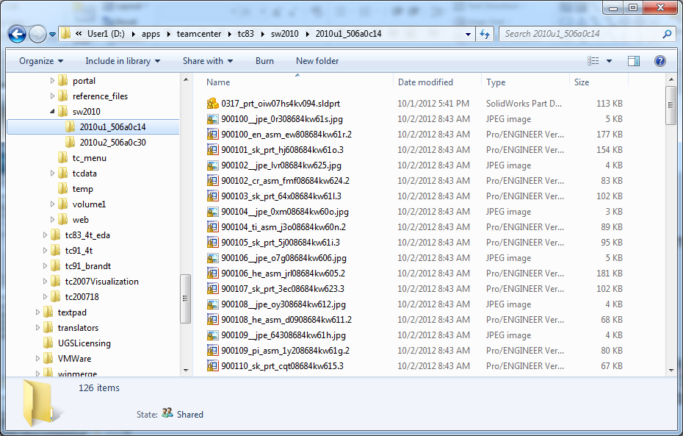
Refile using Task Scheduler
Example data
Two user subdirectories of a volume. Each subdirectory contains:
SolidWorks CAD files, last saved with SolidWorks 2010
Pro/ENGINEER CAD files
PNG thumbnails
JPG thumbnails
The goal is for Task Scheduler to operate on only the SolidWorks CAD files, without breaking any CAD references within the data. In the end, each SolidWorks model can be opened in the new version of SolidWorks 2012, without being tagged for client-side conversion

Slide 5
Refile using Task Scheduler
Each file to be converted must be writeable to the user who will run the Task Scheduler – typically this requires changing permissions at the OS. It may be necessary to use the cacls utility

Slide 6
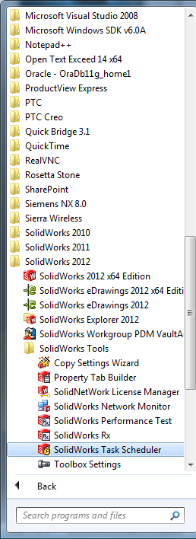
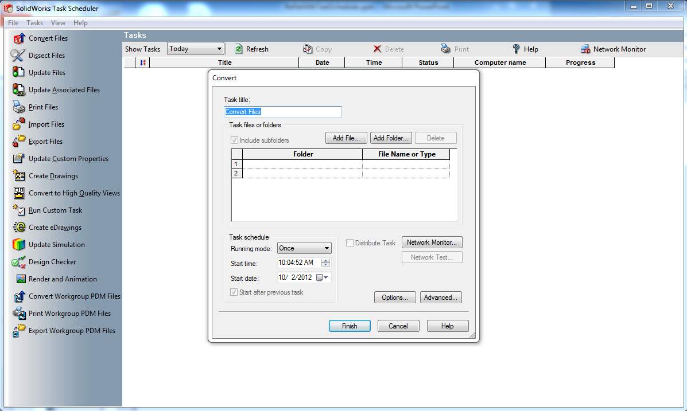
Refile using Task Scheduler
Start Task Scheduler belonging to the new CAD version, then select the Convert Files application

Slide 7
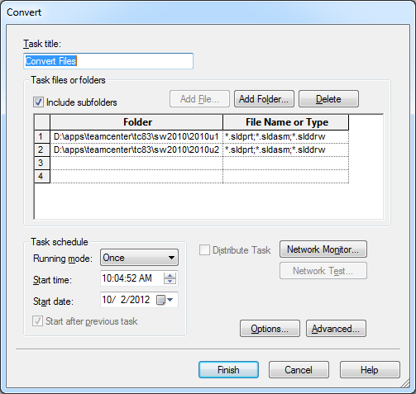
Refile using Task Scheduler
Add folders individually, or just add the top-level volume folder and specify “include subfolders”

Slide 8
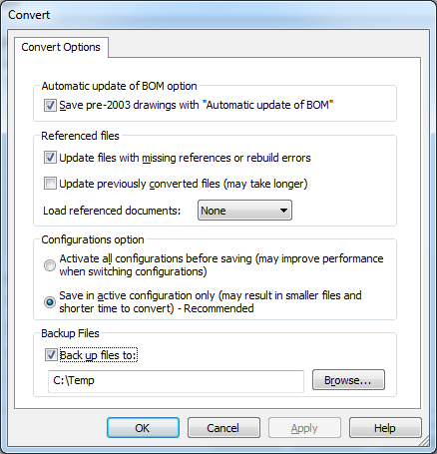
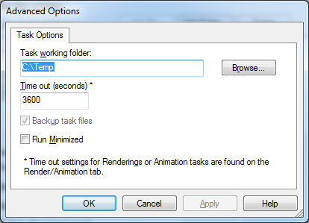
Refile using Task Scheduler
Select basic and advanced options
Set this option to “None” so that SolidWorks won’t try to find assembly and drawing children in the volume, where their file names have been randomized by Teamcenter

Slide 9
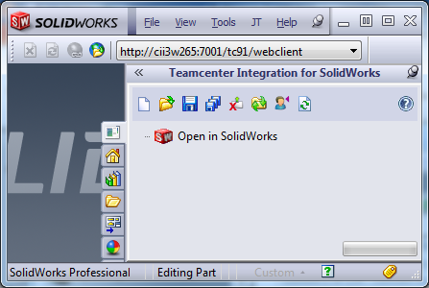
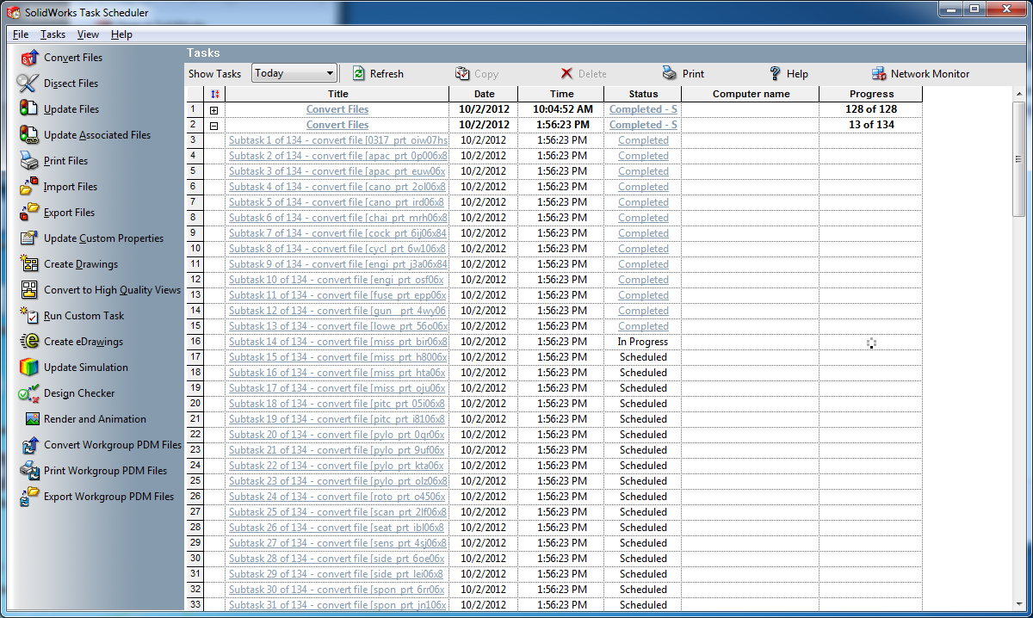
Refile using Task Scheduler
Select stop/start/resume times if desired, then proceed
Task scheduler will open/update/save each Solidworks file in the selected folder(s)

Slide 10
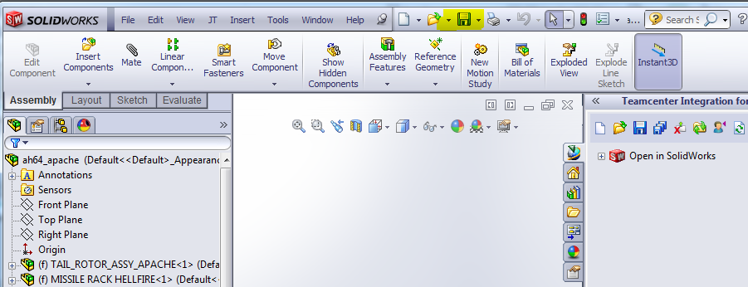
Refile using Task Scheduler
After the files are successfully converted, be sure to restore the permissions on the volume
Also, the FCC cache on each client must be purged, otherwise SWiM will continue to use the “old” files stuck in the cache, instead of downloading the updated files from the volume
Now when the SolidWorks models are opened in the new version of SolidWorks, they will already be up to date

