Slide 1
IPL Data Analytics & Reporting using Excel
SUMMARY PPT
Subject: Data Analytics and Reporting
Prepared by: Aman Kushwaha(202410101150081)
: Faisal Ansari(202410101150078)
Course: B.Tech CSE(DS+AI),Group:- 33

Slide 2
Project Objective
To analyze IPL match performance data using Excel to identify trends, top-performing teams and players, and visualize results through pivot tables and dashboards.

Slide 3
Dataset Description
• Dataset Name: IPL_Analysis_Data.xlsx
• Rows: 1,200
• Columns: 12
• Seasons: 2018–2023
• Data Fields: Match_ID, Team_Batting, Team_Bowling, Batsman, Bowler, Over, Runs, Wickets, etc.
• Dataset generated using realistic IPL match data.

Slide 4
Data Cleaning Steps
• Removed duplicates
• Handled missing values (replaced with 0 or NA)
• Formatted column names and data types
• Added filters for easy analysis

Slide 5
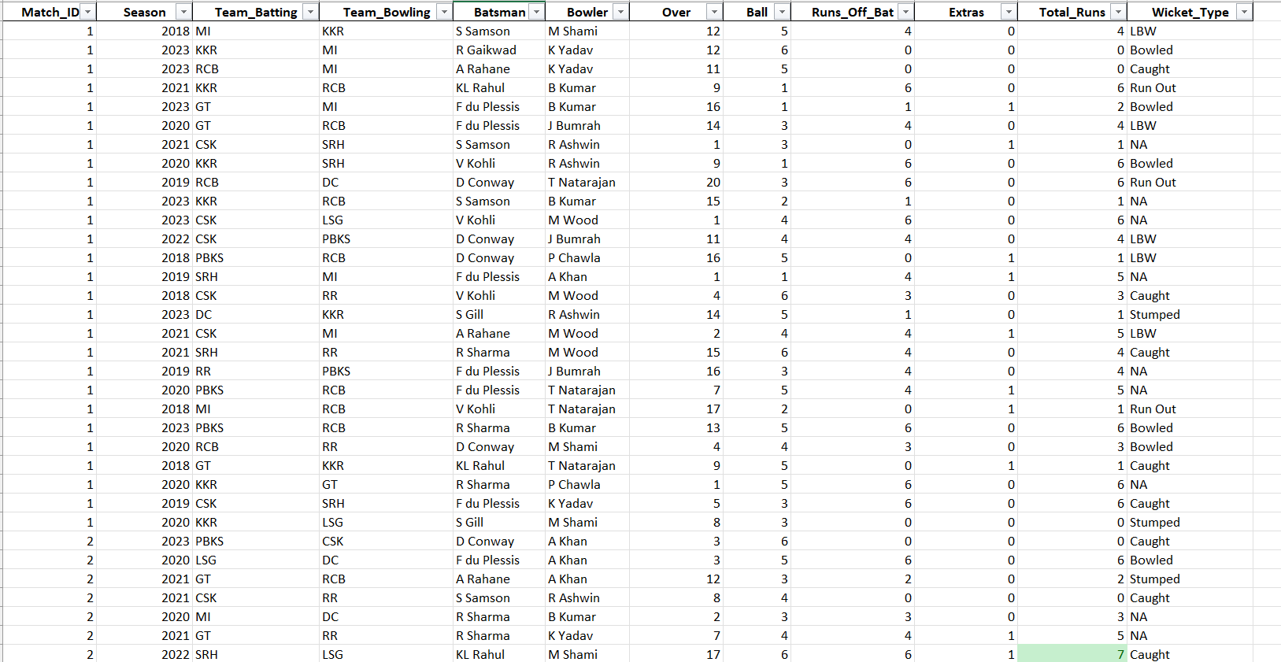
After performing data Cleaning step we got this data set

Slide 6
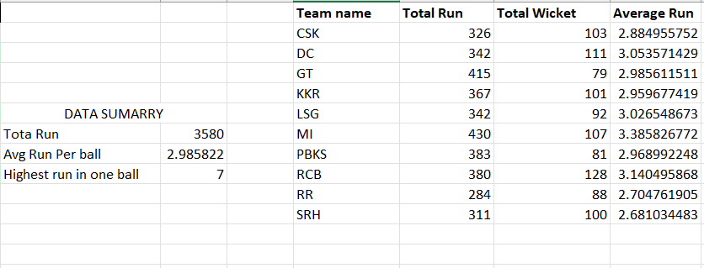
Formulas and Functions Used
• SUM(), AVERAGE(), MAX(), MIN()
• COUNTIF(), SUMIF(), AVERAGEIF()
• IF() for classifying high/low performers

Slide 7
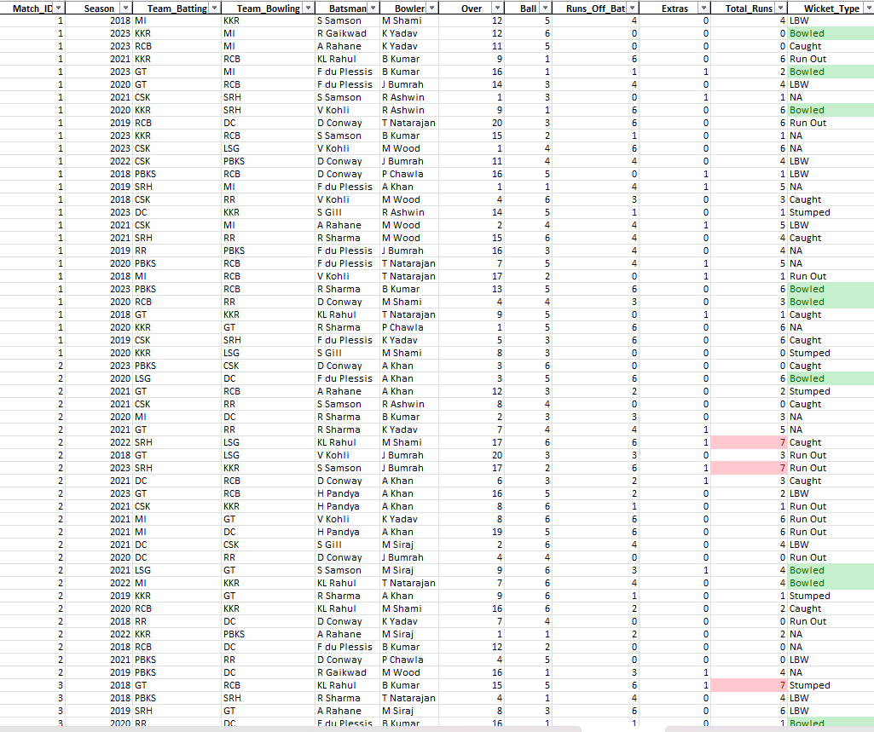
Conditional Formatting for highlighting top scores and wicket

Slide 8
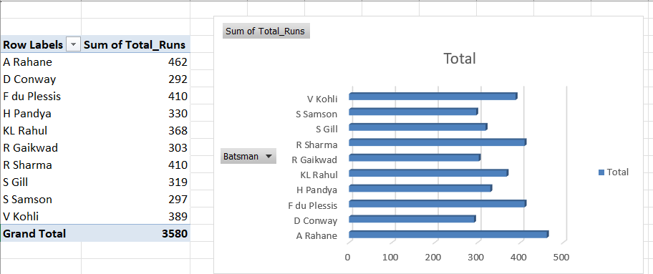
Pivot Table Analysis
• Total Runs by Batting Team=3580

Slide 9
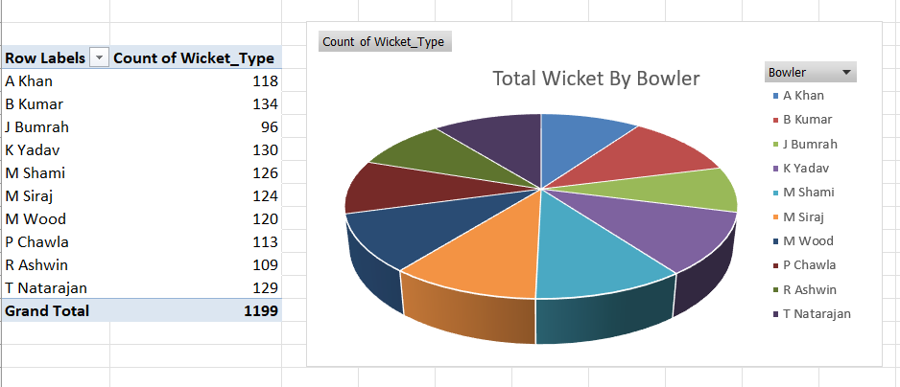
Total Wickets by Bowler

Slide 10
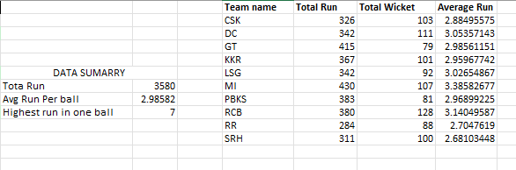
Highest Score on one Ball
Total Run, Average Run per Ball

Slide 11
Created Pivot Tables for quick summarization of Total Run By Batsman per season

Slide 12
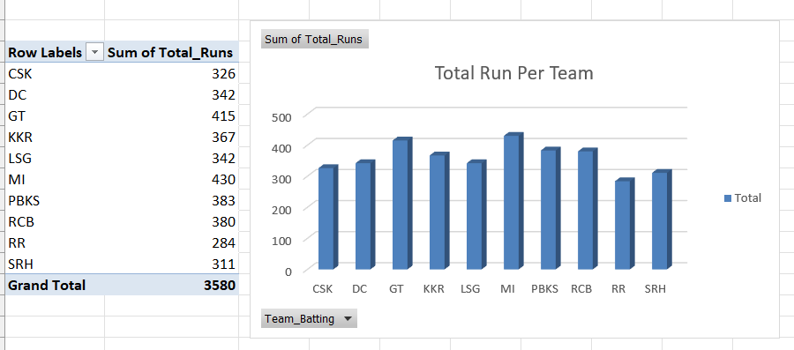
Charts and Visualizations
Column Chart – Team-wise Total Runs

Slide 13
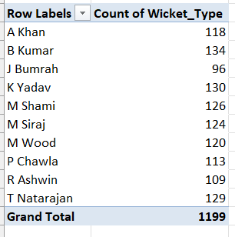
Pie Chart – % of Wickets per Bowler

Slide 14
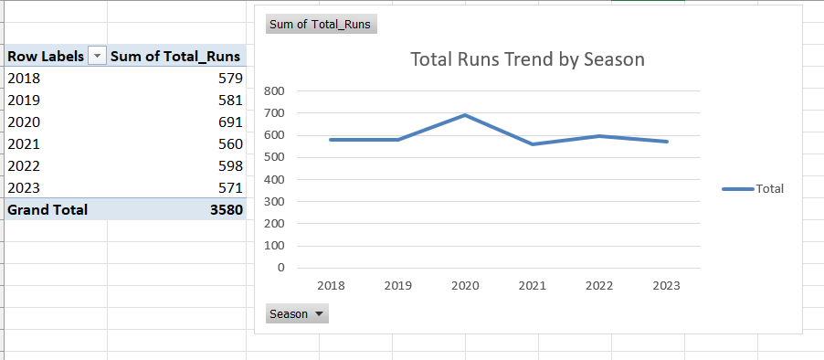
• Line Chart – Season-wise Run Trends

Slide 15
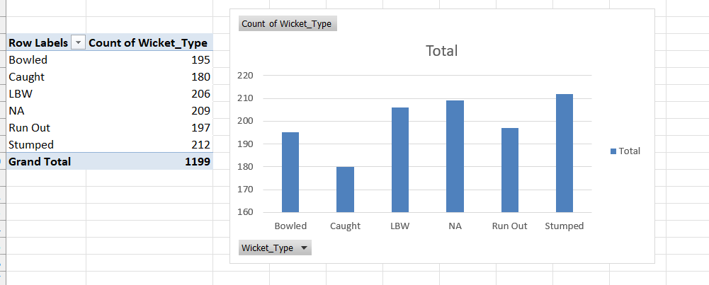
Count of wicket per wicket type

Slide 16
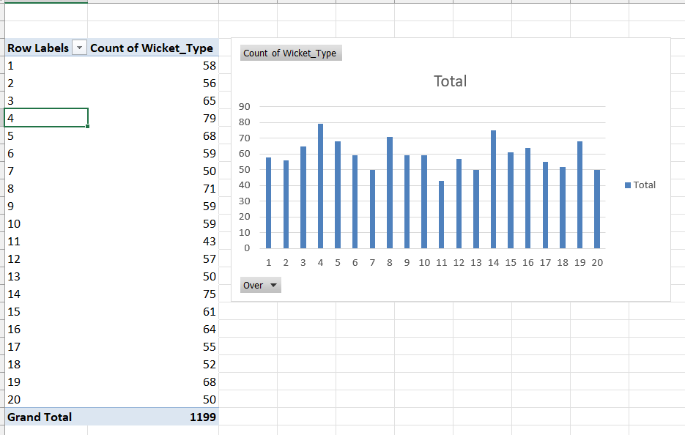
Count of wicket per over

Slide 17
Total Run By Team Per Season

Slide 18
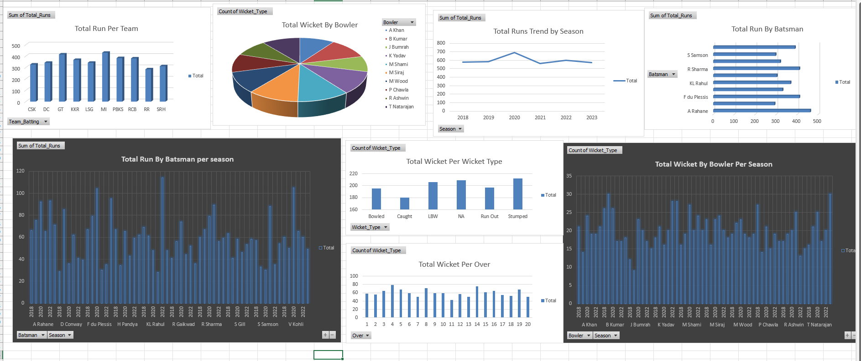
Dashboard Overview

Slide 19
Insights & Findings
• MI recorded the highest total runs
• B Kumar and K Yadav took most wickets
• Average runs per ball ≈ 2.98
• Most wickets occurred in overs 4,8,14
• ‘Stumped' was the most frequent wicket type
• CSK and MI are consistent scoring teams

Slide 20
Conclusion & References
• Successfully analyzed IPL match data using Excel tools
• Identified top players and team performances
• Created interactive visualizations for reporting
References:
• Dataset generated using Python simulation
• IPL reference: www.iplt20.com

