Slide 1

Movie Recommender System
Project By:-
1.Kapil Kumar Sharma (17135048)
2.Vaibhav Mehta(17134024)
3.Sachin Bhuria (17085065)
4.Shrikant Kumar (17135082)

Slide 2
Recommender Systems
Why there is a need?
A recommendation system:-
It is an information filtering technique that provides user the information as per user’s interest.
Recommendation system improves decision making process and quality.
Beneficial for both users and service providers.
Information overload
To get personalised recommender system
Increase Revenue

Slide 3
Type of Movie Recommender System
Simple recommender system
Content based recommender
Collaborative recommender
Hybrid recommender

Slide 4
Simple Recommender
Recommends top 250 rated movies
Same recommendation to all user
Movielens dataset is used.

Slide 5
Our Approach
This recommender system recommends based on popularity and rating of movies and have high probability of getting liked by average user.
This does not provides personalised recommendation to user.
To implement our idea, we have our own model which will sort the movies based on rating and popularity of the movies and will display on the top of list.

Slide 6
Formula used to calculate weighted rating
WR = V * R + M * C
(V+M) (V+M)
WR : Weighted Rating(dimensionless)
V : Number of vote for the movie(Votes dimensionless)
M : Minimum number of votes needed to get listed in top 250 movies.
R : Average for the movies as a number from 1 to 10(mean).
C : Mean report across the whole report(currently 7.0) dimensionless.

Slide 7
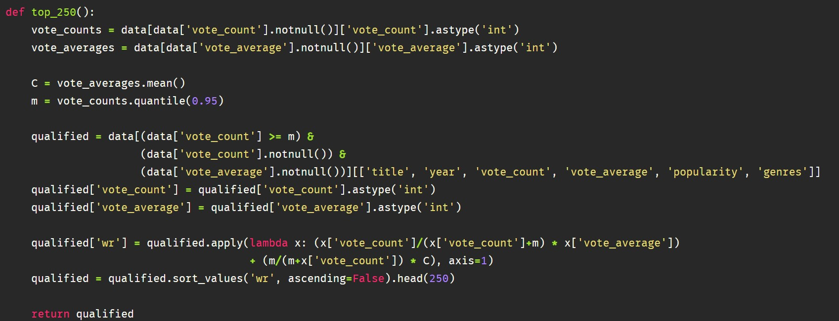
Code Snippet
We used 95th percentile as the cutoff for movie to be displayed in top 250.

Slide 8
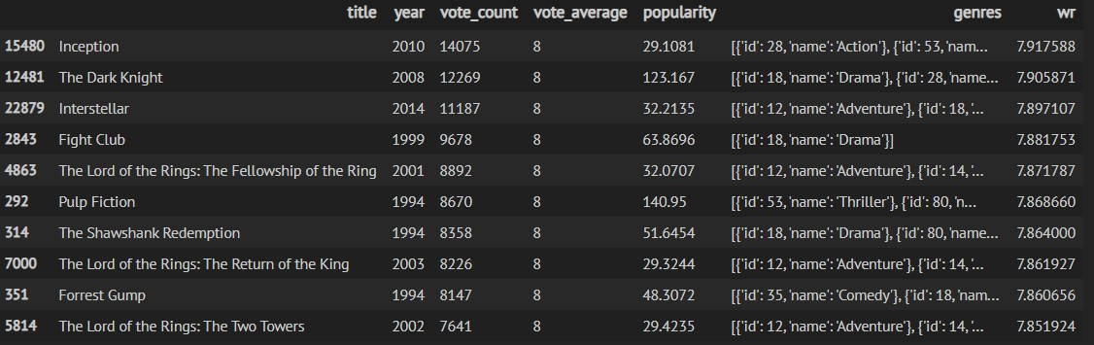
Output

Slide 9
Content Based Recommender
To improve the user experience, and to get more personalised recommendation we have implemented the idea of content based recommender in which engine computes similarity between movies based on certain metrics.
It suggests movies that are most similar to the movies that user liked.
It compares movies based on overview and tagline.
To implement our this content based model we have used Cosine Similarity.

Slide 10
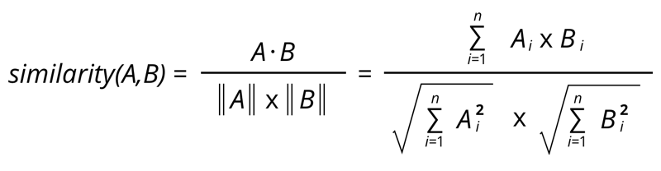
Cosine Similarity
The description data is tokenised, stop words are computed and finally data converted to matrix of TF IDF features.
The cosine similarity computed using the sklearn library
Since TF-IDF Vectorizer is used, calculating the Dot Product will directly give us the Cosine Similarity score.

Slide 11
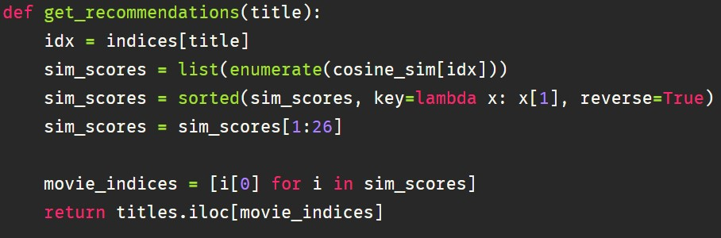
Code Snippet
Sorted the movies in descending order of their cosine similarity score.

Slide 12
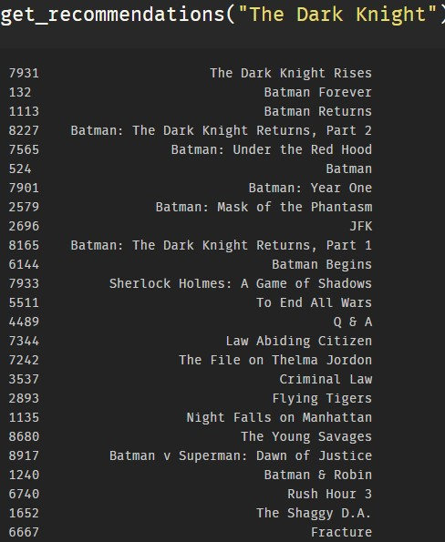
Output
These are recommendations based on user's preference but some low rated movies are present

Slide 13
Rating
Collaborative Filtering
User feature
Weight
Final Recommender
select the highest user feature weight
Content based recommendation
Hybrid Recommendation
Content and collaborative hybrid combiner

