Slide 1
BilliardBall.py

Slide 2


Slide 3
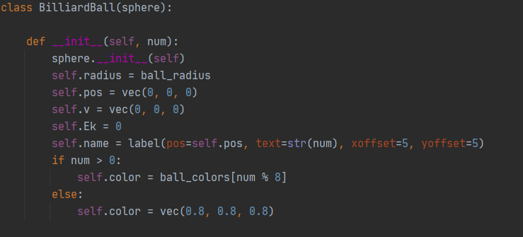

Slide 4
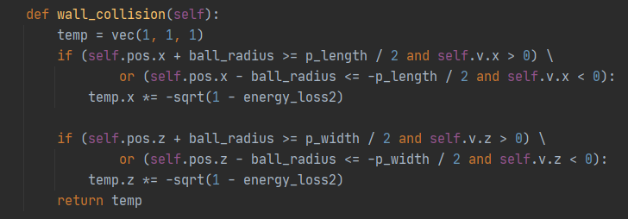

Slide 7
Billiard_ball_simulator.py

Slide 8
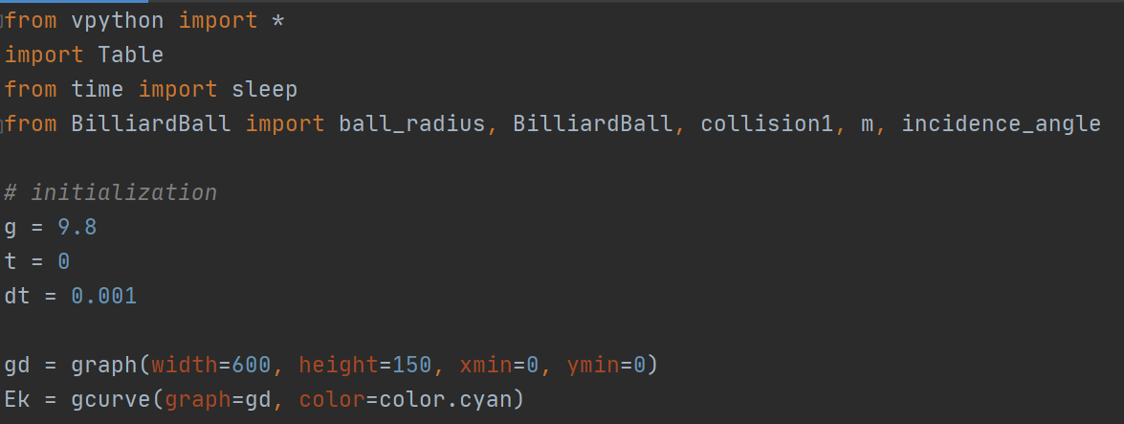

Slide 9
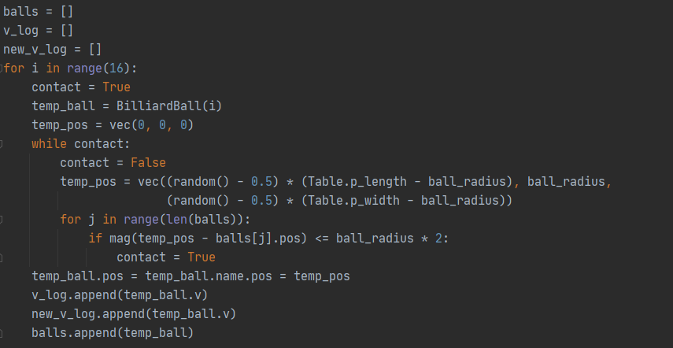

Slide 14



Slide 17


Slide 19
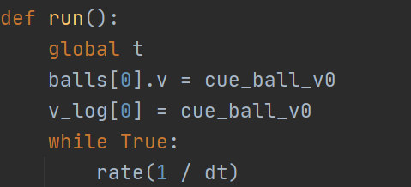

Slide 20
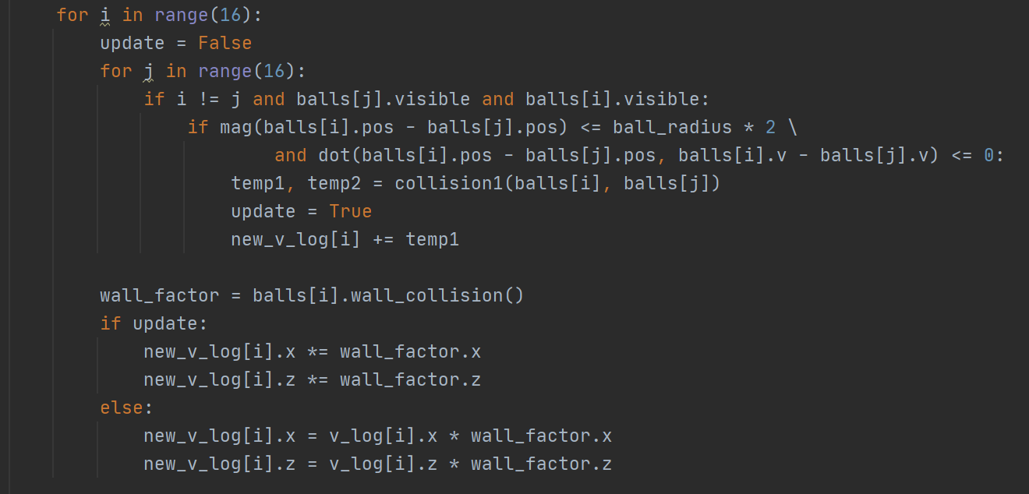

Slide 23


Slide 26


Slide 27


Slide 28
