Slide 1
Popularity-aware content‐based recommender
Jakobitsch, Waysocher, Widmann

Slide 2
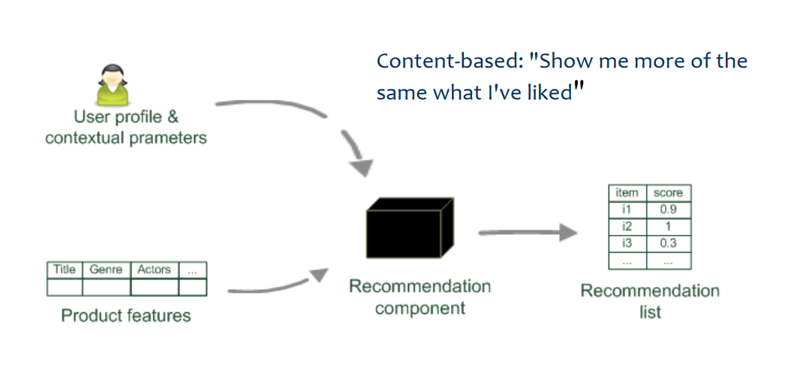
Idea

Slide 3
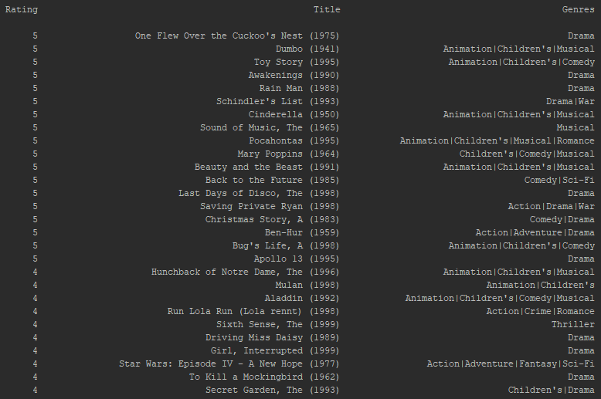
User Profile
Average
(Action, Adventure, Animation, Children’s, Comedy, Crime, …)
(4.2, 4, 3.17, 4.27, 4.13, 4, …)
Occur more than 1
(Action, Adventure, Animation, Children’s, Comedy, Crime, …)
(0, 0, 1, 1, 1, 0, …)
Occurrence/ranking count
(Action, Adventure, Animation, Children’s, Comedy, Crime, …)
(0, 0, 0.18, 0.23, 0.14, 0, …)

Slide 4
Similarity
Many Possibilities (e.g. using the dice coefficient)
Can be influenced by popularity or other means (E.G. sponsorship)
For our Assignment We created two variants
The first one Get all movies which have at least one genre from the user profile and ranked them based on the popularity
The second Variant uses an user profile with ranked Genres and multiply the user profile with the popularity to get a score

Slide 5
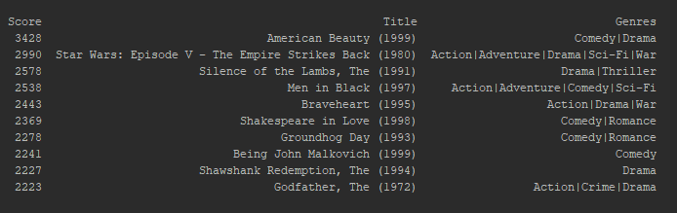
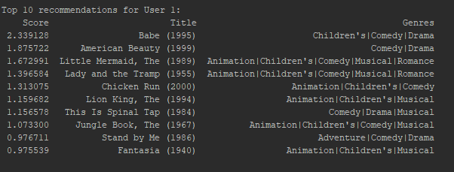
Example Result
Variant 1
Variant 2

