Slide 1
Assignment 4 - RESULTS
Jakobitsch, Waysocher, Widmann

Slide 2
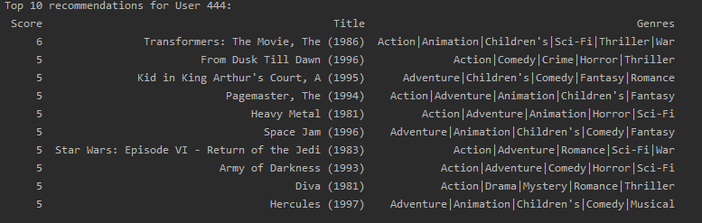
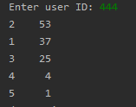
3.2) simple overlap in genres ignoring the amount of ratings
This solution heavily favours movies with multiple genres (because more genres = more potential overlap)
  I tested multiple users and did not find a single movie with less than 3 genres
  Basically a sort by amount of genres function
This shows how often the user rated movies(second column) with the amount of genres (first column)

Slide 3
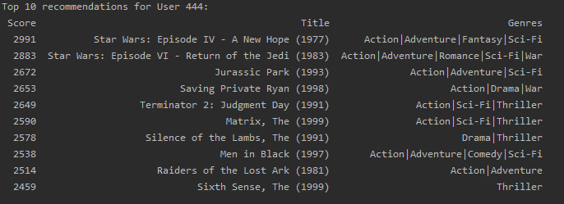
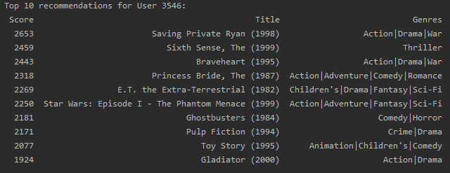
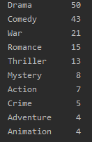
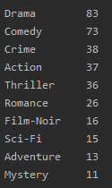
3.3) consider the popularity of the movie
+remove movies without overlap
Does actually work, but it distorts heavily based on popularity now
  the user probably likes genres with multiple of HIS good ratings better
TOP 2 Genres occur in only 3 movies
Amount of good ratings per genre
Notes:
User 144: 120 reviews, 50 and 43 nearly half of his movies, they should be WAY more prominent in the recomendations
User 3546: Seems better right? Well it‘s not, he just watched the other movies!
Since they basically all reviewed every genre positive at least once this is again simply a list of the popular ratings – watchedmovies

Slide 4
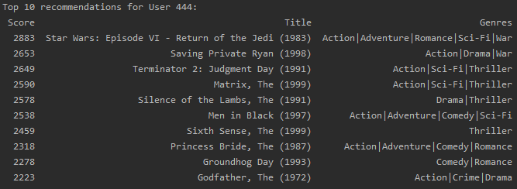
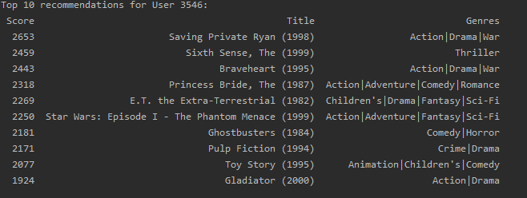
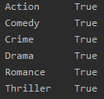
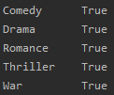
3.4) consider the genre_count
Here we simply filter out “bad” genres that have under the average amount of positive reviews
This still gets distorted by the popularity of the movies, since the genres are only considered with a boolean
Genres that still count
Notes:
Better, actually does something except for displaying stats that are easier accessible from somewhere else

Slide 5
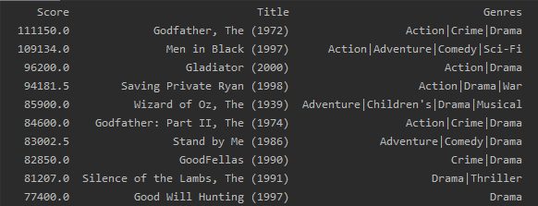
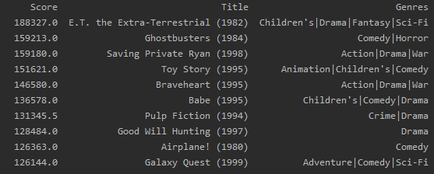
3.4) Advanced user_profile now has RATED genres
Rating is very simple: average amount of good reviews of all genres*popularity
User 444
User 3546
While the popularity still affects this metrics (look at Saving Private Ryan for example)
this algorithm also considers the amount of good reviews the user gives per genre

Slide 6
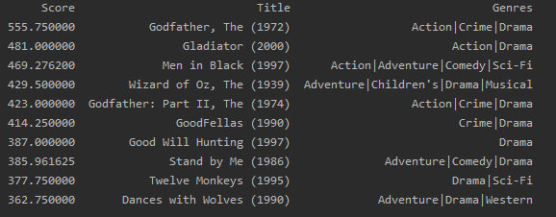
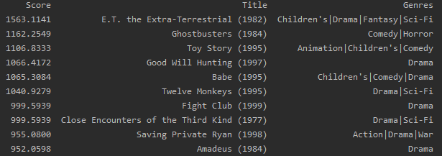
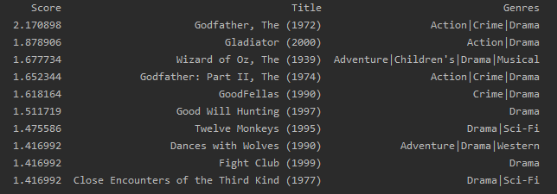
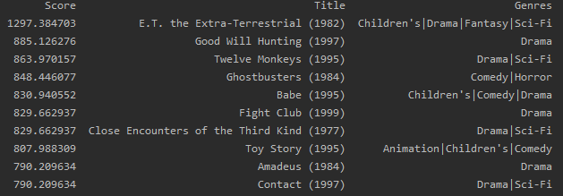
changing the importance of the genre-rating
(Genre-rating/100)²*popularity-rating
(Genre-rating/100)^10 *popularity-rating
(Genre-rating/100)³ *popularity-rating
Explanation: by using a logarithmic function on the rating the weight of multiple “good” reviews
is increased highly for that genre, therefore we see those genres way more
More good reviews = increasingly more impact for the genre
Notes:
The /100 is to keep the score smaller, it doesn’t really matter
444: Stopped changing at times 4
3546: Stopped changing at times 6
At that point the popularity probably became insignificant -> the value should not be higher than 3 at most, best is probably keeping it at

Slide 7
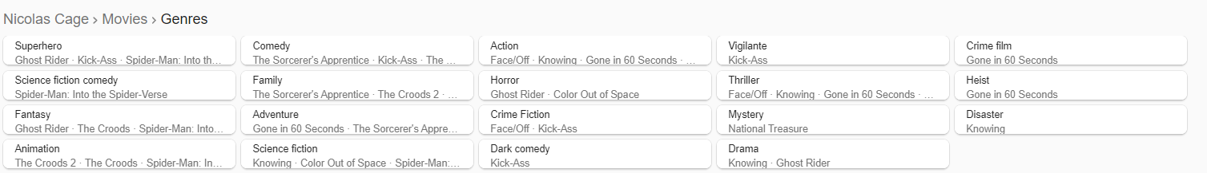
Some things to consider
If I watch over 1000 dramas but rate them rather poorly and on the other hand I only watch like 10 comedies, but rate them highly.
  Can we really assume I like comedies more?
  At what rate can we make such a choice (with closer numbers the average rating will probably become more important)
  Status quo bias
Simply taking movies and ratings are not enough metrics
  Example: The user loves Nicolas Cage as an actor and rates ALL his movies
  highly, if Cages stars in a new movie that SHOULD be recommended/ considered too
    Again: How important is a preference like this and should it be variable for
    different users?

