Slide 1

Open Powerlifting Database
Over 3,000 meets and 300,000 lifts from competitions worldwide
Michael Morales
Mark Burkart
Ramon Flete
John Reedy

Slide 2
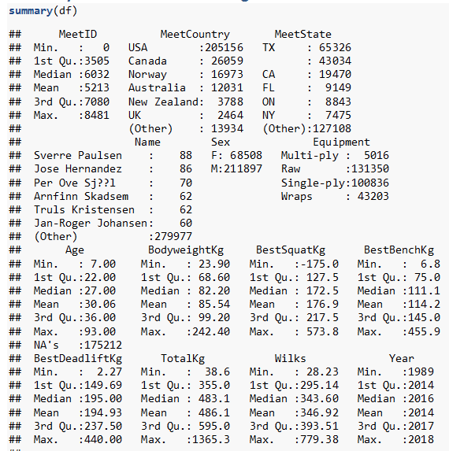
Powerlifting Data Set
This dataset includes meet data from powerlifting meets included in the OpenPowerlifting database.
We used data from the last 30 years, although the dataset goes back further.
Column Name | Description
mEET | Unique ID of the powerlifting meet
Equipment | Multi-ply: composite weightlifting uniform that improves stability Single-ply: weightlifting uniform that improves stability Wraps: hand or knee wraps that provide added stability Raw: no equipment used
Bodyweight | Weight of powerlifting contestant in KG
Best Squat | Best of all attempts in squat
Best bench | Best of all attempts in bench
best deadlift | Best of all attempts in deadlift
total | Sum of the preceding three categories
wilks | “This conundrum of ranking athletes of different weights was tackled by Robert Wilks, the CEO of Powerlifting Australia. He came up with the following formula with the intent of leveling the playing field between men and women of different weights.” https://barbend.com/best-wilks-scores/ = (total lifted)*500/(a+bx+cx²+dx³+ex⁴+fx⁵) (coefficients found in formula below) Where x is the body weight of the lifter in kilograms. The coefficients differ for men and women. https://web.archive.org/web/20120204064459/http://www.isu.edu/~andesean/wform.htm

Slide 3
Questions About the Data
Which set of lifts influence the Wilks Score the most?
Does bench press total affect squat or deadlift total?
Does equipment change the Wilks Score?
Is there a relationship between Wilks and Body weight?

Slide 4
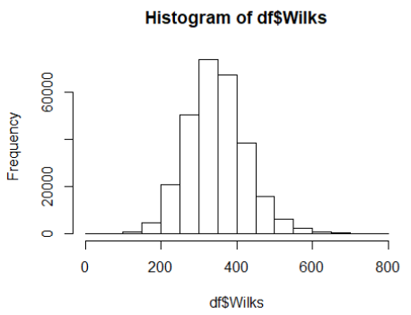
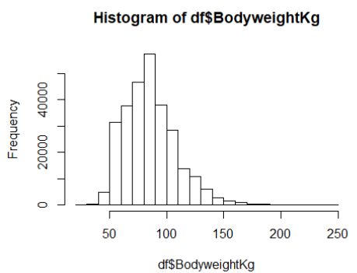
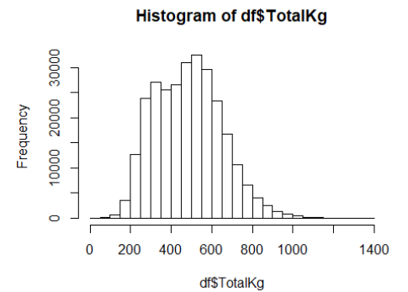
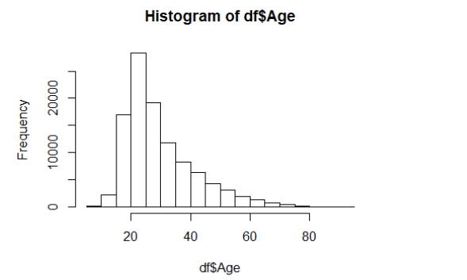
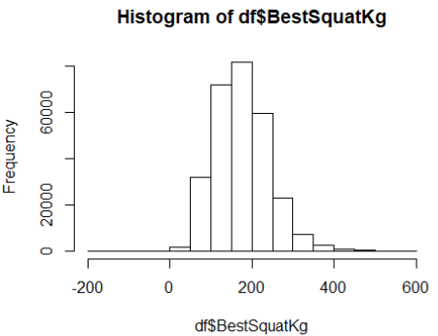
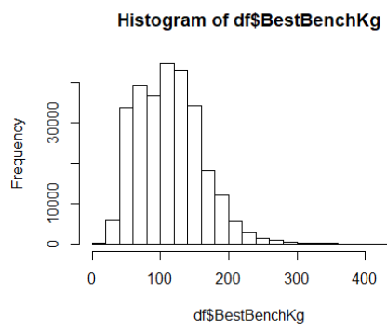
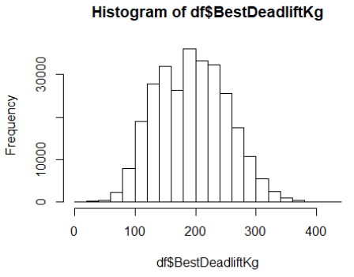
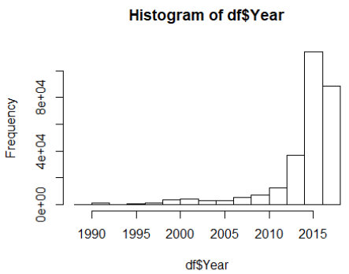
Plotting the Data
Starting with Histograms on the data

Slide 5
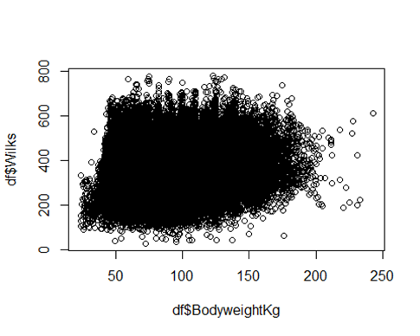
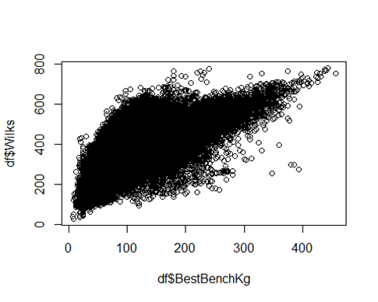
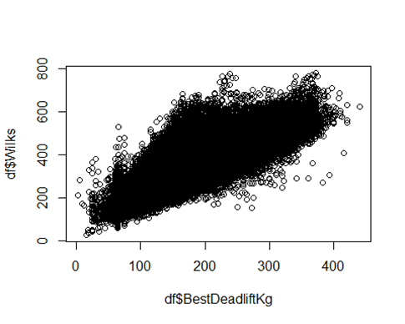
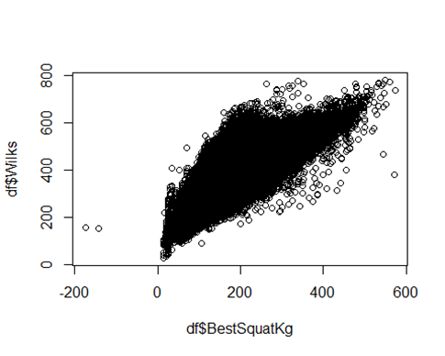
Plotting lifts and weight vs Wilks Scores

Slide 6
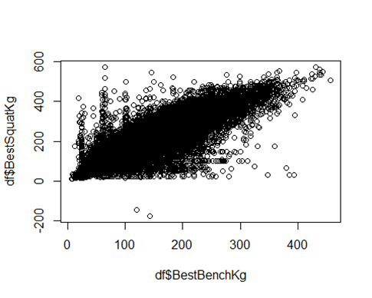
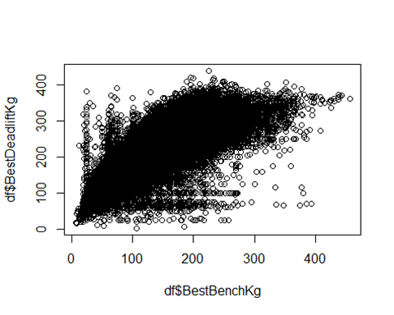
Does Bench press effect Squat or Deadlift?

Slide 7
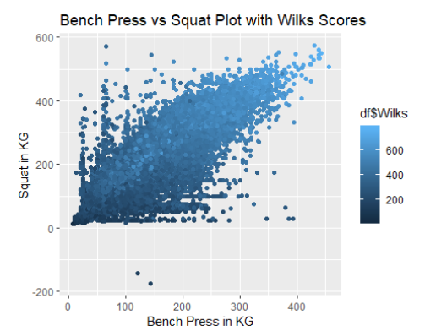
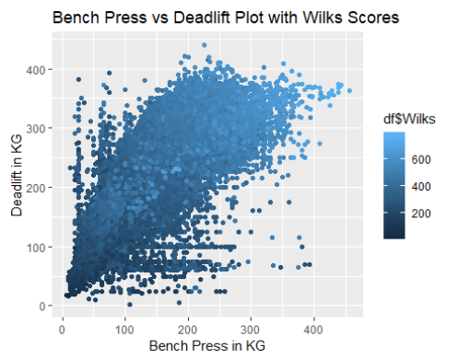
Does Bench press affect Squat or Deadlift?

Slide 8
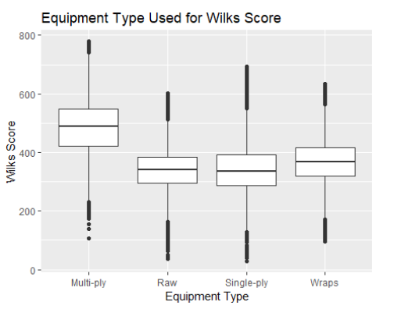
Does Equipment influence Wilks score?

Slide 9
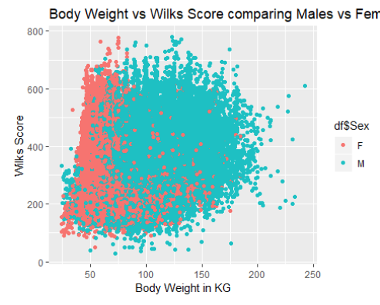
Looking at body weight and Wilks Score

Slide 10
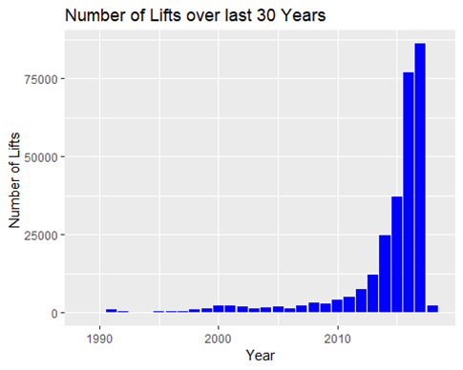
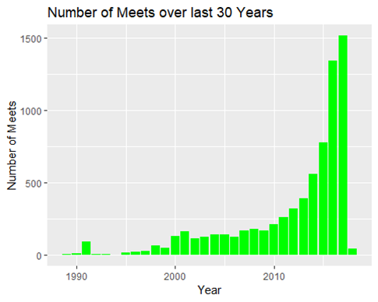
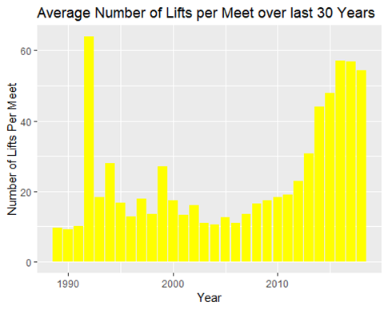
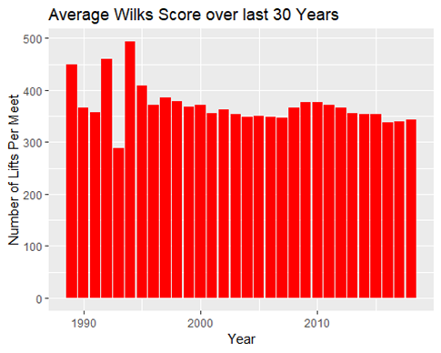
Summary over time

Slide 11
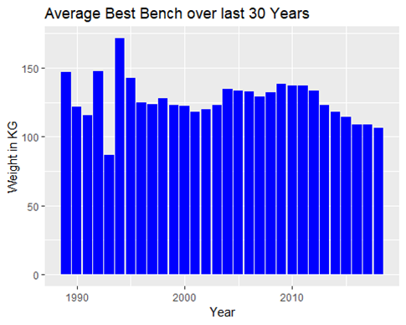
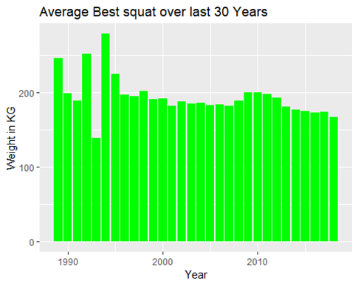
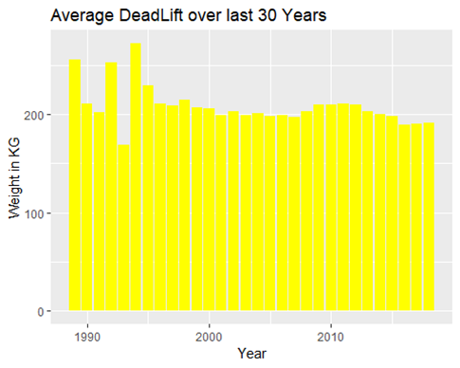
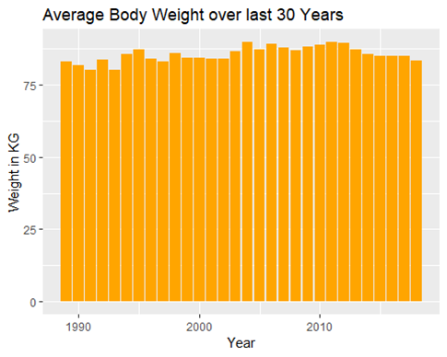
Averages of Lifts over time

Slide 12
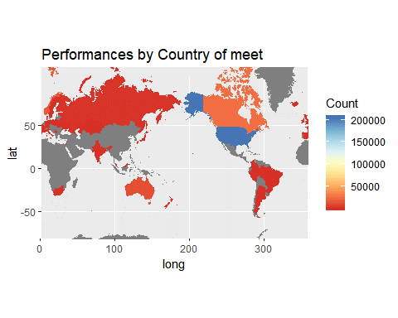
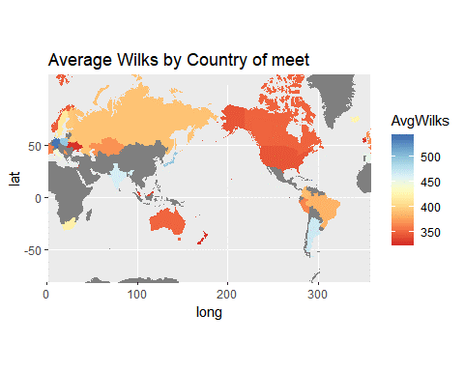
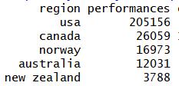
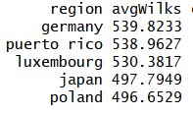
Geographic Distribution
Lift counts and average Wilks by meet country
1) By far most of the meets were held in the U.S. (~205k)
2) The highest avg wilks scores were obtained in meets held in Germany, Puerto Rico, and Luxemborg

Slide 13
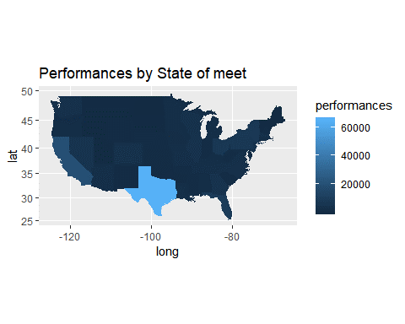
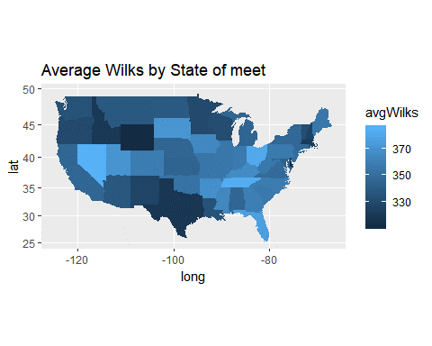
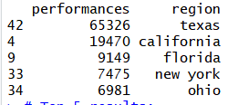
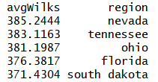
Geographic Distribution
Lift counts and average Wilks by meet state (US meets only)
1) By far most of the meets were held in Texas (~65k)
2) The highest avg wilks scores were obtained in meets held in Nevada, Tennessee, and Ohio

Slide 14
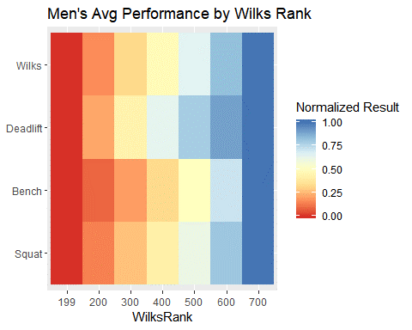
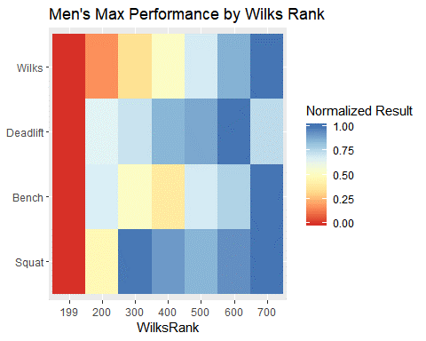
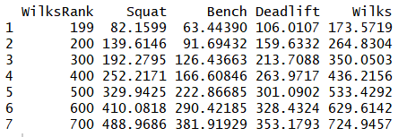
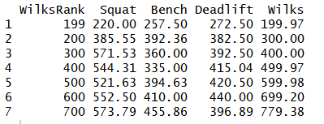
Comparison of Wilks score to Lift Type - Men
1) For men, avg squat appears most similar to avg Wilks across all Wilks ranks
2) For men, max bench appears most similar to max Wilks across all Wilks ranks

Slide 15
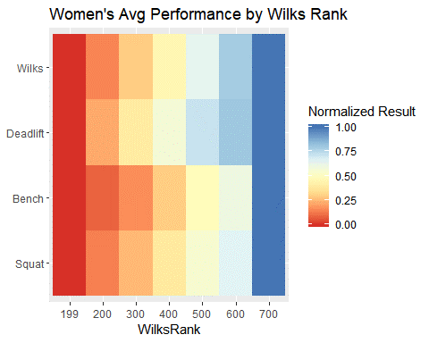
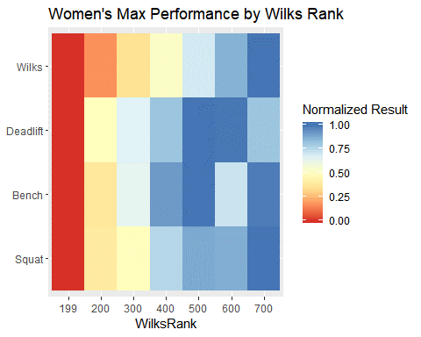
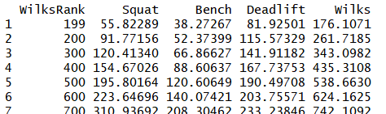
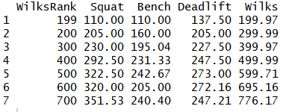
Comparison of Wilks score to Lift Type - Women
1) For women, avg squat appears most similar to avg Wilks across all Wilks ranks
2) For women, max squat appears most similar to max Wilks across all Wilks ranks

Slide 16
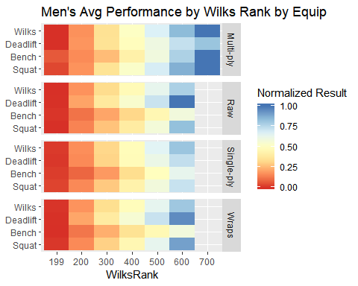
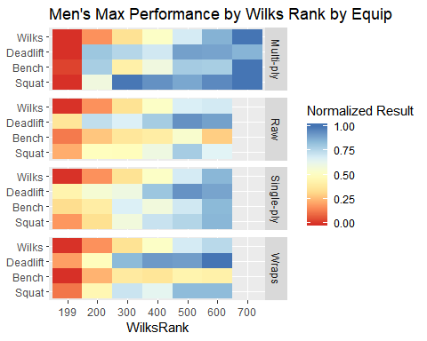
Comparison Wilks to lift type w/ Equipment - Men
1) The very highest Wilks ranks were only obtained by those using Multi-ply equipment
2) Single-ply and double-ply improve performance vs. Raw, especially in Bench press. This makes sense because multi-ply shirts stabilize the shoulders during lifting.

Slide 17
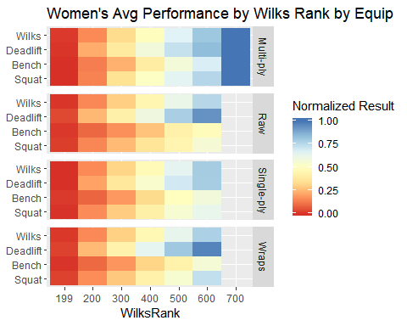
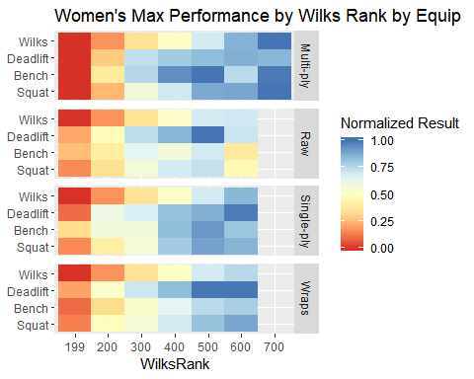
Comparison Wilks to lift type w/ Equipment - Women
1) The very highest Wilks ranks were only obtained by those using Multi-ply equipment
2) Single-ply and double-ply improve performance vs. Raw, especially in Bench press. This makes sense because multi-ply shirts stabilize the shoulders during lifting.

Slide 18
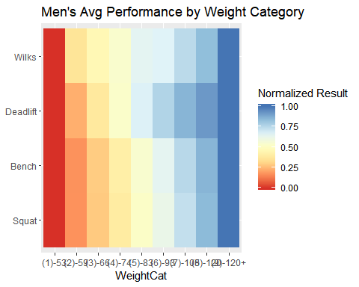
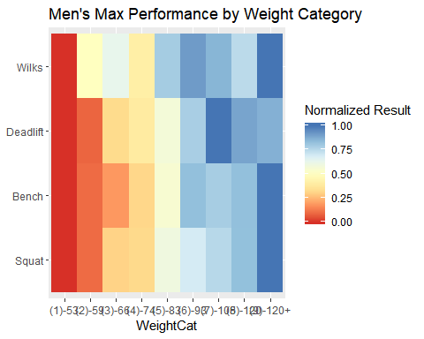
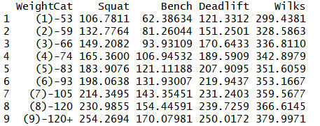

Comparison of Wilks to Weight Category - Men
1) The avg performances for each lift type are positively correlated with increasing weight.
3) The max performances in each lift type are positively correlated with increasing weight.

Slide 19




Comparison of Wilks to Weight Category - Women
1) The avg performances for each lift type are positively correlated with increasing weight.
2) An unexpected result was that the avg Wilks was negatively correlated with increasing weight.
3) The max performances in each lift type are positively correlated with increasing weight.
4) The highest max Wilks rank was obtained by an individual in the second highest weight category who also has the highest squat

Slide 20


Relationship of Wilks and Body Weight
1) In an attempt to achieve a single metric that can be used for both men and women, the Wilks metric is calculated with a different set of coefficients for each sex.
2) For men, the observed avg Wilks has a positive correlation to avg body weight across body weight categories (Pearson 0.989 for weight categories 2-9)
2) For women, the observed avg Wilks has a negative correlation to avg body weight across body weight categories (Pearson -0.977 for weight categories 2-8)

Slide 21

Regression Slides

Slide 22

Regression Slides

Slide 23

Regression Slides

Slide 24

Regression Slides

Slide 25
KSVM
library(arules)
library(tidyverse)
library(arulesViz)
library(kernlab)
library(e1071) library(neuralnet)
library(MASS)
Reading in the csv file
plData <- read.csv(file="C:/PLTrimmed2.csv", header = TRUE)
Creating training and testing datasets
randIndex <- sample (1:dim(plData)[1]) #making a randomized index to avoid systematic bias cutPoint2_3 <- floor(2*dim(plData)[1]/3) #calculating 2/3 cut point based on number of rows trainPLdata <- plData[randIndex[1:cutPoint2_3],] #randomized training data of 2/3 of the dataset testPLdata <- plData[randIndex[(cutPoint2_3+1):dim(plData)[1]],] #randomized test data of 1/3 of the set

Slide 26
KSVM Continued
Building the model
We used C=50 because the previous model at C=5 produced a high rate of error. C=50 did not improve the error, however. Training error in the example in the text was around .8%, while we saw error of more than 90% in each model. Cross validation error was also very high.
svmWilksbw <- ksvm(Wilks ~ BodyweightKg, data=trainPLdata, kernel = "vanilladot",kpar="automatic",C=50,cross=3,prob.model=TRUE)
## Setting default kernel parameters
svmWilksbw
## Support Vector Machine object of class "ksvm" ## SV type: eps-svr (regression) ## parameter : epsilon = 0.1 cost C = 50 ## Linear (vanilla) kernel function. ## Number of Support Vectors : 170860 ## Objective Function Value : -6264243 ## Training error : 0.96763 ## Cross validation error : 5708.135 ## Laplace distr. width : 0
In the Spam example in the book, these values (in red) are very low.

Slide 27
KSVM continued
Predictions
alphaindex(svmWilksbw)[[1]][alpha(svmWilksbw)[[1]] < 0.05] #list of support vectors next to list from training data
## integer(0)
svmPred <- predict(svmWilksbw, testPLdata, type = "votes") #confusion matrix str(svmPred)
## num [1:93469, 1] 327 356 376 337 365 ... ## - attr(*, "dimnames")=List of 2 ## ..$ : chr [1:93469] "39483" "134590" "270933" "39940" ... ## ..$ : NULL
compTable <- data.frame(testPLdata[,13], svmPred[1,]) #13 is the last column containing the type variable
## Warning in data.frame(testPLdata[, 13], svmPred[1, ]): row names were found ## from a short variable and have been discarded
table(compTable) #returns the confusion matrix as output

Slide 28
KSVM Conclusions
The code returned the confusion matrix, but it seems flawed because we are not looking for a yes or no.
Following the instructions from the text (voting on whether email was spam or not spam) we have results, but they do not seem productive. The hypothesis was that higher bodyweight was a good predictor of higher Wilks score, but the SVM didn’t seem to clear this up. With more time, it may have been possible to find a way to classify a distinction between high and low Wilks. Perhaps a way to use the SVM would be to designate a 0 for Wilks scores below the mean and a 1 for scores above it. That would allow us to vote on which bodyweights could be predicted to produce Wilks scores above or below the mean.

Slide 29
randomForest
Random Forest
The Random Forest was run in Rattle, which the code will indicate.
# Load the dataset from file.
fname <- "file:///C:/PLTrimmed2.csv"
rfPlData <- read.csv(fname,
na.strings=c(".", "NA", "", "?"),
strip.white=TRUE, encoding="UTF-8")

Slide 30
randomForest continued
# Action the user selections from the Data tab.
# Build the train/validate/test datasets.
# nobs=280405 train=196284 validate=42061 test=42060
set.seed(crv$seed)
crs$nobs <- nrow(crs$dataset)
crs$train <- sample(crs$nobs, 0.7*crs$nobs)
crs$nobs %>%
seq_len() %>%
setdiff(crs$train) %>%
sample(0.15*crs$nobs) ->
crs$validate
crs$nobs %>%
seq_len() %>%
setdiff(crs$train) %>%
setdiff(crs$validate) ->
crs$test
# The following variable selections have been noted.
crs$input <- c("MeetID", "MeetCountry", "MeetState", "Name",
"Equipment", "Age", "BodyweightKg", "BestSquatKg",
"BestBenchKg", "BestDeadliftKg", "TotalKg",
"Wilks", "Year")
crs$numeric <- c("MeetID", "Age", "BodyweightKg", "BestSquatKg",
"BestBenchKg", "BestDeadliftKg", "TotalKg",
"Wilks", "Year")
crs$categoric <- c("MeetCountry", "MeetState", "Name",
"Equipment")
crs$target <- "Sex"
crs$risk <- NULL
crs$ident <- NULL
crs$ignore <- NULL
crs$weights <- NULL

Slide 31
randomForest continued
# Build the train/validate/test datasets.
# nobs=280405 train=196284 validate=42061 test=42060
set.seed(crv$seed)
crs$nobs <- nrow(crs$dataset)
crs$train <- sample(crs$nobs, 0.7*crs$nobs)
crs$nobs %>%
seq_len() %>%
setdiff(crs$train) %>%
sample(0.15*crs$nobs) ->
crs$validate
crs$nobs %>%
seq_len() %>%
setdiff(crs$train) %>%
setdiff(crs$validate) ->
crs$test
# The following variable selections have been noted.
crs$input <- c("MeetID", "MeetCountry", "MeetState", "Name",
"Sex", "Equipment", "BodyweightKg", "BestSquatKg",
"BestBenchKg", "BestDeadliftKg", "TotalKg",
"Year")
crs$numeric <- c("MeetID", "BodyweightKg", "BestSquatKg",
"BestBenchKg", "BestDeadliftKg", "TotalKg",
"Year")
crs$categoric <- c("MeetCountry", "MeetState", "Name", "Sex",
"Equipment")
crs$target <- "Wilks"
crs$risk <- NULL
crs$ident <- NULL
crs$ignore <- "Age"
crs$weights <- NULL

Slide 32
randomForest continued
# Build randomForest model using traditional approach.
set.seed(crv$seed)
crs$rf <- randomForest::randomForest(Wilks ~ .,
data=crs$dataset[crs$train, c(crs$input, crs$target)],
ntree=100,
mtry=2,
sampsize=c(38408),
importance=TRUE,
na.action=randomForest::na.roughfix,
replace=FALSE)
# Generate textual output of the 'Random Forest' model.
crs$rf
# List the importance of the variables.
rn <- crs$rf %>%
randomForest::importance() %>%
round(2)
rn[order(rn[,1], decreasing=TRUE),]
# Score the validation dataset.
# Obtain predictions for randomForest model.
crs$pr <- predict(crs$rf, newdata=na.omit(crs$dataset
[crs$validate,
c(crs$input)]))
# Extract the relevant variables from the dataset.
sdata <- subset(crs$dataset[crs$validate,],
select=c("Wilks"))

Slide 33
randomForest Conclusions
The Random Forest gave us a spreadsheet with two columns. One is the observed Wilks scores and the other is the predicted scores (?) from the Random Forest analysis. The means and medians from each are very similar, but it’s difficult to ascertain what that tells us. Since this was run with Wilks as the target against bodyweight with 500 trees, we made the decision to run it again with 3 variables and 250 trees, again with Wilks as the target. Below is the code.
Click to add terandomForest(formula = Wilks ~ .,
data = crs$dataset[crs$train, c(crs$input, crs$target)],
ntree = 200, mtry = 3, importance = TRUE, replace = FALSE, na.action = randomForest::na.roughfix)xt

Slide 34

randomForest Summary – 250 Trees

Slide 35


Slide 36

Example of the output of the randomForest
Since this was a regression model, a value was recorded for each observation. This is the testing data.

Slide 37

Summary rF model of the testing data by predicted value cutoffs

Slide 38

Recall, Caseload, and Precision

