Slide 1
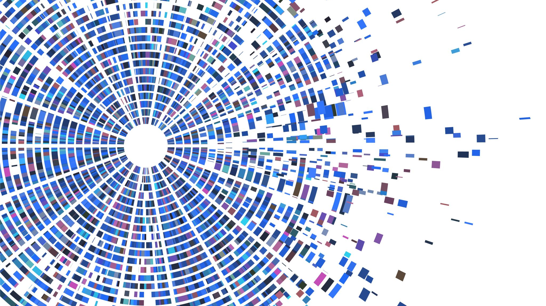
Bioinformatics: Coding Necessities
Jacob M. Green
MARC Summer Program

Slide 2
Check - In
How are you doing this week?

Slide 3
Check - In
How are you doing this week?
Accomplishments
Concerns

Slide 4
Check - In
How are you doing this week?
Accomplishments
Concerns
What did you get out of the professional development sessions?
Was there anything you felt was missing?
What could be improved upon?

Slide 5
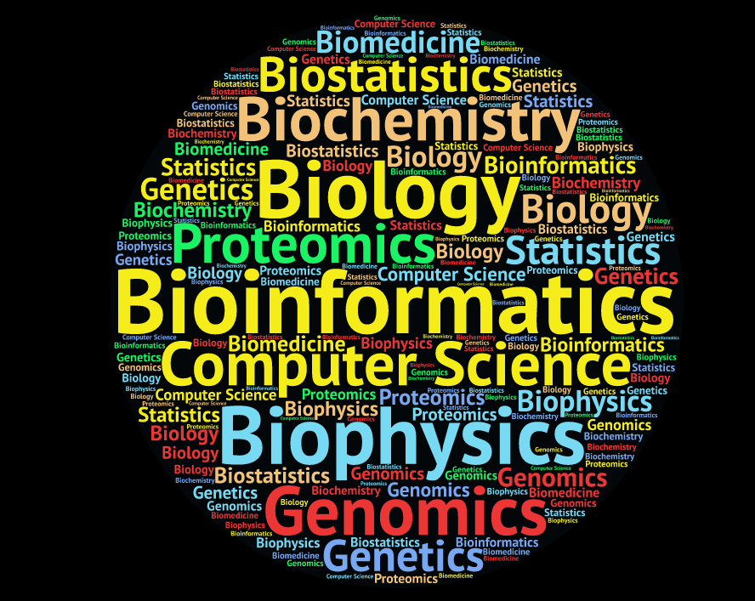

Slide 6
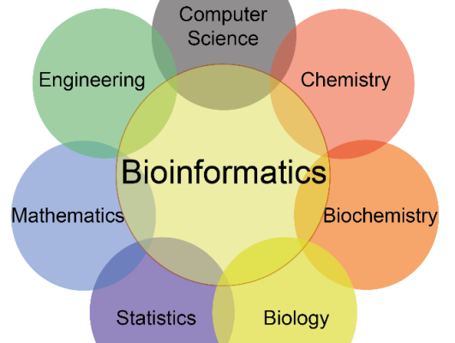

Slide 7
What are we doing?
We are going to work together side by side
Go here: https://astrobiomike.github.io/unix/getting-started
Resources here: https://www.youtube.com/channel/UC5qVqcvUPfgPQWOhBaR_Low
Community here: https://bioinformatic-vcn.slack.com/

Slide 8
Reflection
What was the easiest concept today? Why?
What was the most difficult? Why?
Access your terminal
Mac: Utilities -> Terminal
Windows: Install git-bash
If you need help email me
Navigate through your own computer and use some of the commands we learned

