Slide 1
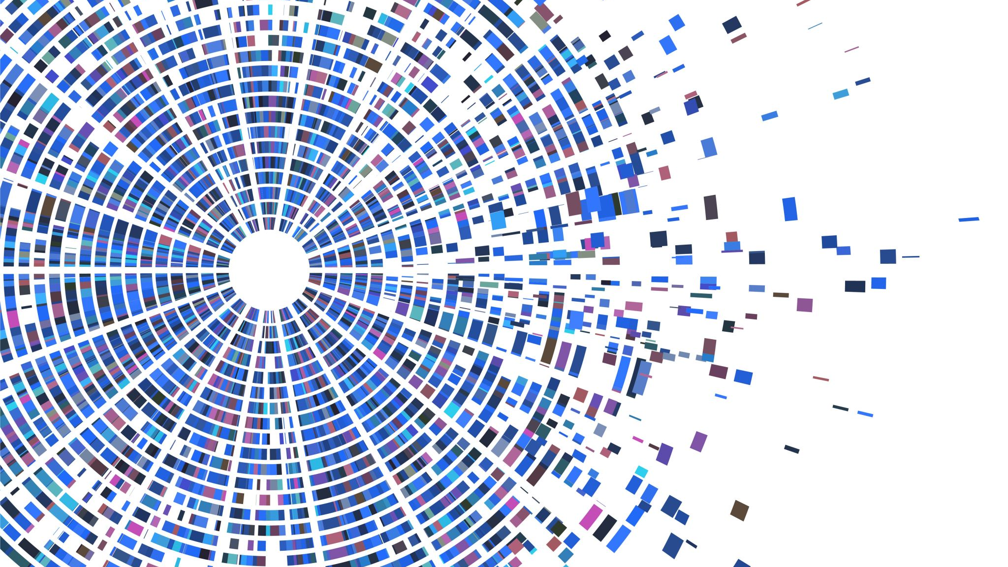
Bioinformatics: Coding Necessities 2
Jacob M. Green
MARC Summer Program

Slide 2
Agenda
500 – 525 pm Check-in
525 – 530 pm Warm up
530 – 615 pm Happy Belly Bioinformatics lesson 2/3 workflow
615 – 630 pm Reflection and Exercises to work

Slide 3
Check - In
How are you doing this week?

Slide 4
Check - In
How are you doing this week?
Accomplishments
Concerns

Slide 5
Check - In
How are you doing this week?
Accomplishments
Concerns
Did anyone try to join the BVCN slack group?

Slide 6
Warm-up (2 mins)
What are the commands, concepts, or skills that were most interesting to you? Why?
Commands: date, head, pwd, ls, cd, find
Concepts: Paths (abs. vs rel.), root, home, tab-completion
Skills: Running commands, navigating directory structures

Slide 7
What are we doing?
We are going to work together side by side
Launch this: https://mybinder.org/v2/gh/AstrobioMike/binder-unix-intro/master?urlpath=lab
Open this: https://astrobiomike.github.io/unix/working-with-files-and-dirs

Slide 8
Reflection
What was the easiest concept today? Why?
What was the most difficult? Why?
Notes:
Command and argument,

Slide 9
To do
Do we want to go into Genome Assembly or work with R?
Notes:
Command and argument,

Slide 10
To do
Do we want to go into Genome Assembly or work with R?
Exercises to assist in command-line comfortability
Exercise 1: Make directories and download data
Exercise 2: Edit files and manipulate them
Exercise 3:
Notes:
Command and argument,

Slide 11
Exercise 1

Slide 12
Exercise 2

Slide 13
Exercise 3

