Slide 1
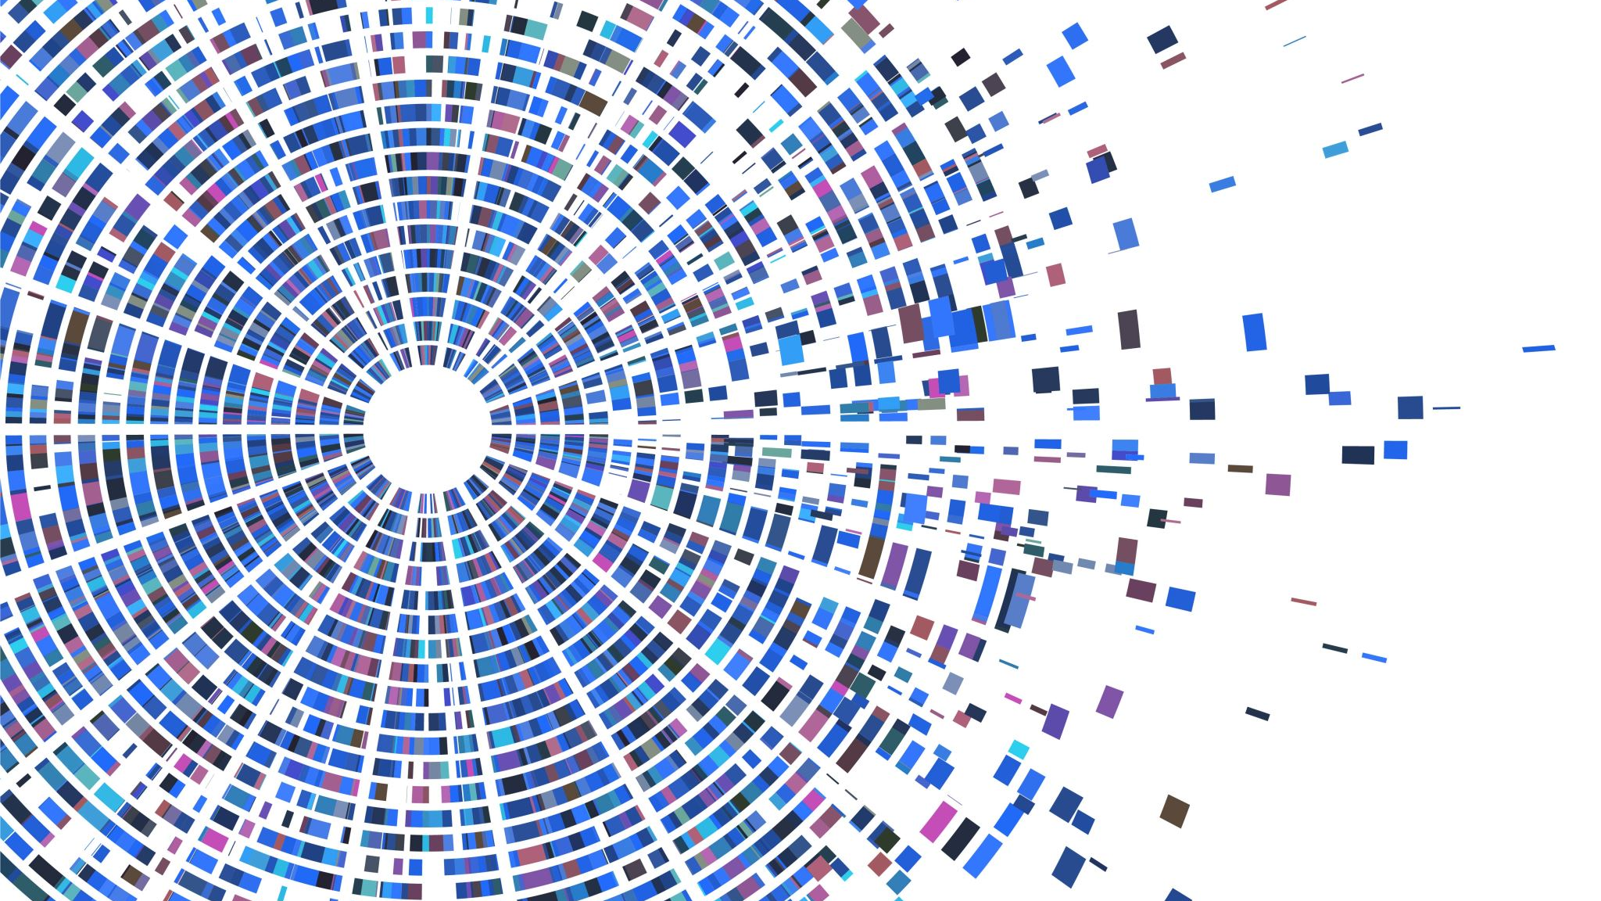
Bioinformatics: Coding Necessities
Jacob M. Green
MARC Summer Program

Slide 2
Agenda
500 – 525 pm Check-in
525 – 530 pm Contextualize bioinformatics
530 – 615 pm Coding necessities workflow
615 – 630 pm Reflection

Slide 3
Check - In
How are you doing this week?

Slide 4
Check - In
How are you doing this week?
Accomplishments
Concerns

Slide 5
Check - In
How are you doing this week?
Accomplishments
Concerns
What did you get out of the professional development sessions?
Was there anything you felt was missing?
What could be improved upon?
Notes:
Figure out a way for further engagement, hopefully in person next year, learned a bit about presenting yourself online, elaborate on how to set up academic blogs, planning applications, resume, self-reflection and adding to those things that you know about yourself, going over CV’

Slide 6
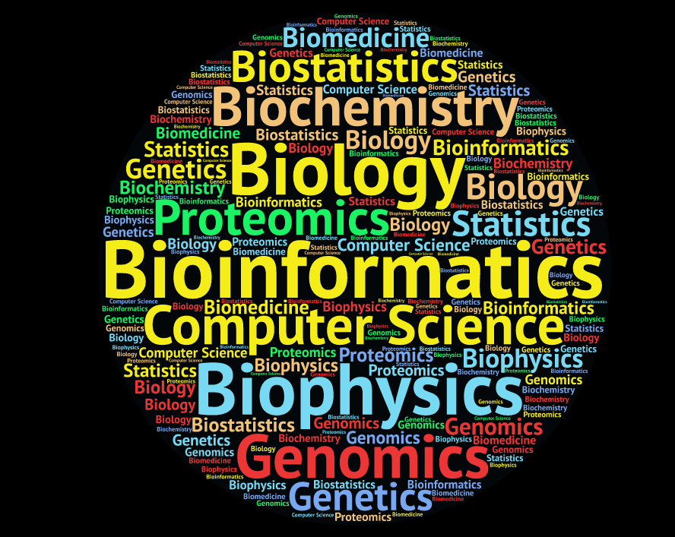

Slide 7
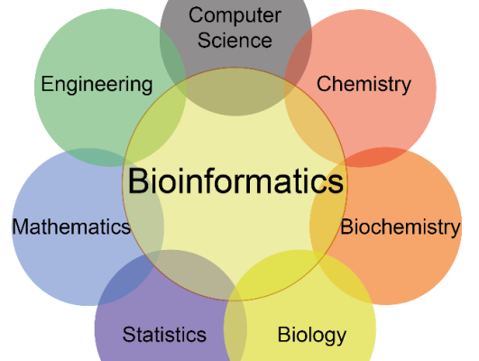

Slide 8
What are we doing?
We are going to work together side by side
Go here: https://astrobiomike.github.io/unix/getting-started

Slide 9
What are we doing?
We are going to work together side by side
Go here: https://astrobiomike.github.io/unix/getting-started
Resources here: https://www.youtube.com/channel/UC5qVqcvUPfgPQWOhBaR_Low
Community here: https://bioinformatic-vcn.slack.com/

Slide 10
Reflection
What was the easiest concept today? Why?
What was the most difficult? Why?
Notes:
Command and argument,

Slide 11
Reflection
What was the easiest concept today? Why?
What was the most difficult? Why?
Access your terminal
Mac: Utilities -> Terminal
Windows: Install git-bash
If you need help email me
Navigate through your own computer and use some of the commands we learned

