Slide 1
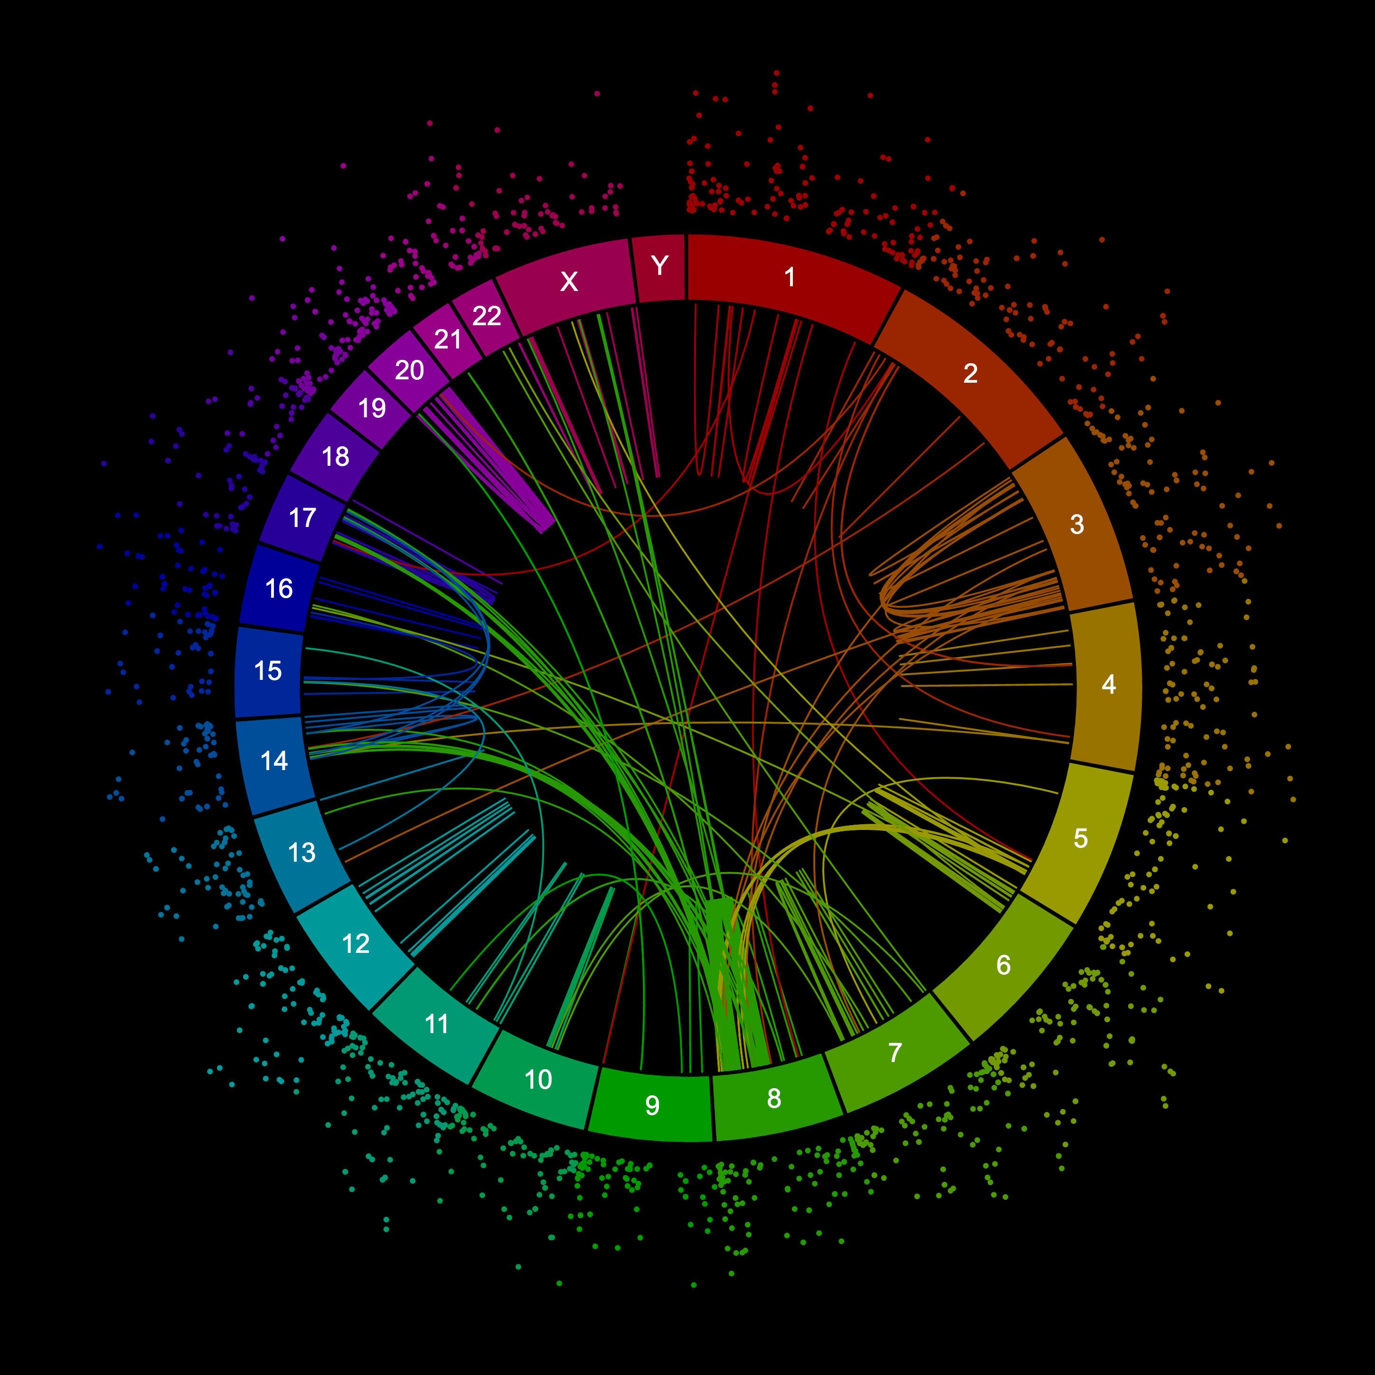
Bioinformatics: Coding Necessities 2
Jacob M. Green
MARC Summer Program
A circos plot of structural variations in a breast cancer cell line.

Slide 2
Agenda
500 – 520 pm Check-in
520 – 525 pm How do we see DNA?
525 – 530 pm Coding warm up
530 – 615 pm Happy Belly Bioinformatics lesson 2/3 workflow
615 – 630 pm Reflection and To do

Slide 3
Check - In
How are you doing this week?

Slide 4
Check - In
How are you doing this week?
Accomplishments
Concerns

Slide 5
Check - In
How are you doing this week?
Accomplishments
Concerns
Did anyone try to join the BVCN slack group?
SACNAS abstract deadline extended to August 6th

Slide 6
How have you seen DNA sequences displayed?

Slide 7
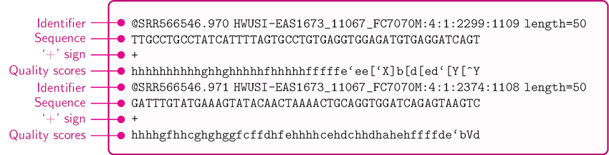
In computational biology we see .fq (fastq)

Slide 8
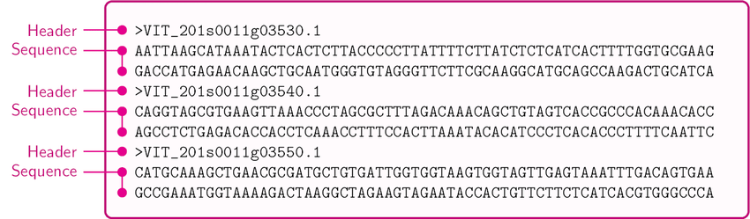
In computational biology we see .fa (fasta)

Slide 9
Warm-up (5 mins)
What are the commands, concepts, or skills that were most interesting to you? Why?
Commands: date, head, pwd, ls, cd, find
Concepts: Paths (abs. vs rel.), root, home, tab-completion
Skills: Running commands, navigating directory structures

Slide 10
What are we doing?
We are going to work together side by side
Launch this: https://mybinder.org/v2/gh/AstrobioMike/binder-unix-intro/master?urlpath=lab
Open this: https://astrobiomike.github.io/unix/working-with-files-and-dirs

Slide 11
Reflection
What was the easiest concept today? Why?
What was the most difficult? Why?
Notes:
Easiest: moving and changing directories,
Difficult: Altering text using nano, exiting different programs,

Slide 12
To do
Do we want to go into Genome Assembly or work with R?
Notes:
Command and argument,

Slide 13
To do
Do we want to go into Genome Assembly or work with R?
Exercises to assist in command-line comfortability
Notes:
Command and argument,

Slide 14
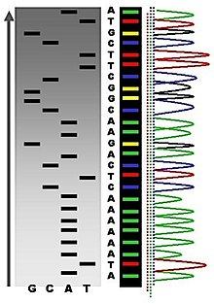
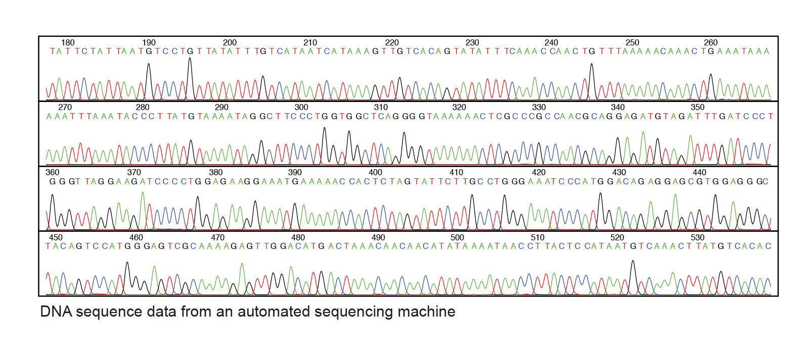
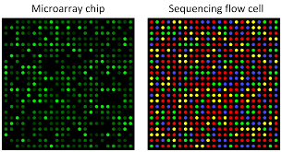
How do we view DNA sequences?

