Slide 1
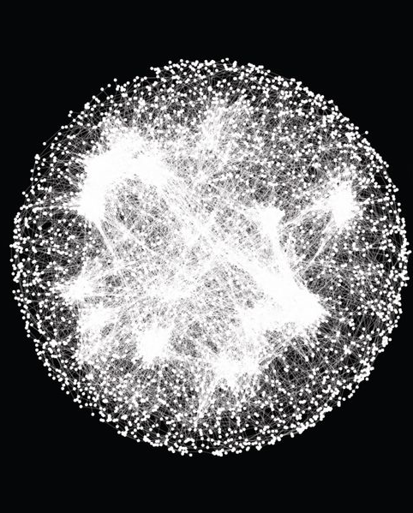
Bioinformatics: Coding Necessities 3
Jacob M. Green

Slide 2
Agenda
Check-in
Coding Warm-up
Bioinformatics lesson 3/4 workflow
Reflection and Exercises

Slide 3
Check-in
How are you doing this week?

Slide 4
Check-in
How are you doing this week?
Concerns?
Notes:
MD/PhD: lack of shadowing opportunities, 50 -100 hours. MA, RN, but would like physician shadowing. Getting in touch with people that have MD/PhD.
Dr. Menon:

Slide 5
Check-in
How are you doing this week?
Concerns?
To join BVCN slack group go here: google_form

Slide 6
Check-in
How are you doing this week?
Concerns?
To join BVCN slack group go here: google_form
Midsummer Reflection Update
Finding a Research Lab or Research Planning Guide due August 6th

Slide 7
Coding Warm-up
Get into binder
Navigate to folder with .fq files
Create a readme.txt file with an explanation of fastq format
This directory contains .fq, .tsv, and .txt files for samples 1-300
Fastq format is:
Line1: Identifier
Line2: Sequence
Line3: ‘+’ sign
Line4: Quality scores
Create copy of readme.txt and move to experiment directory
Bonus:
make new fastq_file directory in all_samples/
move all fastq files into the new fastq_file directory

Slide 8
Coding Warm-up
Get into binder
Navigate to folder with .fq files
Create a readme.txt file with an explanation of fastq format
This directory contains .fq, .tsv, and .txt files for samples 1-300
Fastq format is:
Line1: Identifier
Line2: Sequence
Line3: ‘+’ sign
Line4: Quality scores
Create copy of readme.txt and move to experiment directory
Bonus:
make new fastq_file directory in all_samples
move all fastq files into the new fastq_file directory

Slide 9
Reflection
What was the easiest concept today? Why?
What was the most difficult? Why?
Notes:
Easiest: review from previous sections, grep, cut
Hardest: making new files with carrot, warm-up question with being more specific, nano

Slide 10
To do
Coding exercises
Midsummer reflection
Finding a research lab or Research Planning Guide
Think about end of summer presentation

