Slide 1
Key Findings

Slide 2
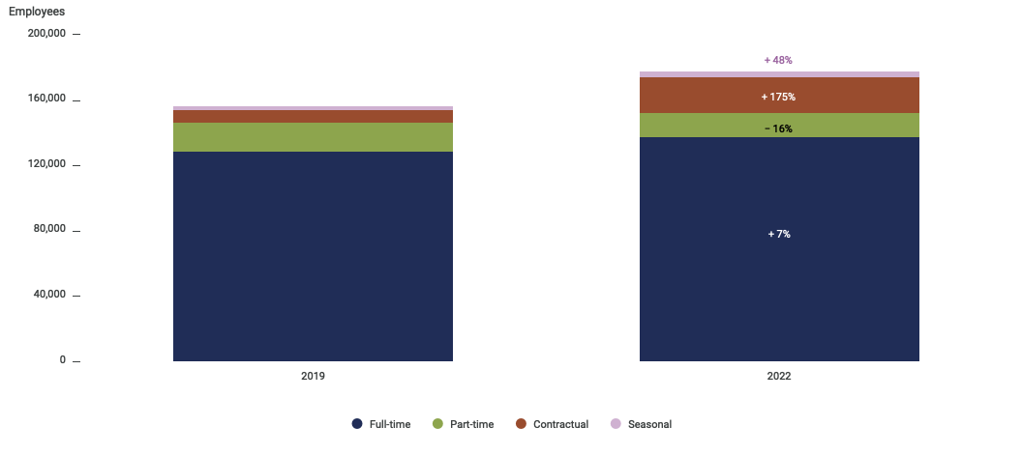
Workforce Trends
Workforce grew during the pandemic, but mostly among contract and seasonal workers.
The LHD workforce grew by 19% between 2019 and 2022, fueled by a 175% increase in contractual employees.

Slide 3
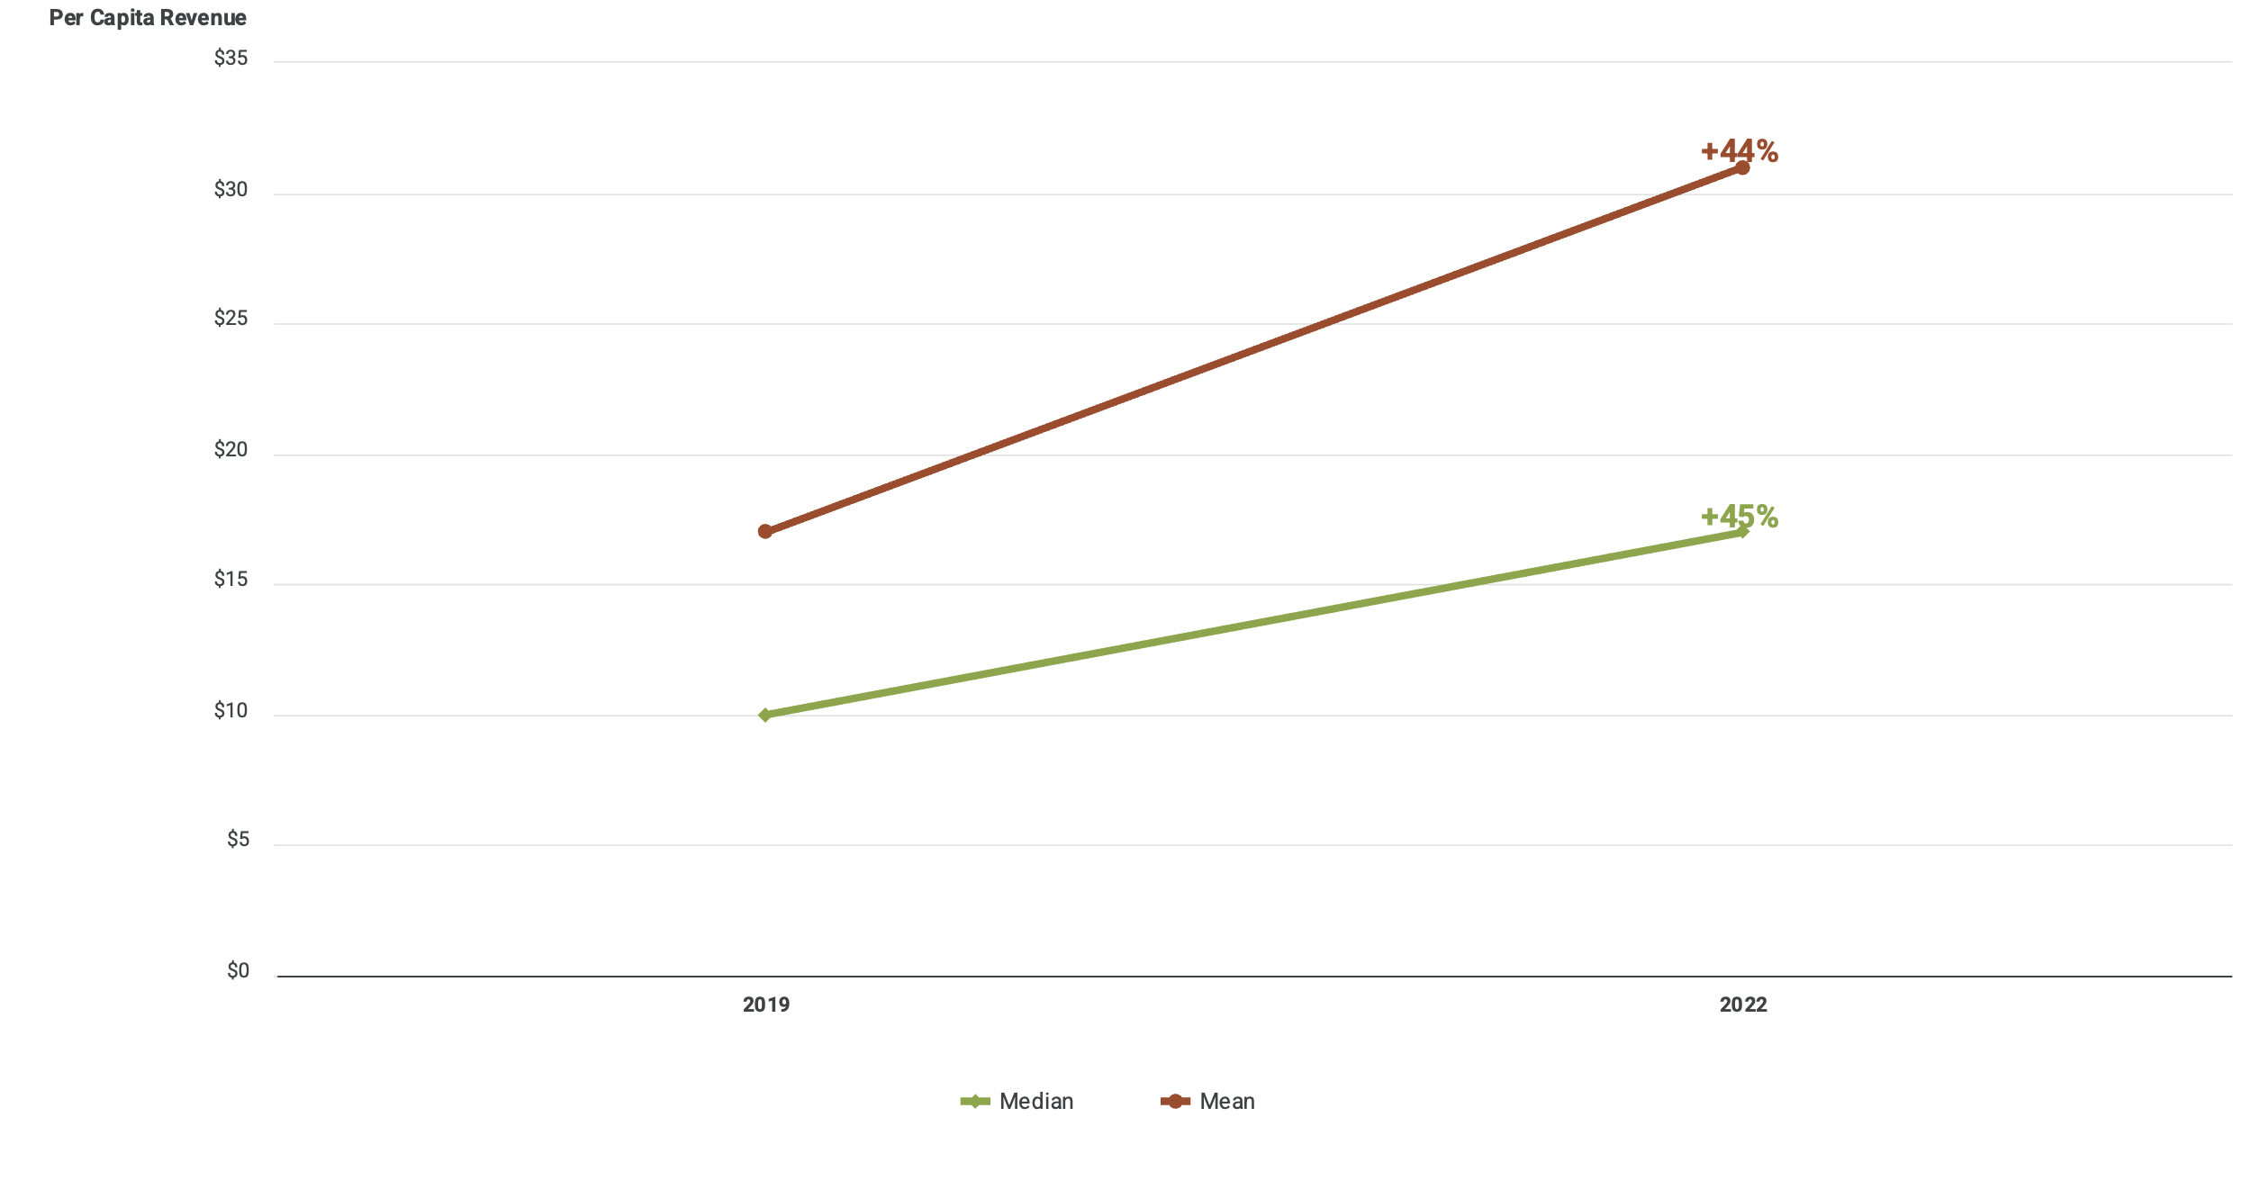
Revenue Increases
Average per capita revenues from federal sources nearly doubled from 2019 to 2022.
Nearly one in five LHDs foresaw budget cuts as federal resources expire.

Slide 4
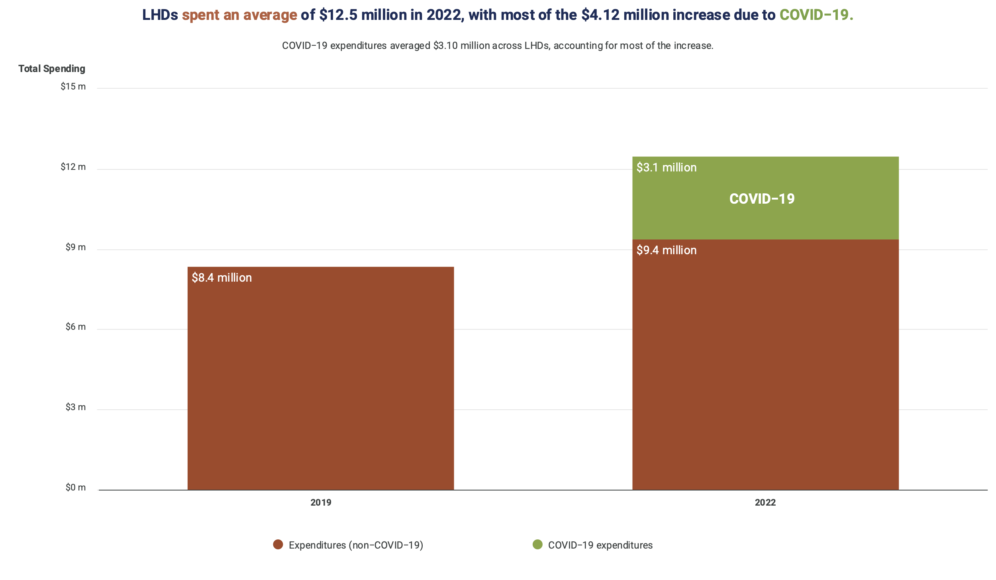
Expenditures
LHDs spent an average of $12.5 million in 2022, with most of the $4.12 million increase due to COVID-19.

Slide 5
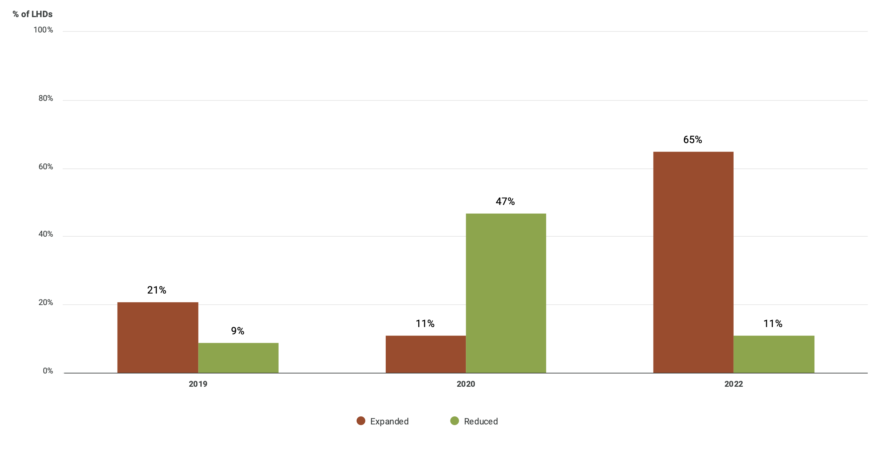
Immunization Services
LHDs expanded immunization services in 2022 following prior decreases.
In 2022, 65% of LHDs expanded immunization services.

Slide 6
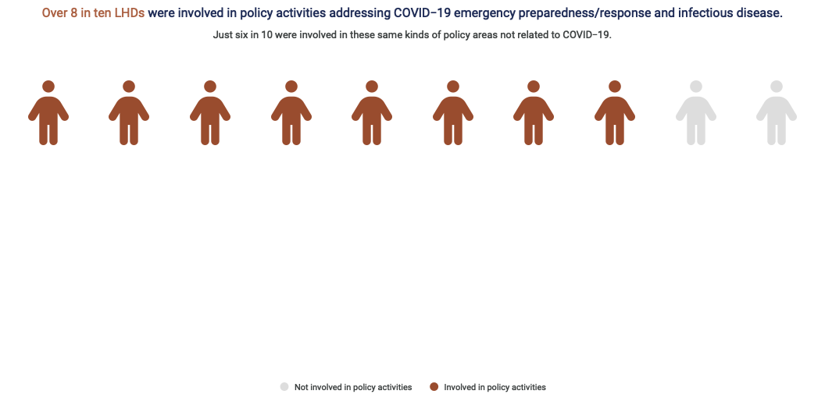
Policy Engagement
Over 80% of LHDs were involved in policy activities addressing COVID-19 emergency preparedness/response and infectious disease.

Slide 7
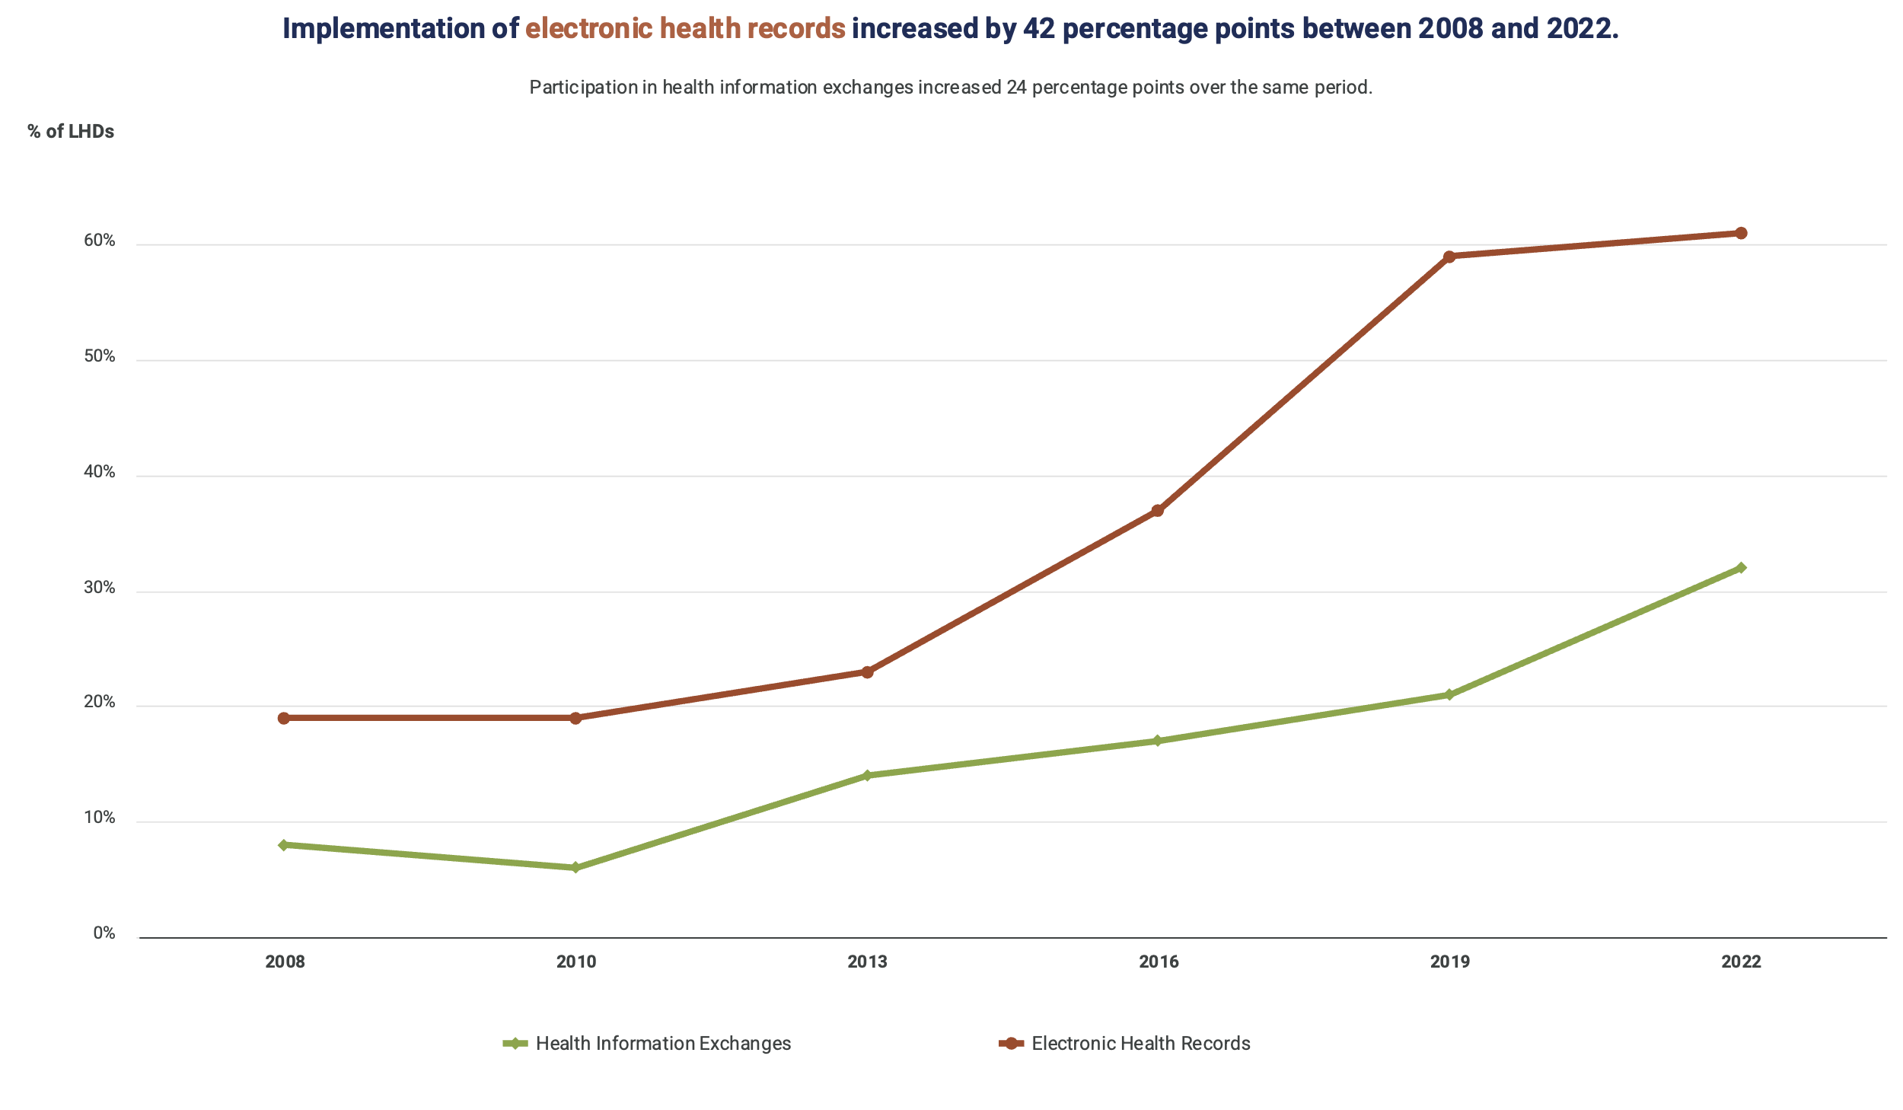
Informatics
Implementation of electronic health records increased by 42 percentage points between 2008 and 2022.
Participation in health information exchanges increased 24 percentage points over the same period.

Slide 8
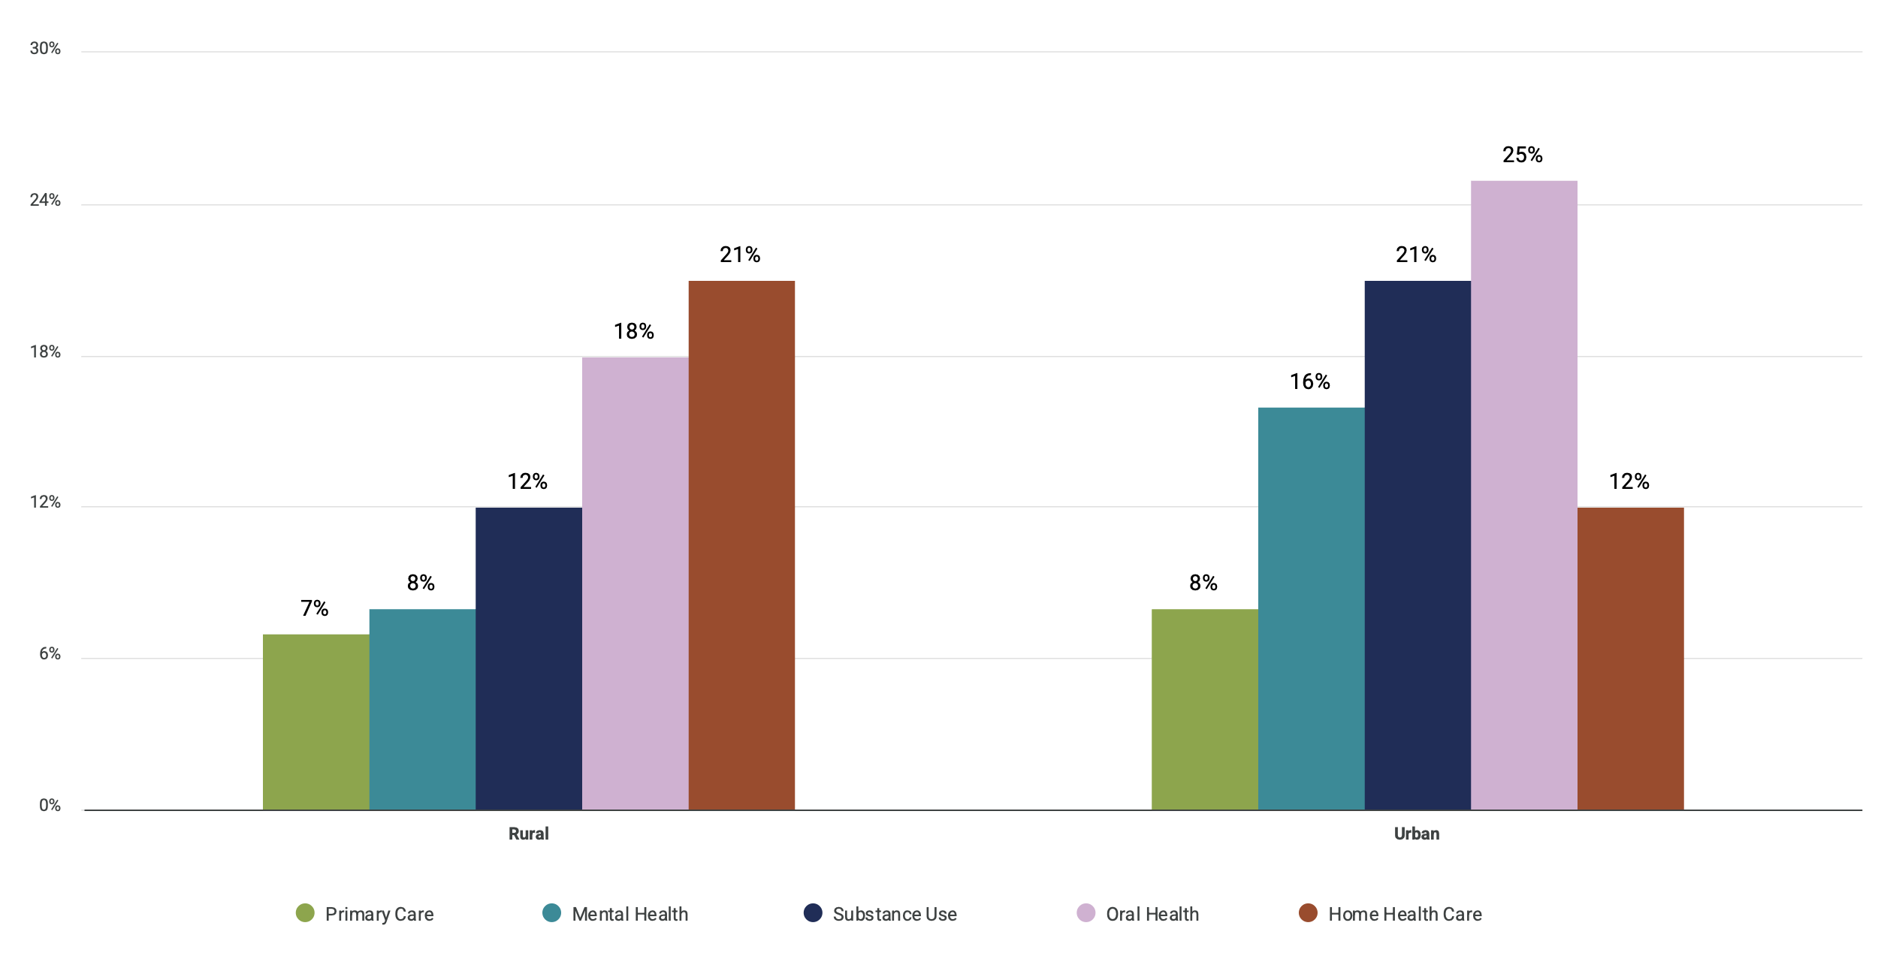
Clinical Services
Provision of direct clinical services varies across rural and urban LHDs.
In general, fewer rural LHDs provide direct clinical services.

Slide 9
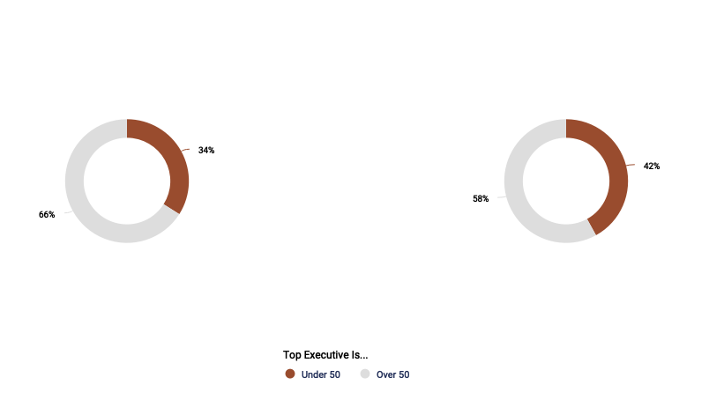
Executive Tenure
Top executives are slightly younger and less tenured now than in 2008.
In 2022, 42% of LHDs had a top executive younger than 50, compared to 34% in 2008.
2008
2022

