Slide 1
Key Findings

Slide 2
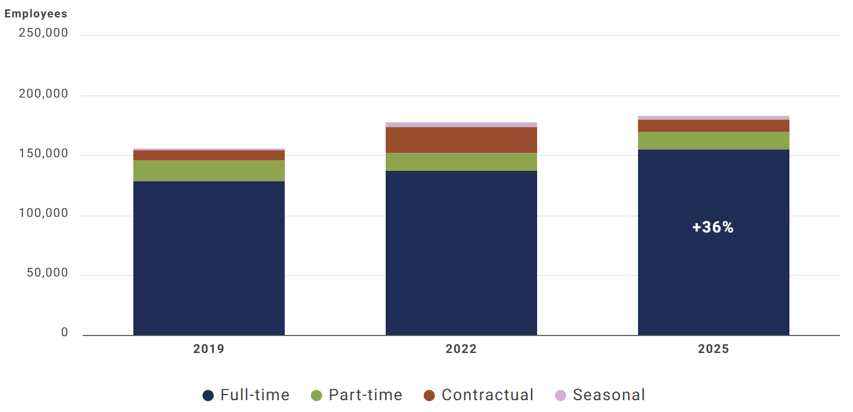
Workforce Trends
The local health department workforce grew between 2019 and 2025, with shifts in the employment types driving that growth.
While contractual employment drove much of the growth from 2019 to 2022, the number of contract workers declined by 53% from 2022 to 2025 as the number of full-time workers increased.

Slide 3
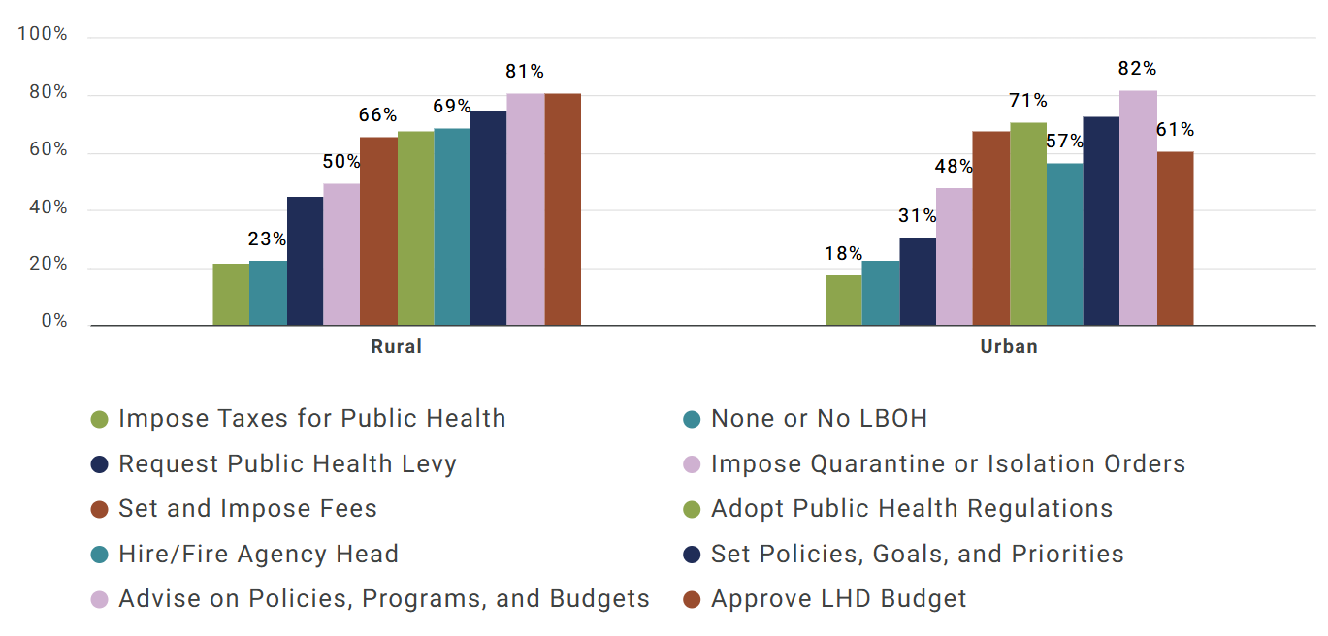
Rural Health
While rural and urban local health departments (LHDs) are similarly likely to have a local board of health (LBOH), there are differences in their final authorities.
Rural LHDs are more likely to have LBOHs with final authority to approve budgets, hire/fire agency heads, and request levies

Slide 4
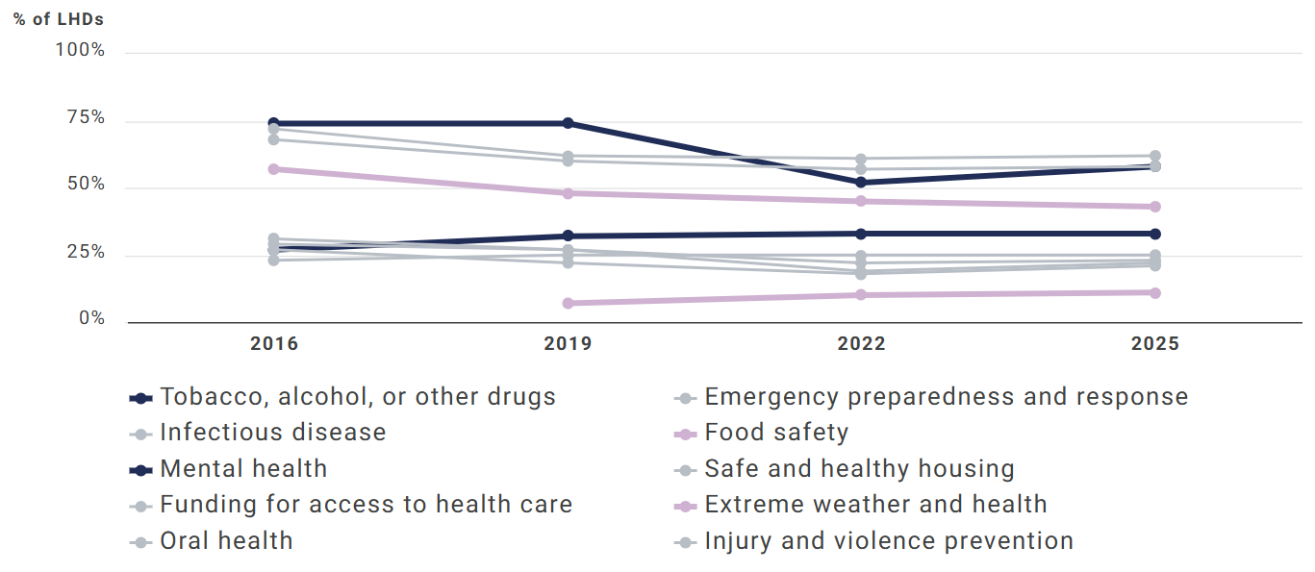
Policy Engagement
While rural and urban local health departments (LHDs) are similarly likely to have a local board of health (LBOH), there are differences in their final authorities.
Rural LHDs are more likely to have LBOHs with final authority to approve budgets, hire/fire agency heads, and request levies

Slide 5
Informatics
Implementation of electronic health records increased by 42 percentage points between 2008 and 2022.
Participation in health information exchanges increased 24 percentage points over the same period.

