Slide 1
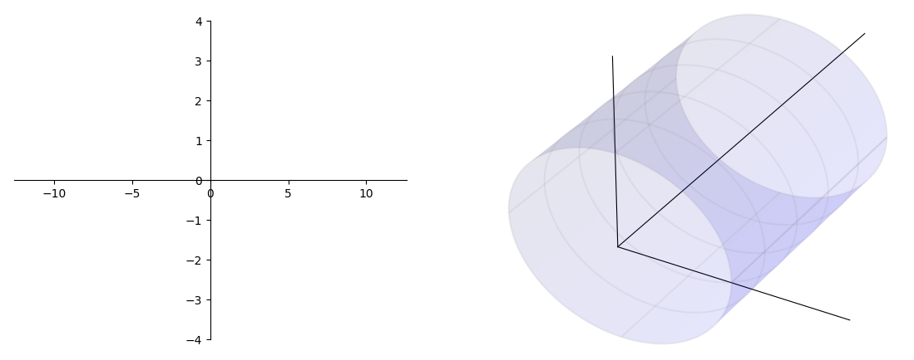



变换关系式
Z
$$X=rcos(θ)$$
X
Z
$$Y=rsin(θ)$$
$$Z=Z$$
θ
import matplotlib.pyplot as plt
from matplotlib import cm
import numpy as np
ax = plt.axes([0.15, 0.10, 0.35, 0.80])
ax3 = plt.axes([0.5, -0.05, 0.6, 1.3], projection="3d")
# 圆柱半径
r = 1.0
# 圆柱长度
length = 5.0
# 圆柱圆周方向分段
ksi_number = 500
# 圆柱轴向分段 注意 Y 方向是圆柱轴向
z_number = 500
# 二维
if True:
ax.spines["bottom"].set_position(("data", 0))
ax.spines["left"].set_position(("data", 0))
ax.spines["right"].set_color("none")
ax.spines["top"].set_color("none")
ax.set_xlim(-2 * 2 * np.pi, 2 * 2 * np.pi)
ax.set_ylim(-4, 4)
if True:
# 定义三维数据
ksi_steps = np.linspace(0, 2 * np.pi, ksi_number)
# 圆柱数据
xx = r * np.cos(ksi_steps)
zz = r * np.sin(ksi_steps)
yy = np.linspace(0, length, z_number)
X, Y = np.meshgrid(xx, yy)
Z, _ = np.meshgrid(zz, yy)
# 圆柱作图
ax3.plot_surface(X, Y, Z, color="blue", alpha=0.1)
ax3.plot_wireframe(X, Y, Z, rstride=100, cstride=125, color="grey", alpha=0.1)
# 扩大图形范围，让圆柱长一点
ax3.plot3D(-2, 0, -2)
ax3.plot3D(2, 0, 2)
# 坐标
ax3.plot3D([0, 2], [0, 0], [0, 0], color="k", lw=0.8)
ax3.plot3D([0, 0], [0, 0], [0, 2], color="k", lw=0.8)
ax3.plot3D([0, 0], [0, 8], [0, 0], color="k", lw=0.8)
plt.axis("off")
ax3.w_xaxis.set_pane_color((1.0, 1.0, 1.0, 1.0))
plt.show()
Y

Slide 2
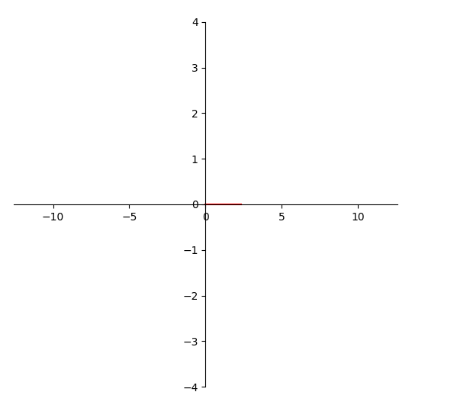
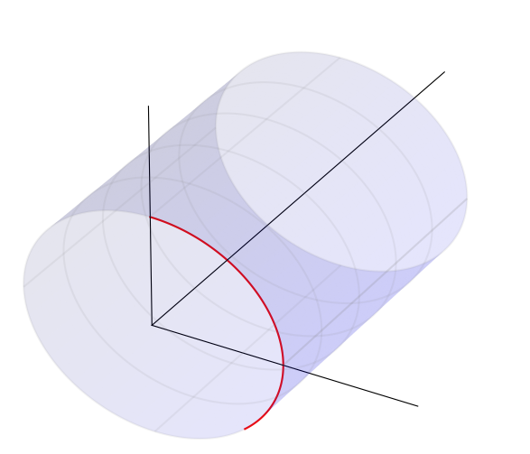





变换关系式
Z
$$X=rcos(θ)$$
$$Y=rsin(θ)$$
Z
X
$$Z=Z$$
θ
θ0
import matplotlib.pyplot as plt
from matplotlib import cm
import numpy as np
# 绝对坐标系，确定绘图板位置
ax = plt.axes([0.15, 0.10, 0.35, 0.80])
ax3 = plt.axes([0.5, -0.05, 0.6, 1.3], projection="3d")
# 圆柱半径
r = 1.0
# 圆柱长度
length = 5.0
# 圆柱圆周方向分段
ksi_number = 500
# 圆柱轴向分段 注意 Y 方向是圆柱轴向
z_number = 500
# 沿着 θ 轴运动
theta = np.linspace(0, np.pi * 0.75, 100)
# 二维运动
x2 = theta
y2 = np.zeros_like(theta)
# 三维运动
x3 = r*np.cos(theta)
z3 = r*np.sin(theta)
y3 = np.zeros_like(theta)
ax.plot(x2,y2,'r-')
ax3.plot(x3,y3,z3,'r-')
# 二维
if True:
ax.spines["bottom"].set_position(("data", 0))
ax.spines["left"].set_position(("data", 0))
ax.spines["right"].set_color("none")
ax.spines["top"].set_color("none")
ax.set_xlim(-2 * 2 * np.pi, 2 * 2 * np.pi)
ax.set_ylim(-4, 4)
if True:
# 定义三维数据
ksi_steps = np.linspace(0, 2 * np.pi, ksi_number)
# 圆柱数据
xx = r * np.cos(ksi_steps)
zz = r * np.sin(ksi_steps)
yy = np.linspace(0, length, z_number)
X, Y = np.meshgrid(xx, yy)
Z, _ = np.meshgrid(zz, yy)
# 圆柱作图
ax3.plot_surface(X, Y, Z, color="blue", alpha=0.1)
ax3.plot_wireframe(X, Y, Z, rstride=100, cstride=125, color="grey", alpha=0.1)
# 扩大图形范围，让圆柱长一点
ax3.plot3D(-2, 0, -2)
ax3.plot3D(2, 0, 2)
# 坐标
ax3.plot3D([0, 2], [0, 0], [0, 0], color="k", lw=0.8)
ax3.plot3D([0, 0], [0, 0], [0, 2], color="k", lw=0.8)
ax3.plot3D([0, 0], [0, 8], [0, 0], color="k", lw=0.8)
plt.axis("off")
ax3.w_xaxis.set_pane_color((1.0, 1.0, 1.0, 1.0))
plt.show()
θ0
平行于θ轴直线
$$X=rcos(t)$$
Y
$$θ=t$$
$$Y=rsin(t)$$
$$Z=0$$
$$Z=0$$

Slide 3
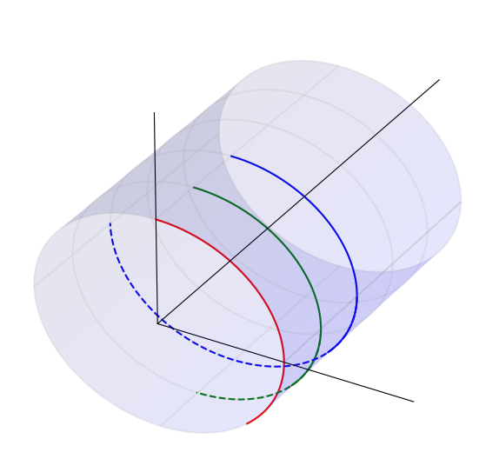
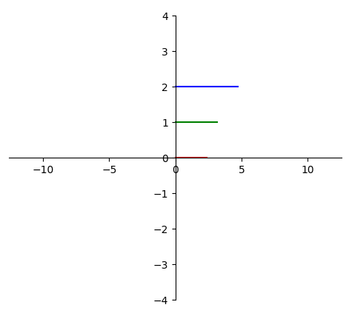


变换关系式
Z
$$X=rcos(θ)$$
$$Y=rsin(θ)$$
Z
X
$$Z=Z$$
θ
import matplotlib.pyplot as plt
from matplotlib import cm
import numpy as np
# 绝对坐标系，确定绘图板位置
ax = plt.axes([0.15, 0.10, 0.35, 0.80])
ax3 = plt.axes([0.5, -0.05, 0.6, 1.3], projection="3d")
# 圆柱半径
r = 1.0
# 圆柱长度
length = 5.0
# 圆柱圆周方向分段
ksi_number = 500
# 圆柱轴向分段 注意 Y 方向是圆柱轴向
z_number = 500
# 沿着 θ 轴运动
theta = np.linspace(0, np.pi * 0.75, 100)
# 二维运动
x2 = theta
y2 = np.zeros_like(theta)
# 三维运动
x3 = r*np.cos(theta)
z3 = r*np.sin(theta)
y3 = np.zeros_like(theta)
ax.plot(x2,y2,'r-')
ax3.plot(x3,y3,z3,'r-')
# 二维
if True:
ax.spines["bottom"].set_position(("data", 0))
ax.spines["left"].set_position(("data", 0))
ax.spines["right"].set_color("none")
ax.spines["top"].set_color("none")
ax.set_xlim(-2 * 2 * np.pi, 2 * 2 * np.pi)
ax.set_ylim(-4, 4)
if True:
# 定义三维数据
ksi_steps = np.linspace(0, 2 * np.pi, ksi_number)
# 圆柱数据
xx = r * np.cos(ksi_steps)
zz = r * np.sin(ksi_steps)
yy = np.linspace(0, length, z_number)
X, Y = np.meshgrid(xx, yy)
Z, _ = np.meshgrid(zz, yy)
# 圆柱作图
ax3.plot_surface(X, Y, Z, color="blue", alpha=0.1)
ax3.plot_wireframe(X, Y, Z, rstride=100, cstride=125, color="grey", alpha=0.1)
# 扩大图形范围，让圆柱长一点
ax3.plot3D(-2, 0, -2)
ax3.plot3D(2, 0, 2)
# 坐标
ax3.plot3D([0, 2], [0, 0], [0, 0], color="k", lw=0.8)
ax3.plot3D([0, 0], [0, 0], [0, 2], color="k", lw=0.8)
ax3.plot3D([0, 0], [0, 8], [0, 0], color="k", lw=0.8)
plt.axis("off")
ax3.w_xaxis.set_pane_color((1.0, 1.0, 1.0, 1.0))
plt.show()
平行于θ轴直线
$$X=rcos(t)$$
Y
$$θ=t$$
$$Y=rsin(t)$$
$$Z=Z_{0}$$
$$Z=Z_{0}$$

Slide 4
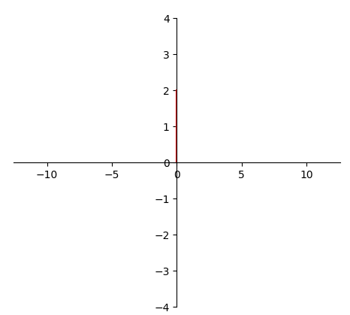
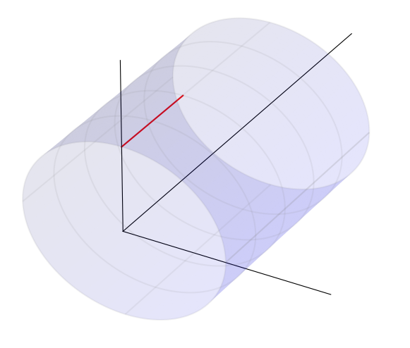





变换关系式
Z
$$X=rcos(θ)$$
X
Z
$$Y=rsin(θ)$$
$$Z=Z$$
z0
import matplotlib.pyplot as plt
from matplotlib import cm
import numpy as np
# 绝对坐标系，确定绘图板位置
ax = plt.axes([0.15, 0.10, 0.35, 0.80])
ax3 = plt.axes([0.5, -0.05, 0.6, 1.3], projection="3d")
# 圆柱半径
r = 1.0
# 圆柱长度
length = 5.0
# 圆柱圆周方向分段
ksi_number = 500
# 圆柱轴向分段 注意 Y 方向是圆柱轴向
z_number = 500
# 沿着 Z 轴运动
z_steps = np.linspace(0, 2.0, 100)
# 二维运动
x2 = np.zeros_like(z_steps)
y2 = z_steps
# 三维运动
x3 = r*np.ones_like(z_steps)
z3 = np.zeros_like(z_steps)
y3 = z_steps
ax.plot(x2,y2,'r-')
ax3.plot(x3,y3,z3,'r-')
# 二维
if True:
ax.spines["bottom"].set_position(("data", 0))
ax.spines["left"].set_position(("data", 0))
ax.spines["right"].set_color("none")
ax.spines["top"].set_color("none")
ax.set_xlim(-2 * 2 * np.pi, 2 * 2 * np.pi)
ax.set_ylim(-4, 4)
if True:
# 定义三维数据
ksi_steps = np.linspace(0, 2 * np.pi, ksi_number)
# 圆柱数据
xx = r * np.cos(ksi_steps)
zz = r * np.sin(ksi_steps)
yy = np.linspace(0, length, z_number)
X, Y = np.meshgrid(xx, yy)
Z, _ = np.meshgrid(zz, yy)
# 圆柱作图
ax3.plot_surface(X, Y, Z, color="blue", alpha=0.1)
ax3.plot_wireframe(X, Y, Z, rstride=100, cstride=125, color="grey", alpha=0.1)
# 扩大图形范围，让圆柱长一点
ax3.plot3D(-2, 0, -2)
ax3.plot3D(2, 0, 2)
# 坐标
ax3.plot3D([0, 2], [0, 0], [0, 0], color="k", lw=0.8)
ax3.plot3D([0, 0], [0, 0], [0, 2], color="k", lw=0.8)
ax3.plot3D([0, 0], [0, 8], [0, 0], color="k", lw=0.8)
plt.axis("off")
ax3.w_xaxis.set_pane_color((1.0, 1.0, 1.0, 1.0))
plt.show()
θ
z0
平行于Z轴直线
$$X=r$$
$$θ=0$$
Y
$$Y=0$$
$$Z=t$$
$$Z=t$$

Slide 5
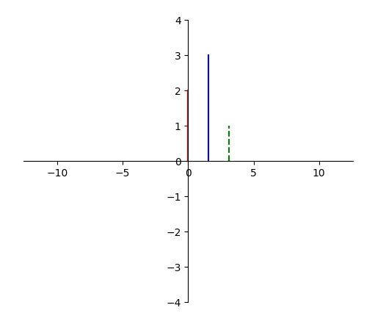
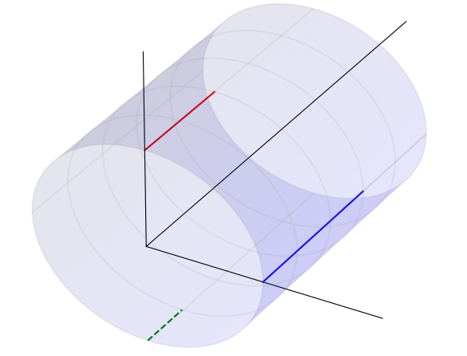



Z
变换关系式
$$X=rcos(θ)$$
X
Z
$$Y=rsin(θ)$$
$$Z=Z$$
import matplotlib.pyplot as plt
from matplotlib import cm
import numpy as np
# 绝对坐标系，确定绘图板位置
ax = plt.axes([0.15, 0.10, 0.35, 0.80])
ax3 = plt.axes([0.5, -0.05, 0.6, 1.3], projection="3d")
# 圆柱半径
r = 1.0
# 圆柱长度
length = 5.0
# 圆柱圆周方向分段
ksi_number = 500
# 圆柱轴向分段 注意 Y 方向是圆柱轴向
z_number = 500
# 沿着 Z 轴运动
z_steps = np.linspace(0, 2.0, 100)
# 二维运动
x2 = np.zeros_like(z_steps)
y2 = z_steps
# 三维运动
x3 = r*np.ones_like(z_steps)
z3 = np.zeros_like(z_steps)
y3 = z_steps
ax.plot(x2,y2,'r-')
ax3.plot(x3,y3,z3,'r-')
# 二维
if True:
ax.spines["bottom"].set_position(("data", 0))
ax.spines["left"].set_position(("data", 0))
ax.spines["right"].set_color("none")
ax.spines["top"].set_color("none")
ax.set_xlim(-2 * 2 * np.pi, 2 * 2 * np.pi)
ax.set_ylim(-4, 4)
if True:
# 定义三维数据
ksi_steps = np.linspace(0, 2 * np.pi, ksi_number)
# 圆柱数据
xx = r * np.cos(ksi_steps)
zz = r * np.sin(ksi_steps)
yy = np.linspace(0, length, z_number)
X, Y = np.meshgrid(xx, yy)
Z, _ = np.meshgrid(zz, yy)
# 圆柱作图
ax3.plot_surface(X, Y, Z, color="blue", alpha=0.1)
ax3.plot_wireframe(X, Y, Z, rstride=100, cstride=125, color="grey", alpha=0.1)
# 扩大图形范围，让圆柱长一点
ax3.plot3D(-2, 0, -2)
ax3.plot3D(2, 0, 2)
# 坐标
ax3.plot3D([0, 2], [0, 0], [0, 0], color="k", lw=0.8)
ax3.plot3D([0, 0], [0, 0], [0, 2], color="k", lw=0.8)
ax3.plot3D([0, 0], [0, 8], [0, 0], color="k", lw=0.8)
plt.axis("off")
ax3.w_xaxis.set_pane_color((1.0, 1.0, 1.0, 1.0))
plt.show()
θ
平行于Z轴直线
$$X=rcos(θ_{0})$$
$$θ=θ_{0}$$
Y
$$Y=rsin(θ_{0})$$
$$Z=t$$
$$Z=t$$

Slide 6
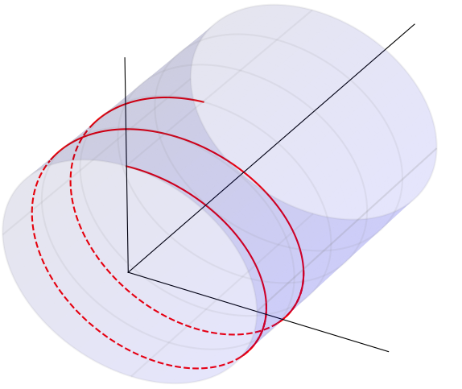
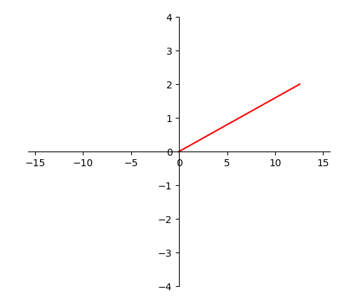




Z
变换关系式
Z
$$X=rcos(θ)$$
Y
$$Y=rsin(θ)$$
$$Z=Z$$
$$Z=\frac{z_{0}}{2π}θ$$
import matplotlib.pyplot as plt
from matplotlib import cm
import numpy as np
# 绝对坐标系，确定绘图板位置
ax = plt.axes([0.15, 0.10, 0.35, 0.80])
ax3 = plt.axes([0.5, -0.05, 0.6, 1.3], projection="3d")
# 圆柱半径
r = 1.0
# 圆柱长度
length = 5.0
# 圆柱圆周方向分段
ksi_number = 500
# 圆柱轴向分段 注意 Y 方向是圆柱轴向
z_number = 500
# 螺线
theta_steps = np.linspace(0, 2 * 2 * np.pi, 720)
z0 = 1.0
# 二维运动
x2 = theta_steps
y2 = z0 / (2 * np.pi) * theta_steps
# 三维运动
x3 = r*np.cos(theta_steps)
z3 = r*np.sin(theta_steps)
y3 = y2
ax.plot(x2, y2, "r-")
ax3.plot(x3[0:90+40], y3[0:90+40], z3[0:90+40], "r-")
ax3.plot(x3[90:300], y3[90:300], z3[90:300], "r--")
ax3.plot(x3[300:450+40], y3[300:450+40], z3[300:450+40], "r-")
ax3.plot(x3[450:660], y3[450:660], z3[450:660], "r--")
ax3.plot(x3[660:], y3[660:], z3[660:], "r-")
# 二维
if True:
ax.spines["bottom"].set_position(("data", 0))
ax.spines["left"].set_position(("data", 0))
ax.spines["right"].set_color("none")
ax.spines["top"].set_color("none")
ax.set_xlim(-2.5 * 2 * np.pi, 2.5 * 2 * np.pi)
ax.set_ylim(-4, 4)
if True:
# 定义三维数据
ksi_steps = np.linspace(0, 2 * np.pi, ksi_number)
# 圆柱数据
xx = r * np.cos(ksi_steps)
zz = r * np.sin(ksi_steps)
yy = np.linspace(0, length, z_number)
X, Y = np.meshgrid(xx, yy)
Z, _ = np.meshgrid(zz, yy)
# 圆柱作图
ax3.plot_surface(X, Y, Z, color="blue", alpha=0.1)
ax3.plot_wireframe(X, Y, Z, rstride=100, cstride=125, color="grey", alpha=0.1)
# 扩大图形范围，让圆柱长一点
ax3.plot3D(-2, 0, -2)
ax3.plot3D(2, 0, 2)
# 坐标
ax3.plot3D([0, 2], [0, 0], [0, 0], color="k", lw=0.8)
ax3.plot3D([0, 0], [0, 0], [0, 2], color="k", lw=0.8)
ax3.plot3D([0, 0], [0, 8], [0, 0], color="k", lw=0.8)
plt.axis("off")
ax3.w_xaxis.set_pane_color((1.0, 1.0, 1.0, 1.0))
plt.show()
θ
一般直线
X
$$X=rcos(t)$$
$$θ=t$$
$$Y=rsin(t)$$
$$Z=\frac{z_{0}}{2π}t$$
$$Z=\frac{z_{0}}{2π}t$$

Slide 7
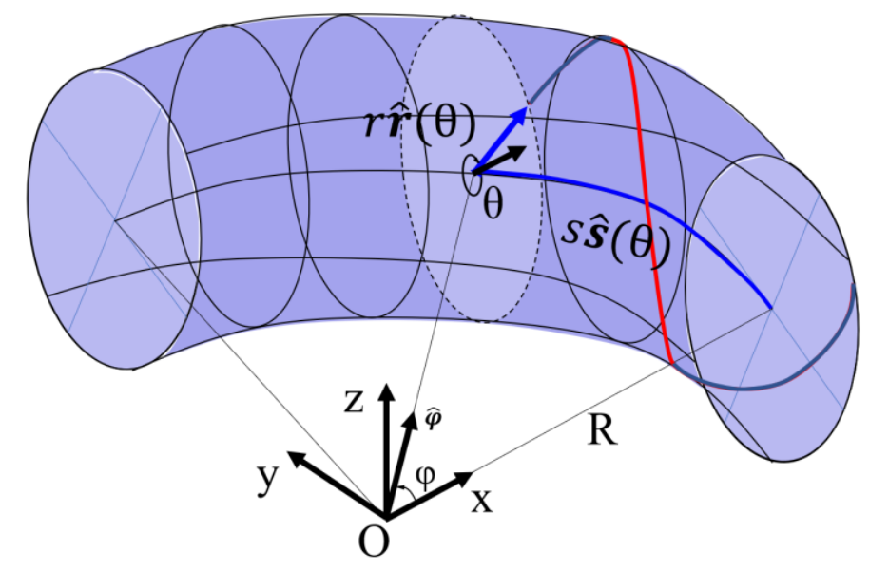
圆环轴
圆环环心

Slide 8
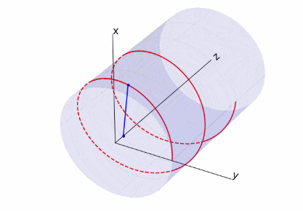
Y
Y
rib
✂
X
S
X
S
圆柱轴心
圆柱轴心

Slide 9
✂
2πr
最短距离
z0
z0

Slide 10
最短距离
最短距离
2πr
2πr
z0
z0

Slide 11
Θ=rθ
Θ=rθ
314mm
最短距离
最短距离
2πr
z0
z0
Z
z0
z0
Z
2πr
10mm

Slide 12
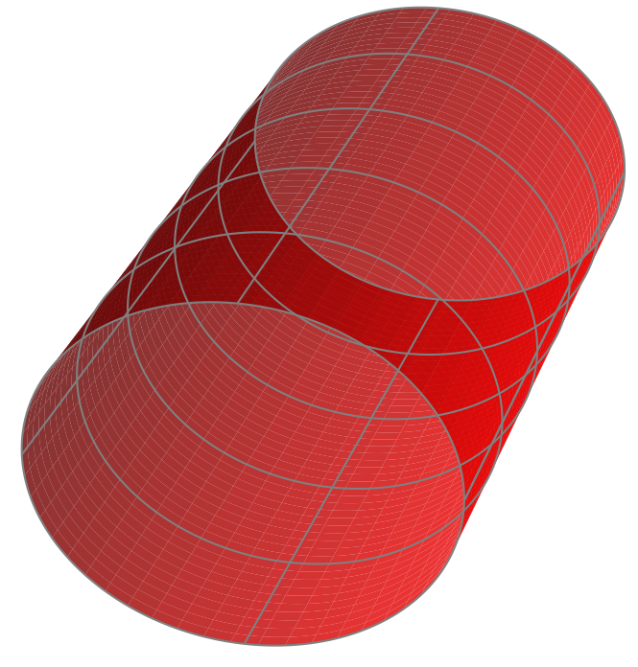
A
A
B
B

Slide 13
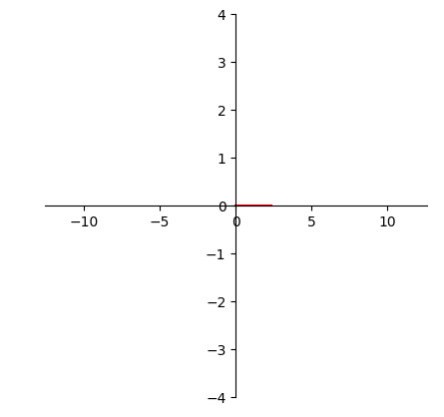
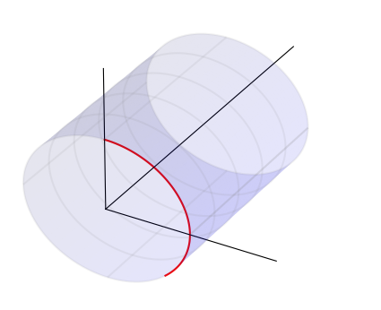

Slide 14
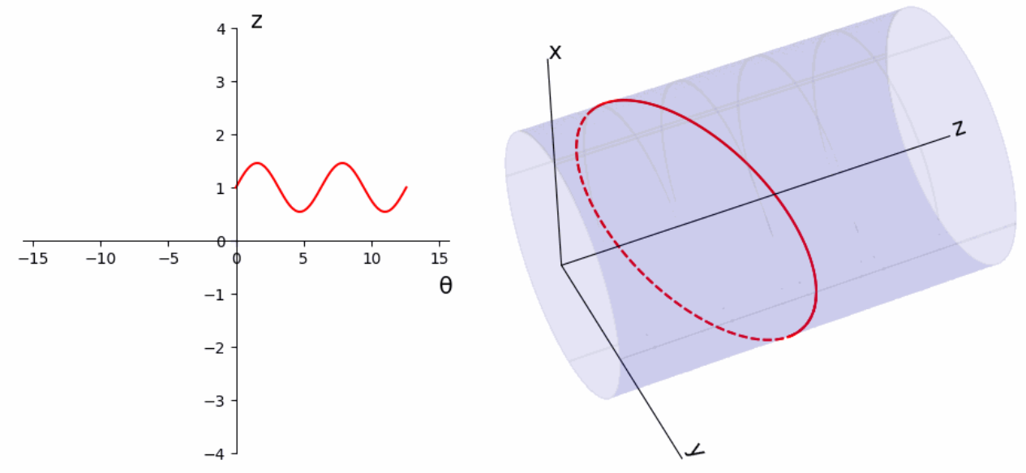
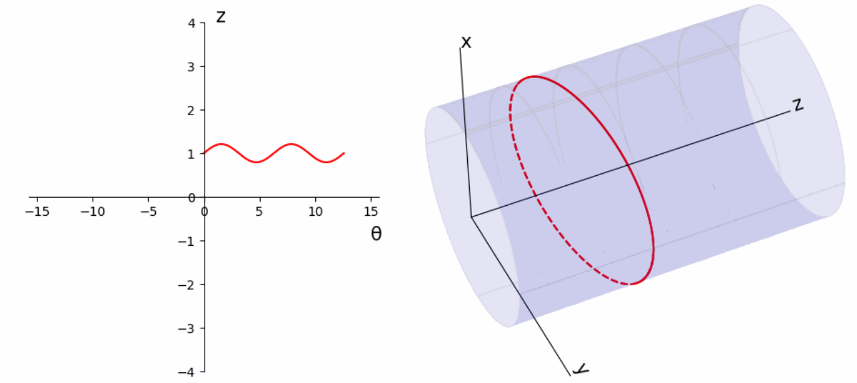
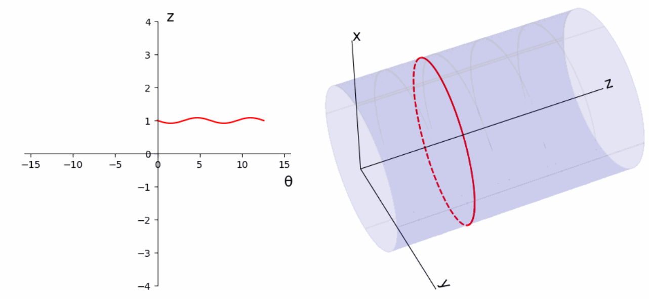
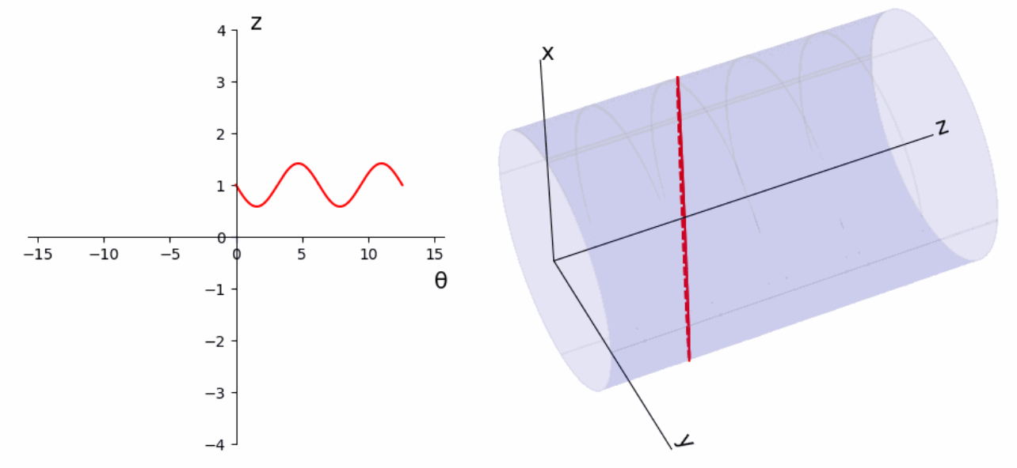

Slide 15
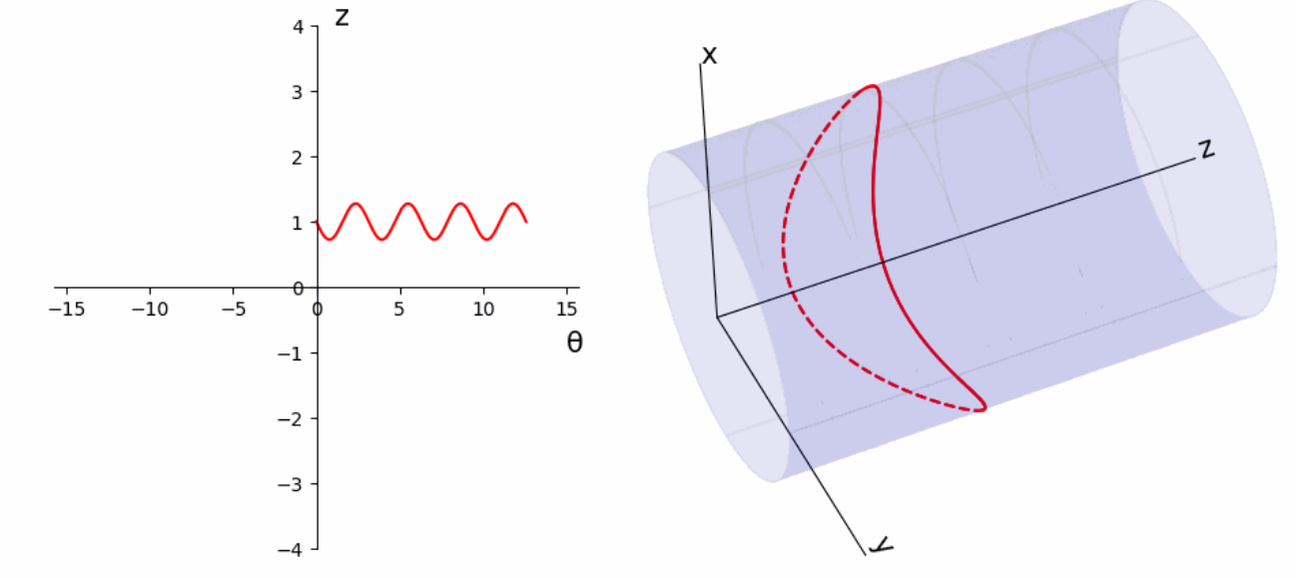
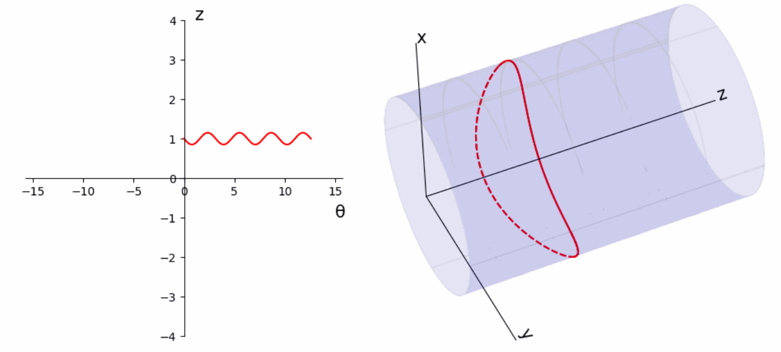
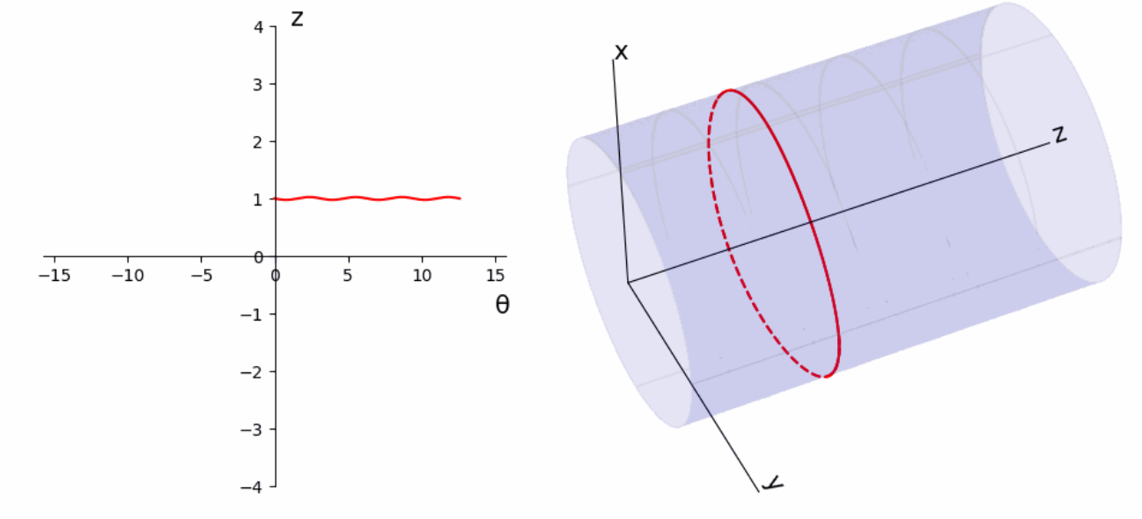


Slide 16
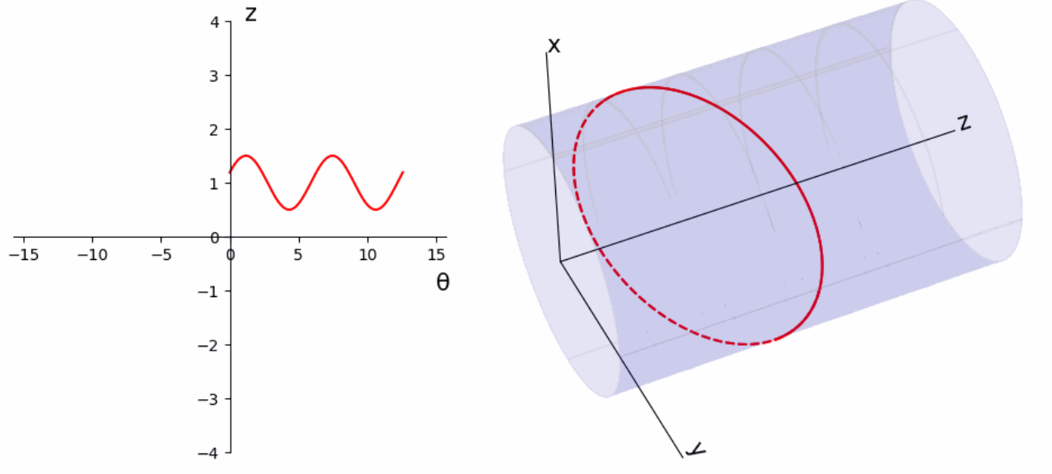
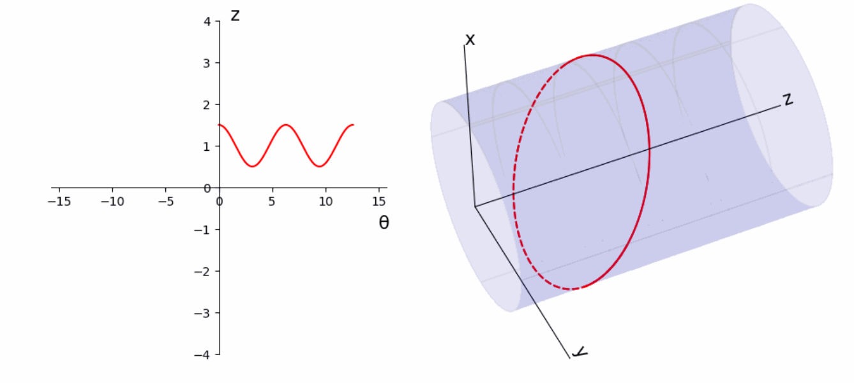

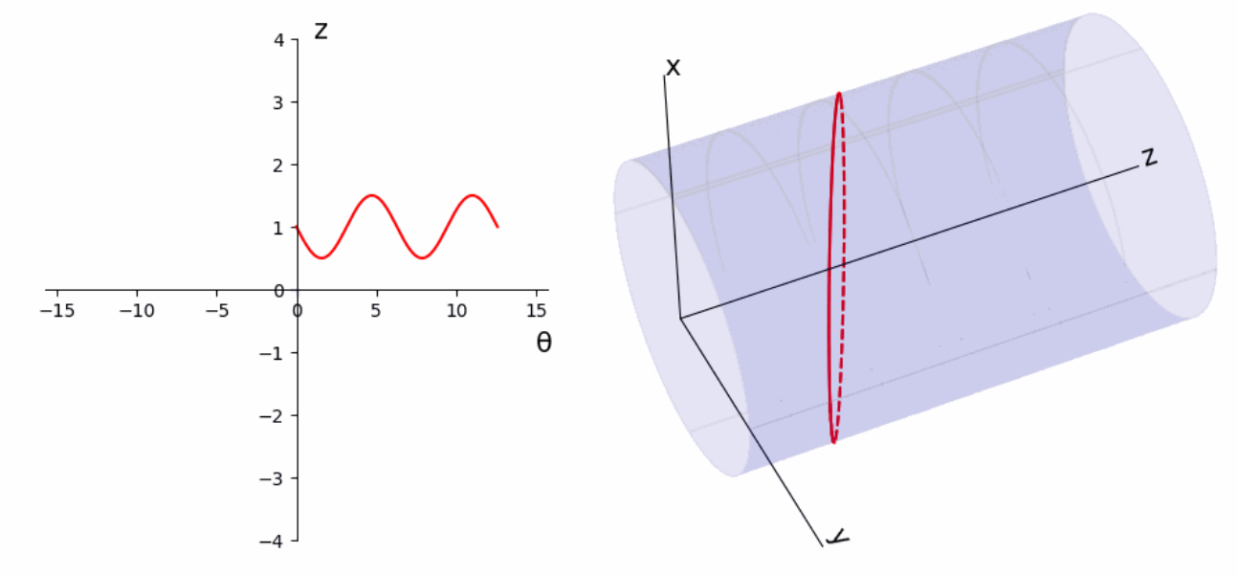
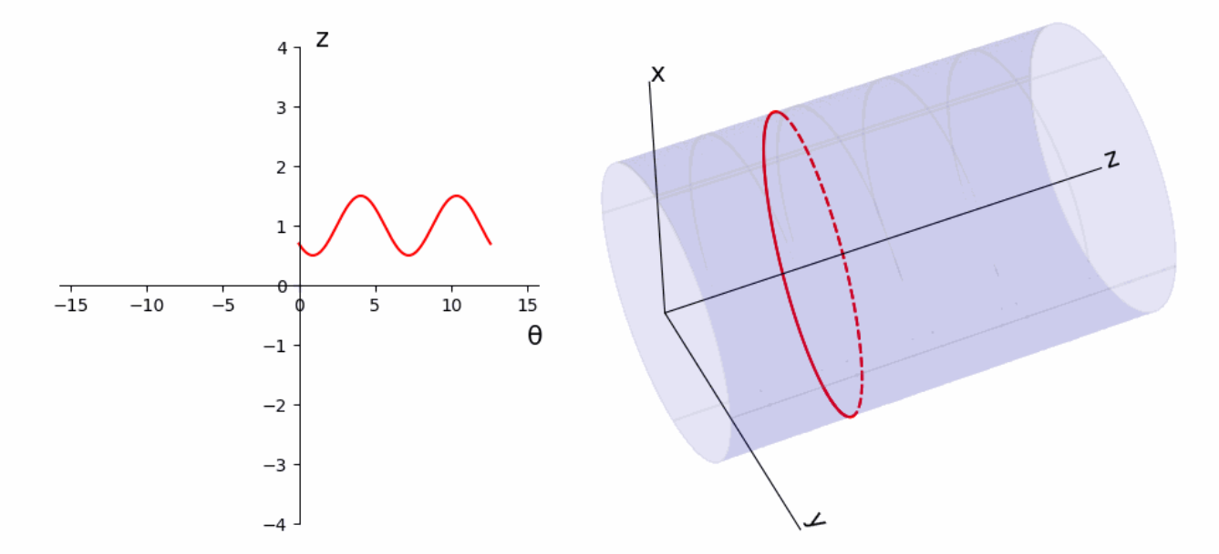
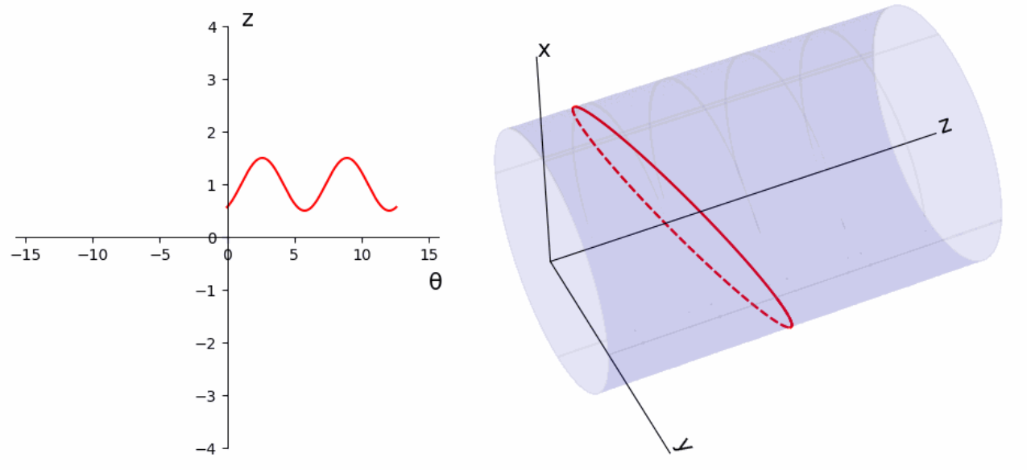

Slide 17
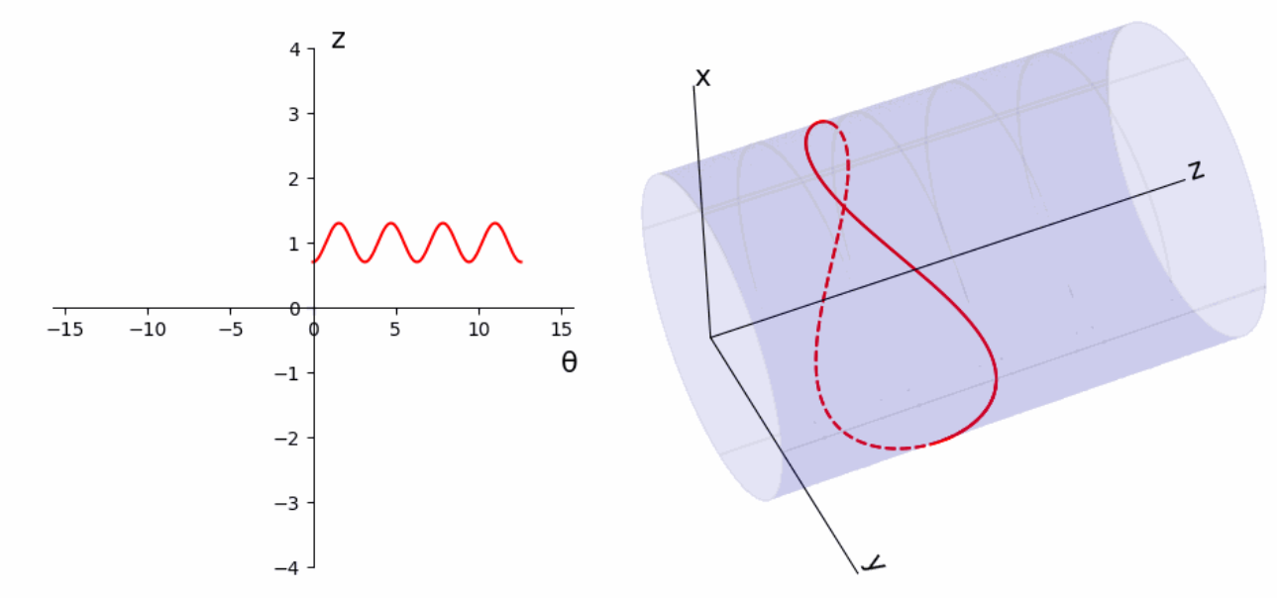
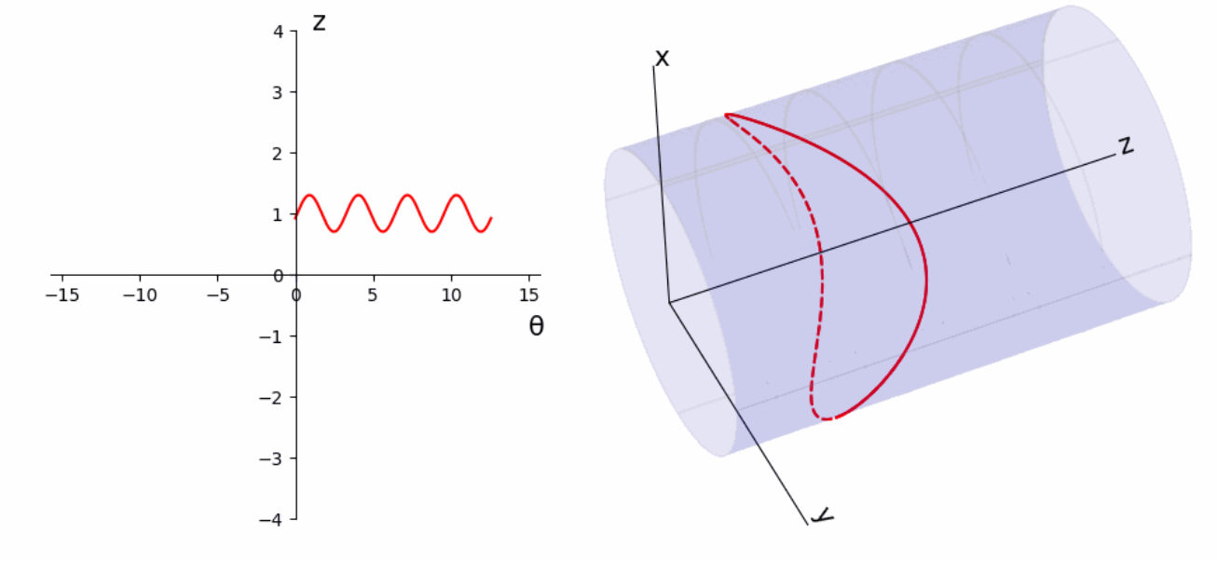
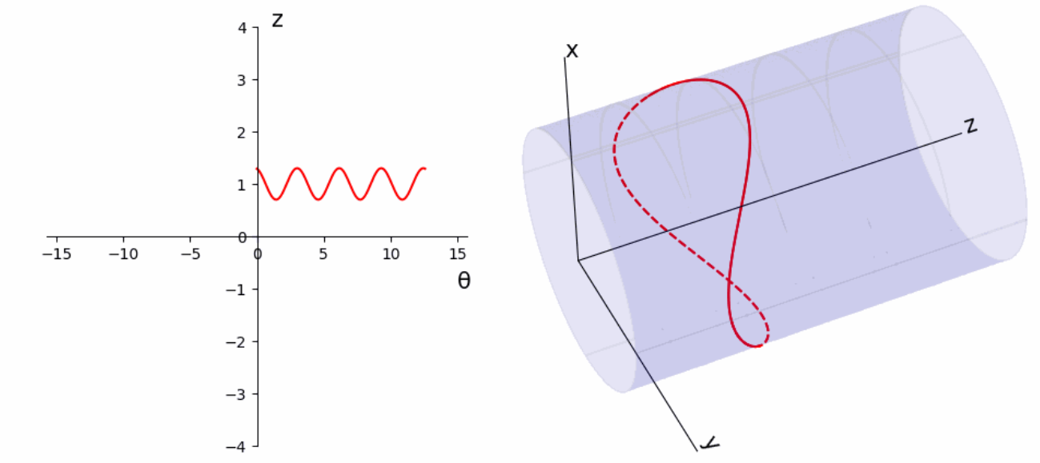


Slide 18
