Slide 1
Why ci/cd and how does it boost our business ?

Slide 2

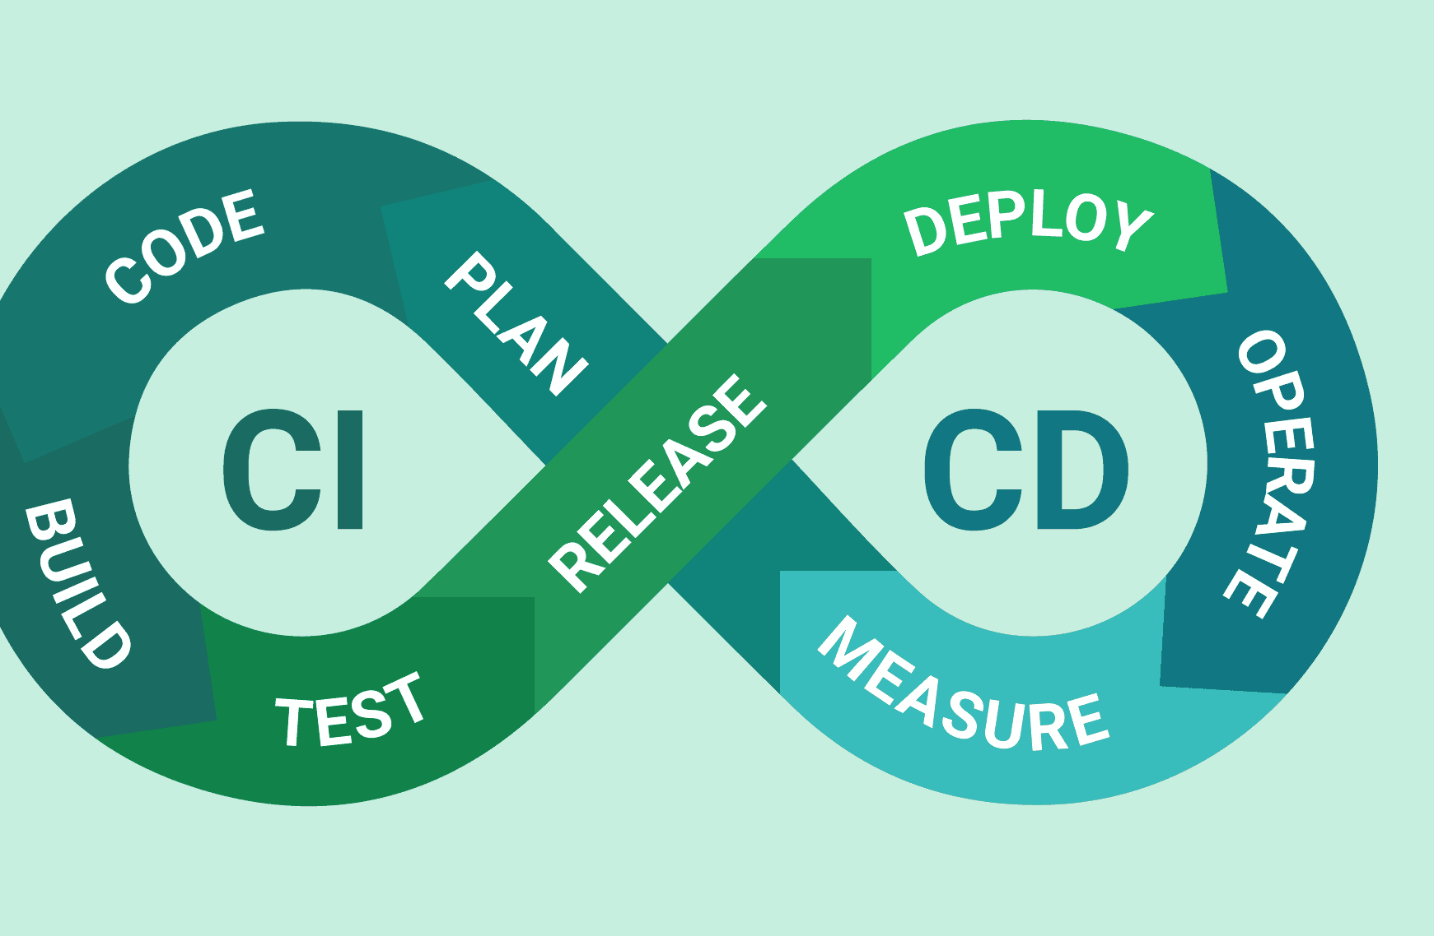
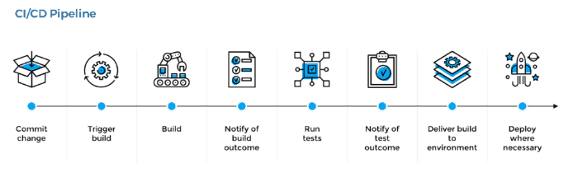
Continuous Development /continuous Deployment / delivery

Slide 3

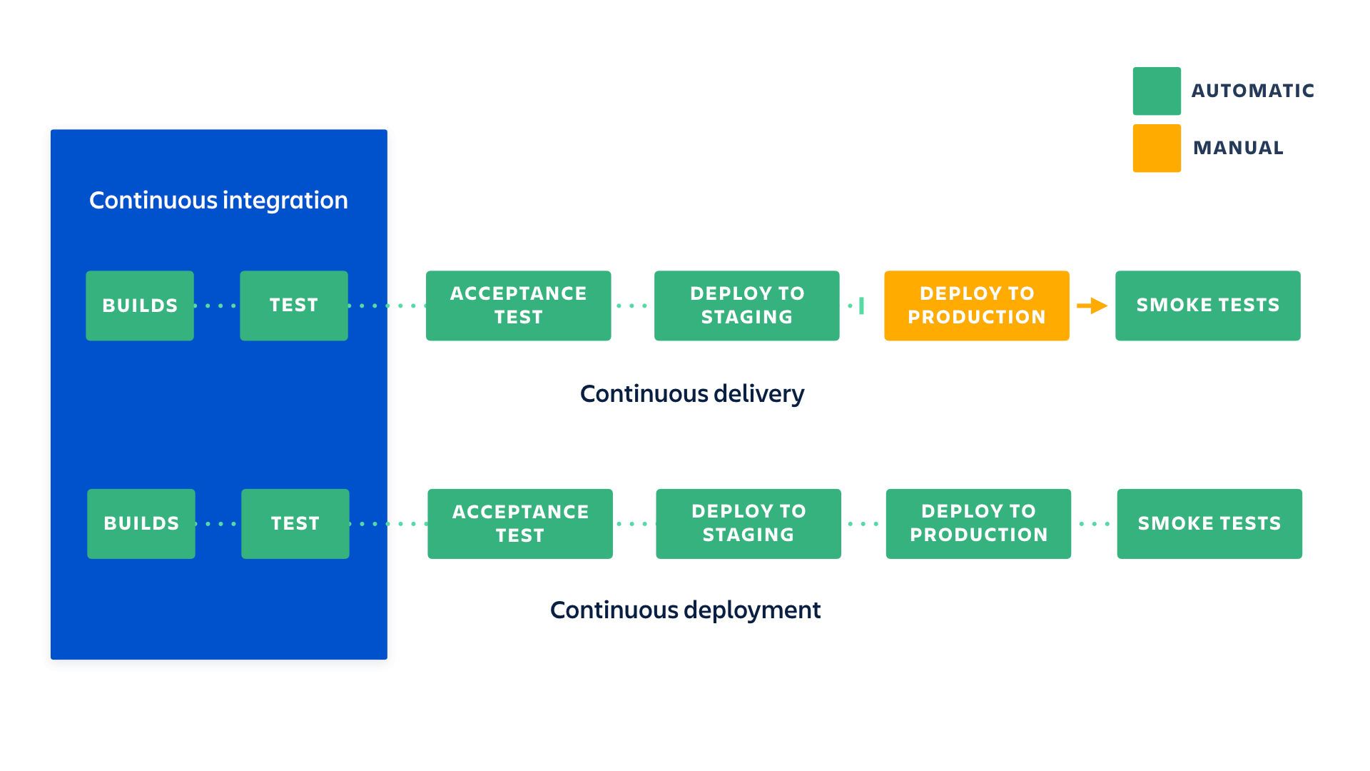
continuous Deployment Vs Continuous delivery

Slide 4
Benefits of Continuous integration
Less bugs get shipped to production
Building the release is easy as all integration issues have been solved early.
Testing costs are reduced drastically.
Your QA team spend less time testing and can focus on significant improvements to the quality culture.

Slide 5
Benefits of Continuous deployment & Continuous delivery
Continuous deployment
Continuous delivery
he complexity of deploying software has been taken away.
You can release more often.
There is much less pressure on decisions for small changes.
You can develop faster as there's no need to pause development for releases.
Releases are less risky and easier to fix in case of problem.
Customers see a continuous stream of improvements, and quality increases every day, instead of every month, quarter or year.

Slide 6

Conclusion
Moving to Continuous Deployment will change your development dramatically. It will make you more productive and lead to a more stable and better product.

