Slide 1
UI Patterns not provided by Twitter Bootstrap

Slide 2
UI Patterns defined here
Dashboard container
Dashboard widgets
Datatable
Picklist
Reveal right

Slide 3
UI Patterns not provided by TBS
A majority of the UI patterns (widgets) we have in our existing application are not in Twitter Bootstrap for a variety of reasons.
Made up of UI components that exist in JQuery
UI component standalone exists in Jquery
In many cases styles for a given component exist in TBS because it applies to standard html widgets. (table striping etc.)., but the generation for that object is left open ended to provide more options in interaction or customization.

Slide 4
Dashboard (container)
Purpose: To “house” all the dashboard widgets. This is the main/overall container for all the widgets.

Slide 5
Container Requirements
Layout that accommodates drag/drop placement of widgets
1/3-2/3 (or 1/4-3/4) page split
Drop areas that allow resizing of widgets
Ability to turn widgets on/off
Ability to make widget display full-screen
Style Guide Compliance
Font – color, size, type
Colors – background, foreground, text, buttons
Buttons – color, size, type, behavior
Icons
Responsive design to accommodate at least desktop and tablet sizes

Slide 6
Container Requirements
 | Native/Jquery | Perfectum | Steve Pallen | Caldara
Page split | x | x | x | x
Resize Widgets | x |  | x | x
Manage Widgets | x | x | x | x
Style Guide | x
Responsive Design | x | x |  | x
Free |  |  | x | x
Description | Hybrid | Existing | Tutorial | Themed

Slide 7
Dashboard Widgets (individual widget containers)
Purpose:
“House” the individual widgets (these are the containers that we populate with things like the alerts).

Slide 8
Dashboard Widget Requirements:
Drag/drop functionality
Responsive design
Ability to collapse widget to title bar
Ability to add menu items (such as cog for Edit Settings and X to close) to title bar
Resizing based on height of contents; location ( 1/3-2/3 or 1/4-3/4 page split)
Resizable within space (drag lower right corner to expand vertically)
Widgets will need to accommodate things like dynamic tables, calendars, etc.
Style Guide Compliance
Font – color, size, type
Colors – background, foreground, text, buttons
Buttons – color, size, type, behavior
Icons

Slide 9
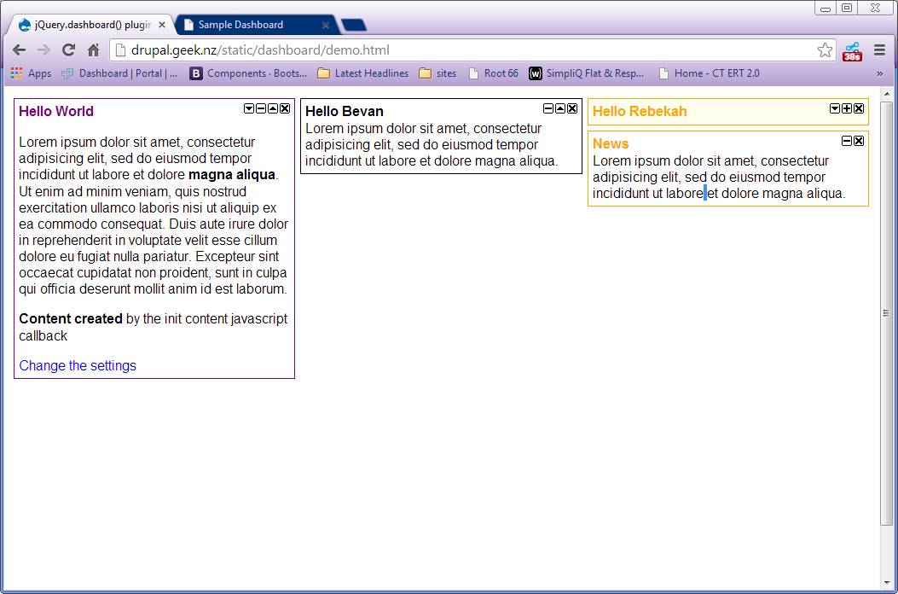
Civic Actions Tutorial (Starting point for in house app)

Slide 10
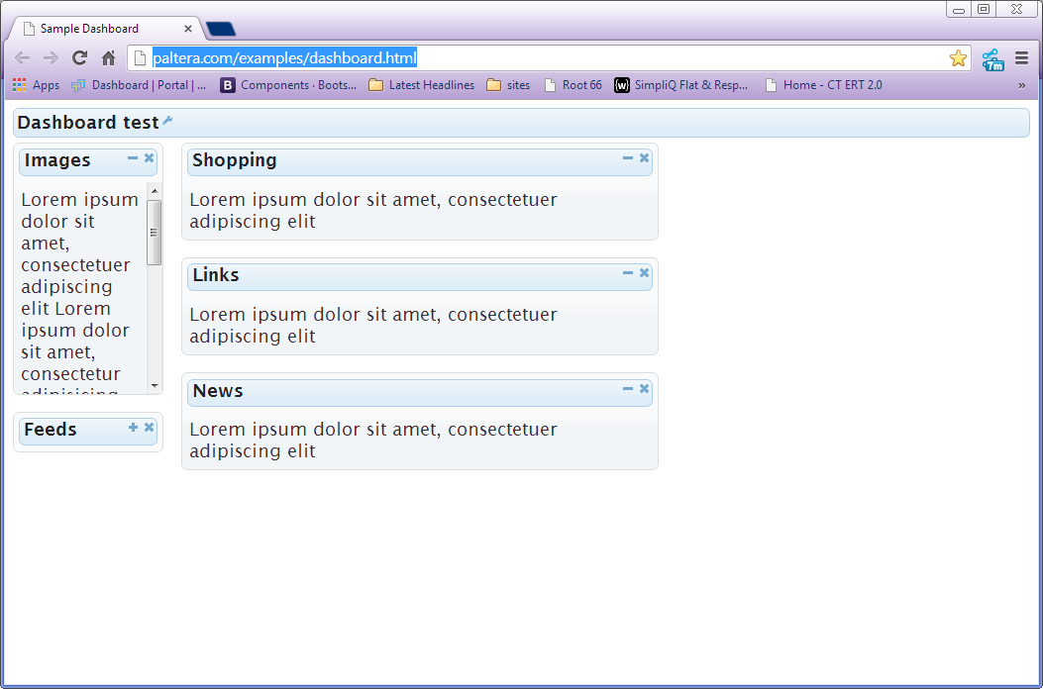
Paltera tutorial

Slide 11
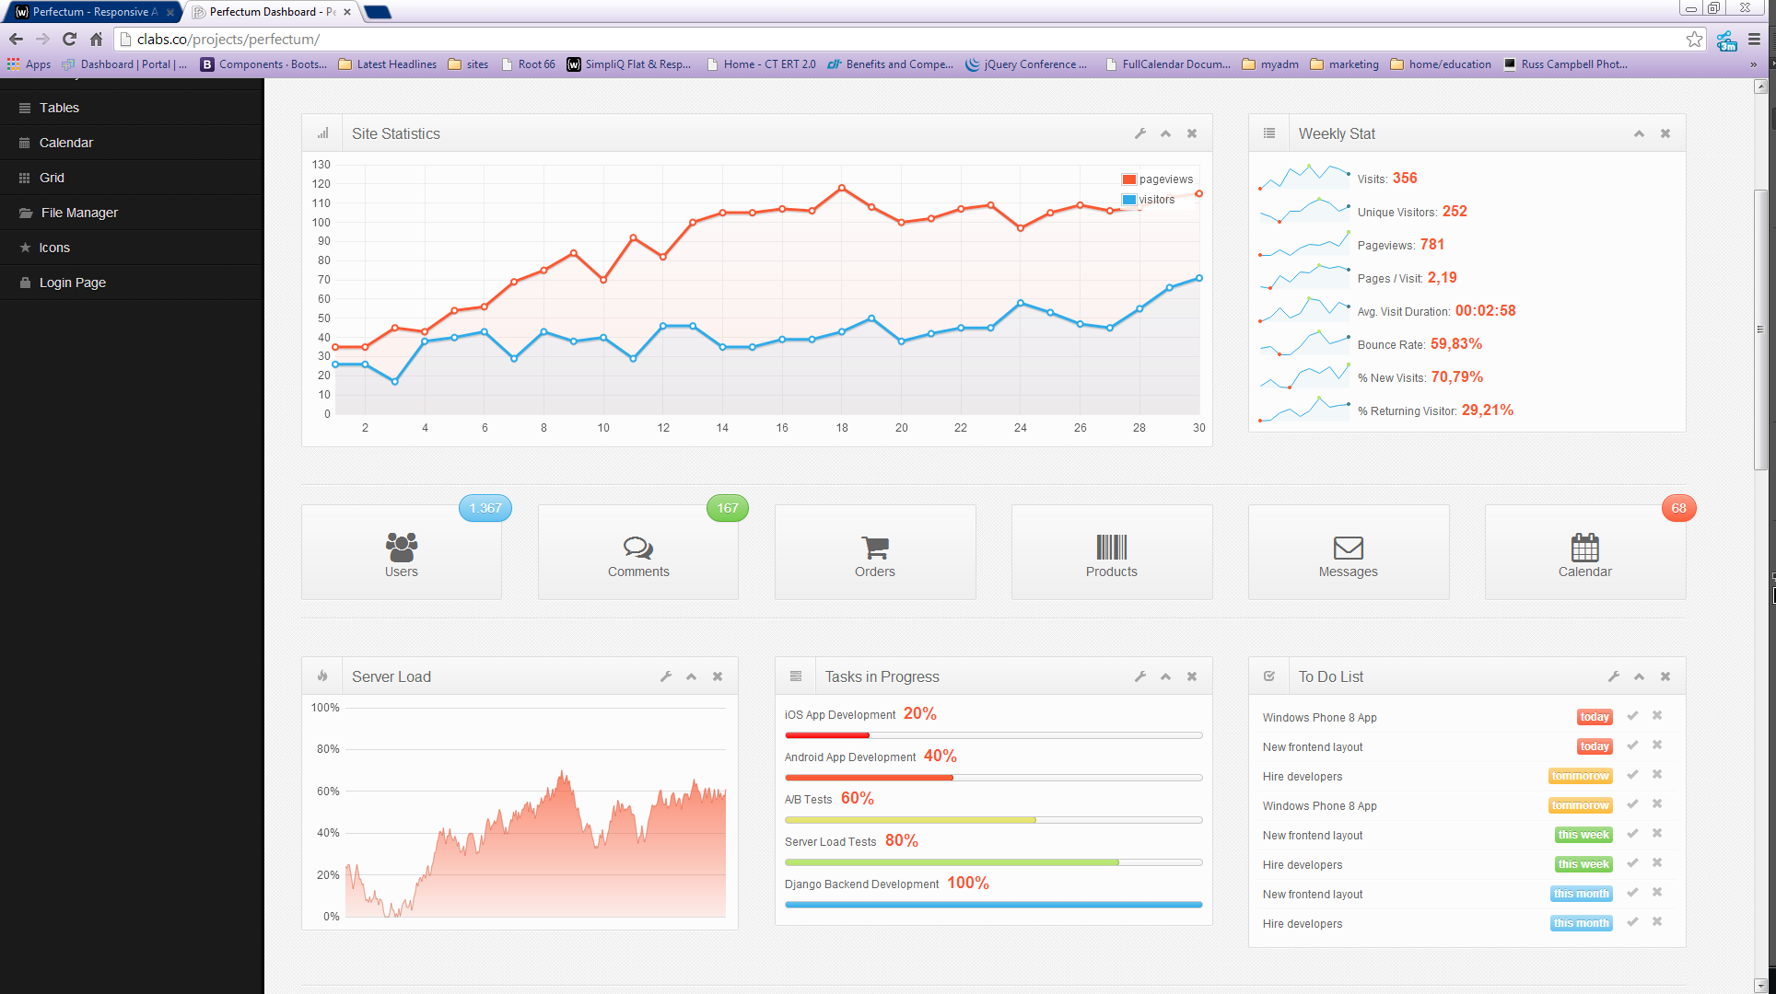
Perfectum Dashboard – $$ (Twitter Bootstrap Themed)

Slide 12
Suggested Solution
Begin by building the dash (It is not a hard thing to build). Use jquery UI for drag and drop and grid resizing.
Containers (portlets) conform to grid widths
Build portlets to specs using tutorial[s] listed for minimize, maximize etc.
Define Visual Displays for standard data
Add the look and feel of the paid Twitter template.

Slide 13
Data Table

Slide 14
Datatable (dynamic)
Purpose:
To display deal information in table format. (Current implementations include Deal Alerts (Dashboard) and Logbook.)

Slide 15
Functional Requirements
Sort columns
Drag/drop to reorder columns
Filter on columns - dynamically update
Pagination
# Records/Page view (all)
Display content (dynamically?)
Support Hyperlinks
Select entire row
Allow in-cell editing
Fix column headers (to remain visible during scrolling)
Allow shift + click to select group of rows
Allow Control + click to select multiple individual rows
Allow double click on column header to expand cell to widest value (?)
Facilitate select All checkbox column

Slide 16
Tabular Data UI Requirements
Zebra striping
Display icons in a cell (and sort on the column)
Facilitate in-cell dropdowns
Facilitate add/remove column functionality (picklist), including the ability to prevent column(s) from being removed
Style Guide Compliance
Fonts Colors Buttons Icons Spacing
Responsive design to accommodate at least desktop and tablet sizes

Slide 17
Datatable (“normal”) Requirements
Purpose:
To display deal information in table format. (Current implementation includes Manage Transactions.)
Requirements:
Same as for dynamic table only without user ability to add/remove columns (and maybe drag/drop to reorder)

Slide 18
Tablular Data
 | “DataTables” | Handsontable | Flexgrid | tableSorter | SlickGrid
Sort By Col | x | x | x | x | x
Reorder Col | x | x | x | x | x
Show/Hide Col | x | x | x |  | x
Pagination | x | x | x | x | x
Select row | x | x | x | x | x
Fixed Headers | x | x | x | x | x
TBS Integration | x | x |  | x | x
Infinite Scroll | x | x | x
AJAX | x | x | x | x
plug-in | JQuery/proprietary | JQuery | jQuery | jQuery, Twitter
Notes | Mature & Plugins, Seems Heavy | Small / Lightweight Customizable | Seems to easily do what we need but I wonder about skinnability | Integrated with TBS

Slide 19
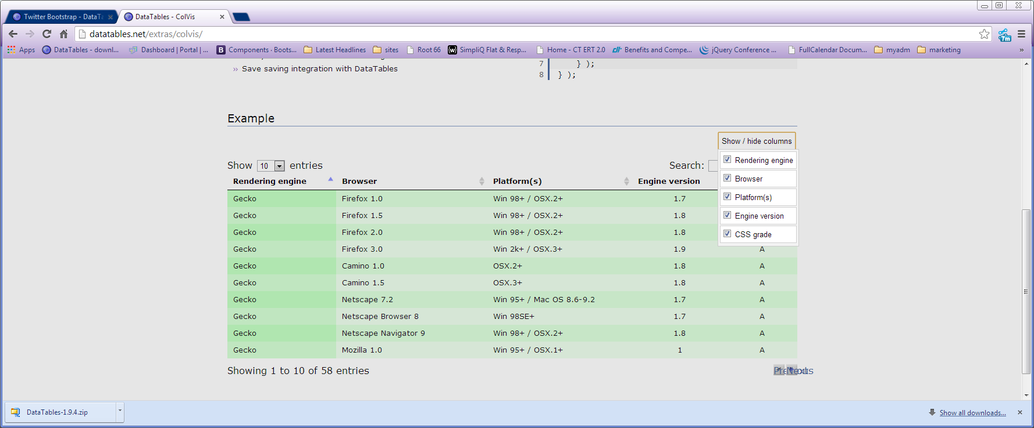
Datatable

Slide 20
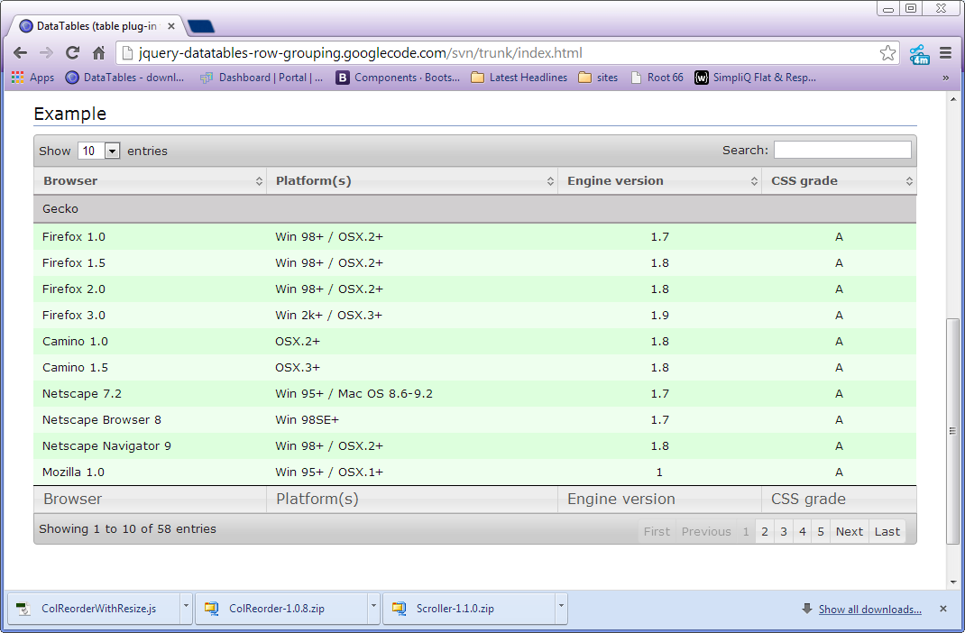
Datatable

Slide 21
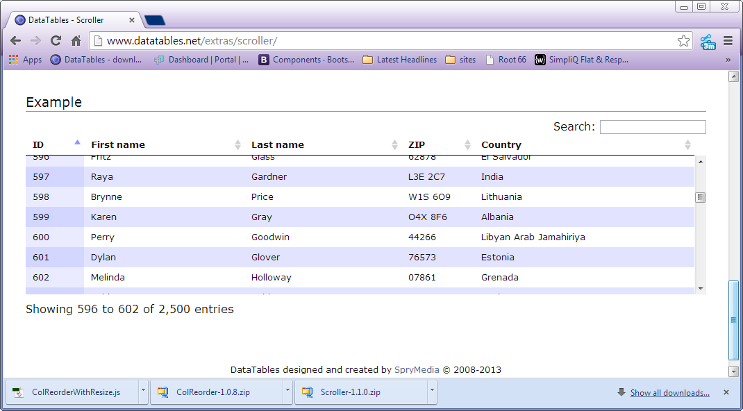
Datatable

Slide 22
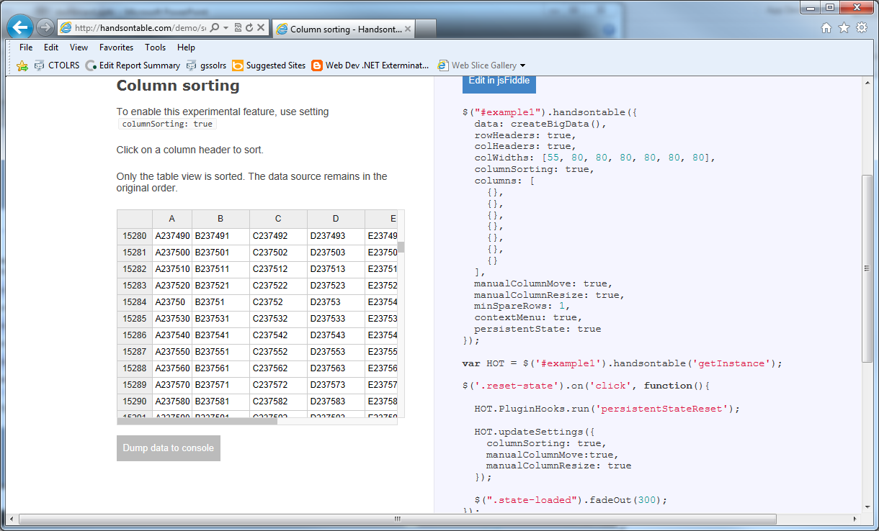
HandsonTable

Slide 23
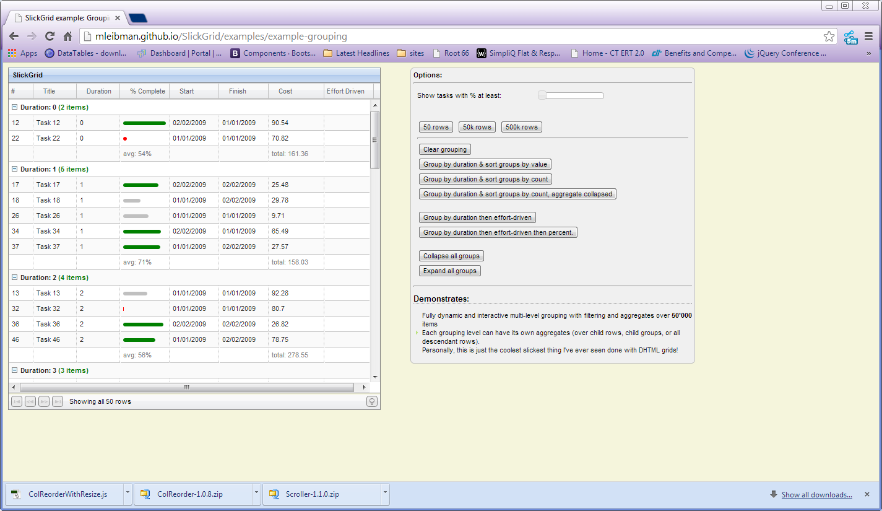
Slick Grid

Slide 24
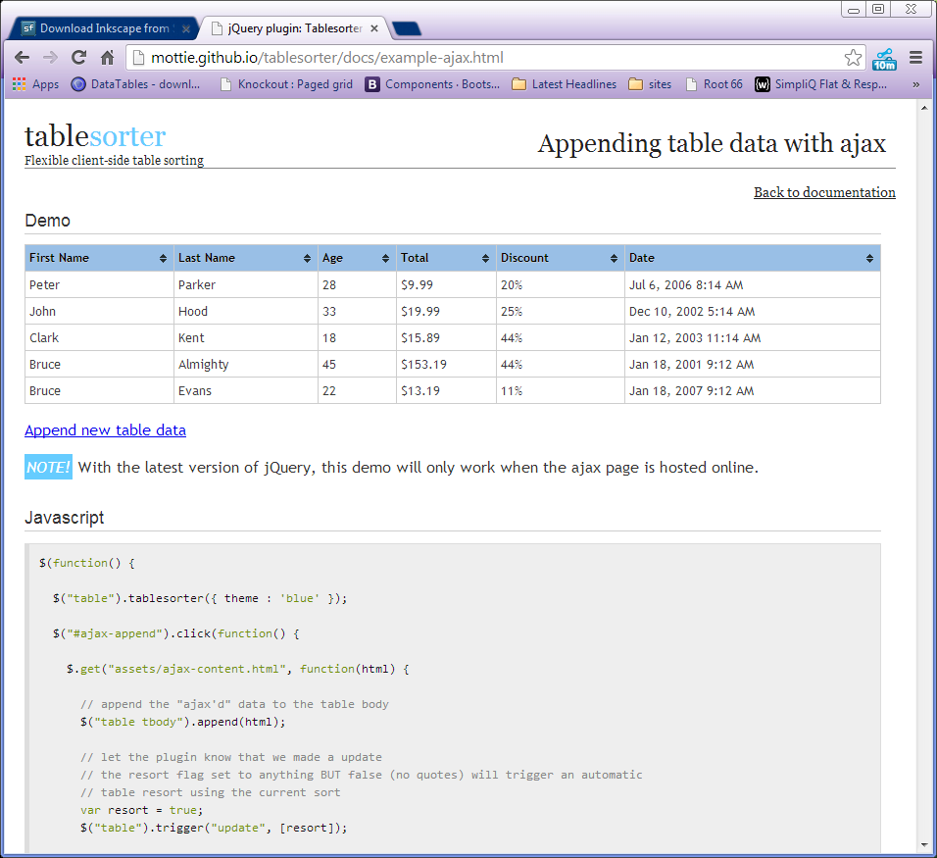
TableSorter

Slide 25
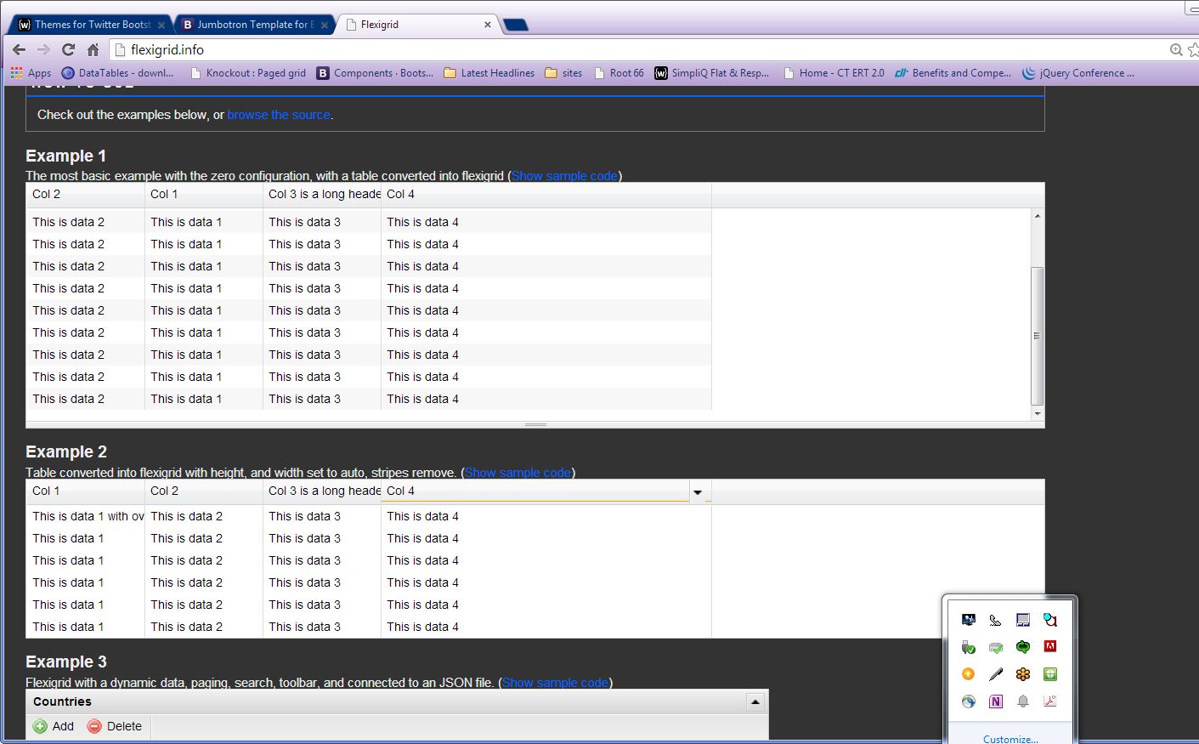
Flex Grid

Slide 26
Recommendation
Datatables is the most robust. Tabular data can be difficult for a wide range of functionality. Though simple is usually better, when I think of things like Logbook, I think we need to provide all the power we can. It will please repeat (power)users at the expense of casual users not needing its full potential.
In most cases for web apps simple is best. But in applications, sometimes we need to think about providing a higher level of control in data manipulation.
You should be able to print what you see. (not backgrounds etc.) But data views should provide a print version of the filters and format (intent) you create on screen without a plugin (using @media queries)
This plugin would take more configuration and customization that some of the others, but it seems like it would be easy to extend…
Second choice would be TableSorter, while it seems limited, it is linked to and integrated as an example on the TBS site…. (previous TBS version).

Slide 27
Reference
http://stackoverflow.com/questions/3127503/sorting-table-columns-with-jquery-table-sorter
http://www.kryogenix.org/code/browser/sorttable/

Slide 28
Pick List

Slide 29
Requirements
Add Remove Items
Add All Remove All Items
Reorder Items
Skinnable
Draggable
Fixed Items

Slide 30
Pick List Requirements
Page split
Resize Widgets
Manage Widgets
Style Guide Compliance
Responsive
 | Native/Jquery-1 | Native/Jquery-2 | Jquery custom
Move Single Items Between two lists | x | x | X
Move multiple items between two lists | x | x | X
Move all | x | x | X
Restrict item* (poor usability – if you cant pick unpick it, it doesn’t belong in a picklist)
Move Up Down |  |  | X
List Items/ Option Menu | option | option | li
Notes | Could be extended | Could be extended | I built this.

Slide 31
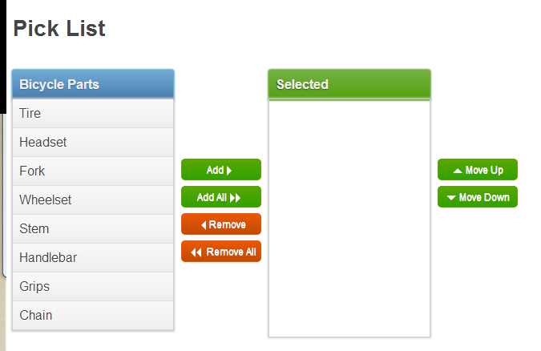
Pick List

Slide 32
Pick List Reference
Basic sample from https://code.google.com/p/jquery-ui-picklist/wiki/Demos
jQuery UI Multiselect - http://quasipartikel.at/multiselect_next/
Build a hybred solution from these two demos… http://jquerywall.com/multi-transfer-jquery-ui-selectable/

Slide 33
Pick List Recommenation
JQuery UI provides all the functionality we need
Can be linked to styles from TBS stack.
Already have a pretty functional prototype, just needs to be styled.
Need to communicate best implementation based on how code would be generated.
Sample in Git project.

