Slide 1

Unix Shell
Weeks 1

Slide 2
To talk about today
Unix Refresh
Files and File structures – show pictures talk about homework
Loops - refresh
Documentation – in this class we will be talking about in-line documentation

Slide 3

The Unix Shell

Slide 4
Computers do 4 things
Run programs
Store data
Communicate with each other
Interact with us
Notes:
Computers can interact with us in many different ways, such as through a keyboard and mouse, touch screen interfaces, or using speech recognition systems. While touch and voice interfaces are becoming more commonplace, most interaction is still done using traditional screens, mice, touchpads and keyboards.

Slide 5
Graphical User Interface - GUI
Pull down menus -- Most widely used way to interact with computers
Make new files, copy things, move things around etc… all with clicks
What if you need to move 1,000 files? Run a program 300 times?
Notes:
We give instructions (to run a program, to copy a file, to create a new folder/directory) with the convenience of a few mouse clicks. This way of interacting with a computer is intuitive and very easy to learn. But this way of giving instructions to a computer scales very poorly if we are to give a large stream of instructions even if they are similar or identical. For example if we have to copy the third line of each of a thousand text files stored in thousand different directories and paste it into a single file line by line. Using the traditional GUI approach of clicks will take several hours to do this.

Slide 6
Command Line Interface - CLI
Great to make repetitive tasks automatic and fast.
At the heart of it is the read-evaluate-print loop (REPL)
You type a command and hit enter:
The shell reads your command
Evaluates or executes it
Prints the output of your command
Loops back and waits for the next
Notes:
. It can take a single instruction and repeat it as is or with some modification as many times as we want. The task in the example above can be accomplished in a few minutes at most.

Slide 7
The Shell
A program that runs other programs.
Most popular Unix shell is BASH
The Bourne Again SHell – derived from a shell written by Stephen Bourne
Notes:
Those programs can be as complicated as climate modeling software and as simple as a program that creates a new directory.
The simple programs which are used to perform stand alone tasks are usually referred to as commands. The most popular Unix shell is Bash, (the Bourne Again SHell — so-called because it’s derived from a shell written by Stephen Bourne).
Bash is the default shell on most modern implementations of Unix and in most packages that provide Unix-like tools for Windows.

Slide 8
Shell prompt
When you first open the shell you get a prompt
Typically you get a $
Type in first program ‘ls’
Type in ‘ks’
Notes:
Go to shell and show the prompt
Type in ls – first program,

Slide 9
Difficulty
Difficult to learn over a GUI – takes effort and time to learn
GUI – presents you with choices and you pick one
CLI – the choices are a combinations of commands and parameters like words in a language
Notes:
Rather than buttons on a screen. They are not presented to you so you must learn a few, like learning some vocabulary in a new language. But a small number of commands gets you a long way, and we’ll cover those essential few today.

Slide 10
Flexibility and Automation
The grammar of the shell allows you to combine existing tools into powerful pipelines and handle large volumes of data automatically.
Sequences of commands can be written into a script, improving the reproducibility of workflows and allowing you to repeat them easily.
..and allows you to interact with remote computers.
Notes:
You have to be able to work with the shell to do any work on clusters/cloud computing and other high perforrmace computing systems.
As clusters and cloud computing systems become more popular for scientific data crunching, being able to interact with the shell is becoming a necessary skill. We can build on the command-line skills covered here to tackle a wide range of scientific questions and computational challenges.

Slide 11
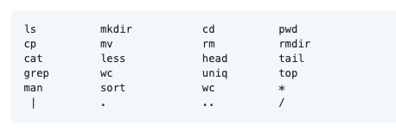
Shell Programs to Refresh

Slide 12
Navigating Files and Directories
The part of the operating system responsible for managing files is called the
file system
Several commands are frequently used to create inspect, rename and delete files and directories.

Slide 13
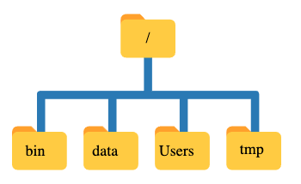
File System – my computer
Root directory – holds everything else
/Users/julieallen
*begins with a /
/Users/julieallen/tmp

Slide 14
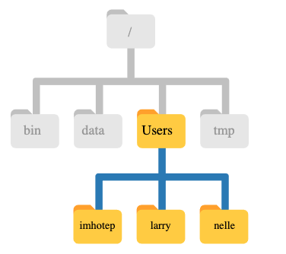
File System – my computer – you will draw this on the homework
/Users/julieallen
/Users/julieallen/Users
/Users/julieallen/Users/nelle

Slide 15
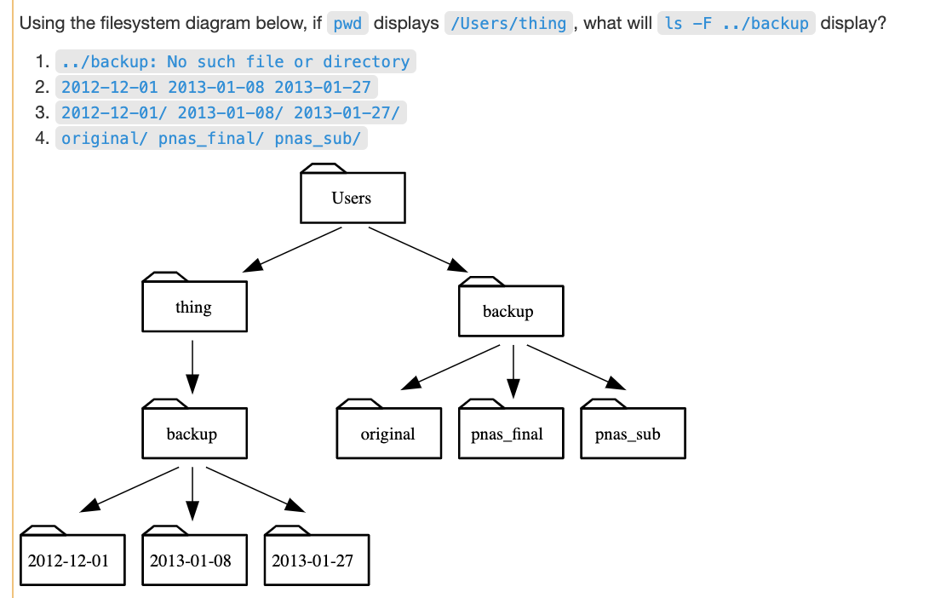

Slide 16
Absolute vs. Relative Paths
All paths are either relative or absolute
Absolute path always contains the root element and the complete directory list to the location or file.
Relative path – relative to where you are. These change as you move around
. my current directory
.. up a directory

Slide 17
Absolute vs. relative paths
Starting from /users/amanda/data , which of the following commands could Amanda use to navigate to her home directory, which is /users/amanda
cd .
cd /
cd /home/Amanda
cd ../..
cd ~
cd home
cd ~/data/..
cd
cd ..

Slide 18
Absolute vs. relative paths
Starting from /Users/Amanda/data , which of the following commands could Amanda use to navigate to her home directory, which is /Users/Amanda
cd .
cd /
cd /home/Amanda
cd ../..
cd ~
cd home
cd ~/data/..
cd
cd ..

Slide 19
Loops - loops in every program
For thing in list of things
Do
Operation using thing
Done
Example loop in linux
for file in *.txt
do
echo $file
done

Slide 20
Shell-Scripts
Small program
Way to save our code
Way to run programs on other computers
Bash scripts always start with
#!/usr/bin/sh

Slide 21
Documentation
Process by which a programmer documents their code
Explaining your code, to yourself and the world
Show examples and how I want documentation in this class.

