Slide 1
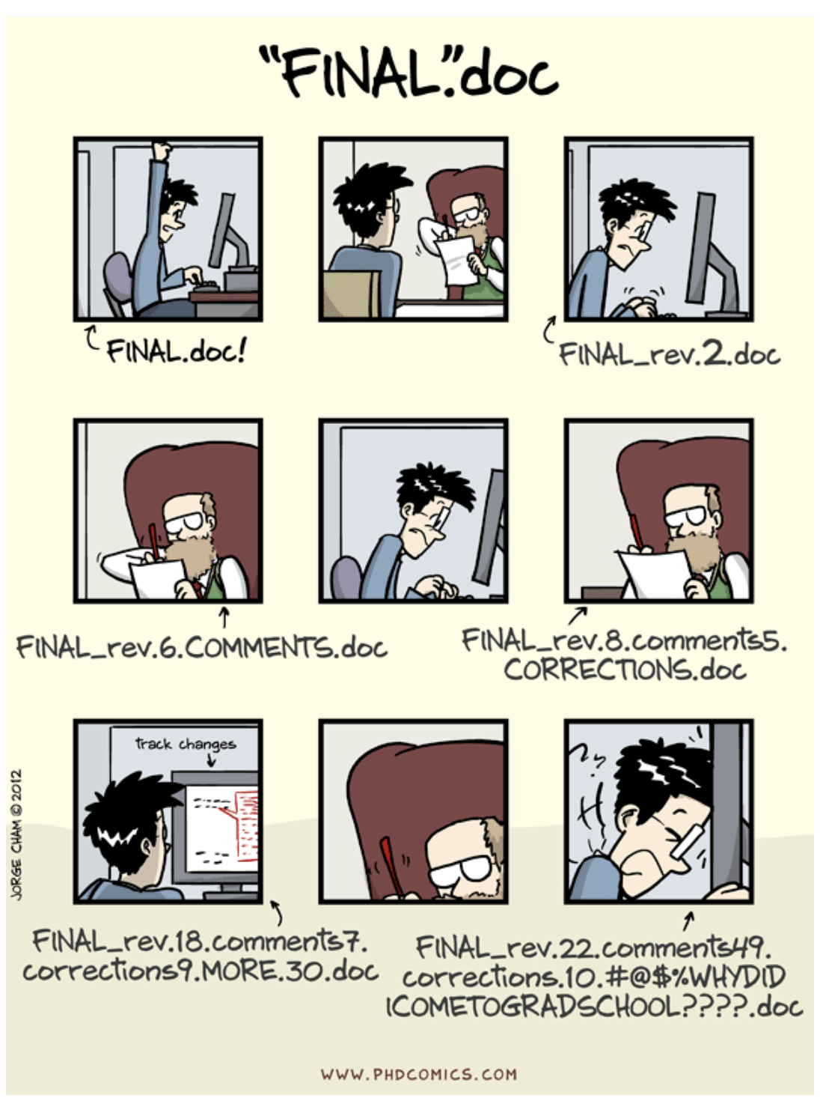
Bioinformatics and Data Science Part II
version control with git
Notes:
We’ve all been in this situation before: it seems ridiculous to have multiple nearly-identical versions of the same document. Some word processors let us deal with this a little better, such as Microsoft Word’s Track Changes, Google Docs’ version history, or LibreOffice’s Recording and Displaying Changes.

Slide 2
How often does this happen?
You and one other person need to work on the same dataset, and one of you edits the data.
You and a group using multiple copies of data/code, and each of you reformats or reorganize the data
Someone sends you back a paper but has not used track changes
You get changes on the same manuscript draft from multiple people
You have to find the data you used for a project a while ago and you need to find the exact version you used?

Slide 3
The answer is version control
Nothing that is committed to version control is ever lost
Old versions of files are saved
It’s always possible to go back in time to see exactly who wrote what on a particular day,
or to see what version of a program was used to generate a particular set of results.
Notes:
This is why we always want to report the version of any software you are using.

Slide 4
The version control system
Have a record of who made what changes when, so we know who to ask if we have questions later on
We can revert to a previous version, much like the “undo” feature in an editor.
When several people collaborate in the same project, it’s possible to accidentally overlook or overwrite someone’s changes.
The version control system automatically notifies users whenever there’s a conflict between one person’s work and another’s.

Slide 5
Version control is key for researchers
Keeping a record of what was changed, when, and why is useful for all researchers if they ever need to come back to the project
Version control is the lab notebook of the digital world: it’s what professionals use to keep track of what they’ve done and to collaborate with other people.
Every large software development project relies on it, and most programmers use it for their small jobs as well.
Can be used for books, papers, small data sets, and anything that changes over time or needs to be shared can and should be stored in a version control system.
Notes:
How many of you have a version control system for your data? How many have used the version control system in google docs?

Slide 6
Version control with Git
Git is a version control system that lets you track who made changes to what when, and has options for easily updating a shared or public version of your code on github.com.
Notes:
github uses git as its version controll system
"git" can mean anything, depending on your mood.
random three-letter combination that is pronounceable, and not actually used by any common UNIX command. The fact that it is a mispronunciation of "get" may or may not be relevant.
stupid. contemptible and despicable. simple. Take your pick from the dictionary of slang.
"global information tracker": you're in a good mood, and it actually works for you. Angels sing, and a light suddenly fills the room.
"goddamn idiotic truckload of sh*t": when it breaks

Slide 7
Version control with Git
Git is a version control system that lets you track who made changes to what when, and has options for easily updating a shared or public version of your code on github.com.
"git" can mean anything, depending on your mood.
random three-letter combination that is pronounceable, and not actually used by any common UNIX command. The fact that it is a mispronunciation of "get" may or may not be relevant.
stupid. contemptible and despicable. simple. Take your pick from the dictionary of slang.
"global information tracker": you're in a good mood, and it actually works for you. Angels sing, and a light suddenly fills the room.
"goddamn idiotic truckload of sh*t": when it breaks
Notes:
github uses git as its version controll system
"git" can mean anything, depending on your mood.
random three-letter combination that is pronounceable, and not actually used by any common UNIX command. The fact that it is a mispronunciation of "get" may or may not be relevant.
stupid. contemptible and despicable. simple. Take your pick from the dictionary of slang.
"global information tracker": you're in a good mood, and it actually works for you. Angels sing, and a light suddenly fills the room.
"goddamn idiotic truckload of sh*t": when it breaks

Slide 8
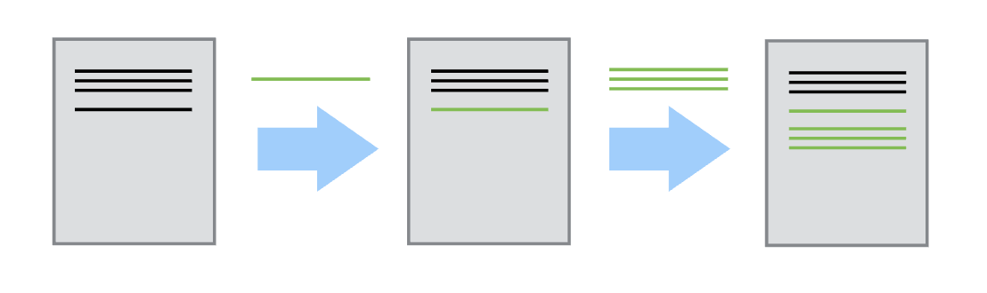
Version control systems start with a base version of the document and then record changes you make each step of the way.
Notes:
You can think of it as a recording of your progress: you can rewind to start at the base document and play back each change you made, eventually arriving at your more recent version.

Slide 9
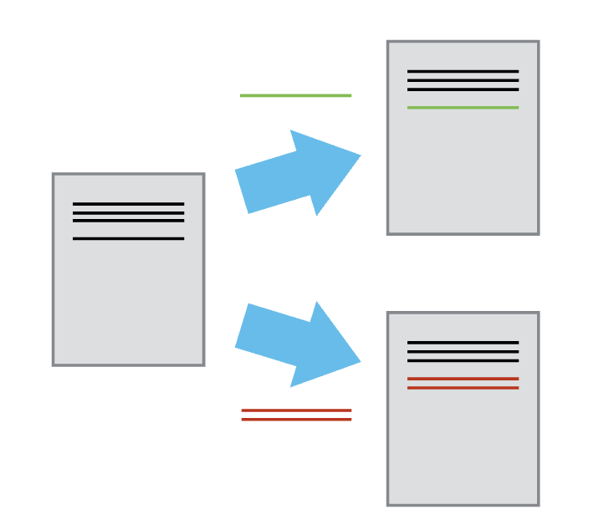
Once you think of changes as separate from the document itself, you can then think about “playing back” different sets of changes on the base document, ultimately resulting in different versions of that document.
Notes:
For example, two users can make independent sets of changes on the same document.

Slide 10
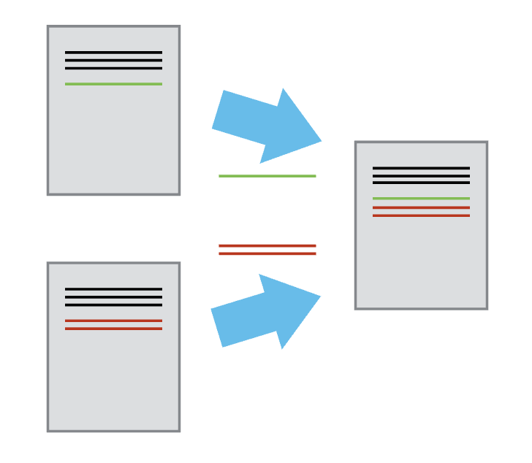
Unless multiple users make changes to the same section of the document - a conflict - you can incorporate two sets of changes into the same base document.

Slide 11
Version control with Git
A version control system is a tool that keeps track of these changes for us, effectively creating different versions of our files.
It allows us to decide which changes will be made to the next version (each record of these changes is called a commit), and keeps useful metadata about them.
The complete history of commits for a particular project and their metadata make up a repository. Repositories can be kept in sync across different computers, facilitating collaboration among different people.
Notes:
Git is a very fancy program for version control and that is what we are going to learn today.

Slide 12
Lets Create a Github account

Slide 14
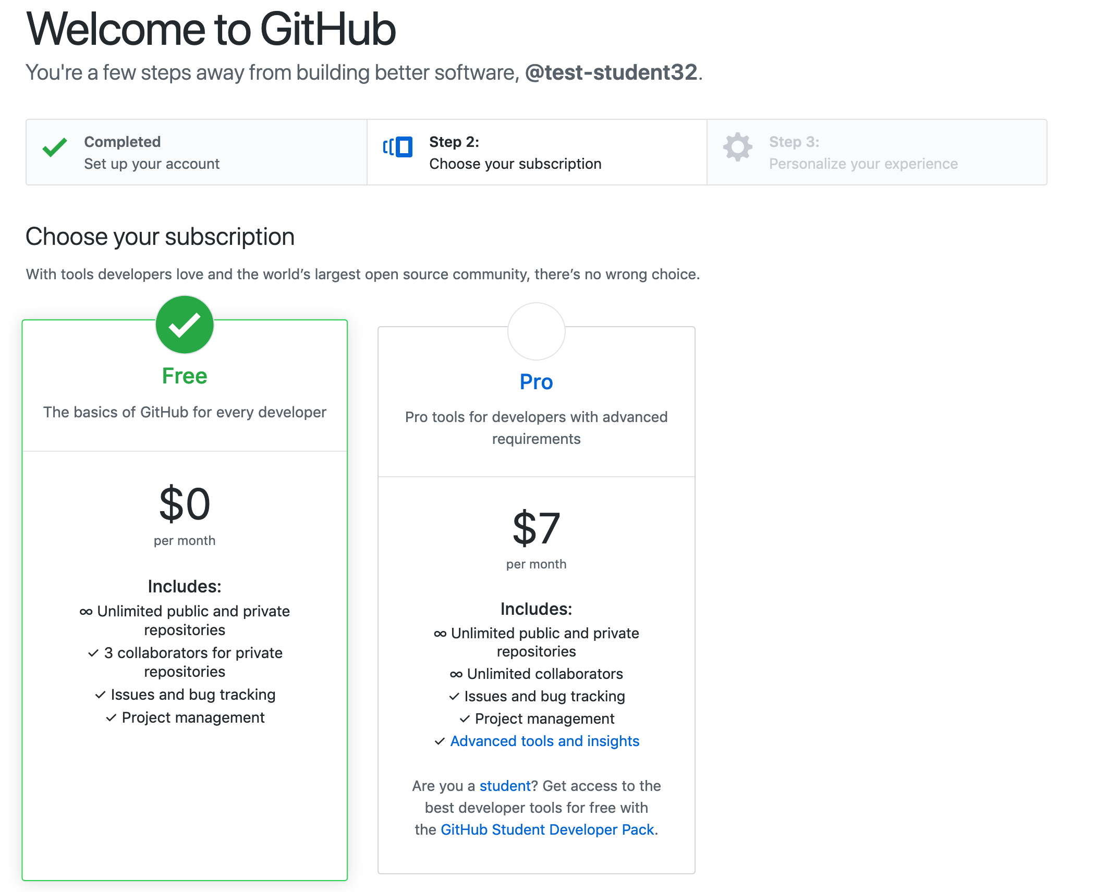
Create a Github Account
Create a username, give an email address and passcode
Will have to verify it by proving you are human
Select the free account
Possibly unclick the ‘send me offers and updates on github’
Answer or skip survey
Verify email

Slide 15
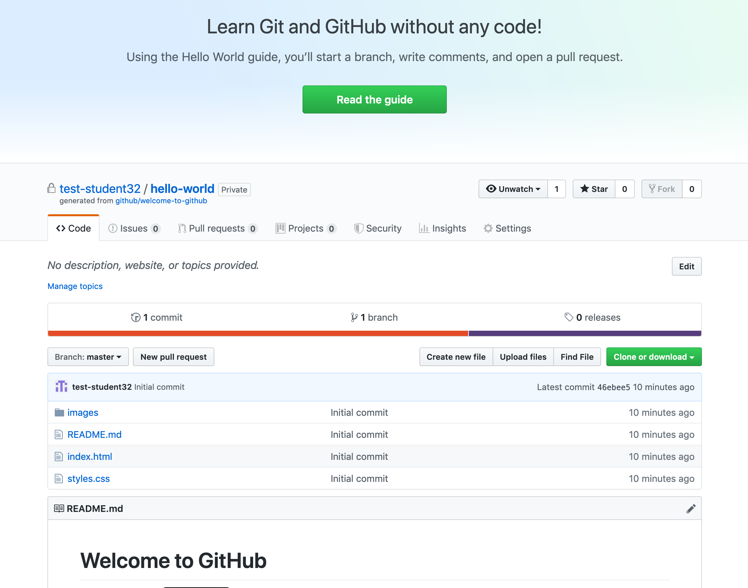
Notes:
My account is on firefox – through yahoo – test-student32

Slide 16
Setting up Git
If you are using git regularly have already done this.
If not need to set:
User Name – same as the one you set for your github account!
Email address – same one you will use with github account!
Preferred text editor
And that we want to use these globally (for every project)

Slide 17
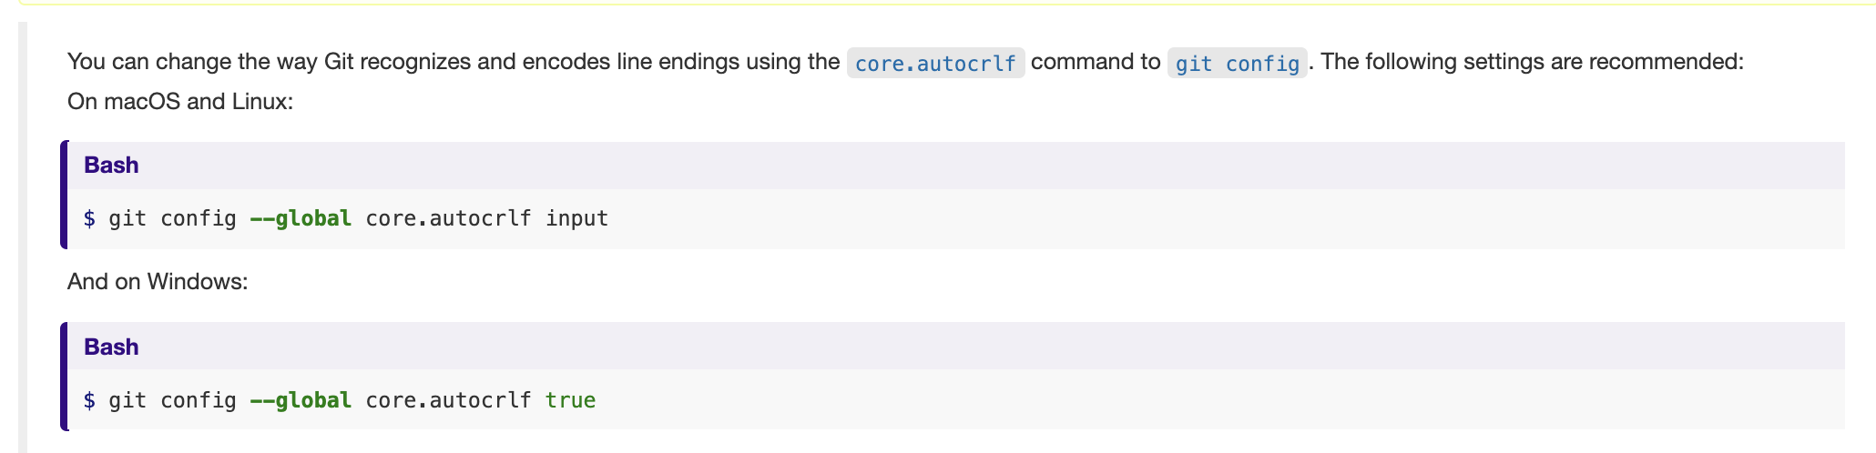
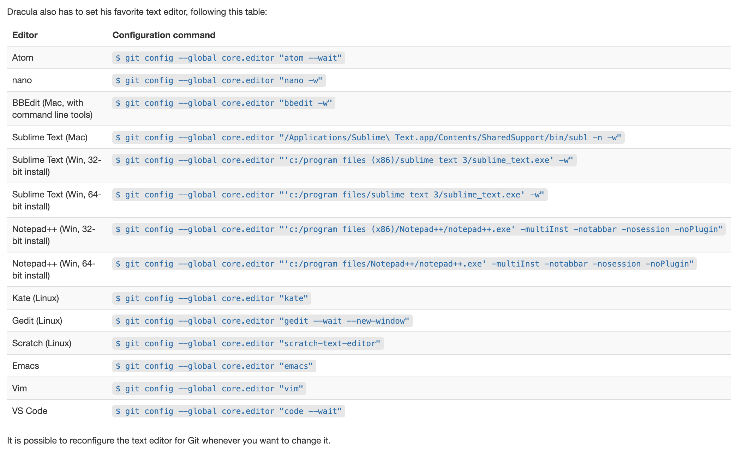
Mac/Linux
Windows
Set your text editor of choice – Nano!
Notes:
More text editor settings at the software carpentry lesson “Setting up Git”

Slide 18
Creating a Repository – to terminal

Slide 19
Git Workflow
You have files you want to put into a version control system
git init

Slide 20
Git Workflow
You have files you want to put into a version control system
git init
edit files

Slide 21
Git Workflow
You have files you want to put into a version control system
git init
edit files
Staging Area
git add
Add everything to the staging area you want to track

Slide 22
Git Workflow
Repository
You have files you want to put into a version control system
git commit
git init
edit files
Commit your changes with a commit message (meta-data)
Staging Area
git add
Add everything to the staging area you want to track

Slide 23
Git Workflow
Commit object
Commit object
Commit object
Repository
HEAD
HEAD ~1
HEAD ~2
HEAD ~3
You have files you want to put into a version control system
git commit
git init
edit files
Commit your changes with a commit message (meta-data)
Staging Area
git add
Add everything to the staging area you want to track

Slide 24
What have we learned
Git is a version control system
We have learned how to:
Create a repository
Track our changes
Show our log of commits
Revert to a previous version
How to teach git to ignore files
Next
How to share changes with others on the web (Remotes)
How to collaborate with others
How to deal with Conflicts

Slide 25
Git Workflow
You have files you want to put into a version control system
* Create a repository
git init

Slide 26
Git Workflow
You have files you want to put into a version control system
* Create a repository
git init
*make edits to your files

Slide 27
Git Workflow
You have files you want to put into a version control system
* Create a repository
git init
*make edits to your files
Staging Area
* Add edited files to your staging area
git add
Add everything to the staging area you want to track

Slide 28
Git Workflow
Repository
You have files you want to put into a version control system
git commit
* Create a repository
git init
*Commit your changes with a commit message (meta-data)
*make edits to your files
Staging Area
* Add edited files to your staging area
git add
Add everything to the staging area you want to track

Slide 29
Git Workflow
Latest commited changes are in HEAD
Repository
HEAD
You have files you want to put into a version control system
git commit
* Create a repository
git init
Commit your changes with a commit message (meta-data)
*make edits to your files
Staging Area
* Add edited files to your staging area
git add
Add everything to the staging area you want to track

Slide 30
Git Workflow
Git stores your current version and all past versions of your files
Commit object
Commit object
Commit object
Latest commited changes are in HEAD
Repository
HEAD
HEAD ~1
HEAD ~2
HEAD ~3
You have files you want to put into a version control system
git commit
* Create a repository
git init
Commit your changes with a commit message (meta-data)
*make edits to your files
Staging Area
* Add edited files to your staging area
git add
Add everything to the staging area you want to track

Slide 31
Laptop
Master Copy – on a web host (e.g. Github)
git push
git pull

Slide 32
In Class Practice
git init
git status
git add
git commit
git show
git diff
git checkout
git remote add origin
git remote –v
git push origin master
git pull origin master
Create a new folder
Turn it into a repository
Add some files
Make edits to those files
Create 3 commits
Explore those with git log, git diff, git show
Revert to an old commit then back
Go to Github – make a repo
Push changes from laptop to the remote repository
Make changes in github
Pull changes to laptop
Send me the link to your repo!
Rinse repeat

Slide 33
Collaborator 1
Collaborator 2
git push
git pull
git pull
git push
Master Copy – on Github

Slide 34
Open Science? Here is the traditional workflow
A scientist collects some data and stores it on a machine that is occasionally backed up
She then writes or modifies a few small programs (which also reside on her machine) to analyze that data.
Once she has some results, she writes them up and submits her paper. She might include her data – a growing number of journals require this – but she probably doesn’t include her code.
Time passes.
The journal sends her reviews written anonymously by a handful of other people in her field. She revises her paper to satisfy them, during which time she might also modify the scripts she wrote earlier, and resubmits.
More time passes.
The paper is eventually published. It might include a link to an online copy of her data, but the paper itself will be behind a paywall: only people who have personal or institutional access will be able to read it.

Slide 35
Open Science – New Process
The data that the scientist collects is stored in an open access repository like figshare or Zenodo, possibly as soon as it’s collected, and given its own Digital Object Identifier (DOI). Or the data was already published and is stored in Dryad.
The scientist creates a new repository on GitHub to hold her work.
As she does her analysis, she pushes changes to her scripts (and possibly some output files) to that repository. She also uses the repository for her paper; that repository is then the hub for collaboration with her colleagues.
When she’s happy with the state of her paper, she posts a version to arXiv or some other preprint server to invite feedback from peers.
Based on that feedback, she may post several revisions before finally submitting her paper to a journal.
The published paper includes links to her preprint and to her code and data repositories, which makes it much easier for other scientists to use her work as starting point for their own research.

Slide 36
Open Science – Benefits
Increased visibility of code and work
Ensures that your work is fully reproducible – have a colleague try to reproduce your work with your data and scripts
Can turn your code itself into a citable object
Git Large File Storage – can track large files
Licensing - use common licenses - there are a gazillion of them. A few are widely used

Slide 37
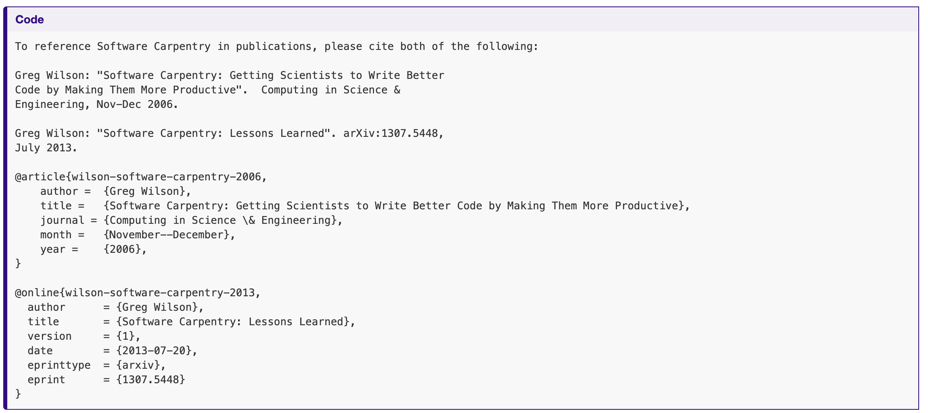
Include a CITATION.txt file

Slide 38
In this Class
Create a repository for your homework
Homework 2 is the code you will use to push your changes up to your repository.
You will turn in your homework from here on out by sending me a link to your repository.

Slide 39
For Tuesday – Install Jupyter Notebooks
Here is an overview of notebooks – read the install part
https://programminghistorian.org/en/lessons/jupyter-notebooks
Easiest way is through Anaconda install
https://www.anaconda.com/products/individual
Mac if you want to be hardcore and do it through the terminal
$pip3 install jupyter
To run it
$jupyter notebook

