Slide 1

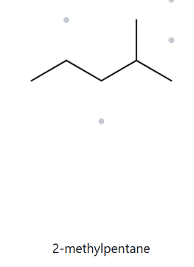


A01.
Foundation
C₆H₁₃
Numbered Parent
Naming Traile
Parent: longest chain = 5 C → pentane.
Numbering: right → left gives 2; left → right gives 4. First point of difference: 2 < 4, so number from the right.
Substituents: methyl on C2 → 2-methyl.
4
2
5
3
1
The Alkane Check
My Name
2-methylpentane
Returned Name: 2-methylpentane
longest chain confirmed
lowest locants
alphabetical order
punctuation
formula counted

Slide 2
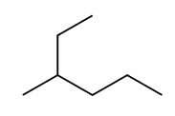
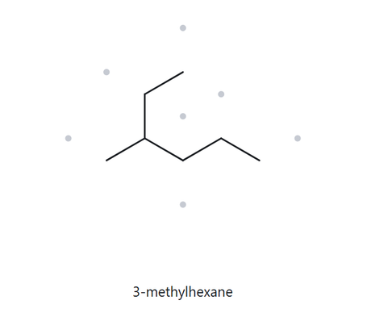
A02.
Foundation
C₇H₁₆
Numbered Parent
Naming Traile
Parent: longest chain = 6 C → hexane.
Numbering: top → right gives 3; right → top gives 4. First point of difference: 3 < 4, so number from the top.
Substituents: methyl on C3 → 3-methyl.
1
2
3
5
4
6
The Alkane Check
My Name
3-methylhexane
Returned Name: 3-methyhexane
longest chain confirmed
lowest locants
alphabetical order
punctuation
formula counted

Slide 3
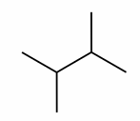
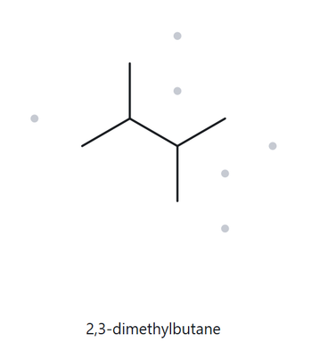
A03.
Foundation
C₆H₁₄
Numbered Parent
Naming Traile
Parent: longest chain = 4 C → butane.
Numbering: left → right gives 2,3; right → left gives 2,3. Both directions are identical, so number from either side.
Substituents: methyl on C2 and C3 → 2,3-dimethyl
1
3
2
4
The Alkane Check
My Name
2,3-dimethylbutane
Returned Name: 2,3-dimethybutane
longest chain confirmed
lowest locants
alphabetical order
punctuation
formula counted

Slide 4
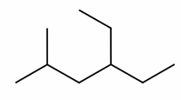
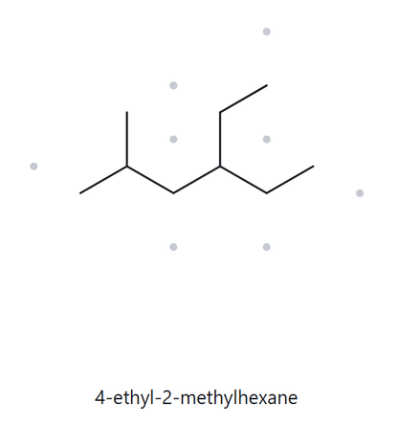
A04.
Developing
C₉H₂₀
Numbered Parent
Naming Traile
Parent: longest chain = 6 C → hexane.
Numbering: left → right gives 2,4; right → left gives 3,5. First point of difference: 2 < 3, so number from the left.
Substituents: methyl on C2 and ethyl on C4 → 4-ethyl-2-methyl.
1
2
4
6
3
5
The Alkane Check
My Name
4-ethyl,2-methylhexane
Returned Name: 4-ethyl,2-methylhexane
longest chain confirmed
lowest locants
alphabetical order
punctuation
formula counted

Slide 5
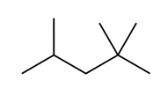
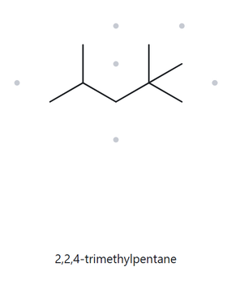
A05.
Developing
C₈H₁₈
Numbered Parent
Naming Traile
Parent: longest chain = 5 C → pentane.
Numbering: right → left gives 2,2,4; left → right gives 2,4,4. First point of difference: 2 < 4, so number from the right.
Substituents: methyl on C2, C2 and C4 → 2,2,4-trimethyl.
1
4
2
5
3
The Alkane Check
My Name
2,2,4-trimethylpentane
Returned Name:2,2,4-trimethylpentane
longest chain confirmed
lowest locants
alphabetical order
punctuation
formula counted

Slide 6
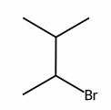
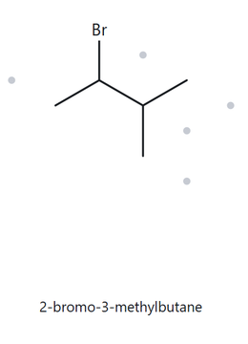
A06.
Developing
C₅H₁₁Br
Numbered Parent
Naming Traile
4
Parent: longest chain = 4 C → butane.
Numbering: bottom-left → top-right gives 2,3 (2-bromo, 3-methyl); top-right → bottom-left gives 2,3 (3-bromo, 2-methyl). Alphabetical order ("b" before "m") means number from the bottom-left.
Substituents: bromo on C2 and methyl on C3 → 2-bromo-3-methyl.
3
2
1
The Alkane Check
My Name
2-bromo-3-methylbutane
Returned Name:2-bromo-3-methylbutane
longest chain confirmed
lowest locants
alphabetical order
punctuation
formula counted

Slide 7
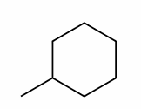
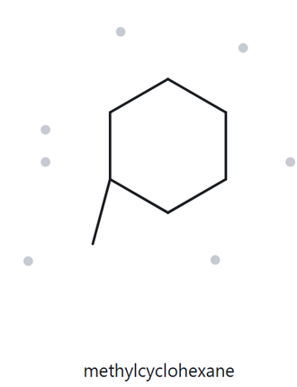
A07.
Developing
C₇H₁₄
Numbered Parent
Naming Traile
5
Parent: 6-carbon ring → cyclohexane.
Numbering:the carbon with the branch must be position 1, so numbering starts directly at that junction.
Substituents: methyl on C1 → methylcyclohexane (the locant number "1" is omitted in the final name for a ring with only one substituent).
6
4
1
3
2
The Alkane Check
My Name
methylcyclohexane
Returned Name:methylcyclohexane
longest chain confirmed
lowest locants
alphabetical order
punctuation
formula counted

Slide 8
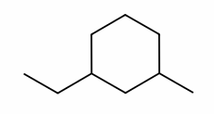
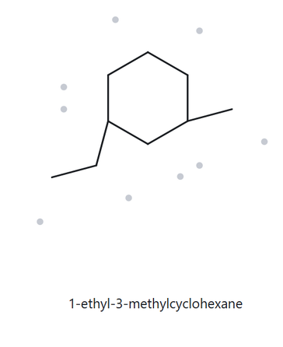
A08.
Challenge
C₉H₁₈
Numbered Parent
Naming Traile
Parent: 6-carbon ring → cyclohexane.
Numbering: ethyl-to-methyl via the bottom path gives 1,3. Alphabetical order ("e" before "m") means position 1 goes to the ethyl group and we number counter-clockwise toward the methyl group.
Substituents: ethyl on C1 and methyl on C3 → 1-ethyl-3-methylcyclohexane.
5
6
4
1
3
2
The Alkane Check
My Name
1-ethyl-3-methylcyclohexane
Returned Name:1-ethyl-3-methylcyclohexane
Match
longest chain confirmed
lowest locants
alphabetical order
punctuation
formula counted

Slide 9
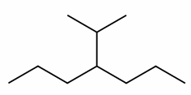
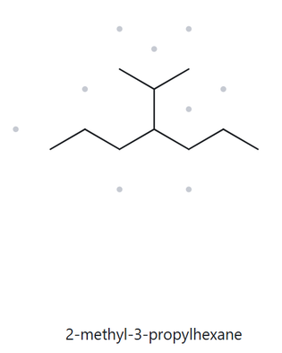
A09.
Challenge
C1₀H₂₂
Numbered Parent
Naming Traile
Parent: longest chain = 6 C → hexane.
Numbering: top-left → bottom-right gives 2,3; bottom-right → top-left gives 4,5. First point of difference: 2 < 4, so number from the top-left branch.
Substituents: methyl on C2 and propyl on C3 → 2-methyl-3-propylhexane.
1
2
3
5
4
6
The Alkane Check
My Name
2-methyl-3-propylhexane
Returned Name:2-methyl-3-propylhexane
Match
longest chain confirmed
lowest locants
alphabetical order
punctuation
formula counted

Slide 10

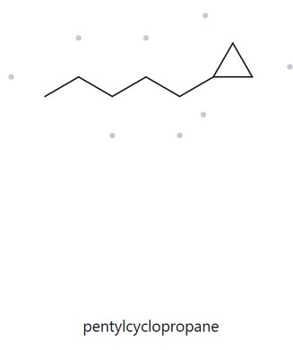
A10.
Challenge
C₈H₁₆
Numbered Parent
Naming Traile
Parent: longest chain = 5 C → pentane.
Numbering: right → left gives 1; left → right gives 5. First point of difference: 1 < 5, so number from the right.
Substituents: cyclopropyl on C1 → 1-cyclopropylpentane.
5
3
1
4
2
The Alkane Check
My Name
1-cyclopropylpentane
Returned Name:pentylcyclopropane
Note: Mismatched. The ring is the one considered as parent chain.
longest chain confirmed
lowest locants
alphabetical order
punctuation
formula counted

Slide 11
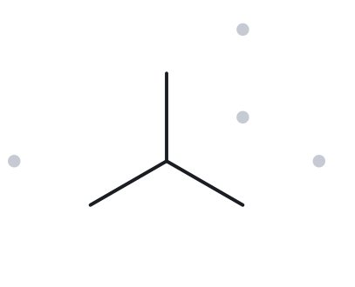
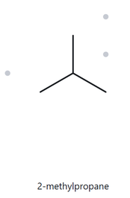
B01.
Foundation
2-methylpropane
Name Decoded
Bond-Line Structure
Parent: butane → a 3-carbon chain.
Substituents: methyl on C2.
Expected formula: 3 + 1 = 4 C; no rings or double bonds → C₄H₁₂
Formula Check
Back- Check
Counted from the drawing: C₄H₁₀
No rings or double bonds: C_{n}H_{2n+2} = C₄H₁₀
Returned by The Alkane: 2-methylpropane
Same as the given name
parent length matches
substituents position match
formula agrees
back-checked recorded

Slide 12
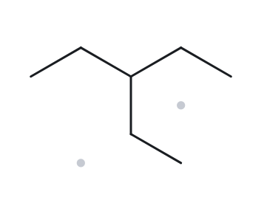
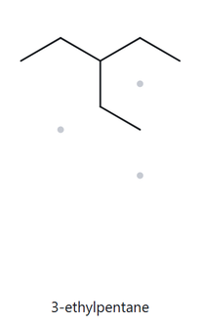
B02.
Foundation
3-ethylpentane
Name Decoded
Bond-Line Structure
Parent: pentane → a 5-carbon chain.
Substituents: ethyl on C3.
Expected formula: 5 + 2 = 7 C; no rings or double bonds → C₇H₁₆
Formula Check
Back- Check
Counted from the drawing: C₇H₁₆
No rings or double bonds: C_{n}H_{2n+2} = C₇H₁₆
Returned by The Alkane: 3-ethylpentane
Same as the given name
parent length matches
substituents position match
formula agrees
back-checked recorded

Slide 13
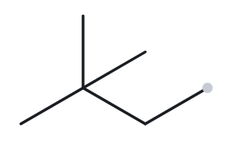
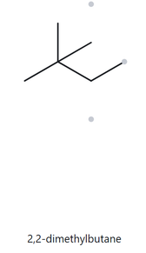
B03.
Foundation
2,2-dimethylbutane
Name Decoded
Bond-Line Structure
Parent: butane → a 4-carbon chain.
Substituents: methyl on C2 and C2.
Expected formula: 4 + 2 = 6 C; no rings or double bonds → C₆H₁₄
Formula Check
Back- Check
Counted from the drawing: C₆H₁₄
No rings or double bonds: C_{n}H_{2n+2} = C₆H₁₄
Returned by The Alkane: 2,2-dimethylbutane
Same as the given name
parent length matches
substituents position match
formula agrees
back-checked recorded

Slide 14
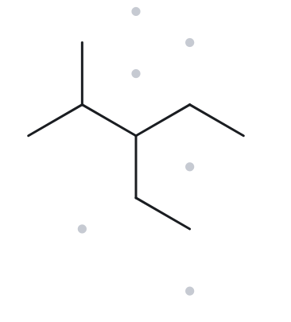
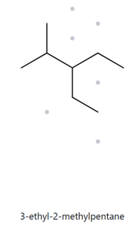
B04.
Developing
3-ethyl-2-methylpentane
Name Decoded
Bond-Line Structure
Parent: pentane → a 5-carbon chain.
Substituents: methyl on C2; ethyl on C3.
Expected formula: 5 + 1 + 2 = 8 C; no rings or double bonds → C₈H₁₈
Formula Check
Back- Check
Counted from the drawing: C₈H₁₈
No rings or double bonds: C_{n}H_{2n+2} = C₈H₁₈
Returned by The Alkane: 3-ethyl-2-methylpentane
Same as the given name
parent length matches
substituents position match
formula agrees
back-checked recorded

Slide 15
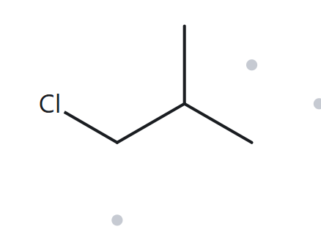
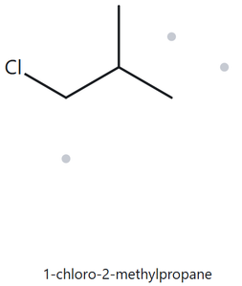
B05.
Developing
1-chloro-2-methylpropane
Name Decoded
Bond-Line Structure
Parent: propane → a 3-carbon chain.
Substituents: chloro on C1; methyl on C2.
Expected formula: 3 + 1 = 4 C; no rings or double bonds → C₄H₁₀; Cl replaces one H→ C₄H₉Cl
Formula Check
Back- Check
Counted from the drawing: C₄H₉Cl
No rings or double bonds: C_{n}H_{2n+2} = C₄H₁₀; minus one H for Cl = C₄H₉Cl
Returned by The Alkane: 1-chloro-2-methylpropane
Same as the given name
parent length matches
substituents position match
formula agrees
back-checked recorded

Slide 16
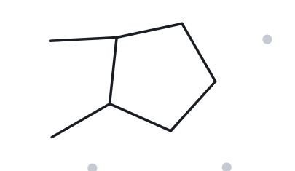
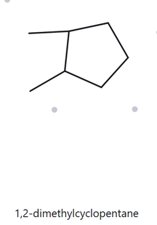
B06.
Developing
1,2-dimethylcyclopentane
Name Decoded
Bond-Line Structure
Parent: cyclopentane → a 5-carbon ring.
Substituents: methyl on C1 and C2.
Expected formula: 5 + 2 = 7 C; one ring → C₇H₁₄
Formula Check
Back- Check
Counted from the drawing: C₇H₁₄
One Ring: C_{n}H_{2n} = C₇H₁₄
Returned by The Alkane: 1,2-dimethylcyclopentane
Same as the given name
parent length matches
substituents position match
formula agrees
back-checked recorded

Slide 17
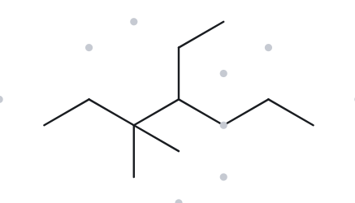
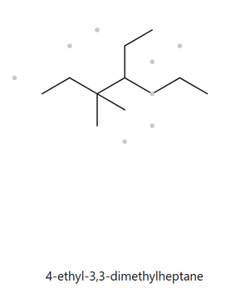
B07.
Developing
4-ethyl-3,3-dimethylheptane
Name Decoded
Bond-Line Structure
Parent: heptane → a 7-carbon chain.
Substituents: methyl on C3 and C3; ethyl on C4.
Expected formula: 7 + 2 + 2 = 11 C; no rings or double bonds → C₁₁H₂₄
Formula Check
Back- Check
Counted from the drawing: C₁₁H₂₄
No rings or double bonds: C_{n}H_{2n+2} = C₁₁H₂₄
Returned by The Alkane: 4-ethyl-3,3-dimethylheptane
Same as the given name
parent length matches
substituents position match
formula agrees
back-checked recorded

Slide 18
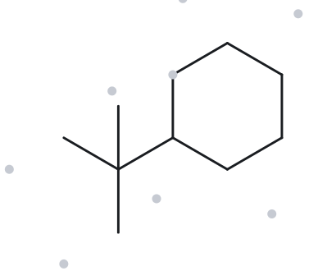
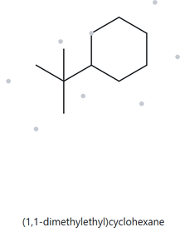
B08.
Challenge
tert-butylcyclohexane
Name Decoded
Bond-Line Structure
Parent: cyclohexane → a 6-carbon ring.
Substituents: tert-butyl on C1.
Expected formula: 6 + 4 = 10 C; one ring → C₁₀H₂₀
Formula Check
Back- Check
Counted from the drawing: C₁₀H₂₀
No rings or double bonds: C_{n}H_{2n} = C₁₀H₂₀
Returned by The Alkane: (1,1-dimethylethyl)cyclohexane
The website displays the formal, systematic IUPAC name instead of the common "tert-butyl" nickname.
parent length matches
substituents position match
formula agrees
back-checked recorded

Slide 19
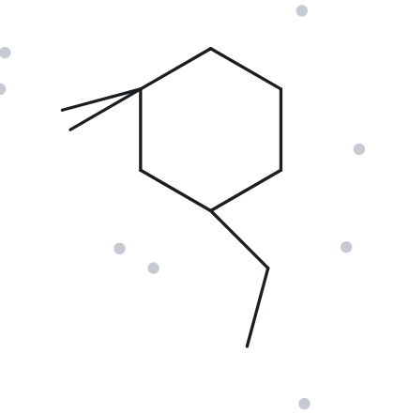
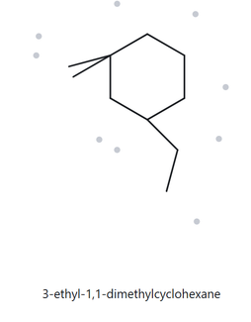
B09.
Challenge
3-ethyl-1,1-dimethylcyclohexane
Name Decoded
Bond-Line Structure
Parent: cyclohexane → a 6-carbon ring.
Substituents: methyl on C1 and C1; ethyl on C3.
Expected formula: 6 + 2 + 2 = 10 C; one ring → C₁₀H₂₀
Formula Check
Back- Check
Counted from the drawing: C₁₀H₂₀
No rings or double bonds: C_{n}H_{2n} = C₁₀H₂₀
Returned by The Alkane: 3-ethyl-1,1-dimethylcyclohexane
Same as the given name
parent length matches
substituents position match
formula agrees
back-checked recorded

Slide 20
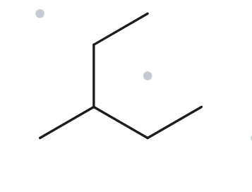
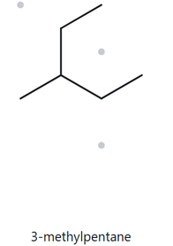
B10.
Challenge
2-ethylbutane
Name Decoded
Bond-Line Structure
Parent: butane → a 4-carbon chain.
Substituents: ethyl on C2.
Expected formula: 4 + 2 = 6 C; no rings or double bonds → C₆H₁₄
Formula Check
Back- Check
Counted from the drawing: C₆H₁₄
No rings or double bonds: C_{n}H_{2n+2} = C₆H₁₄
Returned by The Alkane: 3-methylpentane
Since the initial name is incorrect, it misidentifies the parent chain and branches, causing the expected structure to mismatch
parent length matches
substituents position match
formula agrees
back-checked recorded

